Slide 1
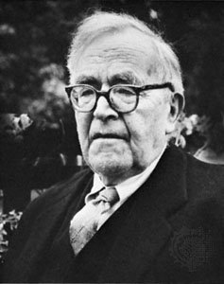
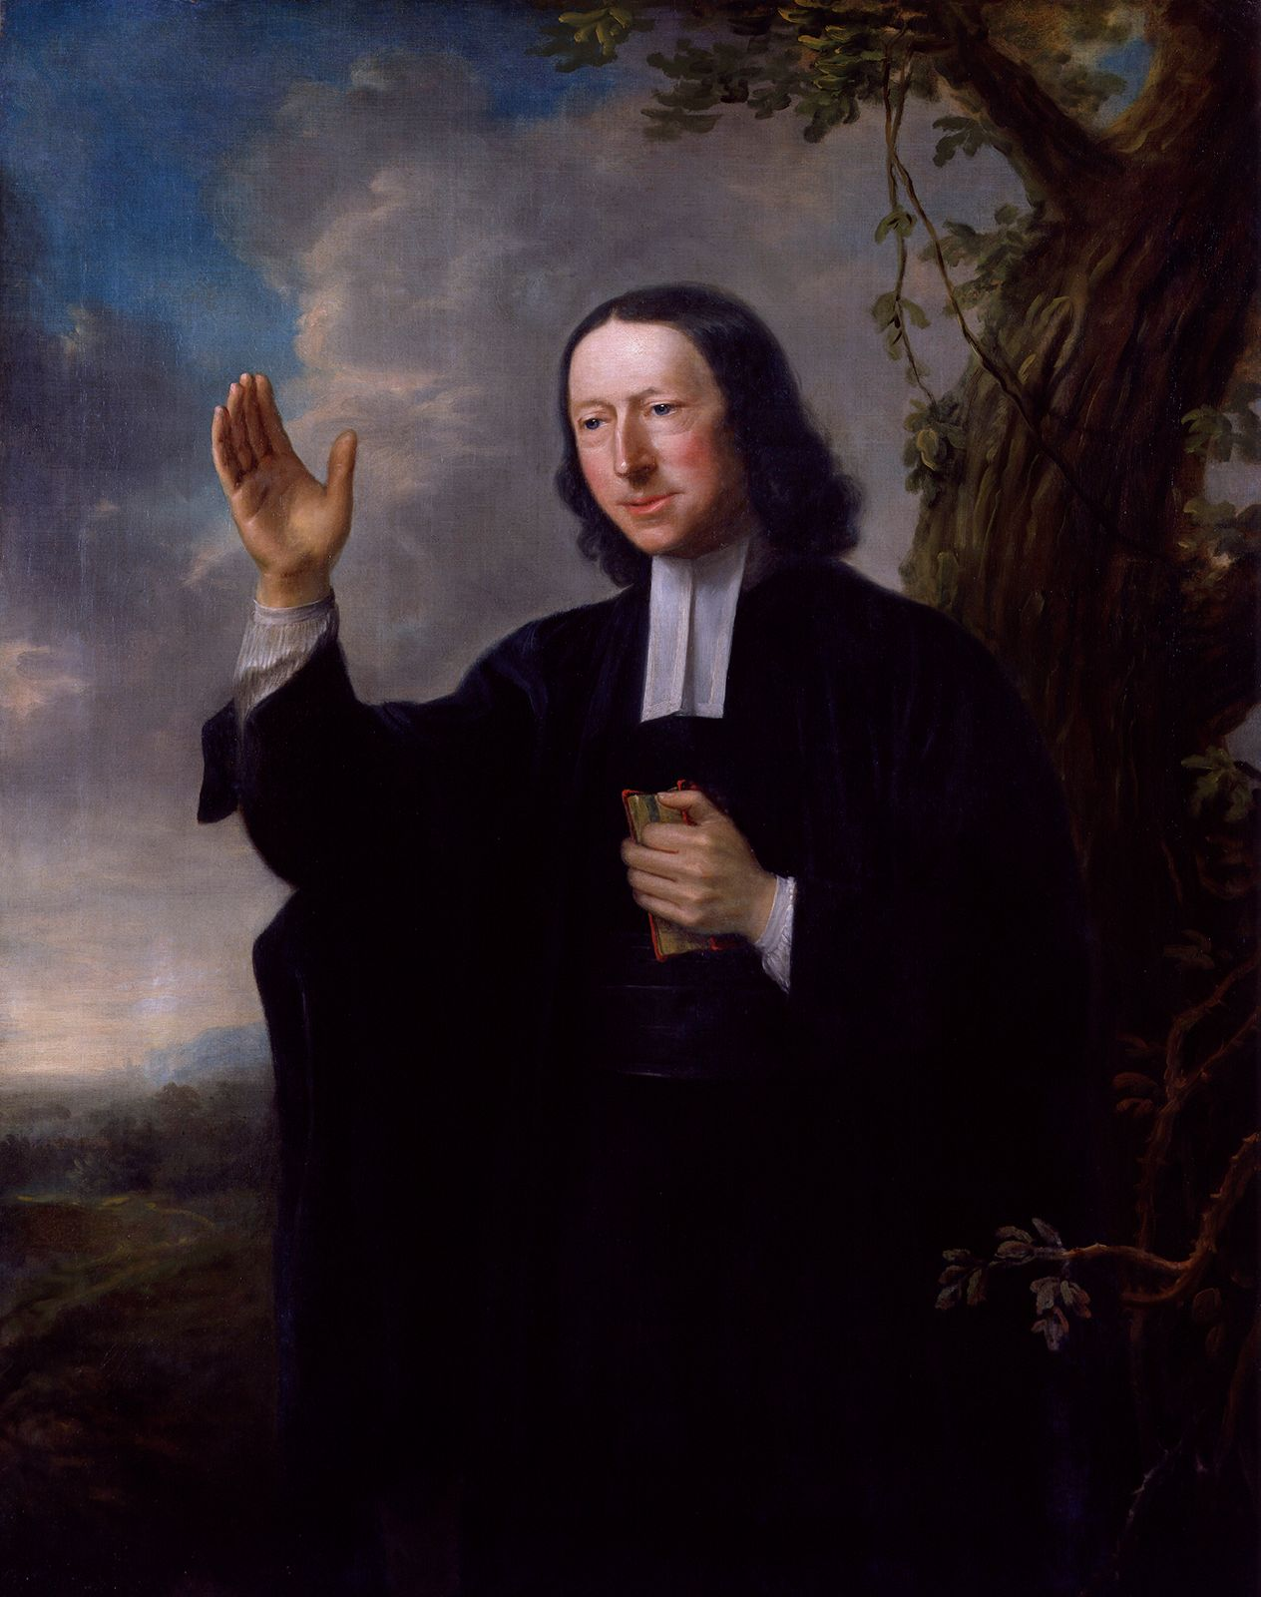
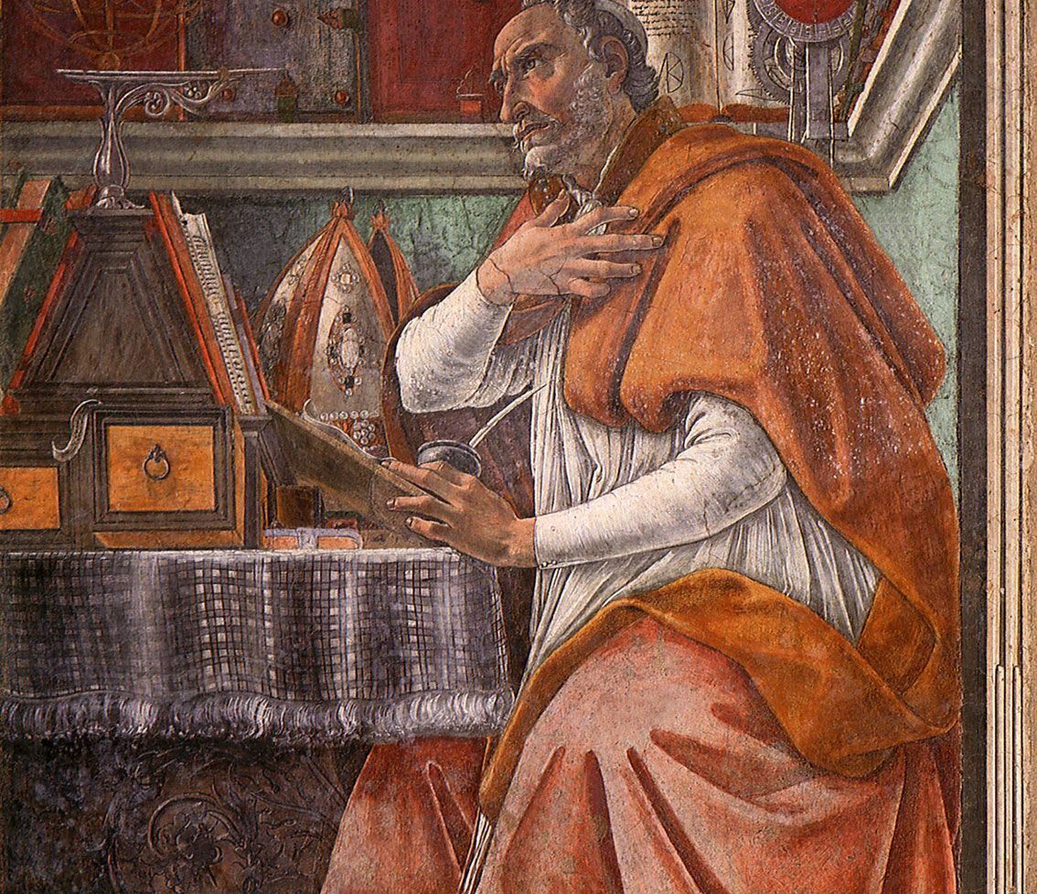
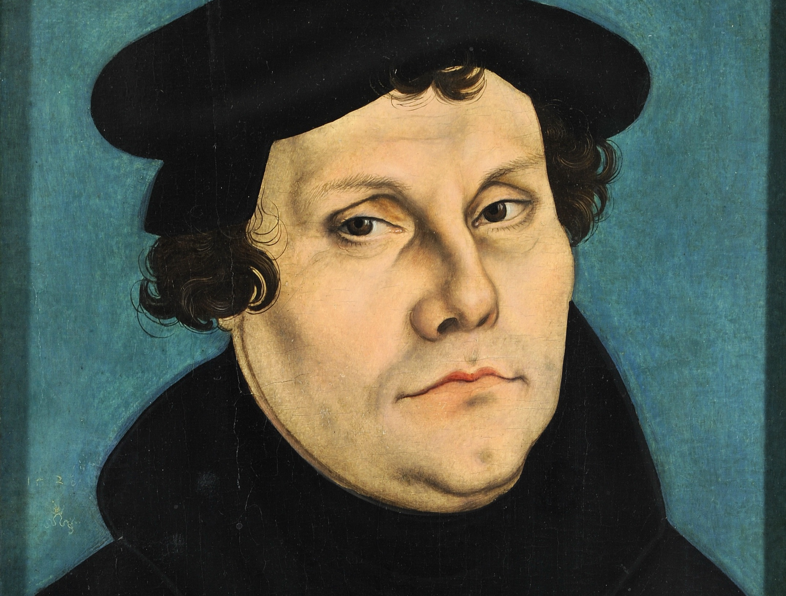

Slide 2
Good News for All: Set Apart
Our Identity
Our Mission
The Gospel and Its Obligation

Slide 3
1. Our Identity (v.1-7)
Paul, a servant of Christ Jesus, called to be an apostle and set apart for the gospel of God—

Slide 4
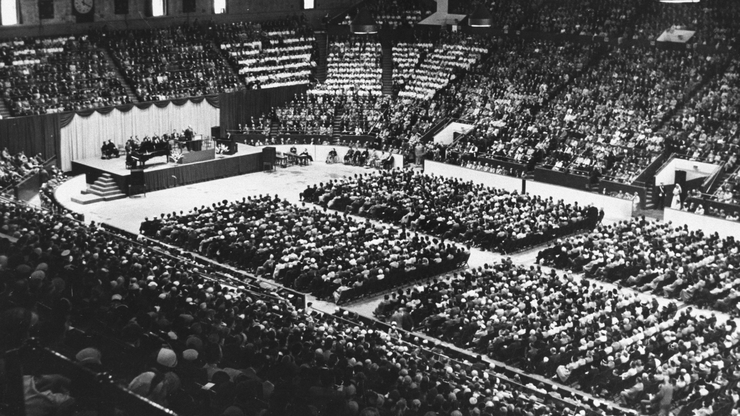

Slide 5
1. Our Identity (v.1-7)
Paul, a servant of Christ Jesus, called to be an apostle and set apart for the gospel of God—

Slide 6
2. Our Mission (v.8-13)
11 I long to see you so that I may impart to you some spiritual gift to make you strong— 12 that is, that you and I may be mutually encouraged by each other’s faith. 13 I do not want you to be unaware, brothers and sisters,[d] that I planned many times to come to you (but have been prevented from doing so until now) in order that I might have a harvest among you, just as I have had among the other Gentiles.

Slide 7
2. Our Mission (v.8-13)
11 I long to see you so that I may impart to you some spiritual gift to make you strong— 12 that is, that you and I may be mutually encouraged by each other’s faith. 13 I do not want you to be unaware, brothers and sisters,[d] that I planned many times to come to you (but have been prevented from doing so until now) in order that I might have a harvest among you, just as I have had among the other Gentiles.

Slide 8
3. The Gospel and Its Obligation

Slide 9
2 the gospel he promised beforehand through his prophets in the Holy Scriptures 3 regarding his Son, who as to his earthly life[a] was a descendant of David, 4 and who through the Spirit of holiness was appointed the Son of God in power[b] by his resurrection from the dead: Jesus Christ our Lord. 5 Through him we received grace and apostleship to call all the Gentiles to the obedience that comes from[c] faith for his name’s sake.

Slide 10
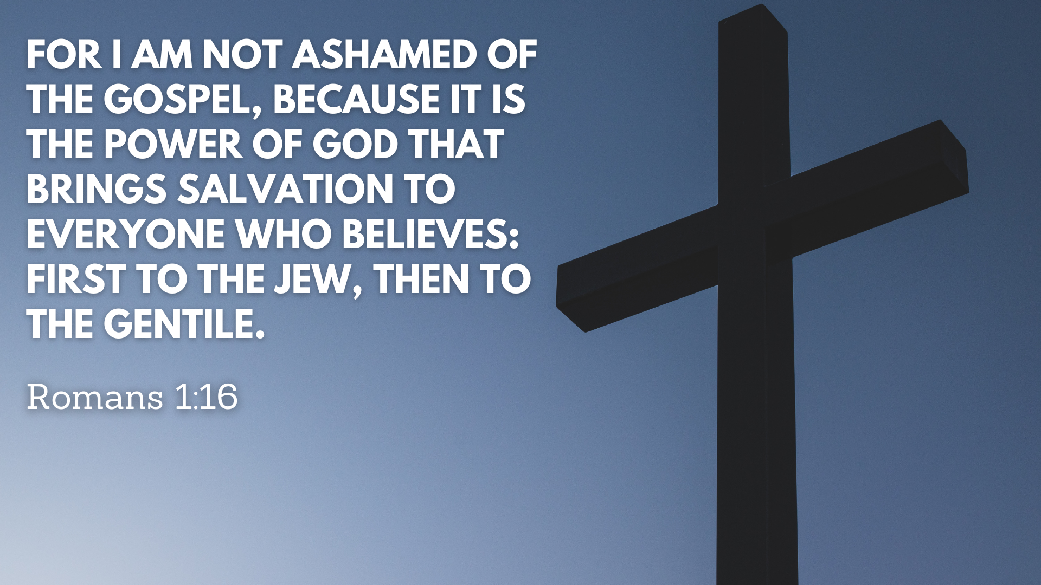

Slide 11


Slide 12
¹⁶ For I am not ashamed of the gospel, because it is the power of God that brings salvation to everyone who believes: first to the Jew, then to the Gentile. ¹⁷ For in the gospel the righteousness of God is revealed—a righteousness that is by faith from first to last,^{[e]} just as it is written: “The righteous will live by faith.”^{[f]}

Slide 13
“God made him who had no sin to be sin for us, so that in him we might become the righteousness of God”
- 2 Cor 5:20

Slide 14
¹⁴ I am obligated both to Greeks and non-Greeks, both to the wise and the foolish. ¹⁵ That is why I am so eager to preach the gospel also to you who are in Rome.
¹⁶ For I am not ashamed of the gospel, because it is the power of God that brings salvation to everyone who believes: first to the Jew, then to the Gentile.

