Slide 1
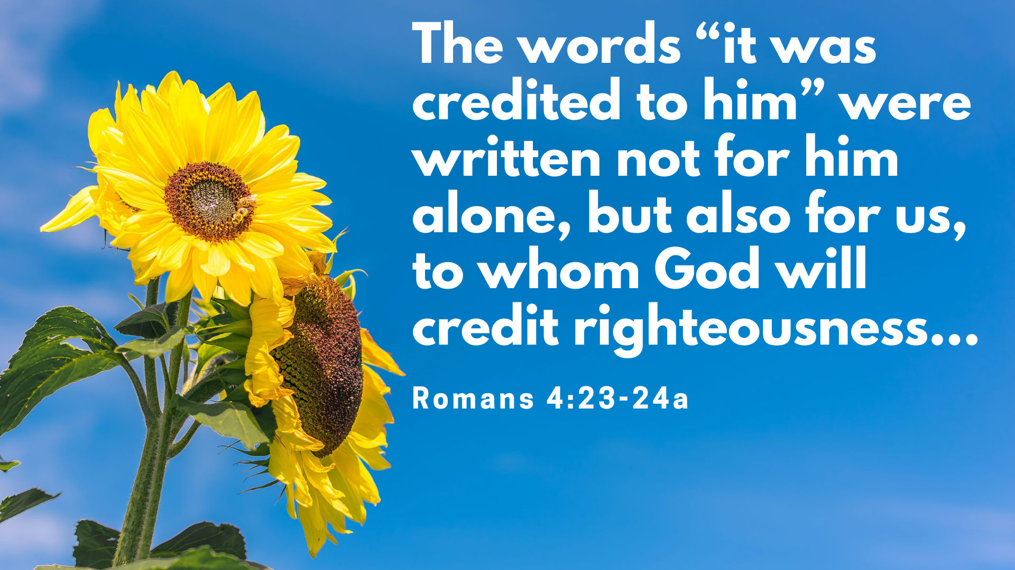

Slide 2
For we maintain that a person is justified by faith apart from the works of the law
Romans 3:28

Slide 3
Justified by Faith Alone
Faith – Always Been the Plan (v.1-8)
Faith – Mark of God’s people (v.9-16)
Faith – Strengthening Exercise (v.17-25)

Slide 4
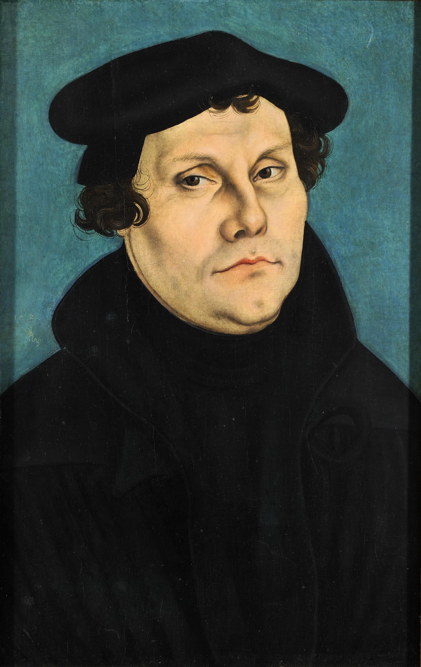
“I felt myself to be reborn and to have gone through open doors into paradise. The whole of Scripture took on a new meaning, whereas before the ‘justice of God’ had filled me with hate, now it became to me inexpressibly sweet in greater love….”

Slide 5
What then shall we say that Abraham, our forefather according to the flesh, discovered in this matter? ² If, in fact, Abraham was justified by works, he had something to boast about—but not before God. ³ What does Scripture say? “Abraham believed God, and it was credited to him as righteousness.”^{[a]}
Romans 4:1-3,
Genesis 15:6

Slide 6
¹ Blessed is the one
whose transgressions are forgiven,
whose sins are covered.
² Blessed is the one
whose sin the Lord does not count against them
and in whose spirit is no deceit.
³ When I kept silent,
my bones wasted away
through my groaning all day long.
⁴ For day and night
your hand was heavy on me;
my strength was sapped
as in the heat of summer.^{[b]}
⁵ Then I acknowledged my sin to you
and did not cover up my iniquity.
I said, “I will confess
my transgressions to the Lord.”
And you forgave
the guilt of my sin.

Slide 7
⁵ However, to the one who does not work but trusts God who justifies the ungodly, their faith is credited as righteousness.
Romans 4:5

Slide 8
Justified by Faith Alone
Faith – Always Been the Plan (v.1-8)
  Don’t look elsewhere for salvation

Slide 9
Justified by Faith Alone
Faith – Always Been the Plan (v.1-8)
Faith – Mark of God’s people (v.9-16)

Slide 10
10 Under what circumstances was it credited? Was it after he was circumcised, or before? It was not after, but before! 11 And he received circumcision as a sign, a seal of the righteousness that he had by faith while he was still uncircumcised. So then, he is the father of all who believe but have not been circumcised, in order that righteousness might be credited to them.
Romans 4:10-11

Slide 12
Justified by Faith Alone
Faith – Always Been the Plan (v.1-8)
Faith – Mark of God’s people (v.9-16)

Slide 13
Justified by Faith Alone
Faith – Always Been the Plan (v.1-8)
Faith – Mark of God’s people (v.9-16)
Faith – Strengthening Exercise (v.17-25)

Slide 14
¹⁷ As it is written: “I have made you a father of many nations.”^{[c]} He is our father in the sight of God, in whom he believed—the God who gives life to the dead and calls into being things that were not.
Romans 4:17

Slide 15
