Slide 1
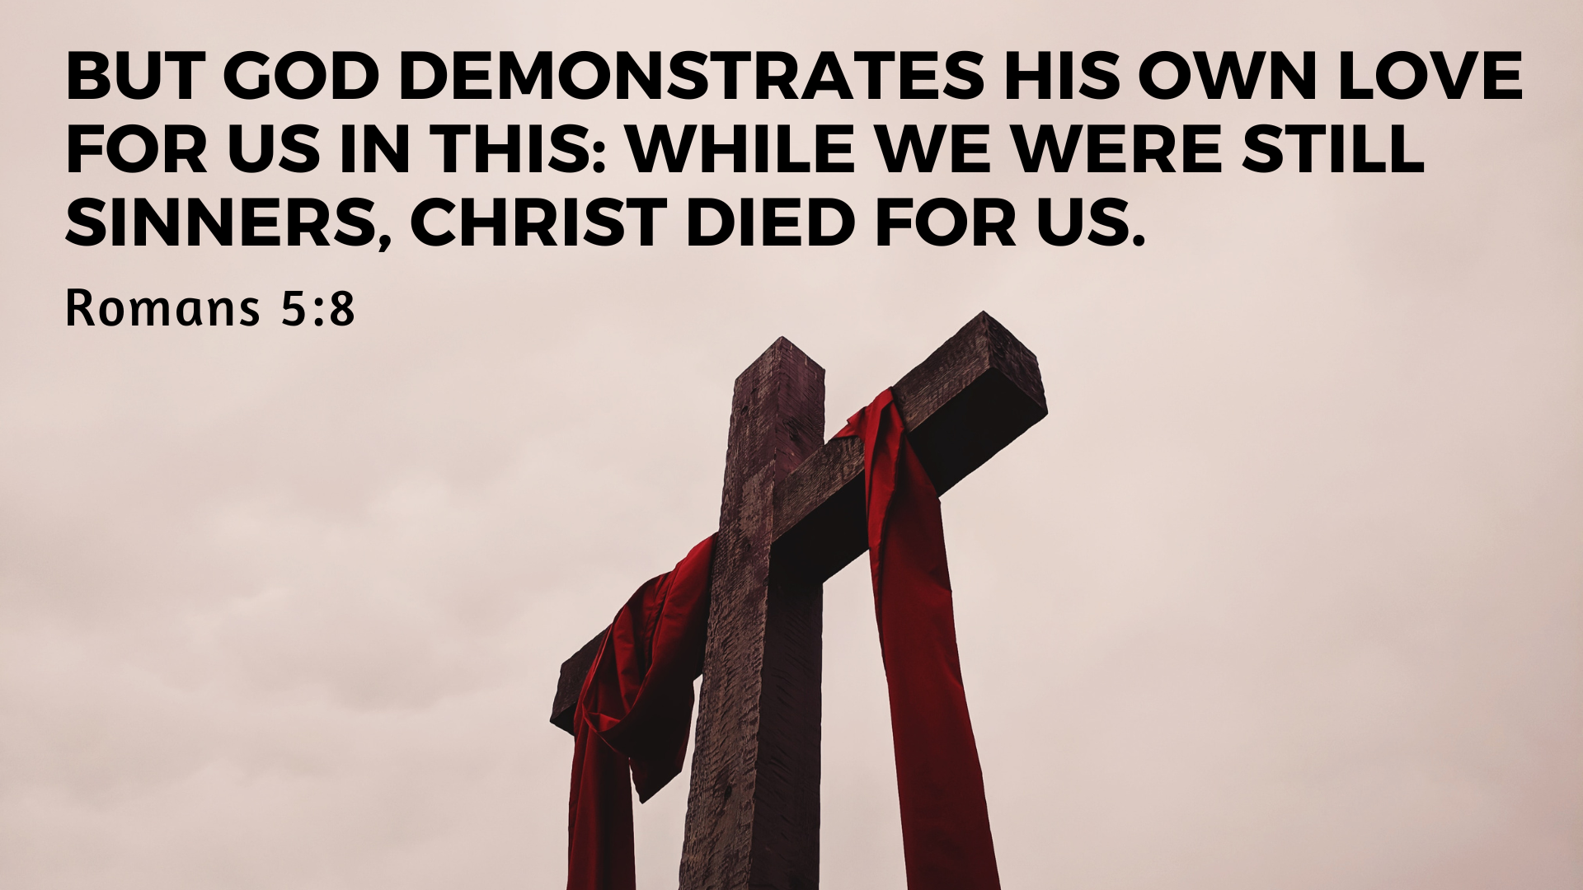

Slide 2
Therefore, since we have been justified through faith, we have peace with God through our Lord Jesus Christ, through whom we have gained access by faith into this grace in which we now stand. And we boast [rejoice] in the hope of the glory of God.
Romans 5:1-2

Slide 3
Good News for All: We Rejoice
In the Hope of Glory (v.1-2)
In Our Suffering (v.3-5)
In God’s Love (v.5-11)

Slide 4
Good News for All: We Rejoice
In the Hope of Glory (v.1-2)

Slide 5
9 Since we have now been justified by his blood, how much more shall we be saved from God’s wrath through him! 10 For if, while we were God’s enemies, we were reconciled to him through the death of his Son, how much more, having been reconciled, shall we be saved through his life!
Romans 5:9-10

Slide 6
Good News for All: We Rejoice
In the Hope of Glory (v.1-2)
In Our Suffering (v.3-5)

Slide 7
3 Not only so, but we also glory [rejoice] in our sufferings, because we know that suffering produces perseverance; 4 perseverance, character; and character, hope. 5 And hope does not put us to shame, because God’s love has been poured out into our hearts through the Holy Spirit, who has been given to us.
Romans 5:9-10

Slide 8
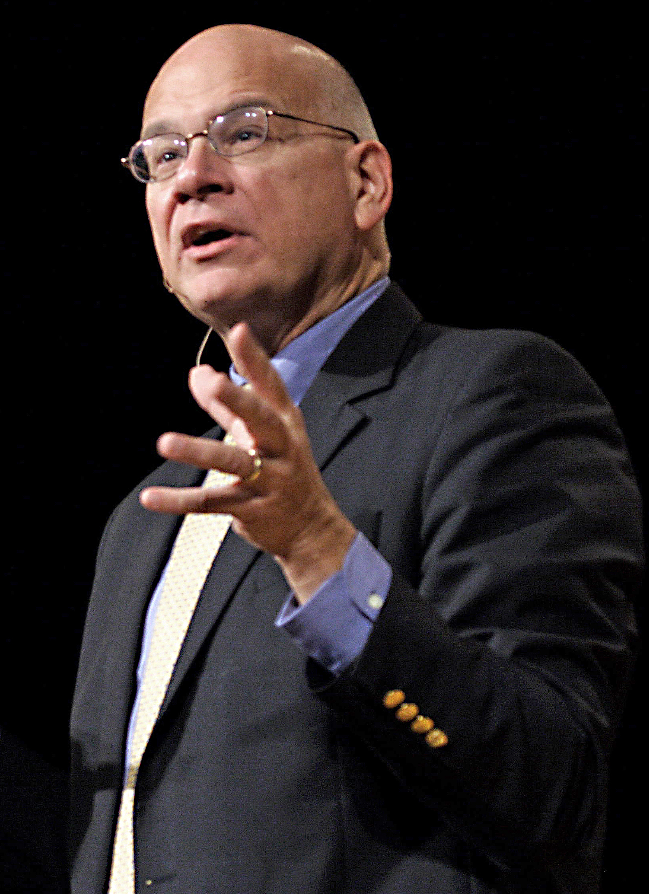
“For me as a Christian, Jesus’s costly love, death, and resurrection had become not just something I believed and filed away, but a hope that sustained me all day.”

Slide 9
“I can sincerely say, without any sentimentality or exaggeration, that I’ve never been happier in my life, that I’ve never had more days filled with comfort. But it is equally true that I’ve never had so many days of grief.”

Slide 10
Good News for All: We Rejoice
In the Hope of Glory (v.1-2)
In Our Suffering (v.3-5)
In God’s Love (v.5-11)

Slide 11
And hope does not put us to shame, because God’s love has been poured out into our hearts through the Holy Spirit, who has been given to us.
6 You see, at just the right time, when we were still powerless, Christ died for the ungodly. 7 Very rarely will anyone die for a righteous person, though for a good person someone might possibly dare to die. 8 But God demonstrates his own love for us in this: While we were still sinners, Christ died for us.

Slide 12
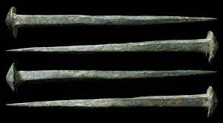

Slide 13
Good News for All: We Rejoice
In the Hope of Glory (v.1-2)
In Our Suffering (v.3-5)
In God’s Love (v.5-11)

