Slide 1

Facing Our Doubts
Psalm 73

Slide 2


Slide 3
Psalm 73
The Problem of Doubt
V1-14
Facing Our Doubts
V15-20
Seeing The Whole Picture
V21-28

Slide 4
The Problem of Doubt
¹ Surely God is good to Israel, to those who are pure in heart.
³ For I envied the arrogant when I saw the prosperity of the wicked.
¹³ Surely in vain I have kept my heart pure and have washed my hands in innocence.

Slide 5
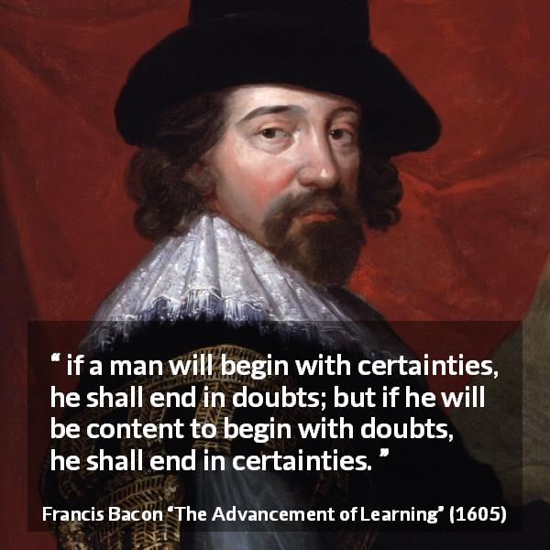

Slide 6

Facing Our Doubts
“If we get our eyes off ourselves, our problems, our wants and lacks, and off of what everyone else seems to have, we realize how blessed we really are just for having him.”
Lydia Brownback

Slide 7
Facing Our Doubts
In the Sanctuary - Finding Perspective
¹⁶ When I tried to understand all this, it troubled me deeply ¹⁷ till I entered the sanctuary of God; then I understood their final destiny.
¹⁸ Surely you place them on slippery ground; you cast them down to ruin.
²¹ When my heart was grieved and my spirit embittered, ²² I was senseless and ignorant; I was a brute beast before you.

Slide 8
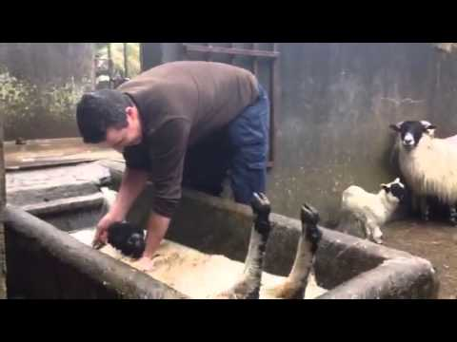

Slide 9
“I’ve had some experiences in my life which have made me feel very sympathetic to those poor sheep. There are times I couldn’t figure out any reason for the treatment I was getting from my great shepherd whom I trusted. And like these sheep, I didn’t have a hint of an explanation.
There will be no intellectual satisfaction on this side of heaven to that age old question, “Why?” But although I have not found intellectual satisfaction, I have found peace. And the answer I say to you is not an explanation but a person, Jesus Christ, my Lord and my God.
It’s He who was the Word before the foundation of the world, suffering as a lamb slain, and He has a lot up His sleeve that you and I haven’t the slightest idea about now. He’s told us enough so that we know that suffering is not for nothing.”
Elizabeth Elliot

Slide 10
Seeing The Whole Picture
²³ Yet I am always with you; you hold me by my right hand. ²⁴ You guide me with your counsel, and afterward you will take me into glory.
²⁶ My flesh and my heart may fail, but God is the strength of my heart and my portion forever.
²⁷ Those who are far from you will perish; you destroy all who are unfaithful to you.

Slide 11
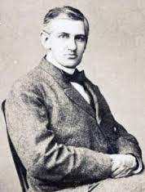
“Though Satan should buffet, though trials should come
Let this blest assurance control
That Christ has regarded my helpless estate
And has shed His own blood for my soul”
It Is Well With My Soul

Slide 12
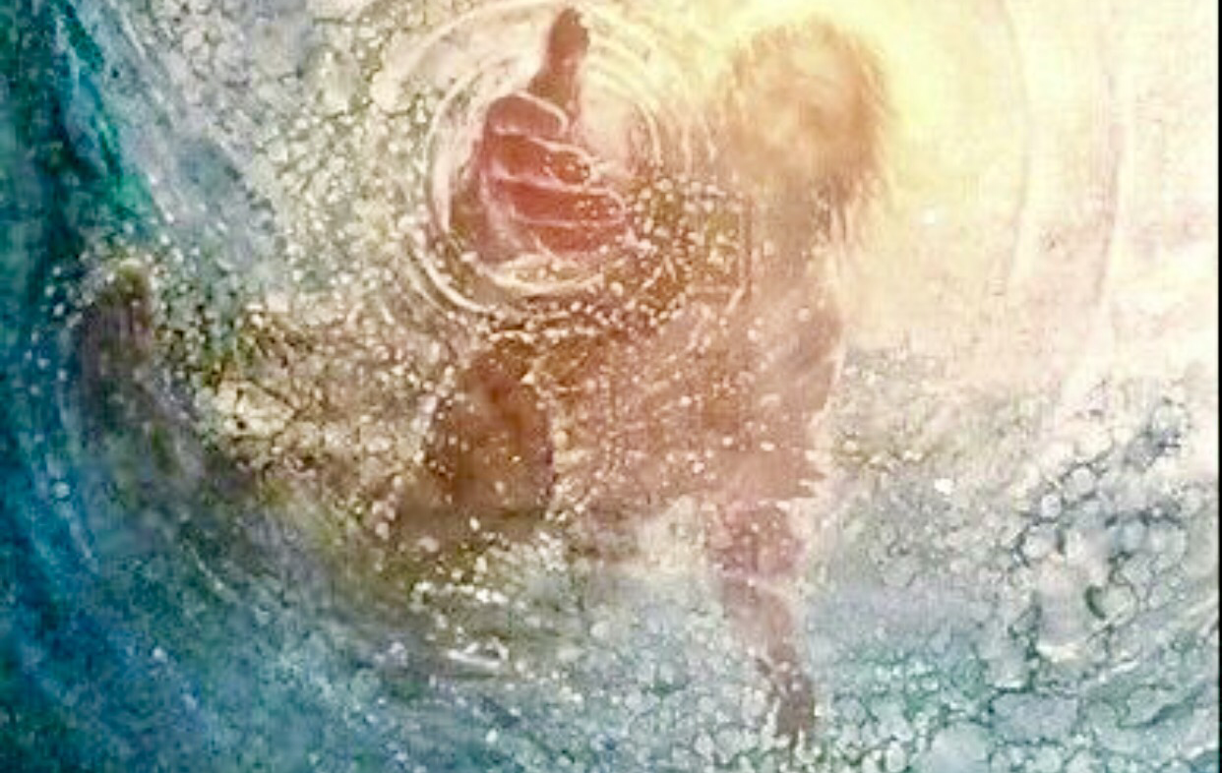
“Whom have I in heaven but you? And earth has nothing I desire besides you.”

