Slide 1
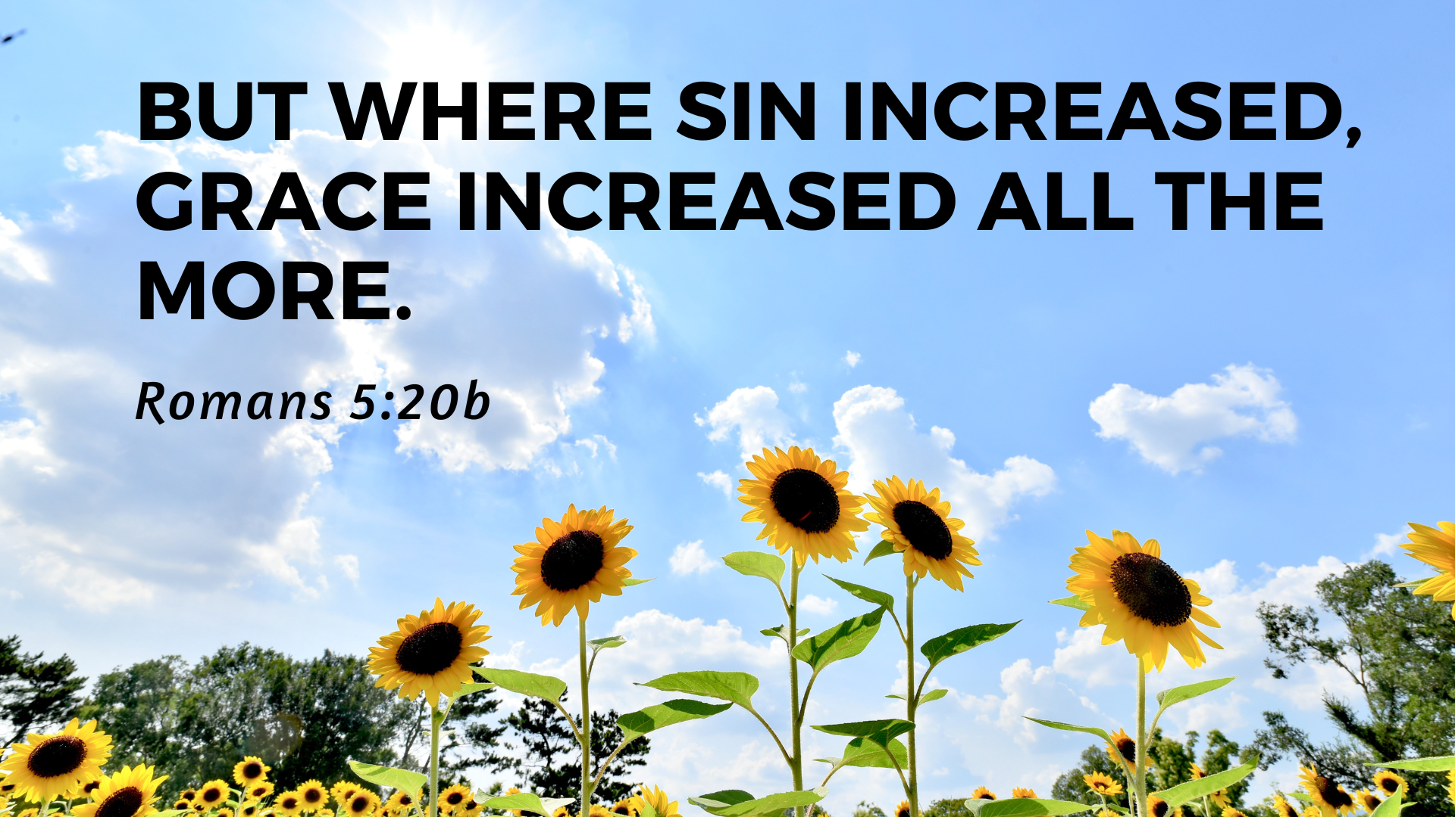

Slide 2


Slide 3
1. Gravity of Our Plight (v.12-14)
¹² Therefore, just as sin entered the world through one man, and death through sin, and in this way death came to all people, because all sinned— ¹³ To be sure, sin was in the world before the law was given, but sin is not charged against anyone’s account where there is no law. ¹⁴ Nevertheless, death reigned from the time of Adam to the time of Moses, even over those who did not sin by breaking a command, as did Adam, who is a pattern of the one to come.

Slide 4
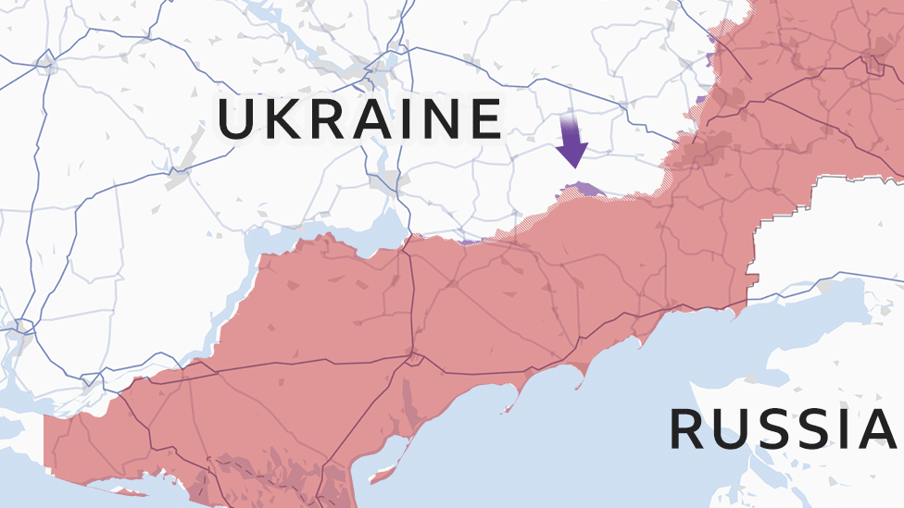

Slide 5
1. Gravity of Our Plight (v.12-14)
Adam sins (Gen 3)
Cain kills Abel (Gen 4)
List of Adam’s descendants (Gen 5)
  “…and he died.”

Slide 6
1. Gravity of Our Plight (v.12-14)
¹² Therefore, just as sin entered the world through one man, and death through sin, and in this way death came to all people, because all sinned— ¹³ To be sure, sin was in the world before the law was given, but sin is not charged against anyone’s account where there is no law. ¹⁴ Nevertheless, death reigned from the time of Adam to the time of Moses, even over those who did not sin by breaking a command, as did Adam, who is a pattern of the one to come.

Slide 7
15 But the gift is not like the trespass. For if the many died by the trespass of the one man, how much more did God’s grace and the gift that came by the grace of the one man, Jesus Christ, overflow to the many!16 Nor can the gift of God be compared with the result of one man’s sin: The judgment followed one sin and brought condemnation, but the gift followed many trespasses and brought justification. 17 For if, by the trespass of the one man, death reigned through that one man, how much more will those who receive God’s abundant provision of grace and of the gift of righteousness reign in life through the one man, Jesus Christ! 18 Consequently, just as one trespass resulted in condemnation for all people, so also one righteous act resulted in justification and life for all people. 19 For just as through the disobedience of the one man the many were made sinners, so also through the obedience of the one man the many will be made righteous.

Slide 8
2. Greatness of Our Salvation (v.15-19)
Trespass/sin vs. obedience

Slide 9
2. Greatness of Our Salvation (v.15-19)
Trespass/sin vs. obedience
Judgment vs. grace/gift

Slide 10
2. Greatness of Our Salvation (v.15-19)
Trespass/sin vs. obedience
Judgment vs. grace/gift
Condemnation vs. justification/righteousness

Slide 11
2. Greatness of Our Salvation (v.15-19)
Trespass/sin vs. obedience
Judgment vs. grace/gift
Condemnation vs. justification/righteousness
Death vs. life

Slide 12
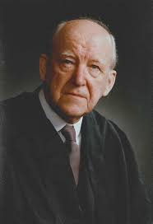
“Look at yourself in Adam; though you had done nothing you were declared a sinner. Look at yourself in Christ; and see that, though you have done nothing, you are declared to be righteous. That is the parallel.”
- Martyn Lloyd Jones

Slide 13
15 But the gift is not like the trespass. For if the many died by the trespass of the one man, how much more did God’s grace and the gift that came by the grace of the one man, Jesus Christ, overflow to the many!16 Nor can the gift of God be compared with the result of one man’s sin: The judgment followed one sin and brought condemnation, but the gift followed many trespasses and brought justification. 17 For if, by the trespass of the one man, death reigned through that one man, how much more will those who receive God’s abundant provision of grace and of the gift of righteousness reign in life through the one man, Jesus Christ! 18 Consequently, just as one trespass resulted in condemnation for all people, so also one righteous act resulted in justification and life for all people. 19 For just as through the disobedience of the one man the many were made sinners, so also through the obedience of the one man the many will be made righteous.

Slide 14
3. Grace Increased (v.20-21)

Slide 15


