Slide 2
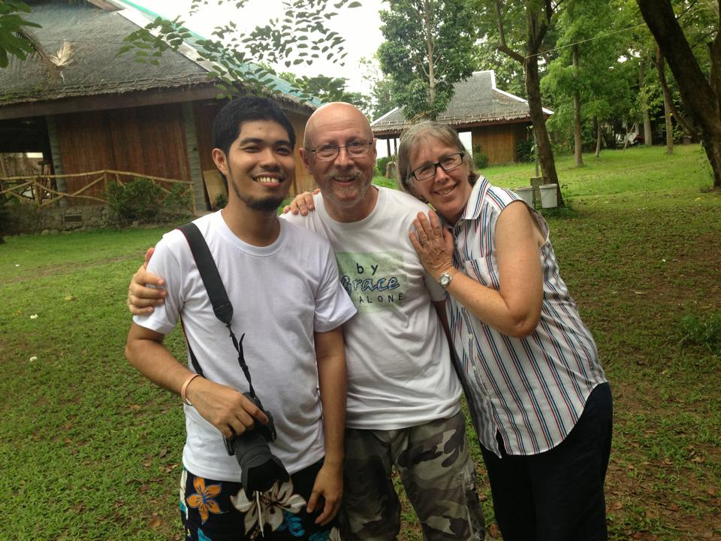

Slide 4
David’s Prayer - Psalm 86
Asking God’s Mercy (1-7) (14-17)
Trusting God’s Sovereignty (8-13)

Slide 6
1) Asking God’s Mercy (1-7) (14-17)
- Protection
vs 14 “Arrogant foes are attacking me, O God; ruthless people are trying to kill me— they have no regard for you.”

Slide 7
1) Asking God’s Mercy (1-7) (14-17)
- Protection
vs 14 “Arrogant foes are attacking me, O God; ruthless people are trying to kill me— they have no regard for you.”
vs 3 “…have mercy on me, Lord,”
vs 6 “…listen to my cry for mercy.”
vs 16 “…have mercy on me;”

Slide 8
What is mercy? - the compassionate treatment of those in distress, especially when it is within one’s power to punish or harm them.
The word “mercy” derives from the medieval Latin merced or merces, which means "price paid." It has the connotation of forgiveness, benevolence and kindness. Mercy is often used in a religious context of giving alms, caring for the sick or the poor.
In the legal sense, mercy often refers to compassionate behavior from a person in power, such as when a judge shows clemency, leniency or mercy during sentencing.
(Biblical Definition)
Mercy appears in the Bible as it relates to forgiveness or withholding punishment.
resource: compassion.com

Slide 9
vs 5 “You, Lord, are forgiving and good,
abounding in love to all who call to you.”
vs 15 “But you, Lord, are a compassionate and gracious God,
slow to anger, abounding in love and faithfulness.”

Slide 10
1) Asking God’s Mercy (1-7) (14-17)
- Protection
vs 14 “Arrogant foes are attacking me, O God; ruthless people are trying to kill me— they have no regard for you.”
- Relationship
vs 4 “Bring joy to your servant, Lord, ...”

Slide 12
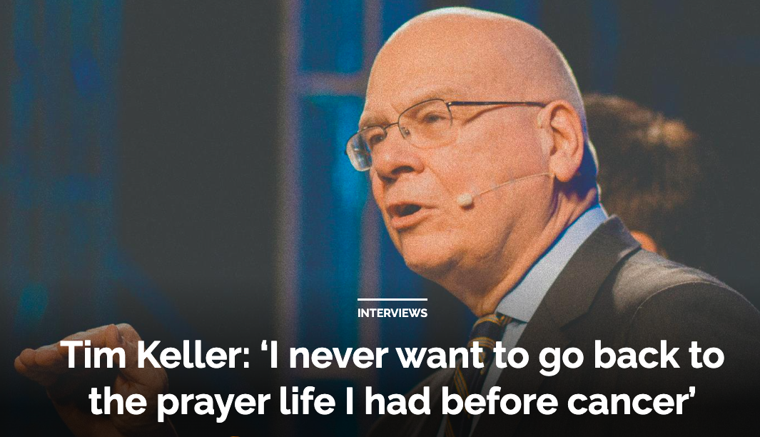

Slide 14
2) Trusting God’s Sovereignty (8-13)

Slide 15
2) Trusting God’s Sovereignty (8-13)
- Only God can do it
vs 13 “...you have delivered me from the depths, from the realm of the dead.”

Slide 17
2) Trusting God’s Sovereignty (8-13)
- Only God can do it
vs 14 “...you have delivered me from the depths, from the realm of the dead.”
Not my own way
vs 11 “Teach me your way, Lord, that I may rely on your faithfulness; give me an undivided heart,
that I may fear your name.”

Slide 19
Proverbs 3:5-6
“Trust in the Lord with all your heart and lean not on your own understanding; in all your ways submit to him, and he will make your paths straight.”

Slide 21
Luke 22:41-42,44
“He withdrew about from the disciples, knelt down and prayed, Father if you are willing, take this cup from me; yet not my will, but yours be done”
“And being anguished, he prayed more earnestly and his sweat like drops of blood falling to the ground.”

Slide 23
