Slide 1
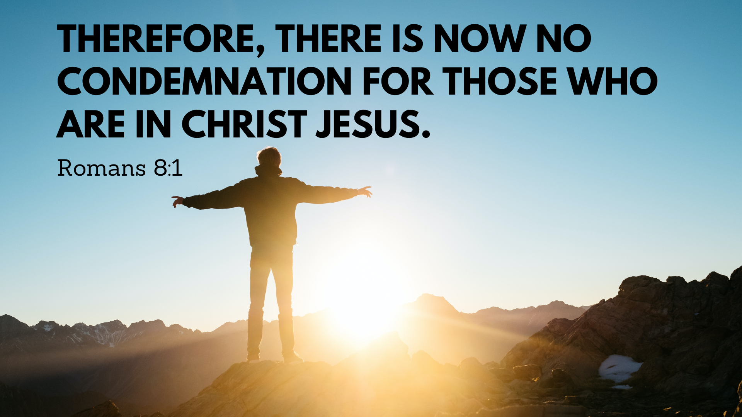

Slide 2





Slide 3



The Spirit Frees Us From Condemnation

Slide 4


Therefore, there is now no condemnation for those who are in Christ Jesus, 2 because through Christ Jesus the law of the Spirit who gives life has set you free from the law of sin and death.

Slide 5
3 For what the law was powerless to do because it was weakened by the flesh, God did by sending his own Son in the likeness of sinful flesh to be a sin offering. And so he condemned sin in the flesh, 4 in order that the righteous requirement of the law might be fully met in us, who do not live according to the flesh but according to the Spirit.

Slide 6

Are you living as though you are still condemned by God?

Slide 7


Slide 8

The Spirit Brings Us Freedom In Our Lives

Slide 9
5 Those who live according to the flesh have their minds set on what the flesh desires; but those who live in accordance with the Spirit have their minds set on what the Spirit desires. 6 The mind governed by the flesh is death, but the mind governed by the Spirit is life and peace.

Slide 10
7 The mind governed by the flesh is hostile to God; it does not submit to God’s law, nor can it do so. 8 Those who are in the realm of the flesh cannot please God.

Slide 11

Are we allowing the Spirit to change our lives?

Slide 12

The Spirit Dwells In Us

Slide 13
9 You, however, are not in the realm of the flesh but are in the realm of the Spirit, if indeed the Spirit of God lives in you. And if anyone does not have the Spirit of Christ, they do not belong to Christ.

Slide 14
10 But if Christ is in you, then even though your body is subject to death because of sin, the Spirit gives life because of righteousness. 11 And if the Spirit of him who raised Jesus from the dead is living in you, he who raised Christ from the dead will also give life to your mortal bodies because of his Spirit who lives in you.

Slide 15


Slide 16


