Slide 1
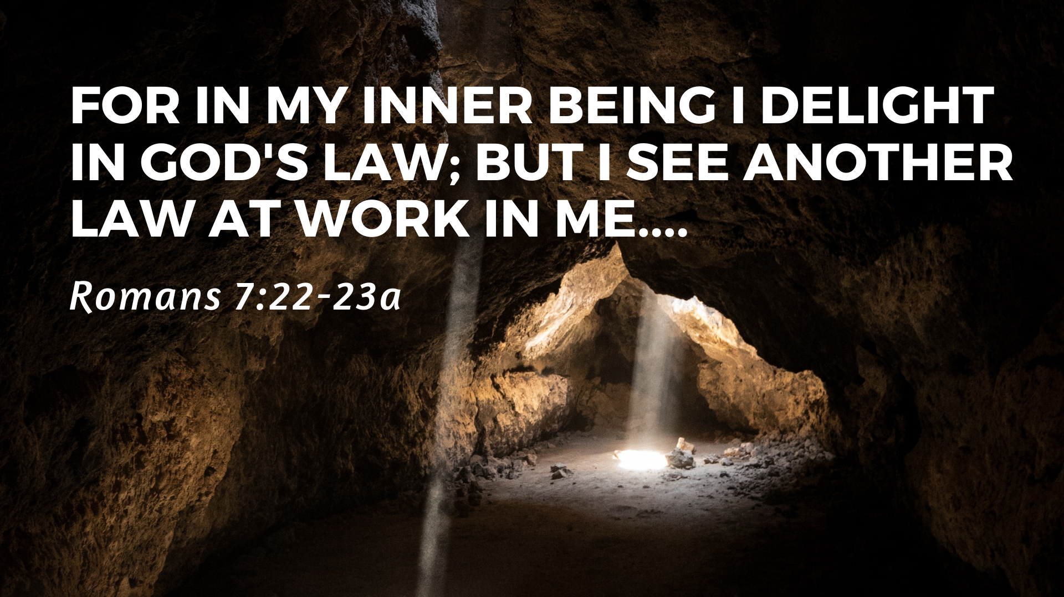

Slide 2
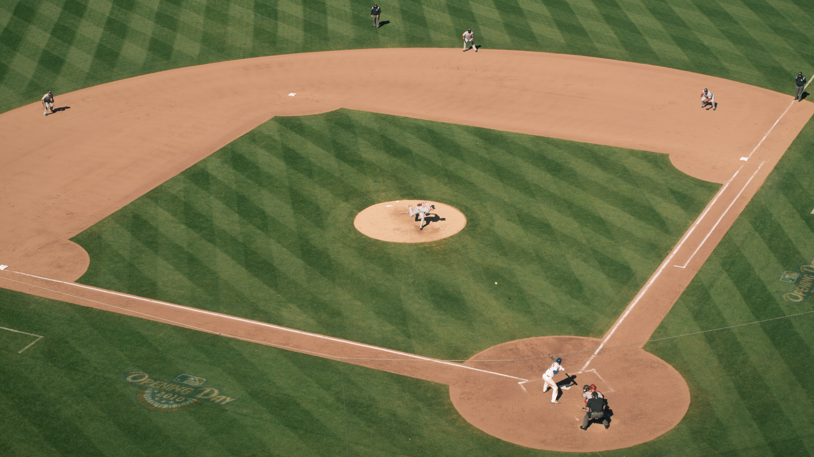

Slide 3
The War Within
The Law Reveals
  The nature of sin
  Utter guilt
The War Within

Slide 4
1. The Law Reveals (7:7-13)
the nature of our sin

Slide 5
1. The Law Reveals (7:7-13)
the nature of our sin
But sin, seizing the opportunity afforded by the commandment, produced in me every kind of coveting. For apart from the law, sin was dead. Once I was alive apart from the law; but when the commandment came, sin sprang to life and I died. 10 I found that the very commandment that was intended to bring life actually brought death.

Slide 6


Slide 7
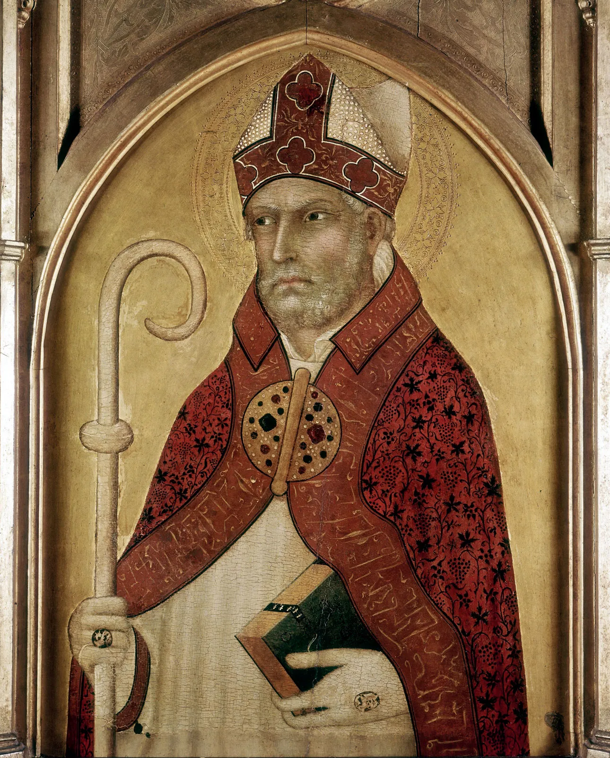
“In a perverse way, all men imitate you who put themselves far from you… What therefore, did I love in that theft of mine, in what manner did I perversely or viciously imitate my Lord?... to do with impunity things bearing a shadowy likeness of your omnipotence?... Could a thing give pleasure… which was done for no other reason but because it was unlawful?”
- St. Augustine, Confessions

Slide 8
1. The Law Reveals (7:7-13)
the nature of our sin
our utter guilt
12 So then, the law is holy, and the commandment is holy, righteous and good. 13 Did that which is good, then, become death to me? By no means! Nevertheless, in order that sin might be recognized as sin, it used what is good to bring about my death, so that through the commandment sin might become utterly sinful.

Slide 9
2. The War Within (v.14-25)

Slide 10
19 For I do not do the good I want to do, but the evil I do not want to do—this I keep on doing. 20 Now if I do what I do not want to do, it is no longer I who do it, but it is sin living in me that does it.
21 So I find this law at work: Although I want to do good, evil is right there with me. 22 For in my inner being I delight in God’s law; 23 but I see another law at work in me, waging war against the law of my mind and making me a prisoner of the law of sin at work within me.

Slide 11
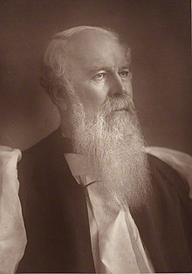
“Do we feel anything of war in our inward man? Well, let us thank God for it! It is a good sign. It is strongly probable evidence of the great work of sanctification. All true saints are soldiers. Anything is better than apathy, stagnation, deadness, and indifference. We are in a better state than many. The most part of so-called Christians have no feeling at all…. I say again, let us take comfort.”
- JC Ryle, Holiness

Slide 12
2. The War Within (v.14-25)
Struggling with sin is normal
We should encourage each other
God works through sinful people
God’s grace shines

