Slide 1
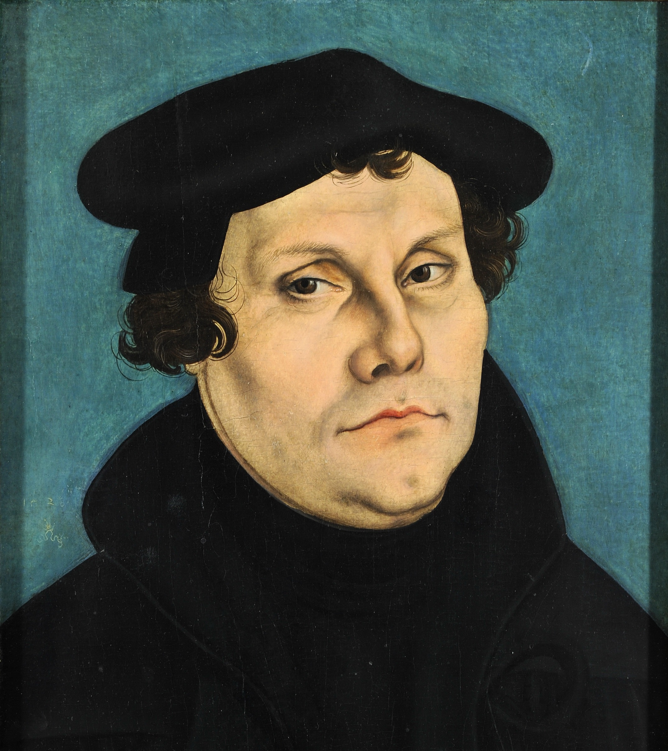
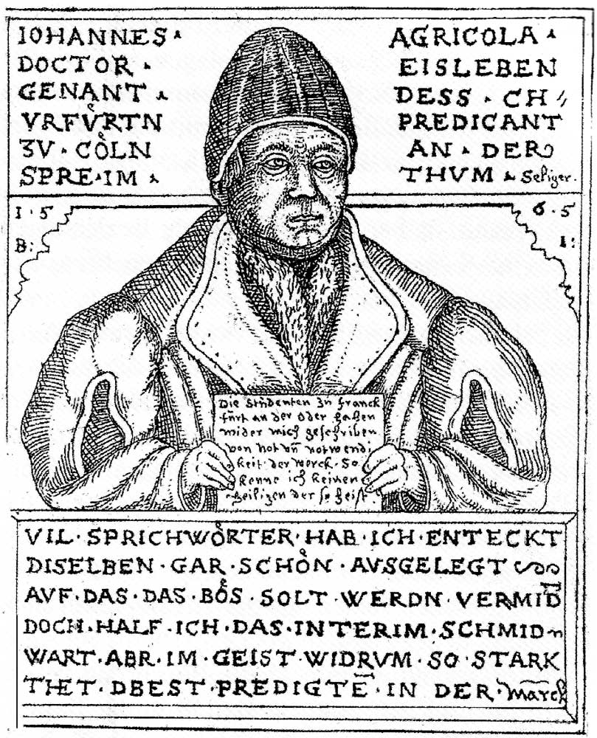

Slide 2
Good News for All: Alive with Christ
United with Christ
Alive in Christ

Slide 3
15 But the gift is not like the trespass. For if the many died by the trespass of the one man, how much more did God’s grace and the gift that came by the grace of the one man, Jesus Christ, overflow to the many!16 Nor can the gift of God be compared with the result of one man’s sin: The judgment followed one sin and brought condemnation, but the gift followed many trespasses and brought justification. 17 For if, by the trespass of the one man, death reigned through that one man, how much more will those who receive God’s abundant provision of grace and of the gift of righteousness reign in life through the one man, Jesus Christ! 18 Consequently, just as one trespass resulted in condemnation for all people, so also one righteous act resulted in justification and life for all people. 19 For just as through the disobedience of the one man the many were made sinners, so also through the obedience of the one man the many will be made righteous.

Slide 4
1. United with Christ
6 What shall we say, then? Shall we go on sinning so that grace may increase? 2 By no means! We are those who have died to sin; how can we live in it any longer? 3 Or don’t you know that all of us who were baptized into Christ Jesus were baptized into his death? 4 We were therefore buried with him through baptism into death in order that, just as Christ was raised from the dead through the glory of the Father, we too may live a new life.

Slide 5
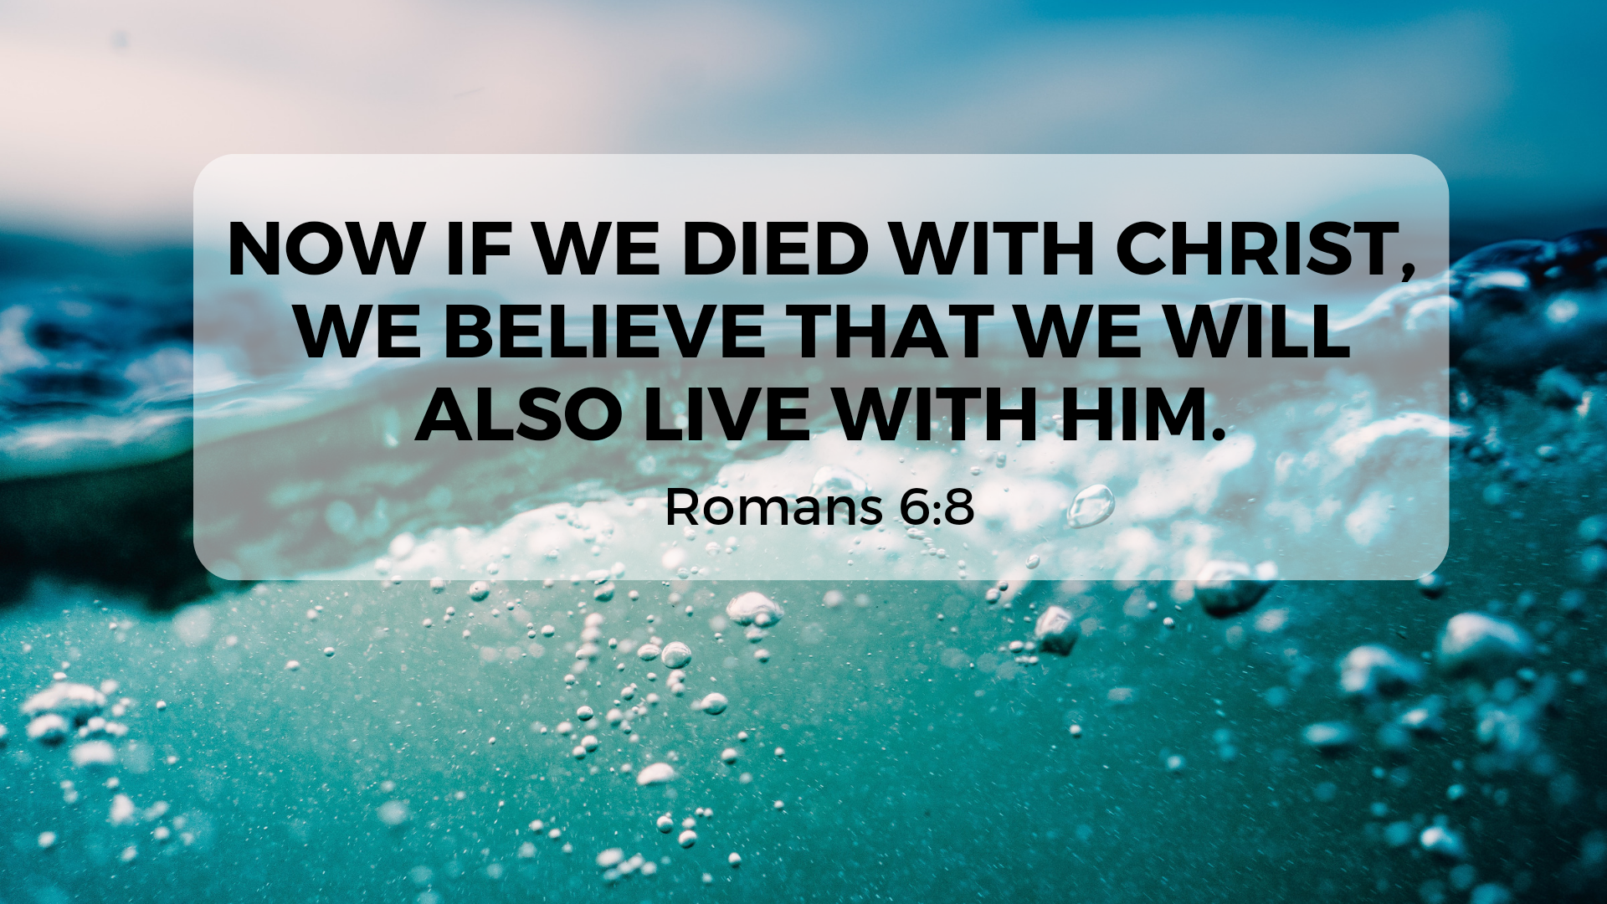

Slide 6
2. Alive in Christ
6 For we know that our old self was crucified with him so that the body ruled by sin might be done away with,[a] that we should no longer be slaves to sin— 7 because anyone who has died has been set free from sin.

Slide 7
2. Alive in Christ
9 For we know that since Christ was raised from the dead, he cannot die again; death no longer has mastery over him. 10 The death he died, he died to sin once for all; but the life he lives, he lives to God. 11 In the same way, count yourselves dead to sin but alive to God in Christ Jesus. 12 Therefore do not let sin reign in your mortal body so that you obey its evil desires. 13 Do not offer any part of yourself to sin as an instrument of wickedness, but rather offer yourselves to God as those who have been brought from death to life; and offer every part of yourself to him as an instrument of righteousness. 14 For sin shall no longer be your master, because you are not under the law, but under grace.

Slide 8
2. Alive in Christ
9 For we know that since Christ was raised from the dead, he cannot die again; death no longer has mastery over him. 10 The death he died, he died to sin once for all; but the life he lives, he lives to God. 11 In the same way, count yourselves dead to sin but alive to God in Christ Jesus. 12 Therefore do not let sin reign in your mortal body so that you obey its evil desires. 13 Do not offer any part of yourself to sin as an instrument of wickedness, but rather offer yourselves to God as those who have been brought from death to life; and offer every part of yourself to him as an instrument of righteousness. 14 For sin shall no longer be your master, because you are not under the law, but under grace.

