Slide 1
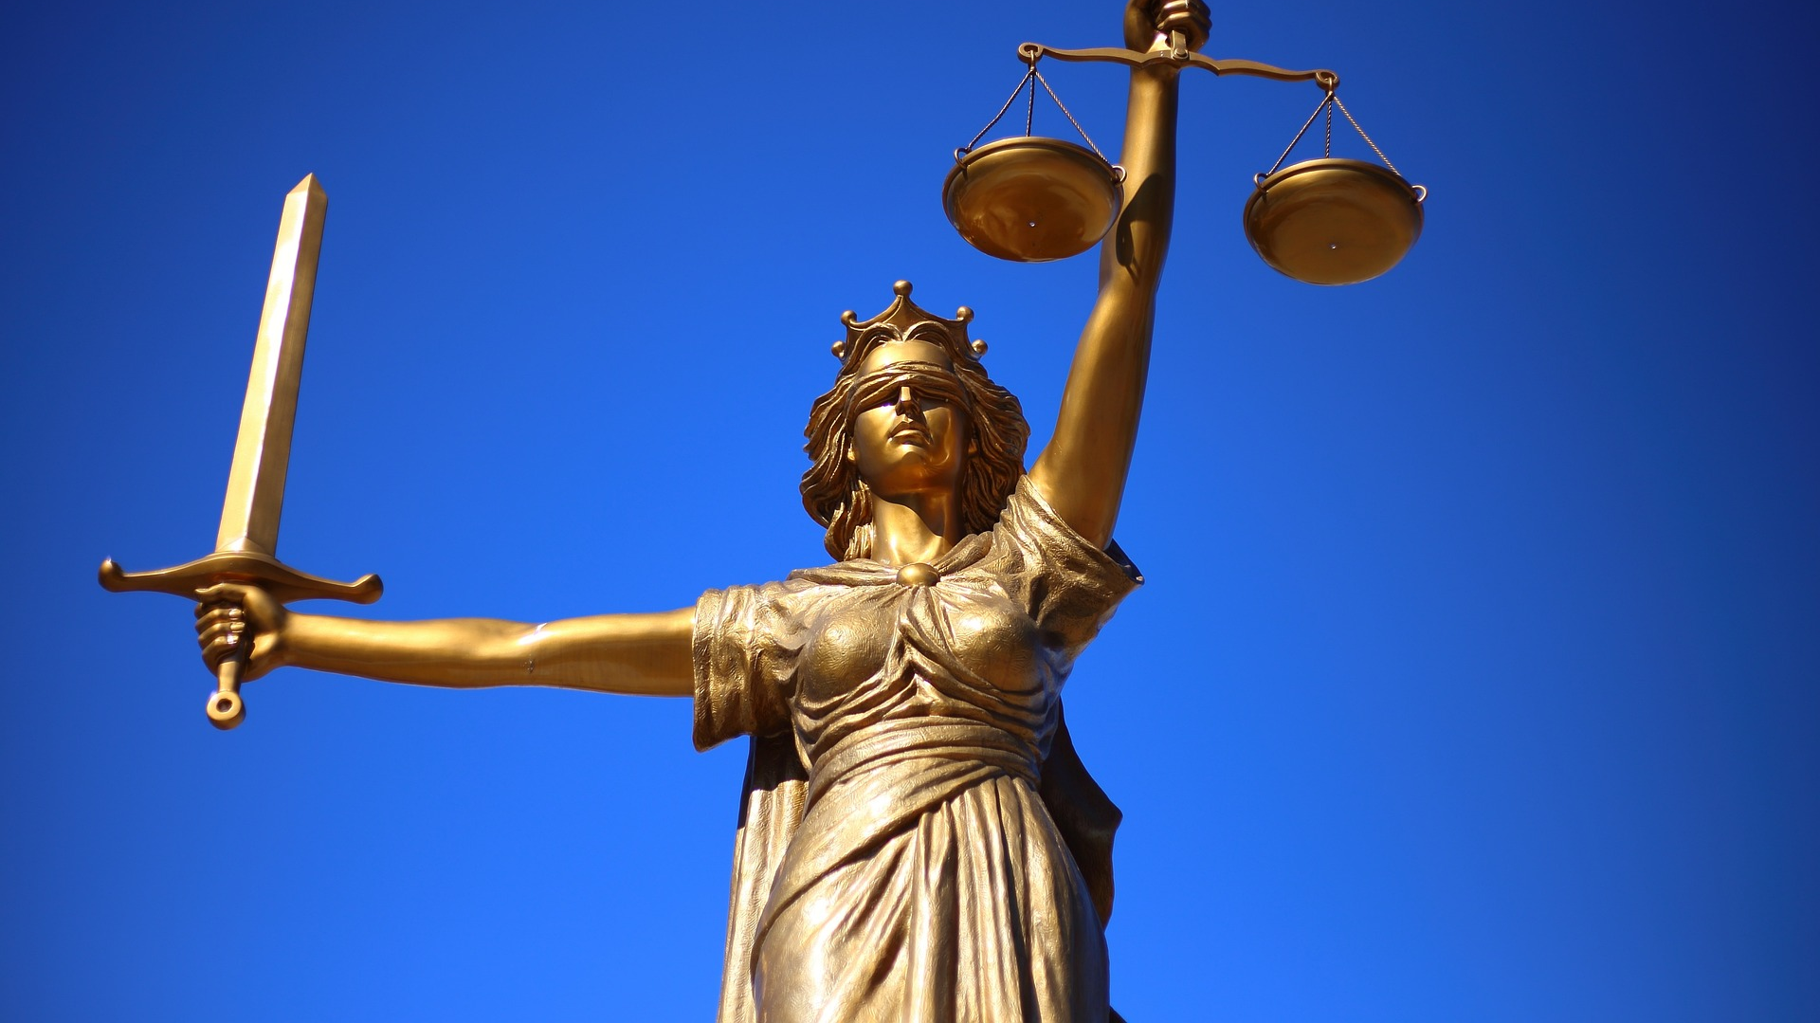

Slide 2
Good News for All: Married to Christ
Who Do You Obey? (6:15-18)
Who’s a Better Master? (6:19-23)
Married to Christ (7:1-6)

Slide 3
1. Who DO You Obey? (6:15-18)
¹⁶ Don’t you know that when you offer yourselves to someone as obedient slaves, you are slaves of the one you obey—whether you are slaves to sin, which leads to death, or to obedience, which leads to righteousness? ¹⁷ But thanks be to God that, though you used to be slaves to sin, you have come to obey from your heart the pattern of teaching that has now claimed your allegiance. ¹⁸ You have been set free from sin and have become slaves to righteousness.

Slide 4
1. Who DO You Obey? (6:15-18)
1 Cor 9:21, “21 To those not having the law I became like one not having the law (though I am not free from God’s law but am under Christ’s law), so as to win those not having the law.
Gal 6:2, “Carry each other’s burdens, and in this way you will fulfill the law of Christ.”
We are slaves and are bound to Christ!

Slide 5
2. Who’s a Better Master? (v.19-23)
What were we like when we were free?
  See the Old Testament
  See the world
  Think back to your life

Slide 6
2. Who’s a Better Master? (v.19-23)
²¹ What benefit did you reap at that time from the things you are now ashamed of? Those things result in death!²² But now that you have been set free from sin and have become slaves of God, the benefit you reap leads to holiness, and the result is eternal life. ²³ For the wages of sin is death, but the gift of God is eternal life in^{[b]} Christ Jesus our Lord.

Slide 7
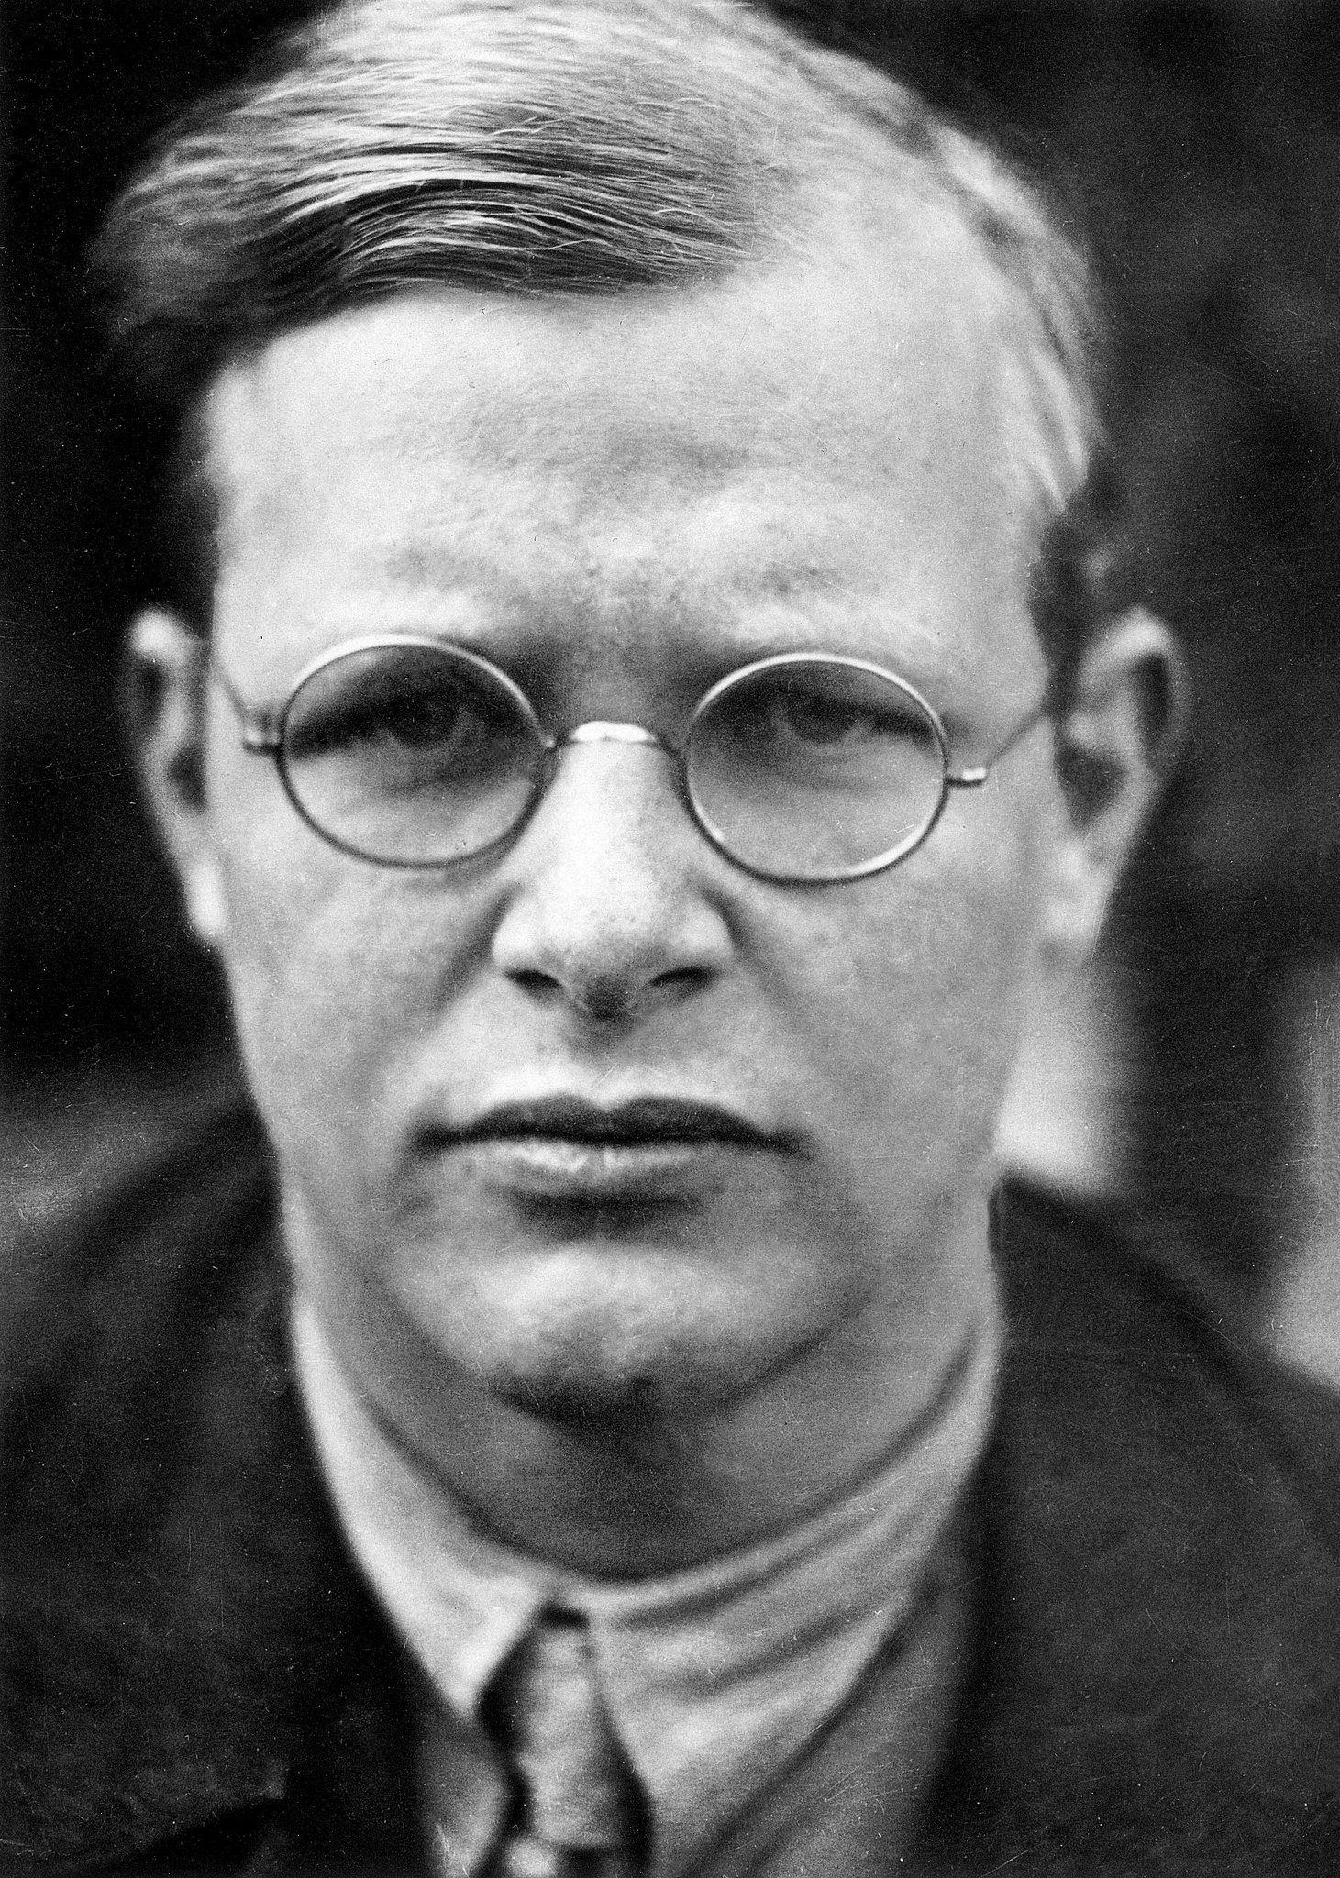
Cheap grace is the preaching of forgiveness without requiring repentance, baptism without church discipline, Communion without confession, absolution without personal confession. Cheap grace is grace without discipleship, grace without the cross, grace without Jesus Christ, living and incarnate….
Such grace is costly because it calls us to follow, and it is grace because it calls us to follow Jesus Christ. It is costly because it costs a man his life, and it is grace because it gives a man the only true life.

Slide 8
3. Married to Christ (7:1-6)

Slide 9
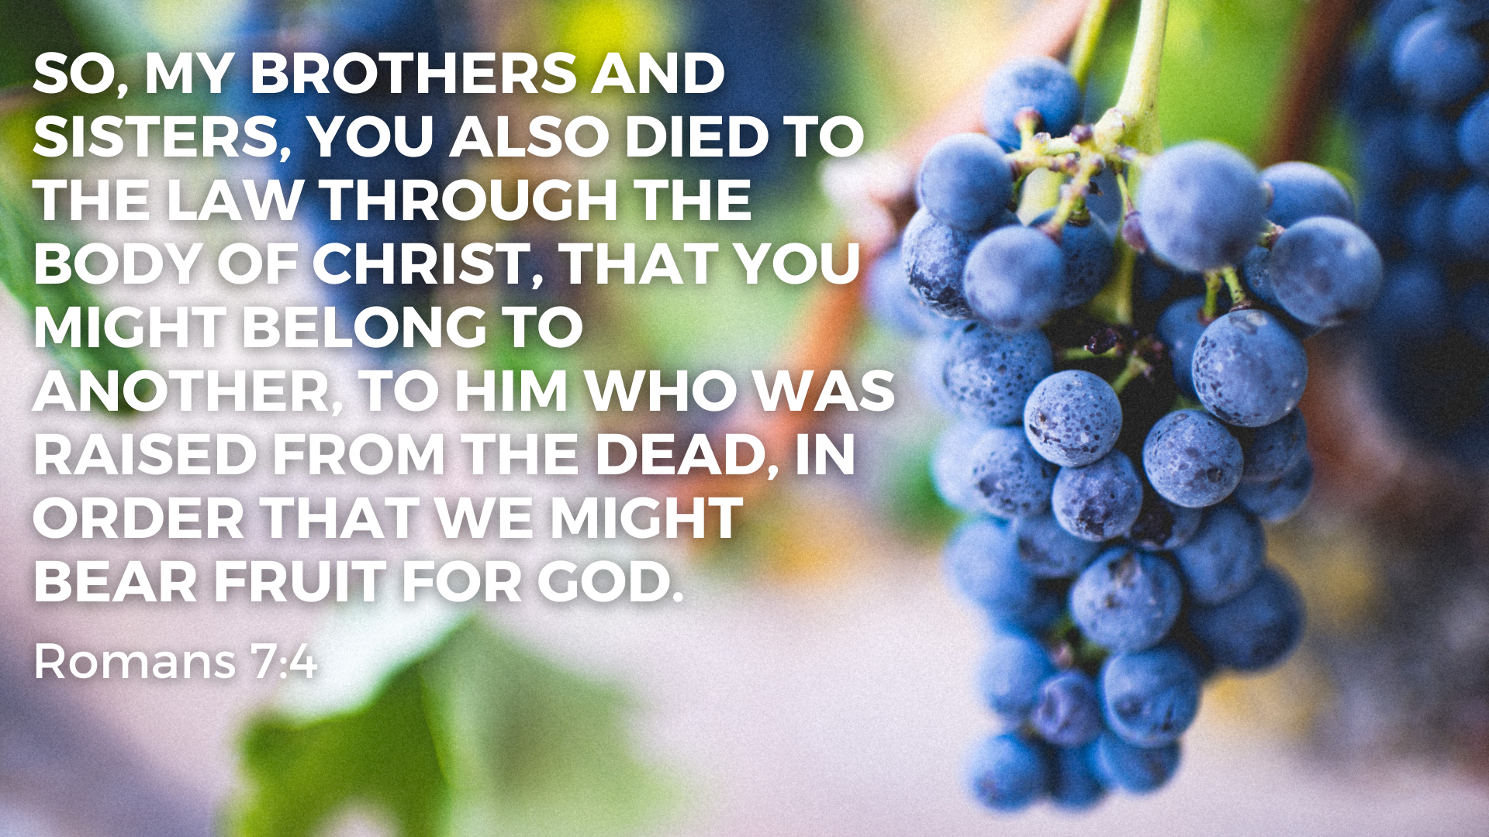

Slide 10
