Slide 1
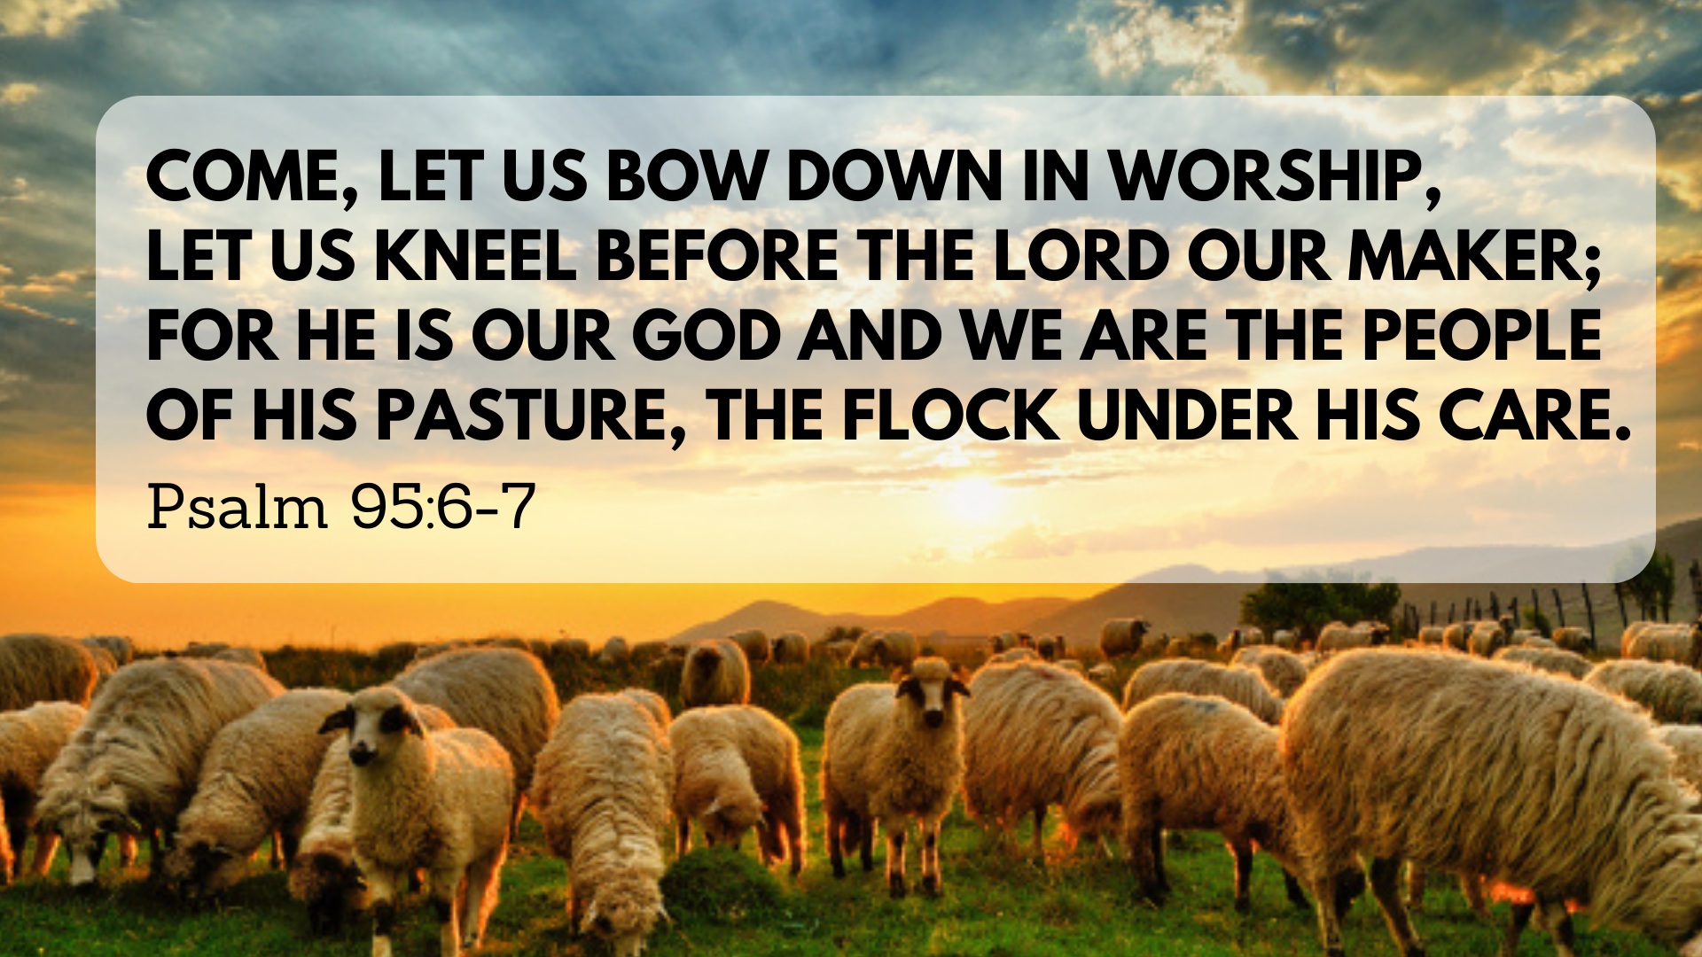

Slide 2
1. Call to Worship (v.1-2)
1 Come, let us sing for joy to the Lord;
let us shout aloud to the Rock of our salvation.
2 Let us come before him with thanksgiving
and extol him with music and song.
* Worship is corporate, before God, a joyful response, and a discipline.

Slide 3
2. Call to Bow Down (v.3-7a)

Slide 4


Slide 5
2. Call to Bow Down (v.3-7a)
6 Come, let us bow down in worship,
let us kneel before the Lord our Maker;
7 for he is our God
and we are the people of his pasture,
the flock under his care.

Slide 6
2. Call to Bow Down (v.3-7a)
6 Come, let us bow down in worship,
let us kneel before the Lord our Maker;
7 for he is our God
and we are the people of his pasture,
the flock under his care.

Slide 7
3. Call to Listen (v.7—11)
Today, if only you would hear his voice,
⁸ “Do not harden your hearts as you did at Meribah,^{[a]}
as you did that day at Massah^{[b]} in the wilderness,

