Slide 1
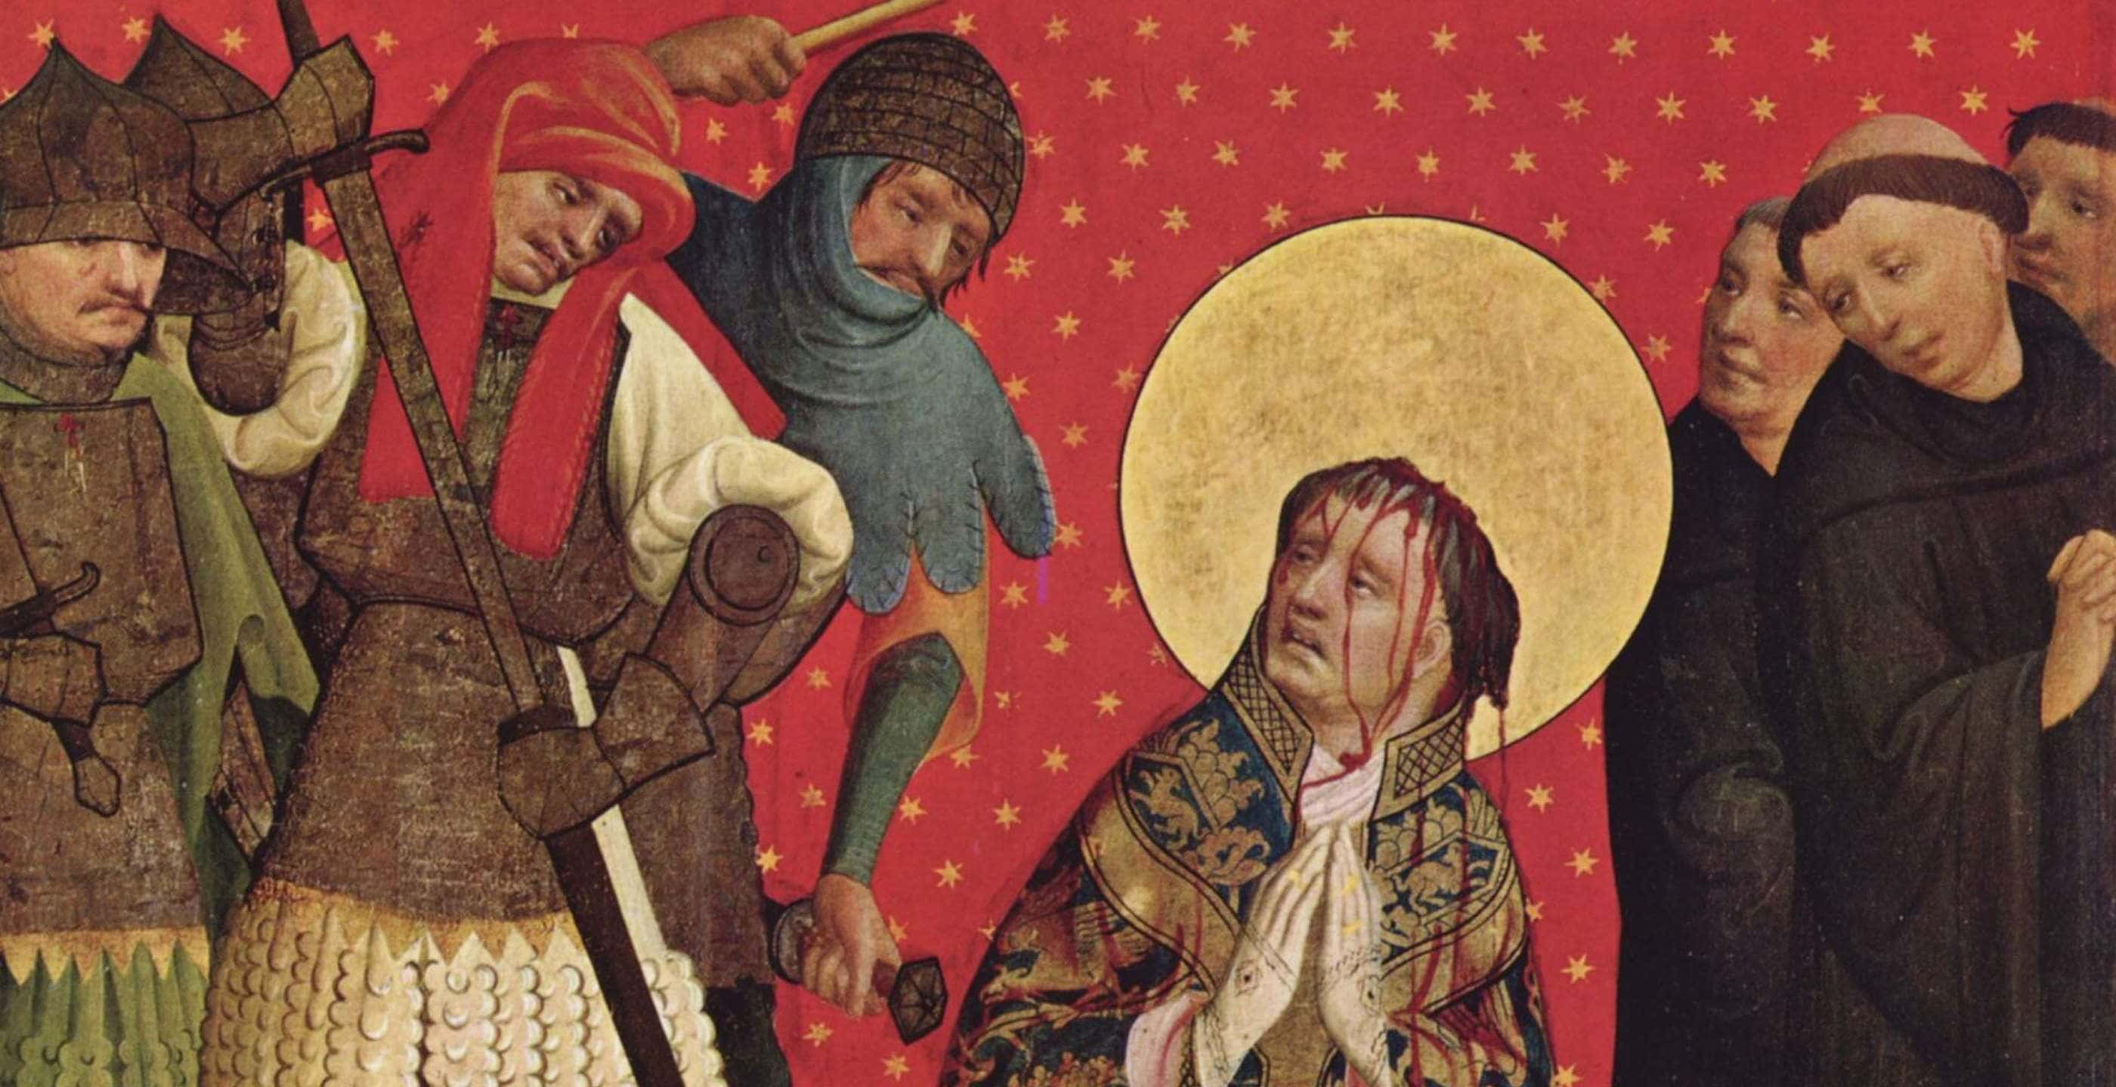

Slide 2
God’s Story, Our Story: Exodus
We’re Rescued First
We’re a Nation of Priests
We Point to Our Rescuer

Slide 3
1. We’re Rescued First
God heard their groaning and he remembered his covenant with Abraham, with Isaac and with Jacob. (Exodus 2:24)

Slide 4
1. We’re Rescued First
“‘You yourselves have seen what I did to Egypt, and how I carried you on eagles’ wings and brought you to myself. 5 Now if you obey me fully…” (19:4-5).

Slide 5


Slide 6
1. We’re Rescued First
“‘You yourselves have seen what I did to Egypt, and how I carried you on eagles’ wings and brought you to myself. 5 Now if you obey me fully…” (19:4-5).

Slide 7
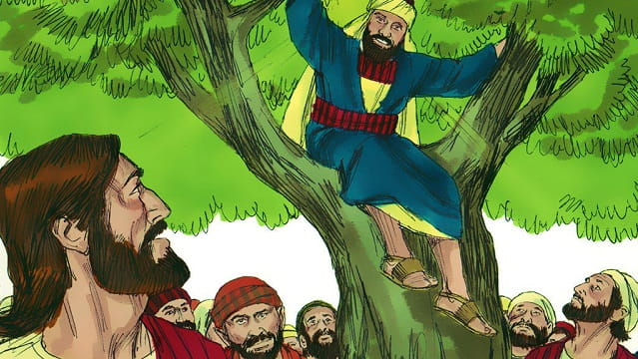

Slide 8
2. We’re a Nation of Priests
“You shall be my treasured possession among all peoples, for all the earth is mine; and you shall be to me a kingdom of priests and a holy nation” (19:5-6, ESV).

Slide 9
2. We’re a Nation of Priests
“You shall be my treasured possession among all peoples, for all the earth is mine; and you shall be to me a kingdom of priests and a holy nation” (19:5-6, ESV).
“9 But you are a chosen people, a royal priesthood, a holy nation, God’s special possession, that you may declare the praises of him who called you out of darkness into his wonderful light” (1 Peter 2:9).

Slide 10


Slide 11
2. We’re a Nation of Priests
We’re called out from the world for the world!
We’re a nation, not a collection of individuals.
“You are the light of the world. A town built on a hill cannot be hidden” (Matthew 5:14)

Slide 12
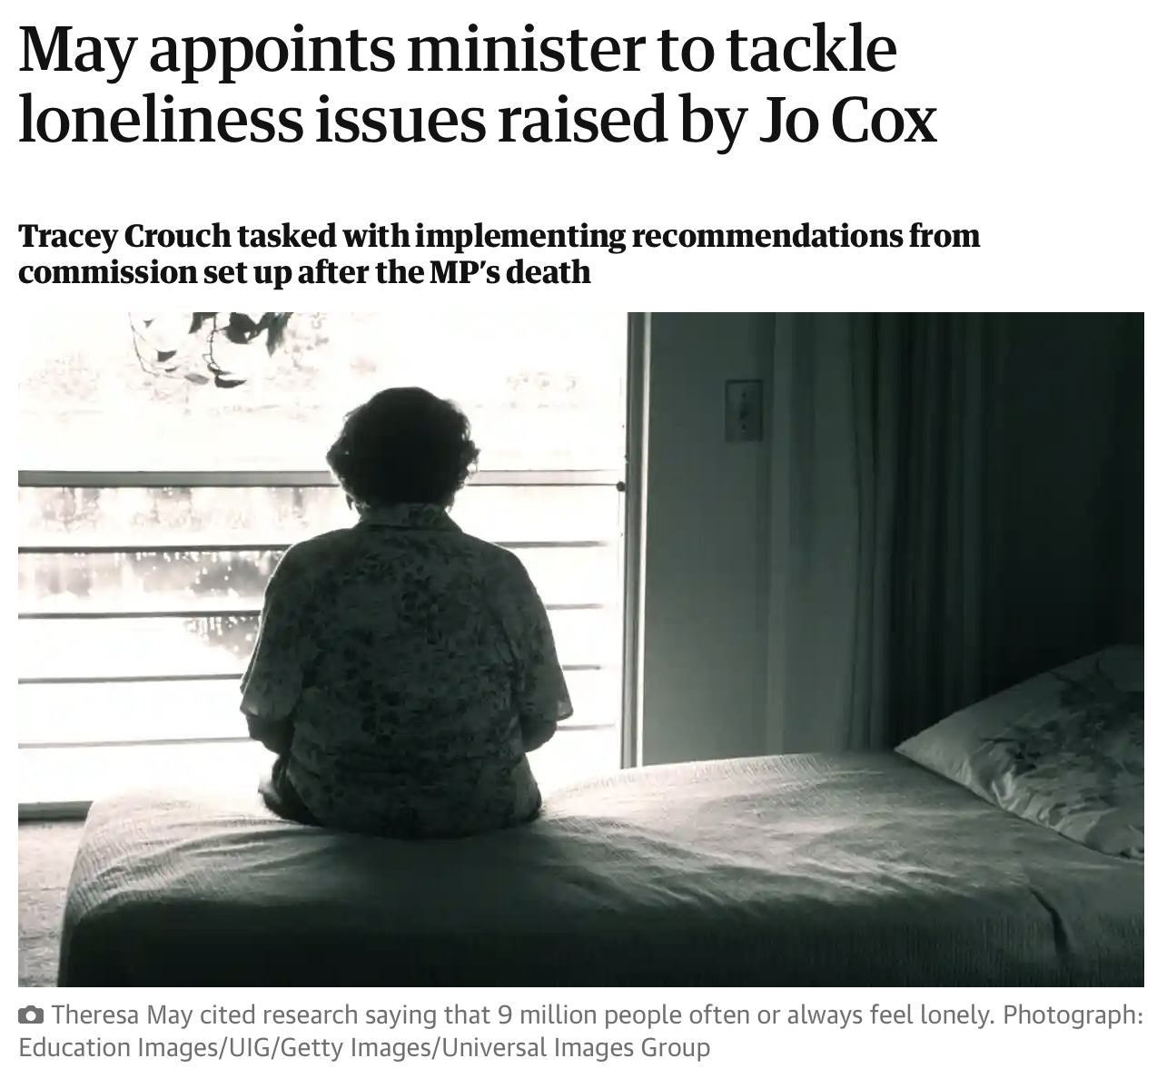

Slide 13
3. We point to the Rescuer
⁴ ‘You yourselves have seen what I did to Egypt, and how I carried you on eagles’ wings and brought you to myself. ⁵ Now if you obey me fullyand keep my covenant, then out of all nations you will be my treasured possession.

Slide 14
3. We point to the Rescuer
The Law reveals God’s standards
The Law reveals our sins
The Law reveals our need for a savior
Jesus = Israel, God’s people

