Slide 1
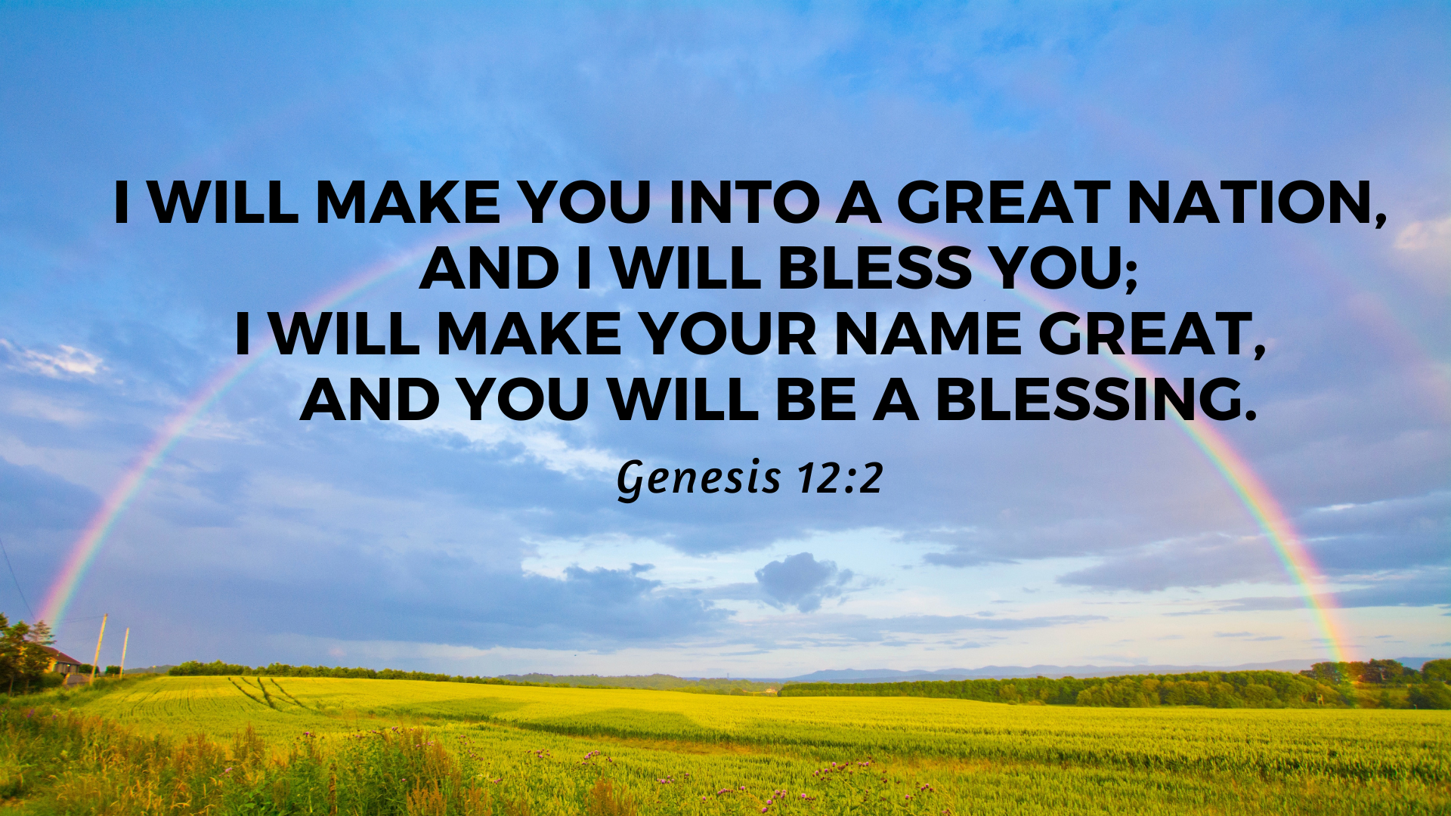

Slide 2
1. Extraordinary Obedience (12:1, 4-7)
The Lord had said to Abram, “Go from your country, your people and your father’s household to the land I will show you.

Slide 3
Joshua said to all the people, “This is what the Lord, the God of Israel, says: ‘Long ago your ancestors, including Terah the father of Abraham and Nahor, lived beyond the Euphrates River and worshiped other gods. (Joshua 24:2)

Slide 4
1. Extraordinary Obedience (12:1, 4-7)
“If anyone comes to me and does not hate father and mother, wife and children, brothers and sisters—yes, even their own life such a person cannot be my disciple. And whoever does not carry their cross and follow me cannot be my disciple” (Luke 14:26-27).

Slide 5
2. Called to Bless the World (12:2-3)

Slide 6
2. Called to Bless the World (12:2-3)
2 “I will make you into a great nation, and I will bless you; I will make your name great, and you will be a blessing.[a] 3 I will bless those who bless you, and whoever curses you I will curse; and all peoples on earth will be blessed through you.”[b]

Slide 7
7 Understand, then, that those who have faith are children of Abraham. 8 Scripture foresaw that God would justify the Gentiles by faith, and announced the gospel in advance to Abraham: “All nations will be blessed through you.” (Gal 3:7-8)

Slide 8
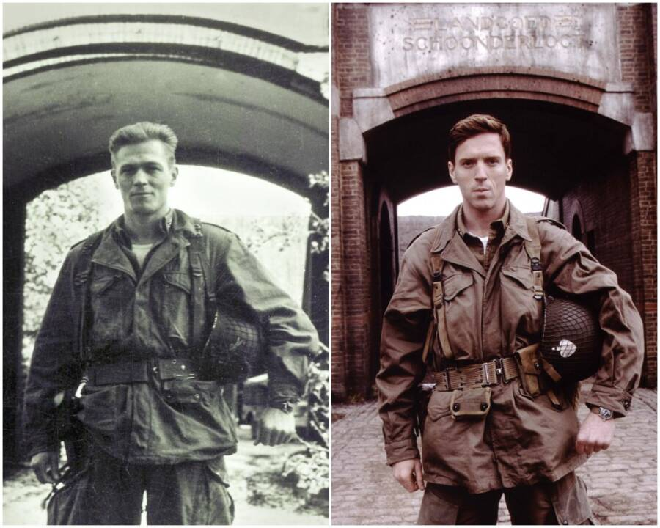

Slide 9
2. Called to Bless the World (12:2-3)

Slide 10


Slide 11
3. People of Great Hope
“Now Sarai was childless because she was not able to conceive” (Genesis 11:30).

Slide 12
3. People of Great Hope
2 “I will make you into a great nation, and I will bless you; I will make your name great, and you will be a blessing.[a] 3 I will bless those who bless you, and whoever curses you I will curse; and all peoples on earth will be blessed through you.”[b]

Slide 13
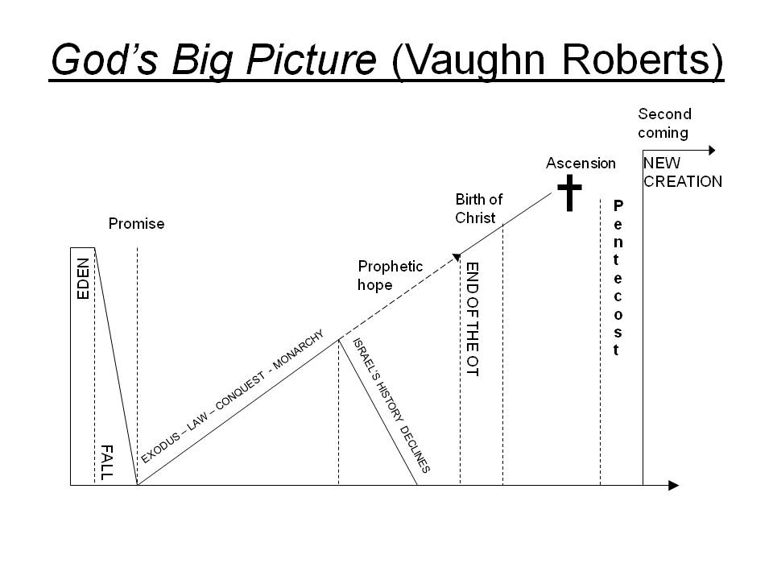
Genesis 12

Slide 14
3. People of Great Hope
6 Abram traveled through the land as far as the site of the great tree of Moreh at Shechem. At that time the Canaanites were in the land. 7 The Lord appeared to Abram and said, “To your offspring[c] I will give this land.” So he built an altar there to the Lord, who had appeared to him. 8 From there he went on toward the hills east of Bethel and pitched his tent, with Bethel on the west and Ai on the east. There he built an altar to the Lord and called on the name of the Lord.

