Slide 2


Slide 4
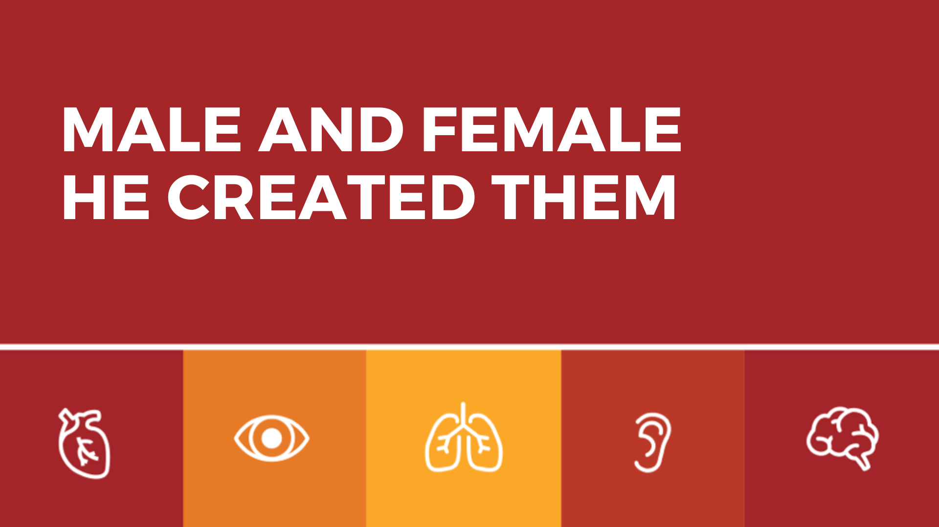

Slide 5
1. GENDER IS EMBODIED
Then God said, “Let us make mankind in our image, in our likeness, so that they may rule over the fish in the sea and the birds in the sky, over the livestock and all the wild animals, and over all the creatures that move along the ground.”
GENESIS 1:26

Slide 6
1. GENDER IS EMBODIED
So God created mankind in his own image, in the image of God he created them; male and female he created them.
GENESIS 1:27

Slide 7
1. GENDER IS EMBODIED
God blessed them and said to them, “Be fruitful and increase in number; fill the earth and subdue it. Rule over the fish in the sea and the birds in the sky and over every living creature that moves on the ground.”
GENESIS 1:28

Slide 9
“Dysphoria feels like being unable to get warm, no matter how many layers you put on. It feels like hunger without appetite… It feels like grieving. It feels like having nothing to grieve.”
ANDREA LONG CHU

Slide 10
2. GENDER AS MALE AND FEMALE IS GOOD
God saw all that he had made, and it was very good. And there was evening, and there was morning—the sixth day.
GENESIS 1:31

Slide 11
2. GENDER AS MALE AND FEMALE IS GOOD
The LORD God said, “It is not good for the man to be alone. I will make a helper suitable for him.”
GENESIS 2:18

Slide 12
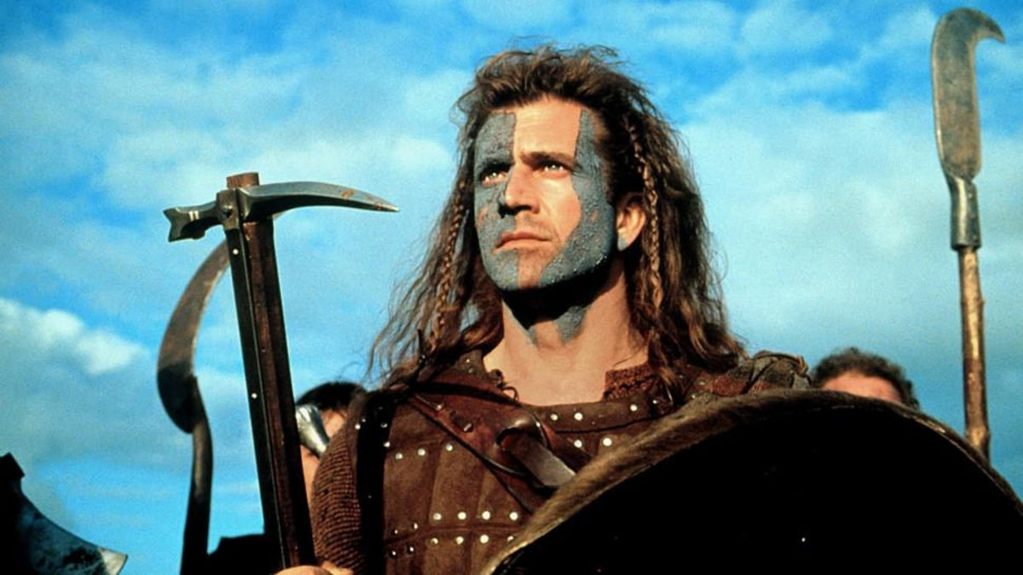

Slide 13
3. GENDER AND GOD’S GIFT OF SEX

Slide 14
3. GENDER AND GOD’S GIFT OF SEX
²³The man said, “This is now bone of my bones and flesh of my flesh; she shall be called ‘woman,’ for she was taken out of man.” ²⁴That is why a man leaves his father and mother and is united to his wife, and they become one flesh.
GENESIS 2:23-24

Slide 15


Slide 16
3. GENDER AND GOD’S GIFT OF SEX
⁴ “Haven’t you read,” he replied, “that at the beginning the Creator ‘made them male and female,’ and said, ‘For this reason a man will leave his father and mother and be united to his wife, and the two will become one flesh’? ⁶So they are no longer two, but one flesh. Therefore, what God has joined together, let no one separate.”
MATTHEW 19:4-6

Slide 17
3. GENDER AND GOD’S GIFT OF SEX
¹¹ Jesus replied, “Not everyone can accept this word, but only those to whom it has been given. ¹² For there are eunuchs who were born that way, and there are eunuchs who have been made eunuchs by others—and there are those who choose to live like eunuchs for the sake of the kingdom of heaven. The one who can accept this should accept it.”
MATTHEW 19:11-12

Slide 18
4. IDENTITY, SEX, AND GENDER

Slide 19
4. IDENTITY, SEX, AND GENDER
⁹Or do you not know that wrongdoers will not inherit the kingdom of God? Do not be deceived: Neither the sexually immoral nor idolaters nor adulterers nor men who have sex with men ¹⁰nor thieves nor the greedy nor drunkards nor slanderers nor swindlers will inherit the kingdom of God.
1 CORINTHIANS 6:9-10

Slide 20
4. IDENTITY, SEX, AND GENDER
And that is what some of you were. But you were washed, you were sanctified, you were justified in the name of the Lord Jesus Christ and by the Spirit of our God.
1 CORINTHIANS 6:11

