Slide 2
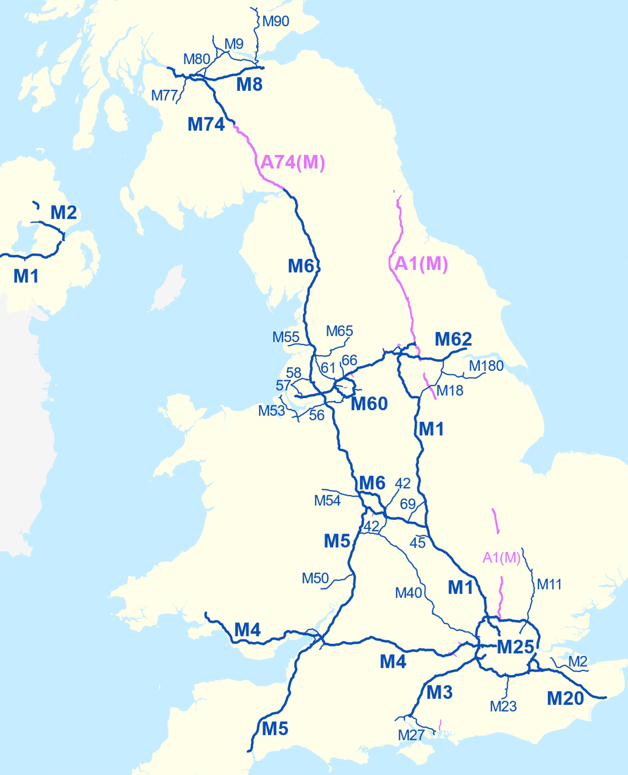

Slide 3
God’s Story, Our Story: Kingdom Arrives!
Jesus Came to Die
Glory of Self-Giving
Grace That Draws

Slide 4
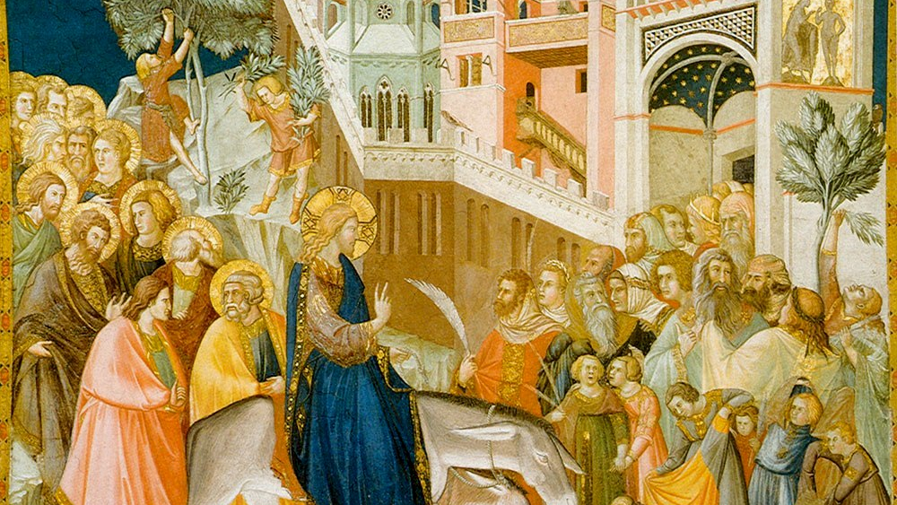

Slide 5
1. Jesus Came to Die
23 Jesus replied, “The hour has come for the Son of Man to be glorified. 24 Very truly I tell you, unless a kernel of wheat falls to the ground and dies, it remains only a single seed. But if it dies, it produces many seeds. 25 Anyone who loves their life will lose it, while anyone who hates their life in this world will keep it for eternal life. 26 Whoever serves me must follow me; and where I am, my servant also will be. My Father will honor the one who serves me.
27 “Now my soul is troubled, and what shall I say? ‘Father, save me from this hour’? No, it was for this very reason I came to this hour. 28 Father, glorify your name!”
Then a voice came from heaven, “I have glorified it, and will glorify it again.”

Slide 6
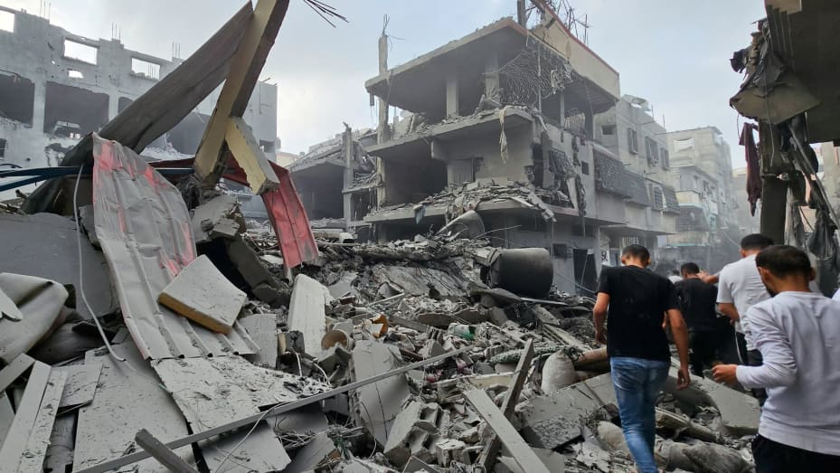

Slide 7
1. Jesus Came to Die
Check your priorities!

Slide 8
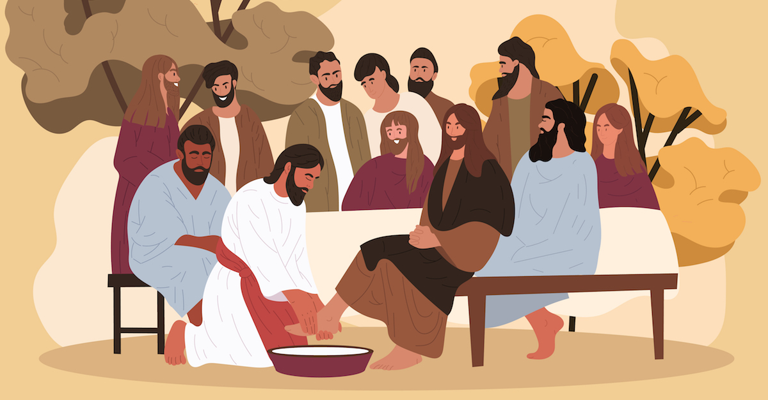

Slide 9
1. Jesus Came to Die
Check your priorities!
To know Jesus is to be served by him!

Slide 10
2. Glory of Self-Giving
23 Jesus replied, “The hour has come for the Son of Man to be glorified. 24 Very truly I tell you, unless a kernel of wheat falls to the ground and dies, it remains only a single seed. But if it dies, it produces many seeds. 25 Anyone who loves their life will lose it, while anyone who hates their life in this world will keep it for eternal life. 26 Whoever serves me must follow me; and where I am, my servant also will be. My Father will honor the one who serves me.
27 “Now my soul is troubled, and what shall I say? ‘Father, save me from this hour’? No, it was for this very reason I came to this hour. 28 Father, glorify your name!”
Then a voice came from heaven, “I have glorified it, and will glorify it again.”

Slide 11
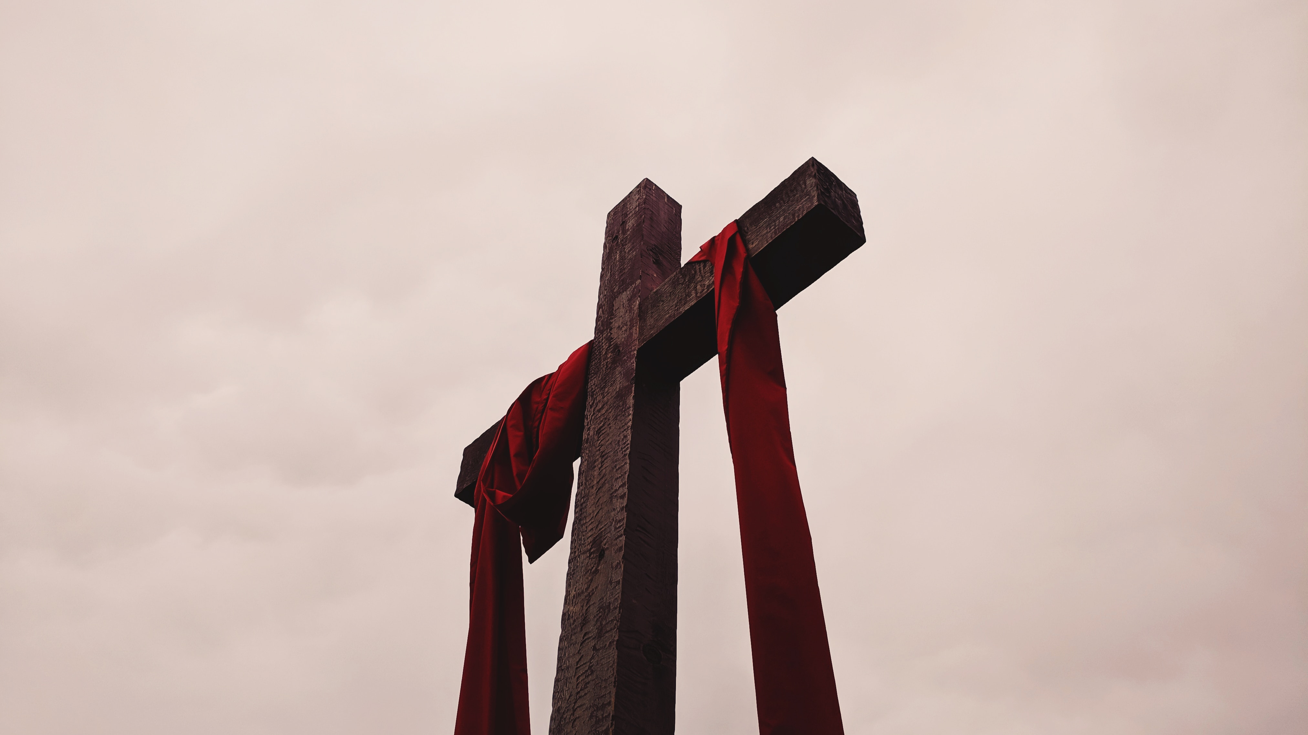

Slide 12
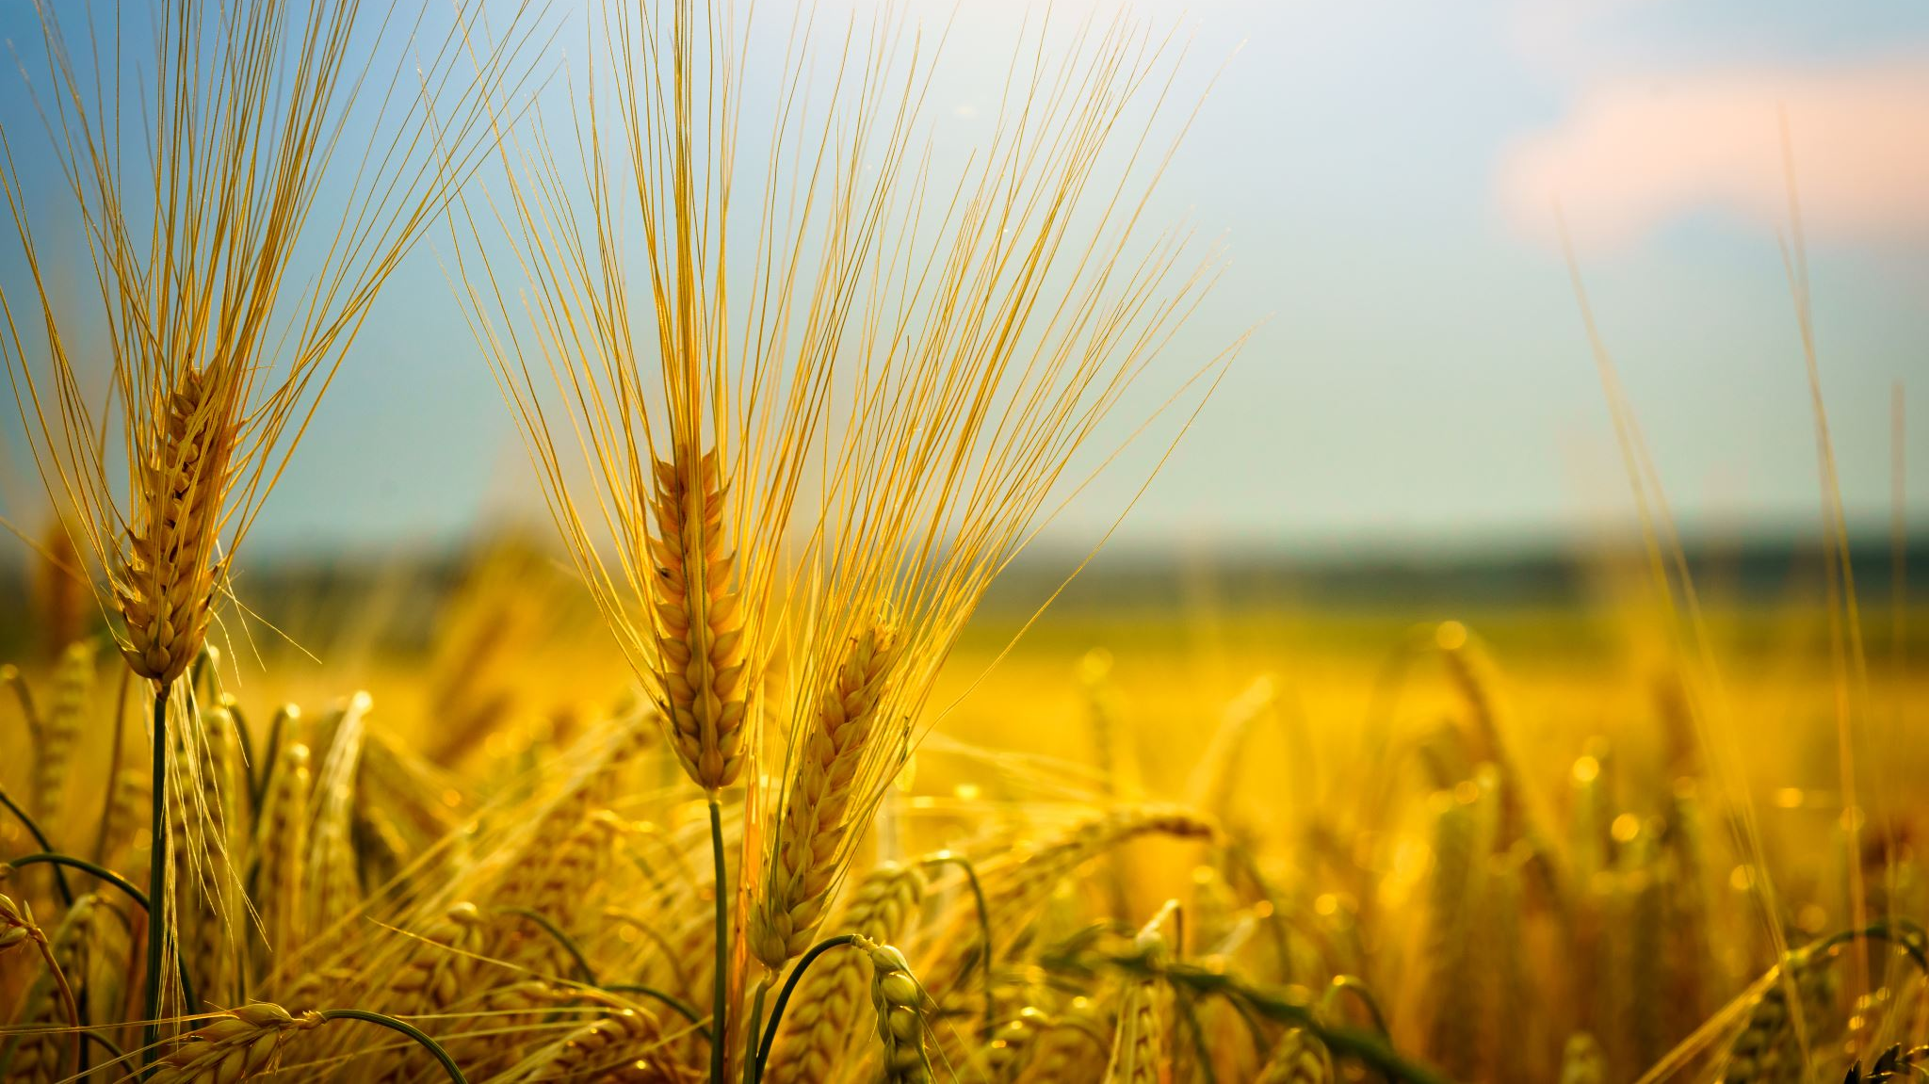
2. Glory of Self-Giving
23 Jesus replied, “The hour has come for the Son of Man to be glorified. 24 Very truly I tell you, unless a kernel of wheat falls to the ground and dies, it remains only a single seed. But if it dies, it produces many seeds. 25 Anyone who loves their life will lose it, while anyone who hates their life in this world will keep it for eternal life. 26 Whoever serves me must follow me; and where I am, my servant also will be. My Father will honor the one who serves me.
27 “Now my soul is troubled, and what shall I say? ‘Father, save me from this hour’? No, it was for this very reason I came to this hour. 28 Father, glorify your name!”
Then a voice came from heaven, “I have glorified it, and will glorify it again.”

Slide 13
2. Glory of Self-Giving
Glory of self-gain or self-giving?

Slide 14
3. Grace that Draws All People
“And I, when I am lifted up from the earth, will draw all people to myself” (v.32).

Slide 15
3. Grace that Draws All People
20 Now there were some Greeks among those who went up to worship at the festival. 21 They came to Philip, who was from Bethsaida in Galilee, with a request. “Sir,” they said, “we would like to see Jesus.”

