Slide 2
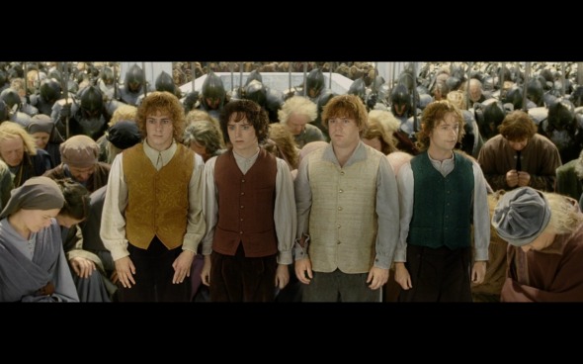

Slide 3
God’s Story, Our Story: The New Creation
End Keeps Us Going
Evil Will Be Defeated
Eden Will Be Consummated

Slide 4
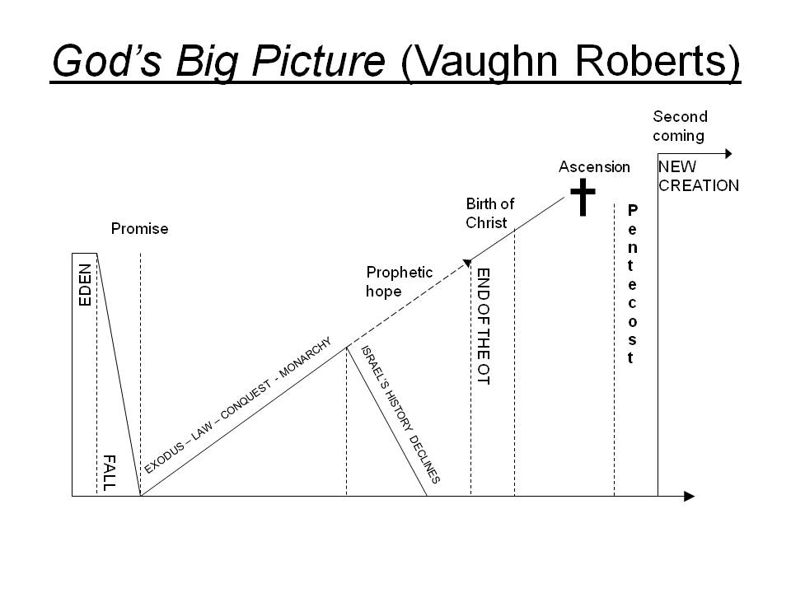

Slide 5
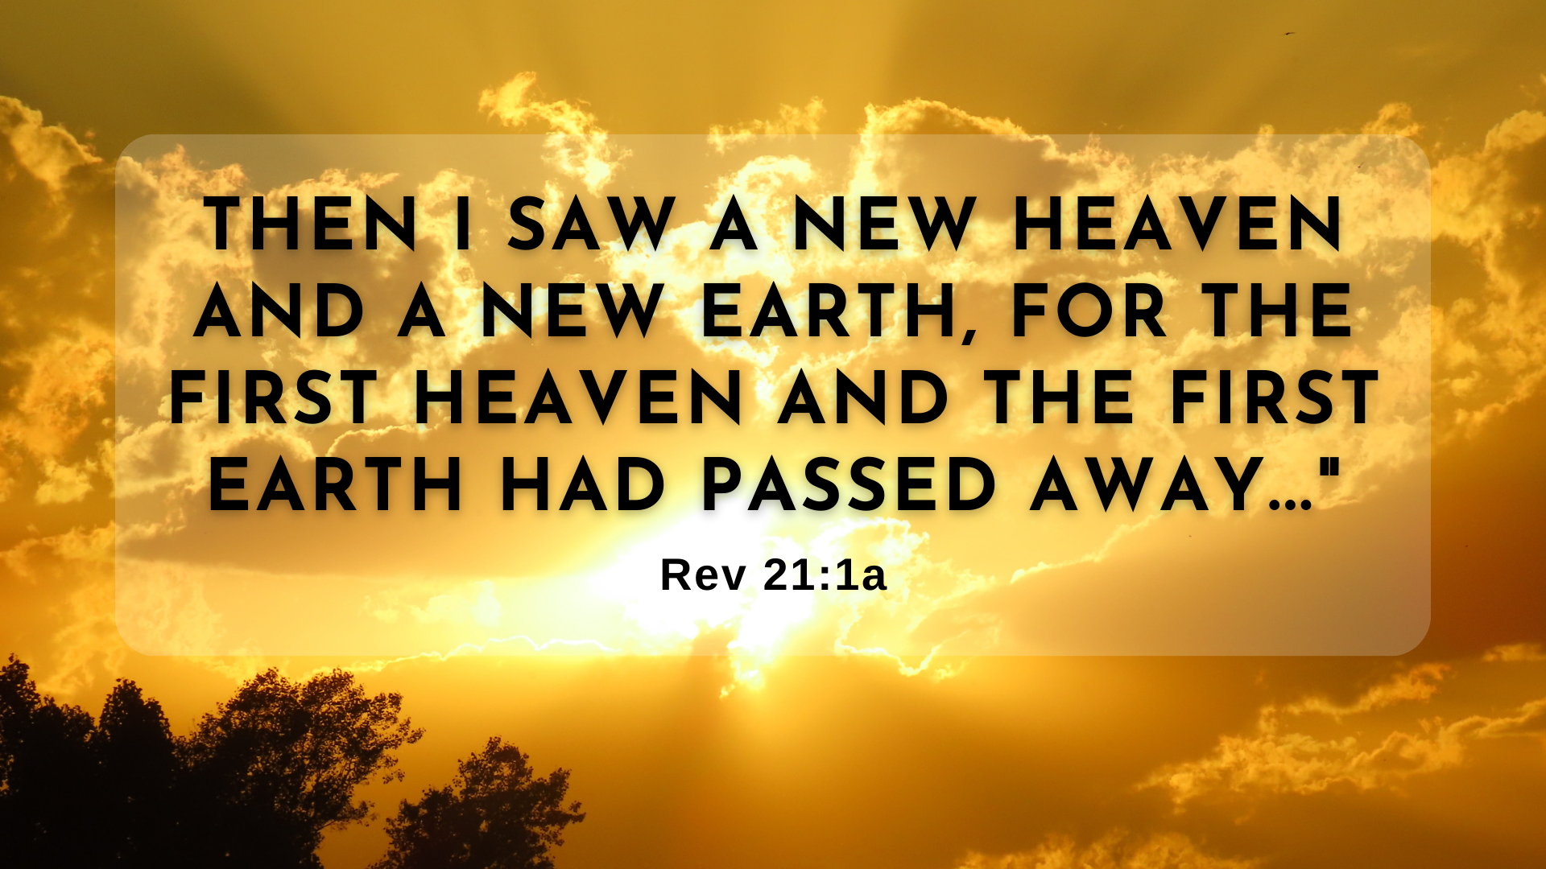

Slide 6
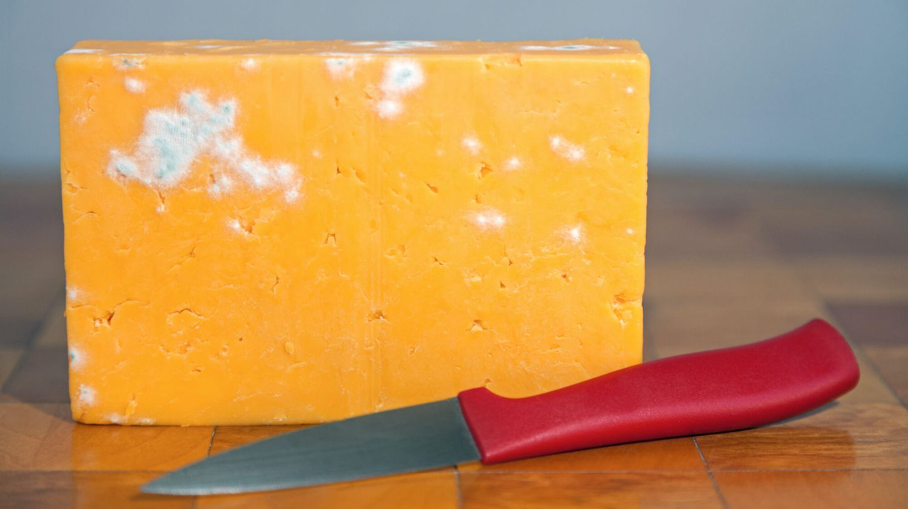

Slide 7
End Keeps Us Going
Then I saw “a new heaven and a new earth,”[a] for the first heaven and the first earth had passed away, and there was no longer any sea. 2 I saw the Holy City, the new Jerusalem, coming down out of heaven from God, prepared as a bride beautifully dressed for her husband. (21:1-2)

Slide 8
2. Evil Will Be Defeated
17:5, “The name written on her forehead was a mystery: Babylon the great; the mother of prostitutes; and of the abominations of the earth.
18:2a, “Fallen! Fallen is Babylon the Great!”
20:10a, “And the devil, who deceived them, was thrown into the lake of burning sulfur.…”

Slide 9
2. Evil Will Be Defeated
There will be a just judgment
  There will be justice
  I can go on loving my enemies and neighbors now

Slide 10
2. Evil Will Be Defeated
There will be a just judgment
  There will be justice
  I can go on loving my enemies and neighbors now
We too will be judged
  Be thankful
  Tell others of Jesus!

Slide 11
3. Eden Will Be Consummated
22 Then the angel showed me the river of the water of life, as clear as crystal, flowing from the throne of God and of the Lamb 2 down the middle of the great street of the city. On each side of the river stood the tree of life, bearing twelve crops of fruit, yielding its fruit every month. And the leaves of the tree are for the healing of the nations. 3 No longer will there be any curse. The throne of God and of the Lamb will be in the city, and his servants will serve him. 4 They will see his face, and his name will be on their foreheads. 5 There will be no more night. They will not need the light of a lamp or the light of the sun, for the Lord God will give them light. And they will reign for ever and ever.

Slide 12

“Martyrdom is not only dying for the truth – though in the first century as in many countries today, it not frequently is – but a mode of being in the world that points away from itself to the glorious, finished work of Christ on the cross, his ascension to reign, and his soon return.”
- Christopher Watkin,
Biblical Critical Theory

Slide 13
