Slide 1

Work Renewed

Slide 2
Genesis 1:26-28
26 Then God said, “Let us make mankind in our image, in our likeness, so that they may rule over the fish in the sea and the birds in the sky, over the livestock and all the wild animals, and over all the creatures that move along the ground.”
27 So God created mankind in his own image,
in the image of God he created them;
male and female he created them.

Slide 3
Genesis 1:26-28
28 God blessed them and said to them, “Be fruitful and increase in number; fill the earth and subdue it. Rule over the fish in the sea and the birds in the sky and over every living creature that moves on the ground.”

Slide 4
Genesis 2:15
15 The Lord God took the man and put him in the Garden of Eden to work it and take care of it.

Slide 5
Genesis 2:1-3
2 Thus the heavens and the earth were completed in all their vast array.
2 By the seventh day God had finished the work he had been doing; so on the seventh day he rested from all his work. 3 Then God blessed the seventh day and made it holy, because on it he rested from all the work of creating that he had done.

Slide 6
Ephesians 2: 8-10
8 For it is by grace you have been saved, through faith—and this is not from yourselves, it is the gift of God— 9 not by works, so that no one can boast.
10 For we are God’s handiwork, created in Christ Jesus to do good works, which God prepared in advance for us to do.

Slide 7
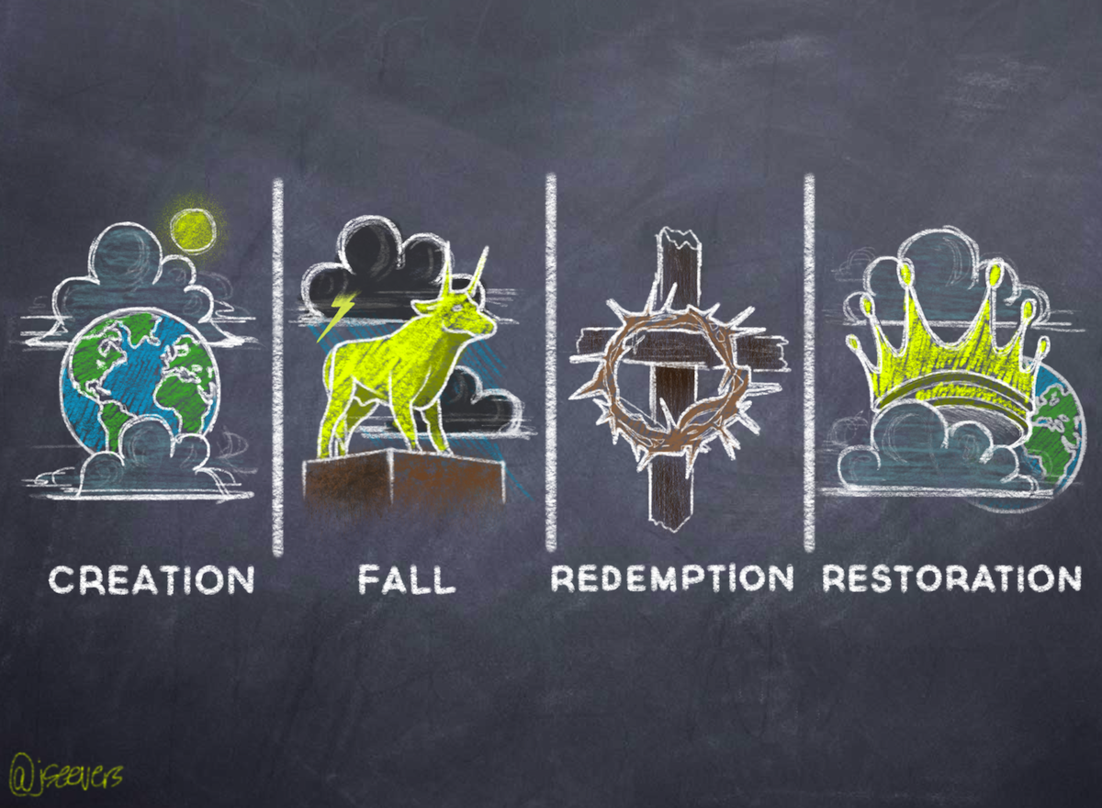

Slide 8
Work in Creation
God blessed them and said to them, “Be fruitful and increase in number; fill the earth and subdue it. Rule over the fish in the sea and the birds in the sky and over every living creature that moves on the ground.”
– Genesis 1:28
The Lord God took the man and put him in the Garden of Eden to work it and take care of it.
– Genesis 2:15

Slide 9
God’s Design for our Work
Blessing
Worship
Flourish
Purpose
Sabbath

Slide 10
God’s Design for our Work
Work is part of the blessing of God given before the Fall
We reflect his glory as we work (avodah = worship/work)
Work is good for us and for the creation (flourishing)
This is what we were meant to do (finding purpose)
God sets healthy limits on work (Sabbath rest)

Slide 11
Work in Fallen Creation
Blessing -> curse
Flourishing -> conflict and exploitation
Purpose -> frustrated
Worship of God -> worship of human self, idolatry
Sabbath Rest -> workaholism and slavery

Slide 12
Work Redeemed
8 For it is by grace you have been saved, through faith—and this is not from yourselves, it is the gift of God— 9 not by works, so that no one can boast.
10 For we are God’s handiwork [ESV: workmanship], created in Christ Jesus to do good works, which God prepared in advance for us to do.
Ephesians 2: 8-10

Slide 13
Work Redeemed
We are saved from sin for good works
Human work remains the main way God provides for humanity’s needs
Godly work blesses others
Redeemed working lives are a witness to the transformational power of the gospel

Slide 14
Whom do you work for?
23 Whatever you do, work at it with all your heart, as working for the Lord, not for human masters, 24 since you know that you will receive an inheritance from the Lord as a reward. It is the Lord Christ you are serving.
Colossians 3:23-24

Slide 15
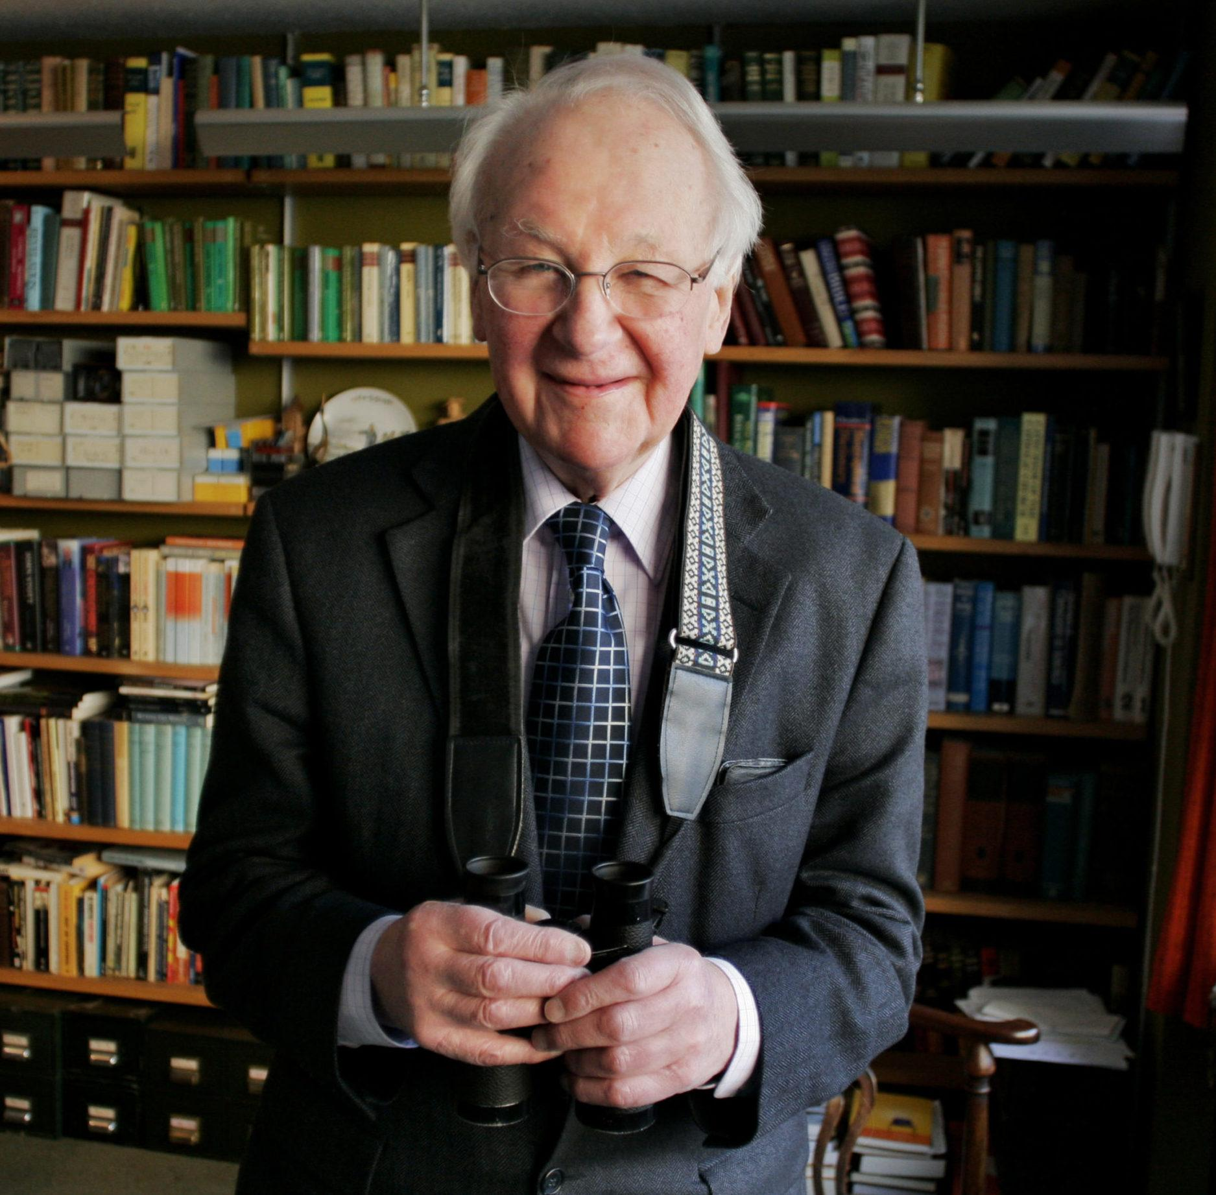
John Stott, Christian Mission in the Modern World
‘If we are Christians, we must spend our lives in the service of God and others. The only difference between us lies in the nature of the service we are called to render. Some are indeed called to be missionaries, evangelists or pastors, and others to the great professions of law, education, medicine and the social sciences. But others are called to commerce, to industry and farming, to accountancy and banking, to local government and parliament, and to the mass media, to homemaking and family building.’

Slide 16
John Stott, Christian Mission in the Modern World
‘In all these spheres, and many others besides, it is possible for Christians to interpret their life’s work Christianly, and to see it neither as a necessary evil (necessary, that is, for survival), nor even as a useful place in which to evangelise or make money for evangelism, but as their Christian vocation, as the way Christ has called them to spend their lives in his service. Further, a part of their calling will be to seek to maintain Christ’s standards of justice, righteousness, honesty, human dignity and compassion in a society that no longer accepts them.’

