Slide 1
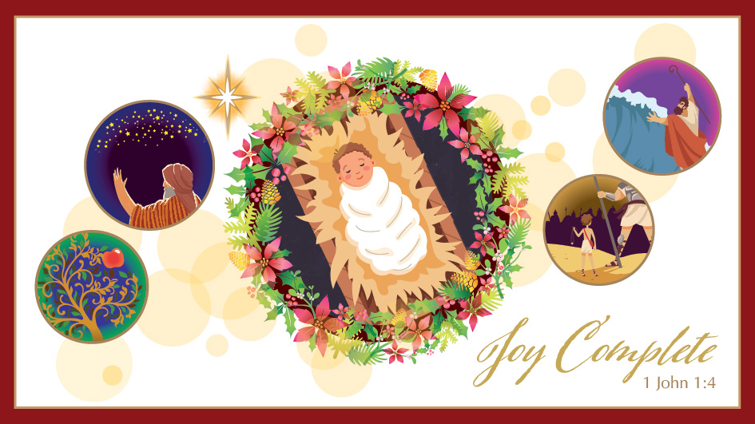

Slide 2
Complete Joy
Christmas means we have a savior
Christmas means this world will be saved
Christmas means an invitation

Slide 3
1. Christmas means we have a savior
Christianity is not a philosophy, technic, or a movement to make the world better.
“[T]hat which was from the beginning, which, we have heard, which we have seen with our eyes, which we have looked at and our hands have touched…” (1:1)

Slide 5
2. Christmas means redemption of this world

Slide 6
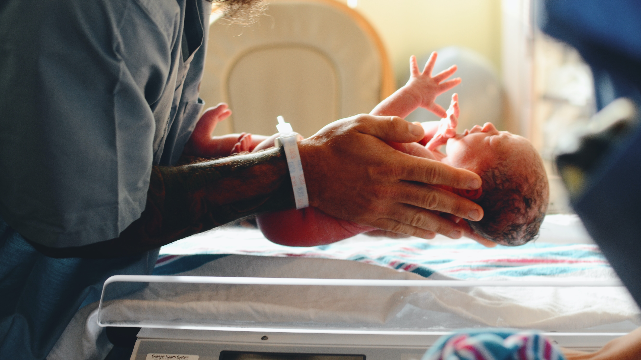

Slide 7
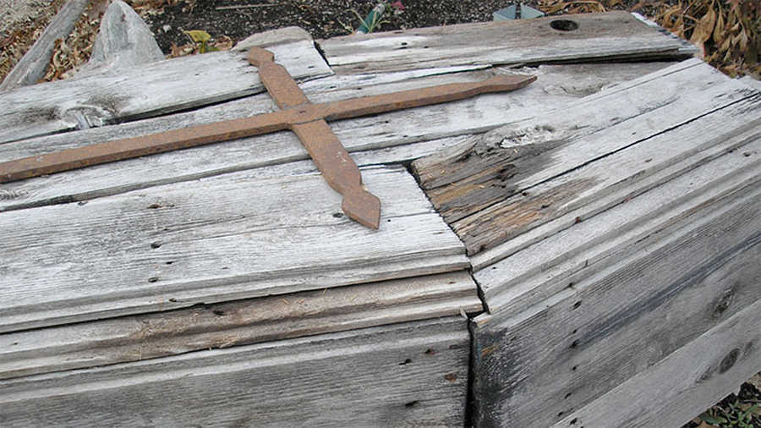

Slide 9
2. Christmas means redemption of this world
And we eagerly await a Savior from there, the Lord Jesus Christ, 21 who, by the power that enables him to bring everything under his control, will transform our lowly bodies so that they will be like his glorious body (Phil 3:20b-21).

Slide 10
3. Christmas means an invitation
1 That which was from the beginning, which we have heard, which we have seen with our eyes, which we have looked at and our hands have touched—this we proclaim concerning the Word of life. 2 The life appeared; we have seen it and testify to it, and we proclaim to you the eternal life, which was with the Father and has appeared to us. 3 We proclaim to you what we have seen and heard, so that you also may have fellowship with us. And our fellowship is with the Father and with his Son, Jesus Christ. 4 We write this to make our joy complete.

Slide 11
3. Christmas means an invitation
1 That which was from the beginning, which we have heard, which we have seen with our eyes, which we have looked at and our hands have touched—this we proclaim concerning the Word of life. 2 The life appeared; we have seen it and testify to it, and we proclaim to you the eternal life, which was with the Father and has appeared to us. 3 We proclaim to you what we have seen and heard, so that you also may have fellowship with us. And our fellowship is with the Father and with his Son, Jesus Christ. 4 We write this to make our joy complete.

Slide 12
