Slide 1
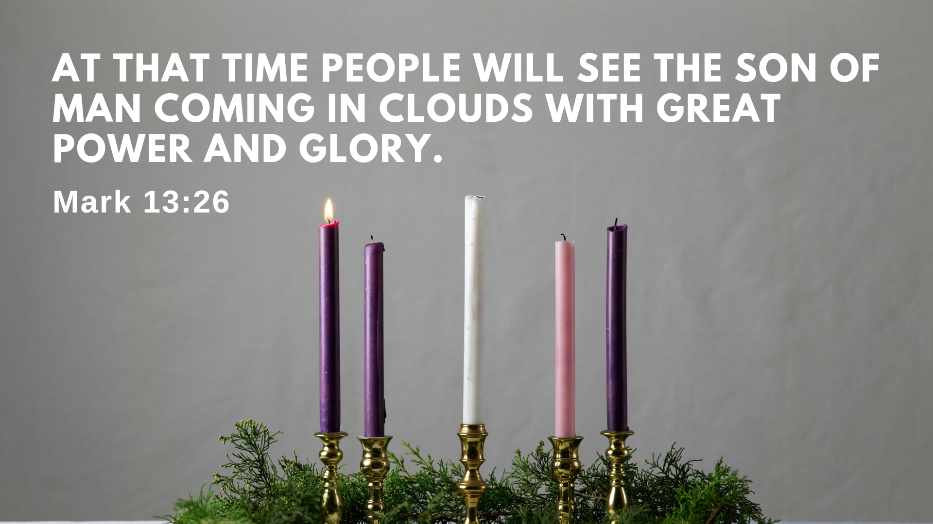

Slide 2
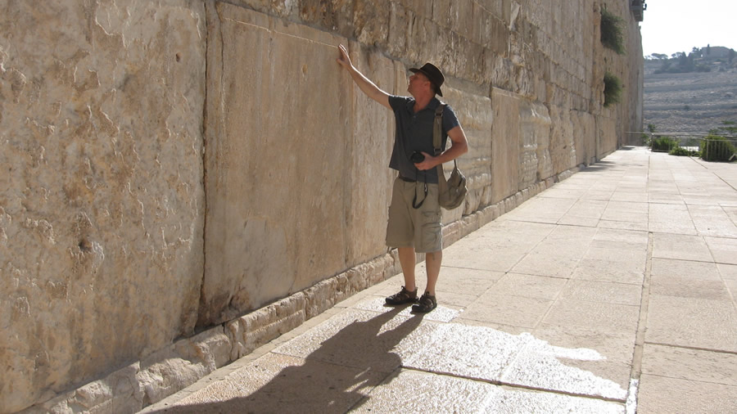

Slide 3
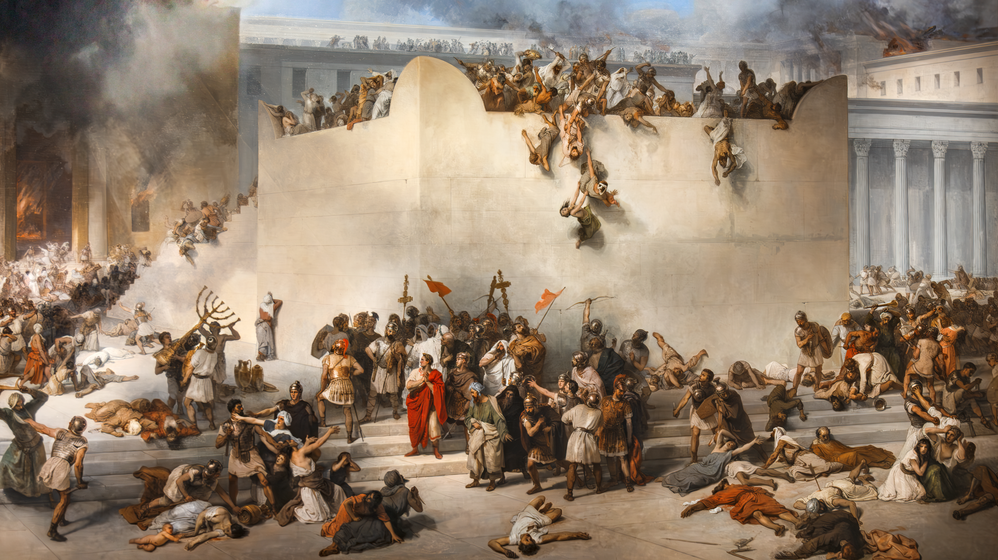
La distruzione del tempio di Gerusalemme -Francesco Hayez

Slide 4
Advent 1: Keep Watch!
He’s Coming in Glory (v.24-27)
Avoid Two Extremes (v.28-33)
Be Alert (v.33-37)

Slide 5
1. He’s Coming in Glory (v.24-27)

Slide 6

“Most ambitions are either achieved or abandoned; either way, they belong to the past. The future, instead of the ladder toward the goals of life, flattens out into a perpetual present. Money, status, all the vanities the preacher of Ecclesiastes described hold so little interest: a chasing after wind, indeed.”

Slide 7
1. He’s Coming in Glory (v.24-27)
²⁴ “But in those days, following that distress,
“‘the sun will be darkened,
and the moon will not give its light;
²⁵ the stars will fall from the sky,
and the heavenly bodies will be shaken.’^{[c]}
²⁶ “At that time people will see the Son of Man coming in clouds with great power and glory. ²⁷ And he will send his angels and gather his elect from the four winds, from the ends of the earth to the ends of the heavens.

Slide 9
2. Avoid Two Extremes (v.28-33)
Watching and predicting

Slide 10
2. Avoid Two Extremes (v.28-33)
Watching and predicting
Too laidback and/or skeptical

Slide 11
Mark 13
V.1-23 - judgment on the temple
V.24-27 – second coming
V.28-31 – judgment on the temple in this generation
V.32-37 – second coming

Slide 12
2. Avoid Two Extremes (v.28-33)
Watching and predicting
Too laidback and/or skeptical
  The temple was destroyed (AD 70)
  All the conditions of Second Coming have been fulfilled

Slide 13
“I began to realize that coming in such close contact with my own mortality had changed both nothing and everything. Before my cancer was diagnosed, I knew that someday I would die, but I didn’t know when. After the diagnosis, I knew that someday I would die, but I didn’t know when. But now I knew it acutely. The problem wasn’t really a scientific one. The fact of death is unsettling. Yet there is no other way to live.”

Slide 14
3. Be Alert (v.33-37)
32 “But about that day or hour no one knows, not even the angels in heaven, nor the Son, but only the Father. 33 Be on guard! Be alert! You do not know when that time will come. 34 It’s like a man going away: He leaves his house and puts his servants in charge, each with their assigned task, and tells the one at the door to keep watch.
35 “Therefore keep watch because you do not know when the owner of the house will come back—whether in the evening, or at midnight, or when the rooster crows, or at dawn. 36 If he comes suddenly, do not let him find you sleeping. 37 What I say to you, I say to everyone: ‘Watch!’”

Slide 15
3. Be Alert (v.33-37)
Two kinds of people who long for Jesus’ return
  Those who are suffering
  Those who are working to build God’s Kingdom

Slide 16
3. Be Alert (v.33-37)
32 “But about that day or hour no one knows, not even the angels in heaven, nor the Son, but only the Father. 33 Be on guard! Be alert! You do not know when that time will come. 34 It’s like a man going away: He leaves his house and puts his servants in charge, each with their assigned task, and tells the one at the door to keep watch.
35 “Therefore keep watch because you do not know when the owner of the house will come back—whether in the evening, or at midnight, or when the rooster crows, or at dawn. 36 If he comes suddenly, do not let him find you sleeping. 37 What I say to you, I say to everyone: ‘Watch!’”

