Slide 1
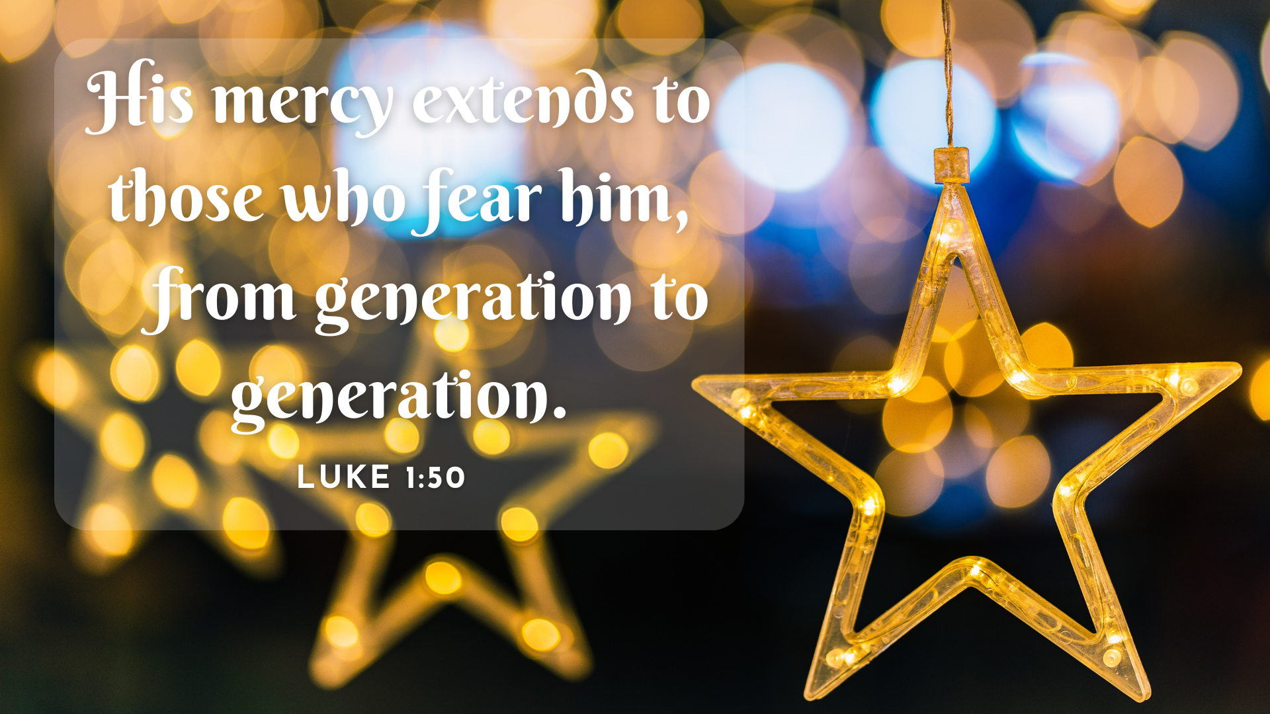

Slide 2
God is mighty to save
Luke 1:46-49

Slide 3
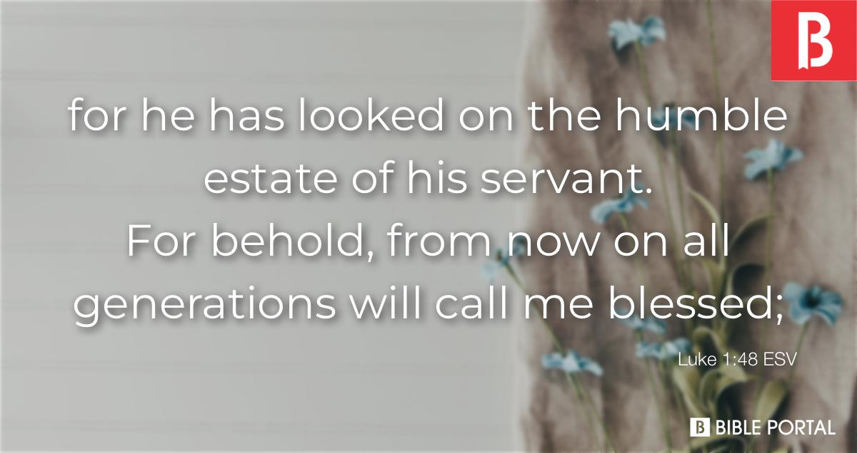

Slide 4
God has mercy to save
Luke 1:50-53

Slide 5


Slide 6
