Slide 1
New Year’s Resolutions
31.xii.2023

Slide 2

UK Top Ten – New Year’s Resolutions
Exercise more
Eat more healthily
Lose weight
Save more money
Pursue career ambition
Less social media
New hobby
Reduce alcohol
Renovate home
More time with family

Slide 3
New Year’s Resolutions – Forbes

Slide 4


Slide 5
Be single-minded
Live a Cross-shaped life
Remember that discipleship involves discipline!

Slide 6

Be single-minded

Slide 7

Live a Cross-shaped life

Slide 8
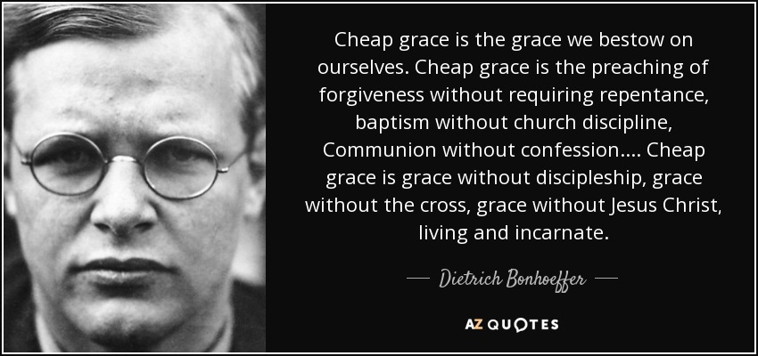

Slide 9

Discipleship involves discipline!

Slide 11


Slide 12
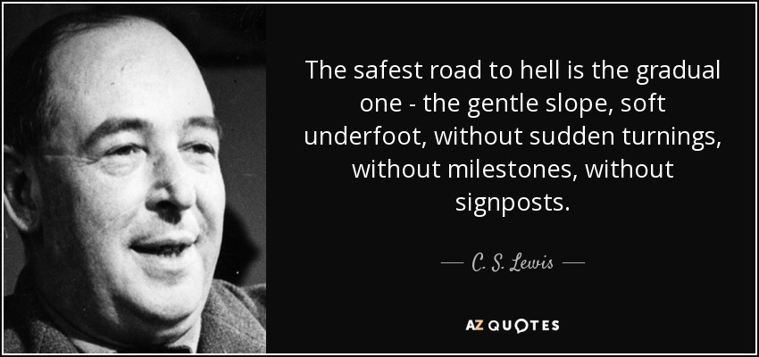

Slide 14
