Slide 1
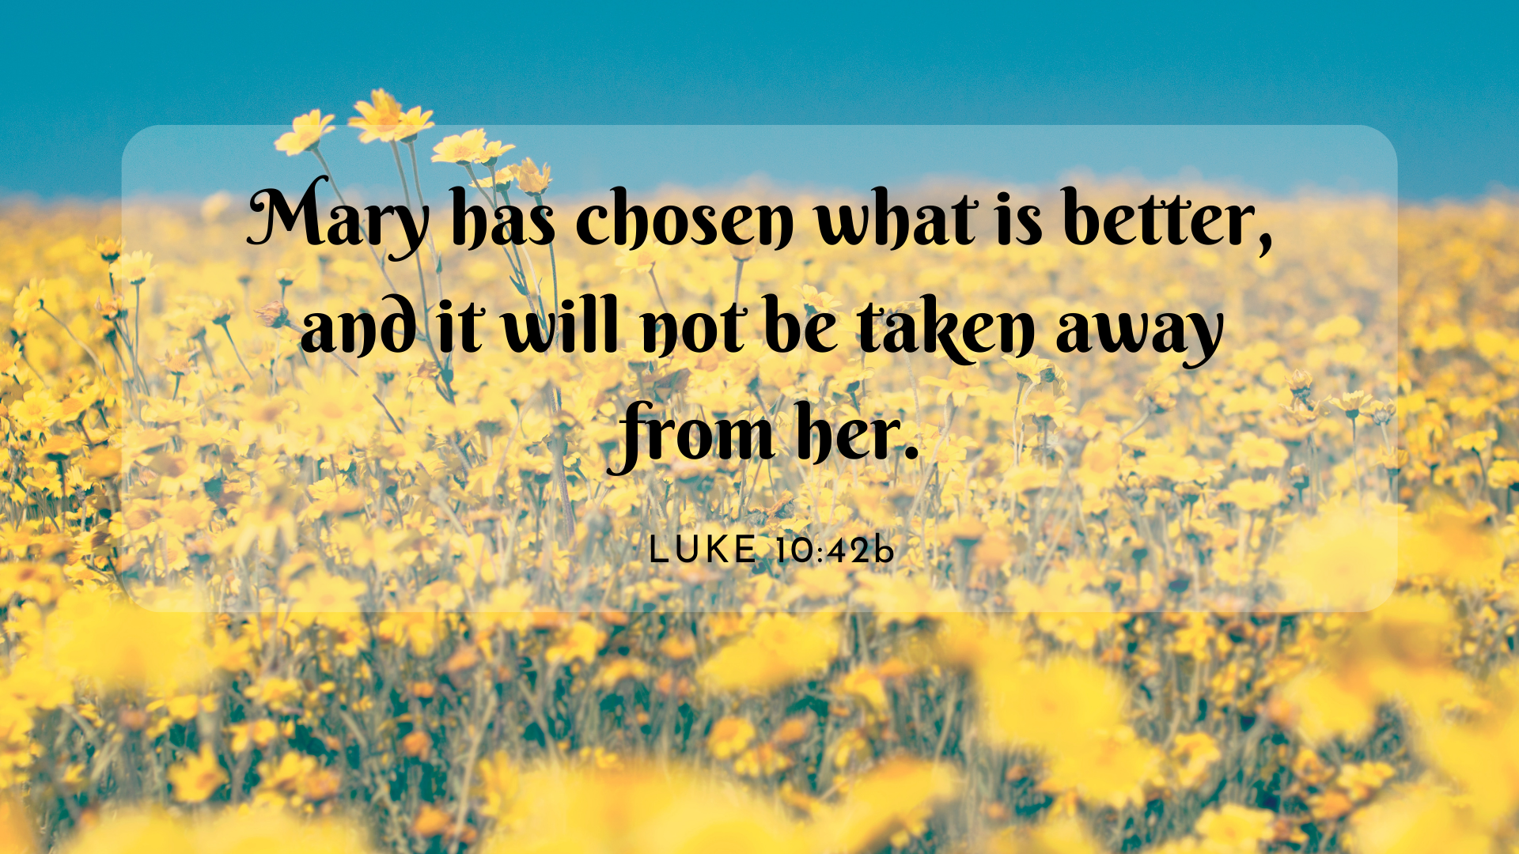

Slide 2
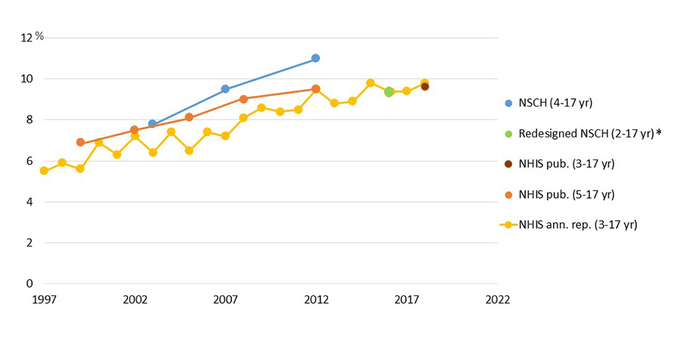

Slide 4
1. Martha: Dangers of Distractions
38 As Jesus and his disciples were on their way, he came to a village where a woman named Martha opened her home to him. 39 She had a sister called Mary, who sat at the Lord’s feet listening to what he said. 40 But Martha was distracted by all the preparations that had to be made. She came to him and asked, “Lord, don’t you care that my sister has left me to do the work by myself? Tell her to help me!”

Slide 5
1. Martha: Dangers of Distractions
38 As Jesus and his disciples were on their way, he came to a village where a woman named Martha opened her home to him. 39 She had a sister called Mary, who sat at the Lord’s feet listening to what he said. 40 But Martha was distracted by all the preparations that had to be made. She came to him and asked, “Lord, don’t you care that my sister has left me to do the work by myself? Tell her to help me!”

Slide 6

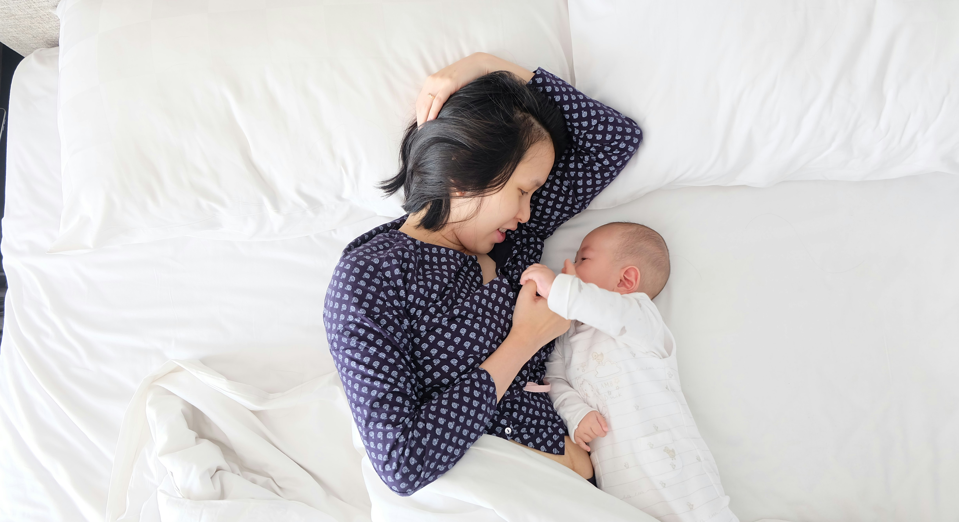
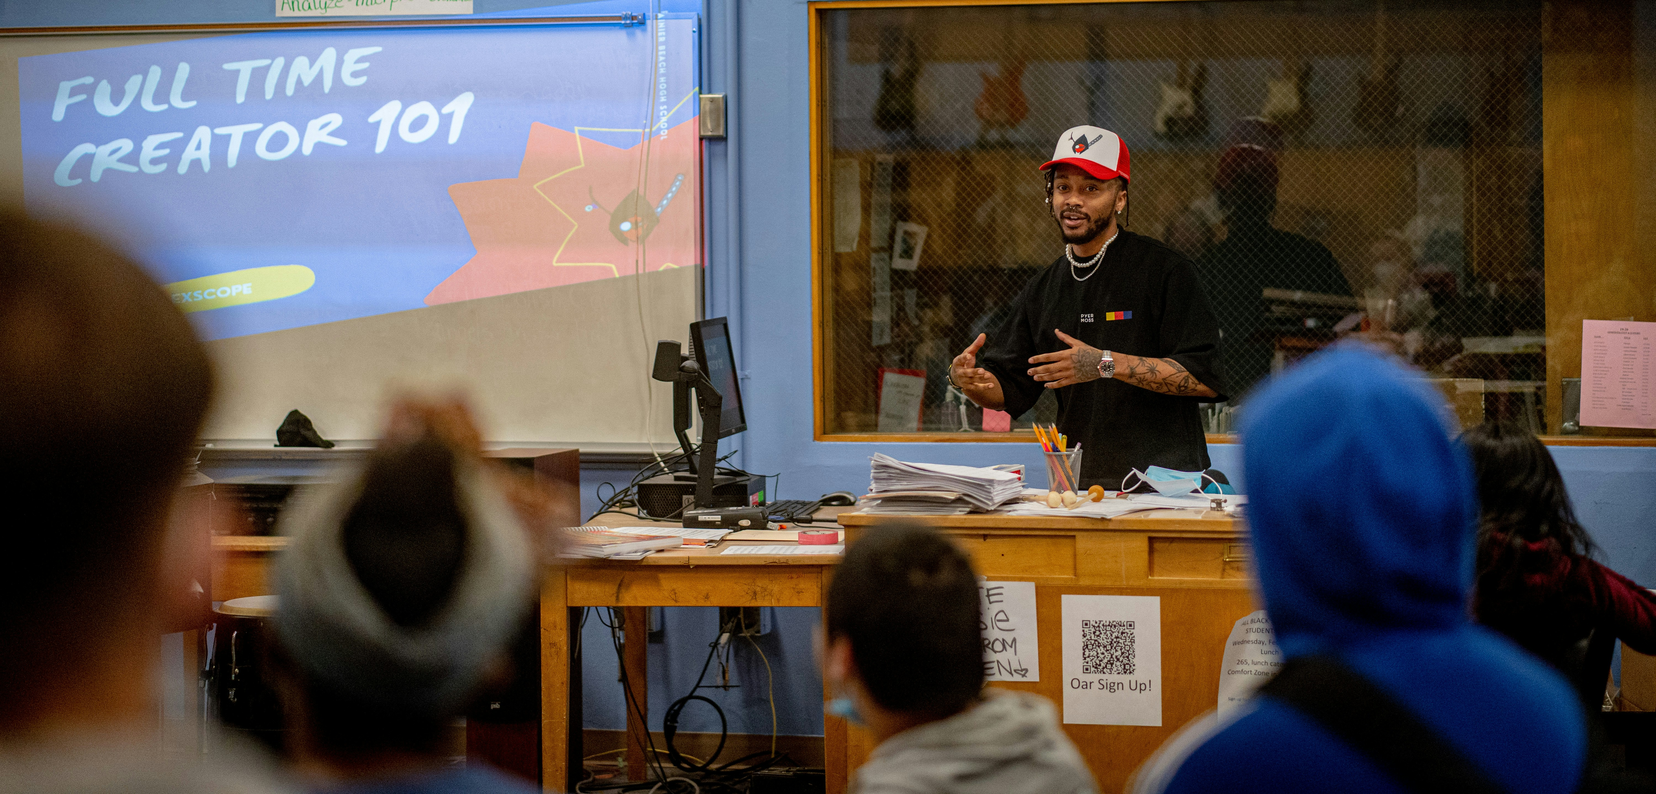


Slide 7
2. Mary: The Better Portion
⁴¹ “Martha, Martha,” the Lord answered, “you are worried and upset about many things, ⁴² but few things are needed—or indeed only one. Mary has chosen what is better, and it will not be taken away from her.”

Slide 8
2. Mary: The Better Portion
⁴¹ “Martha, Martha,” the Lord answered, “you are worried and upset about many things, ⁴² but few things are needed—or indeed only one. Mary has chosen what is better, and it will not be taken away from her.”
11 One day Jesus was praying in a certain place. When he finished, one of his disciples said to him, “Lord, teach us to pray, just as John taught his disciples.”

Slide 9
2. Mary: The Better Portion
4 But one of his disciples, Judas Iscariot, who was later to betray him, objected, 5 “Why wasn’t this perfume sold and the money given to the poor? It was worth a year’s wages.[b]” 6 He did not say this because he cared about the poor but because he was a thief; as keeper of the money bag, he used to help himself to what was put into it.
7 “Leave her alone,” Jesus replied. “It was intended that she should save this perfume for the day of my burial….”

Slide 10
2. Mary: The Better Portion
⁴¹ “Martha, Martha,” the Lord answered, “you are worried and upset about many things, ⁴² but few things are needed—or indeed only one. Mary has chosen what is better, and it will not be taken away from her.”

Slide 11
3. Jesus: Table He Prepares
⁴⁵ For even the Son of Man did not come to be served, but to serve, and to give his life as a ransom for many” (Mark 10:45).

Slide 12
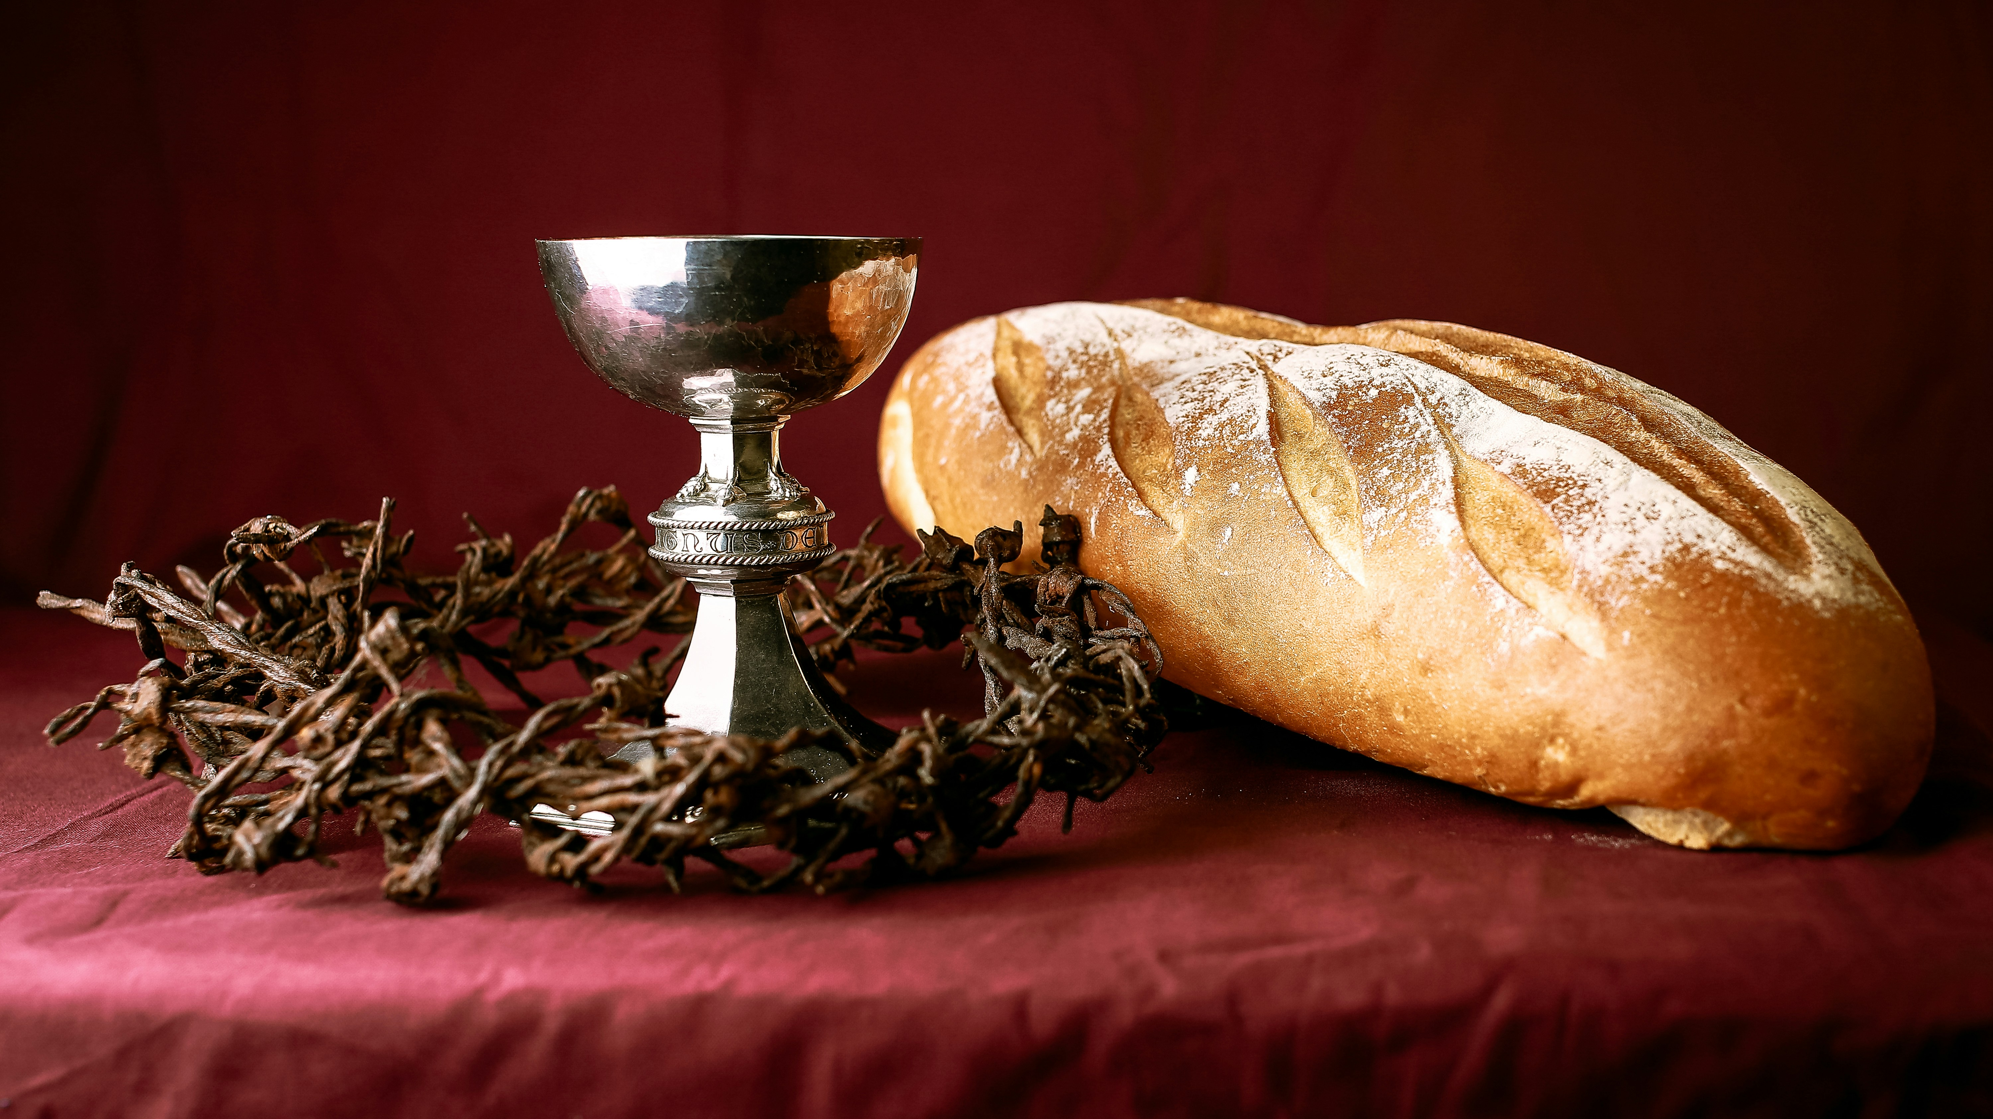

Slide 13
⁴¹ “Martha, Martha,” the Lord answered, “you are worried and upset about many things, ⁴² but few things are needed—or indeed only one. Mary has chosen what is better, and it will not be taken away from her.”

