Slide 1
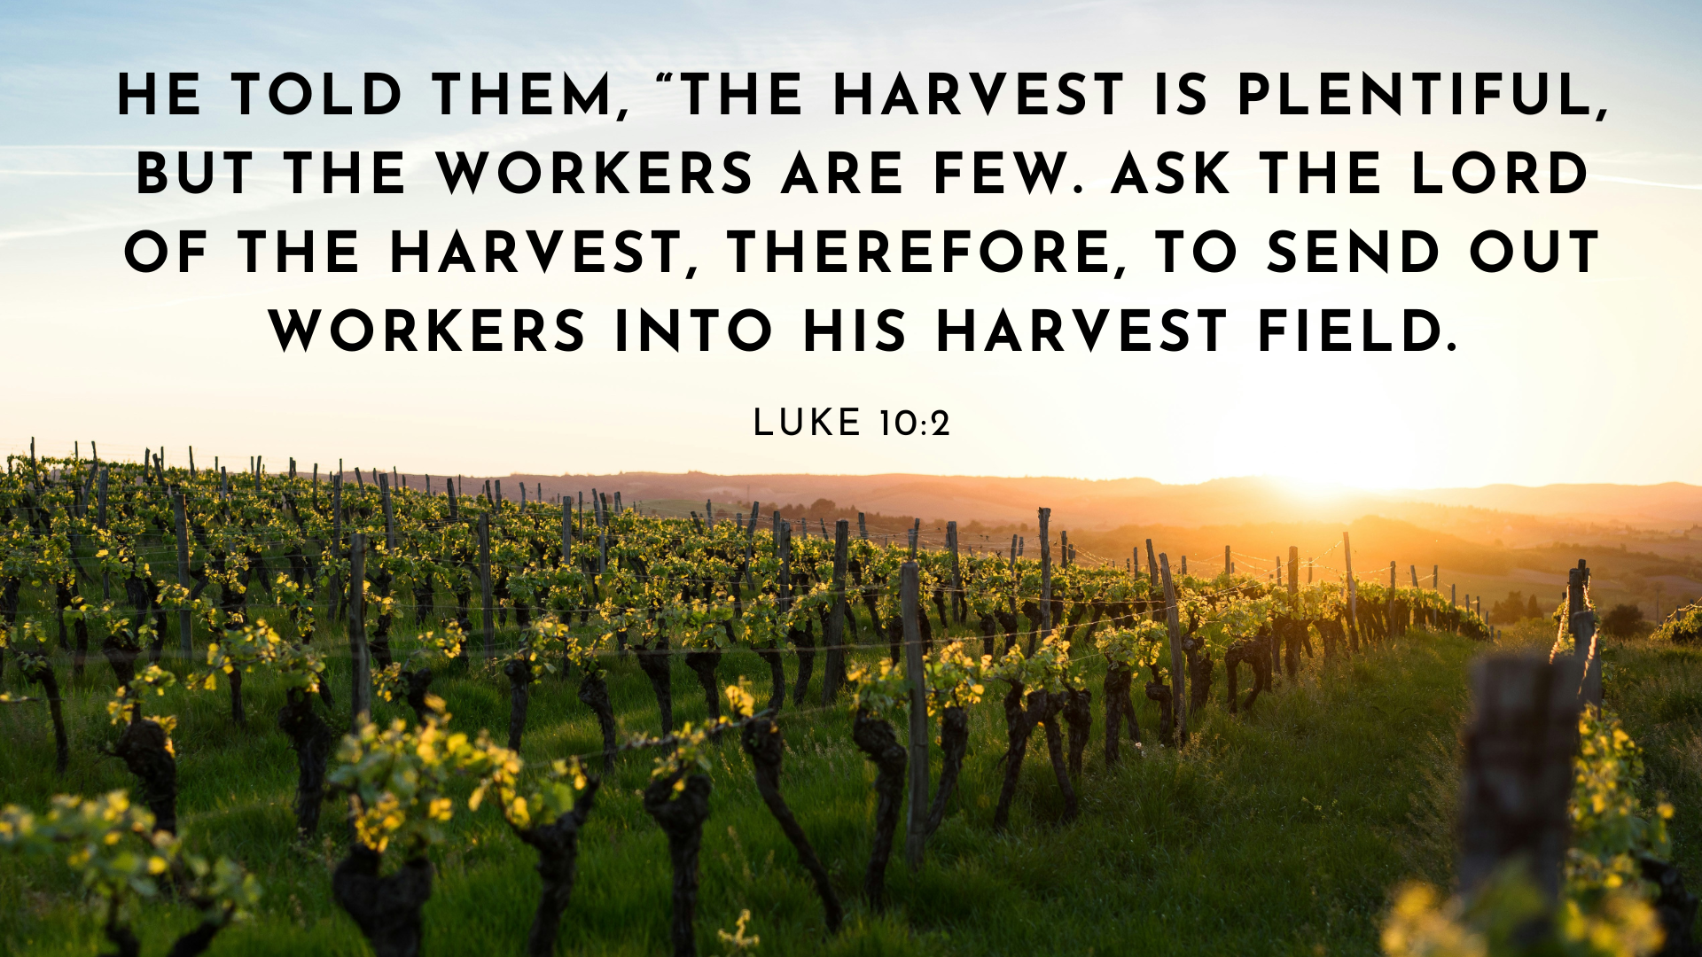

Slide 2
On the Road: Messengers
We Are Heralds (v.1-9)
We Are Ambassadors (v.10-16)
We Are Children (v.17-24)

Slide 3
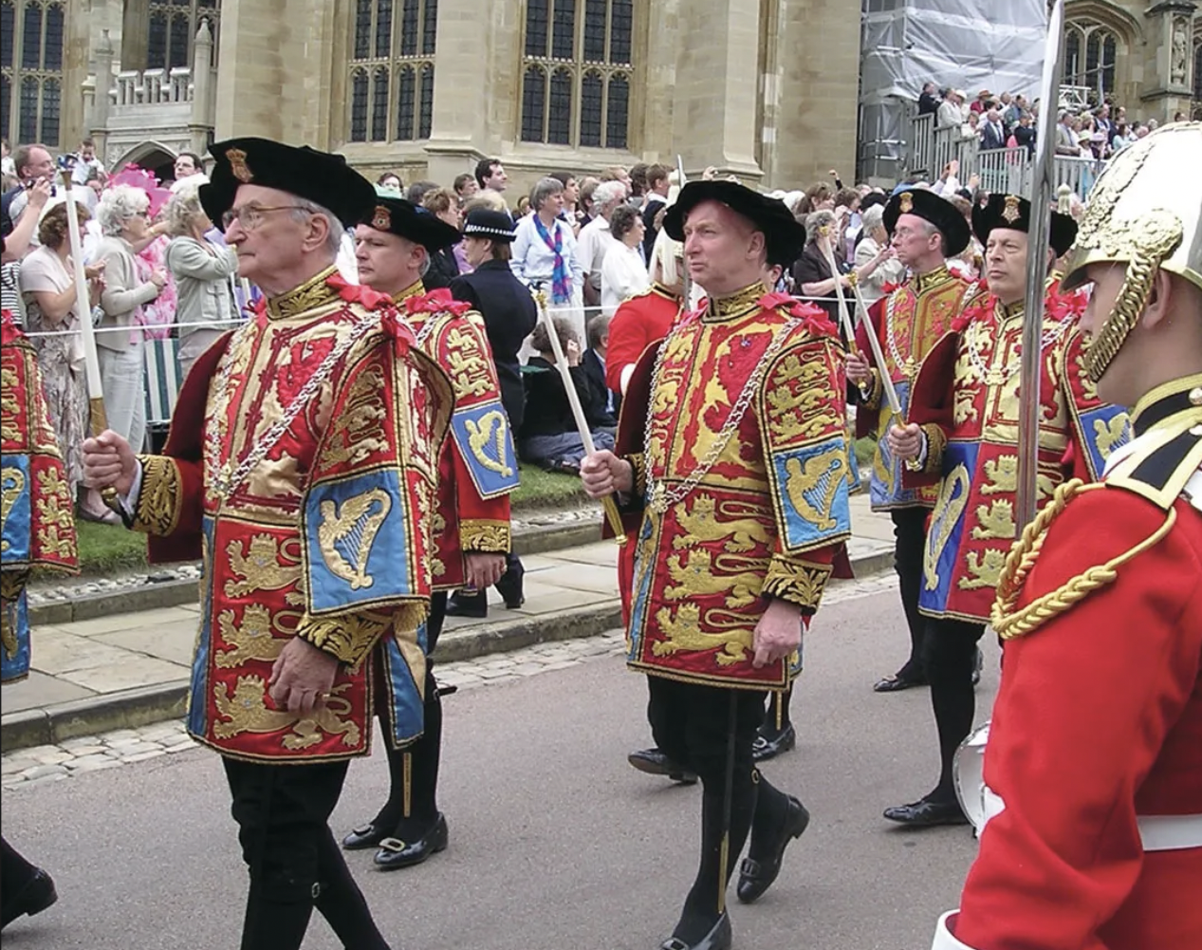
1. We Are Heralds

Slide 4
1. We Are Heralds (v.1-9)
⁴ Do not take a purse or bag or sandals; and do not greet anyone on the road. ⁵ “When you enter a house, first say, ‘Peace to this house.’ ⁶ If someone who promotes peace is there, your peace will rest on them; if not, it will return to you. ⁷ Stay there, eating and drinking whatever they give you, for the worker deserves his wages. Do not move around from house to house. ⁸ “When you enter a town and are welcomed, eat what is offered to you.⁹ Heal the sick who are there and tell them, ‘The kingdom of God has come near to you.’

Slide 5
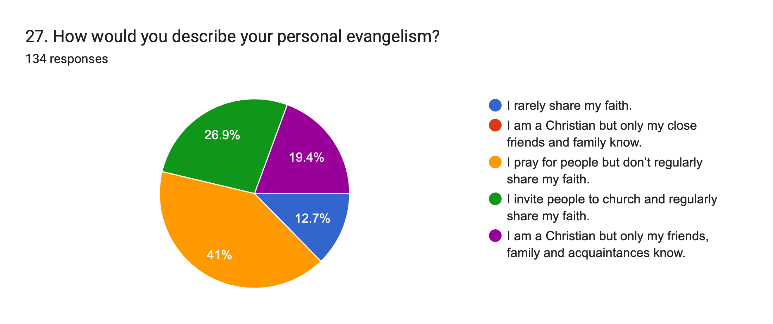

Slide 6
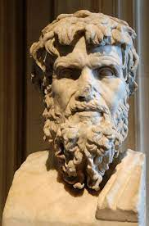
“we see in private houses... the most illiterate and bucolic yokels, who would not dare to say anything at all in front of their elders and more intelligent masters. But they get hold of... any.... who are as ignorant as themselves and say... 'We know how men ought to live. If your children do as we say, you will be happy yourselves and make your home happy too.’”
Celsus, 2nd C

Slide 7
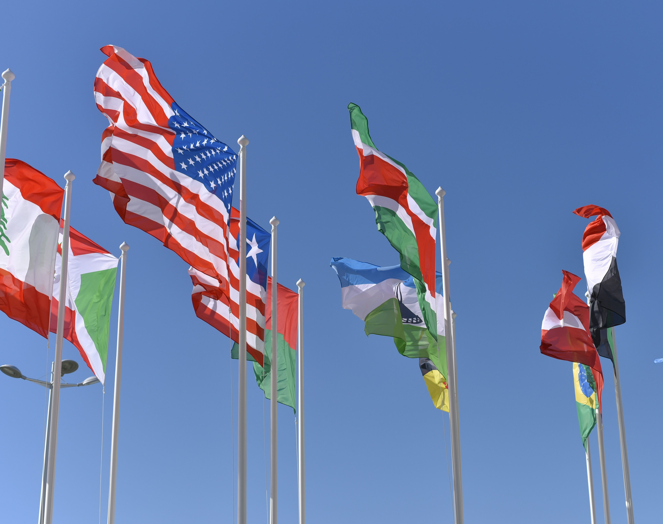
2. We Are Ambassadors (v.10-16)

Slide 8
2. We Are Ambassadors (v.10-16)
16 “Whoever listens to you listens to me; whoever rejects you rejects me; but whoever rejects me rejects him who sent me.”

Slide 10
2. We Are Ambassadors (v.10-16)
Trusting in God’s work of evangelism
Should make us bold
Should make us free

Slide 11
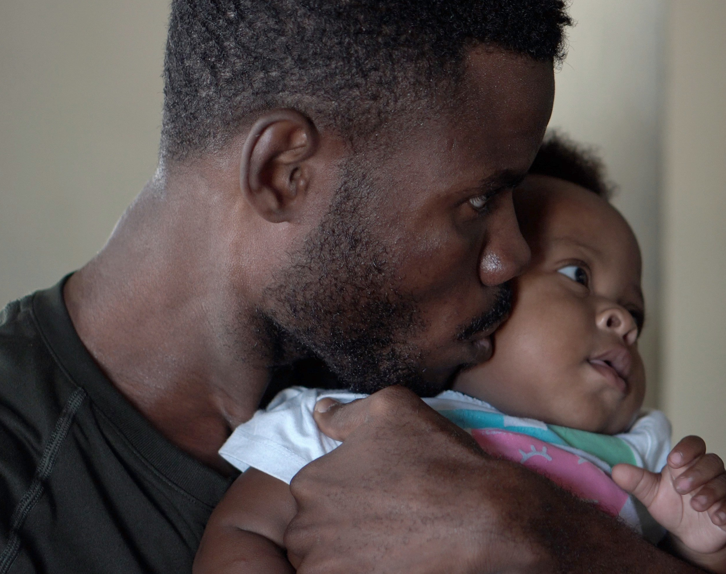
3. We Are Children (v.17-24)

Slide 12
3. We Are Children (v.17-14)
17 The seventy-two returned with joy and said, “Lord, even the demons submit to us in your name.”18 He replied, “I saw Satan fall like lightning from heaven. 19 I have given you authority to trample on snakes and scorpions and to overcome all the power of the enemy; nothing will harm you. 20 However, do not rejoice that the spirits submit to you, but rejoice that your names are written in heaven.”

Slide 13
3. We Are Children (v.17-14)
17 The seventy-two returned with joy and said, “Lord, even the demons submit to us in your name.”18 He replied, “I saw Satan fall like lightning from heaven. 19 I have given you authority to trample on snakes and scorpions and to overcome all the power of the enemy; nothing will harm you. 20 However, do not rejoice that the spirits submit to you, but rejoice that your names are written in heaven.”

Slide 14
Tom Carson never rose very far in denominational structures, but hundreds of people … testify how much he loved them. He never wrote a book, but he loved the Book. He was never wealthy or powerful, but he kept growing as a Christian…He was not a far-sighted visionary, but he looked forward to eternity…

Slide 15
When he died, there were no crowds outside the hospital, no editorial comments in the papers, no announcements on the television, no mention in Parliament, no attention paid by the nation. In his hospital room there was no one by his bedside. There was only the quiet hiss of oxygen, vainly venting because he had stopped breathing and would never need it again.

Slide 16
But on the other side, all the trumpets sounded. Dad won entrance to the only throne-room that matters, not because he was a good man or a great man—he was, after all, a most ordinary pastor—but because he was a forgiven man. And he heard the voice of him whom he longed to hear saying, “Well done, good and faithful servant; enter into the joy of your Lord.”
- Don Carson, Memoirs of an Ordinary Pastor

