Slide 1


Slide 2
On the Road to Jerusalem: Cost
Facing Rejections with Grace (v.51-56)
Total Commitment (v.57-62)
Proclaiming the Good News (v.60, 51)

Slide 3
1. Facing Rejections with Grace (v.51-56)

Slide 4


Slide 5
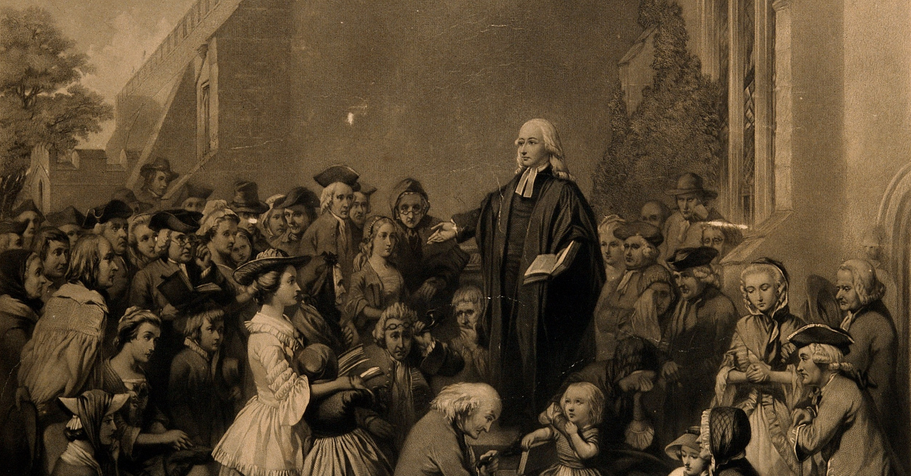

Slide 6
2. Total Commitment (v.57-62)

Slide 7


Slide 8
2. Total Commitment (v.57-62)

Slide 9


Slide 10
3. Proclaiming the Good News (v.60, 51)

