Slide 1
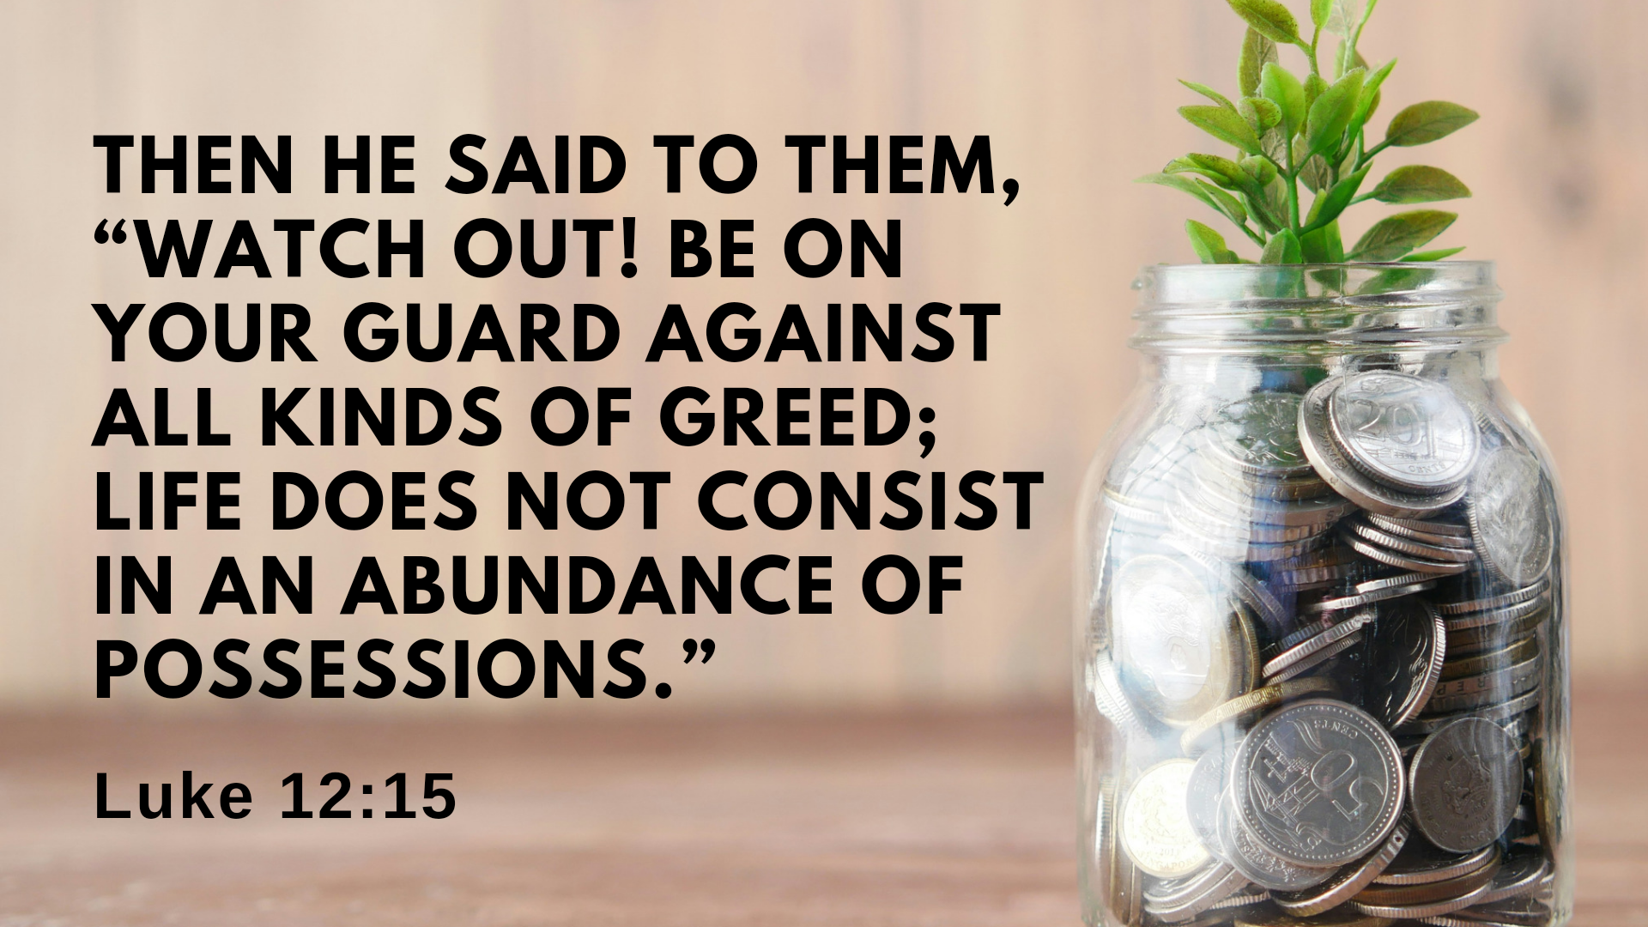

Slide 2
On the Road: Wealth
A Fool...
Lives for Himself
Thinks He's in Control
Never Thinks of His Judgment

Slide 3
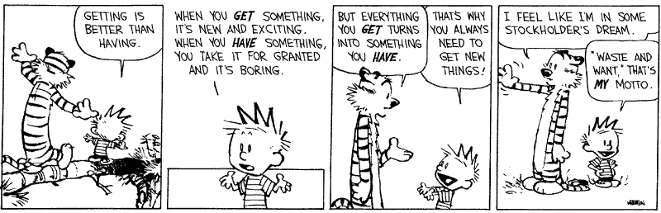

Slide 4


Slide 5
18 “Then he said, ‘This is what I’ll do. I will tear down my barns and build bigger ones, and there I will store my surplus grain. 19 And I’ll say to myself, “You have plenty of grain laid up for many years. Take life easy; eat, drink and be merry.”’
20 “But God said to him, ‘You fool! This very night your life will be demanded from you. Then who will get what you have prepared for yourself?’

Slide 6


Slide 7
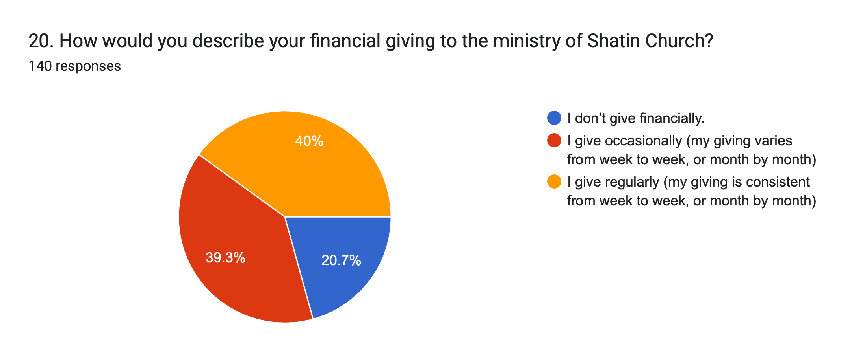

Slide 8
14 Jesus replied, “Man, who appointed me a judge or an arbiter between you?”…
20 “But God said to him, ‘You fool! This very night your life will be demanded from you. Then who will get what you have prepared for yourself?’
21 “This is how it will be with whoever stores up things for themselves but is not rich toward God.”

Slide 9
