Slide 1

Petty Tyrant
Episode 419

Slide 2
The Rise and Fall of Saul (1 Samuel)

Slide 3
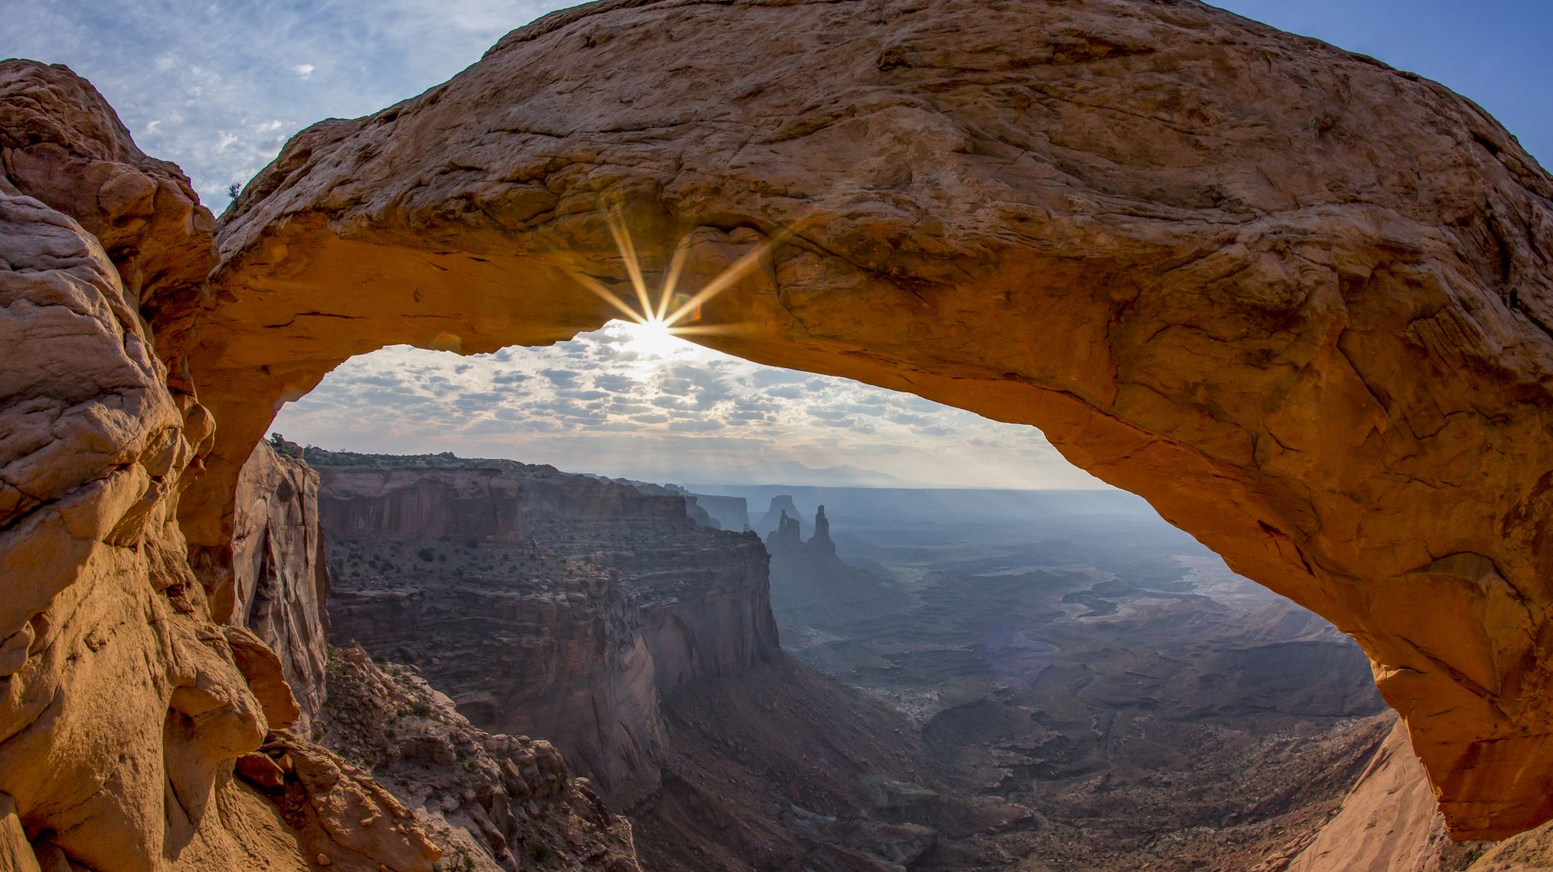
The Rise and Fall of Kingdom (2 Samuel)

Slide 4
1. David Waited (and Suffered)
Amalekite story vs. 1 Samuel 31

Slide 5
1. David Waited (and Suffered)
Amalekite story vs. 1 Samuel 31
Sin begins when we do not fear God and his rule

Slide 6
1. David Waited (and Suffered)
Amalekite story vs. 1 Samuel 31
Amalekite vs. David

Slide 7
2. David Mourned (1:11-12)
Arrival of Amalekites, v1-2
Conversation, v.3-10
Reaction, v11-12
Conversation, v.13-14
Elimination of Amalekite, v.15-16

Slide 8
2. David Mourned (1:11-12)
How do we feel about successes and failures of other churches? Other Christians?

Slide 9
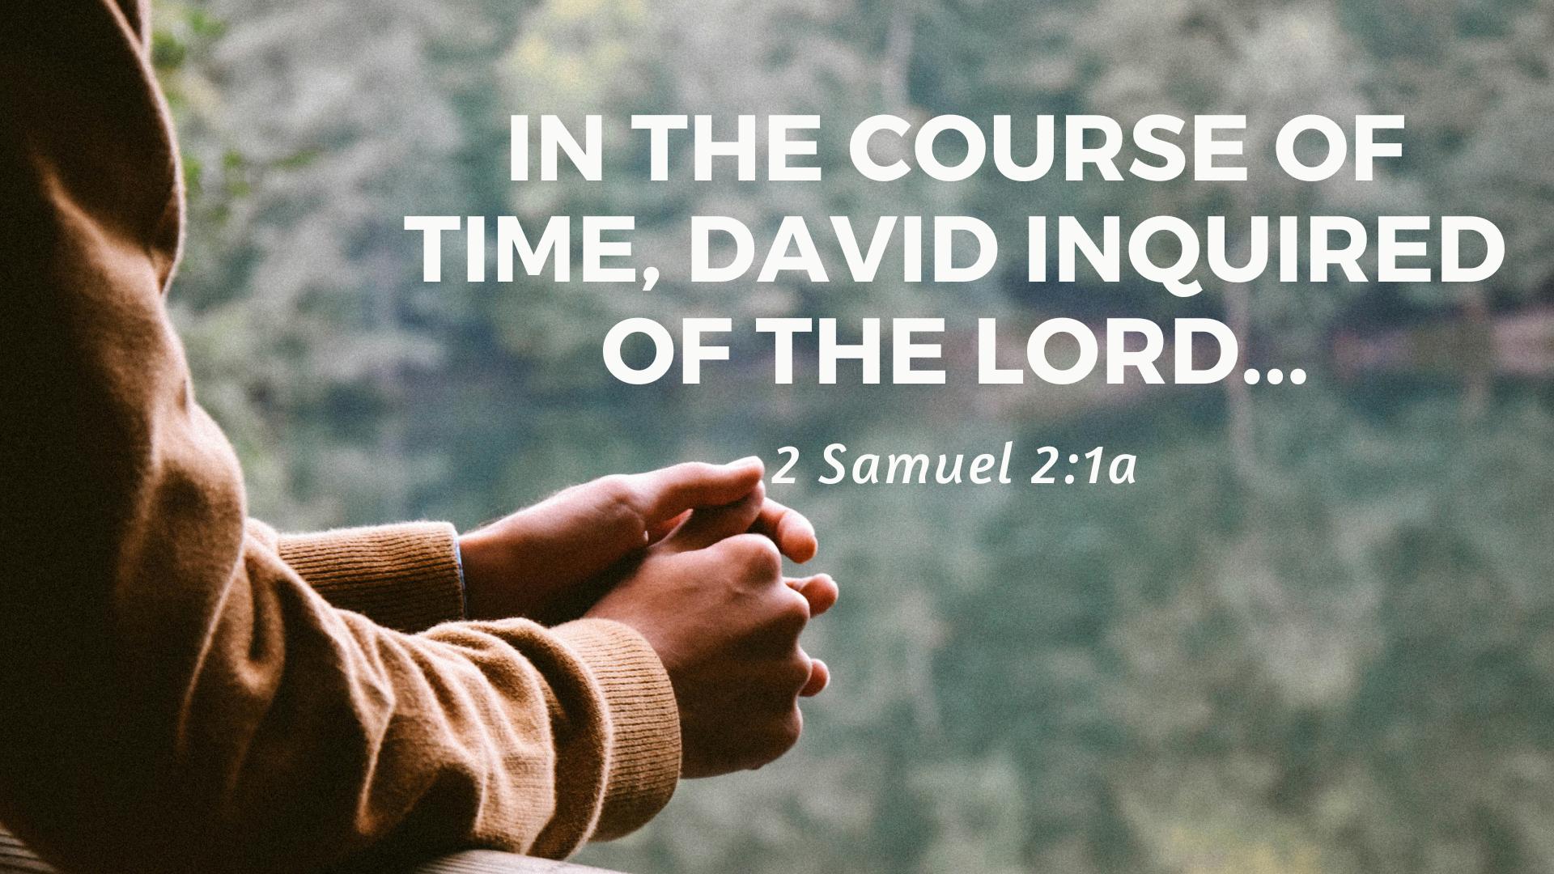
3. David Asked (2:1-4)

Slide 10
3. David Asked (2:1-4)
Are we listening to God through the Bible?
Are we spending time with God in prayers?

Slide 11
מָשִׁיחַ
Messiah, Christos

