Slide 2


Slide 3
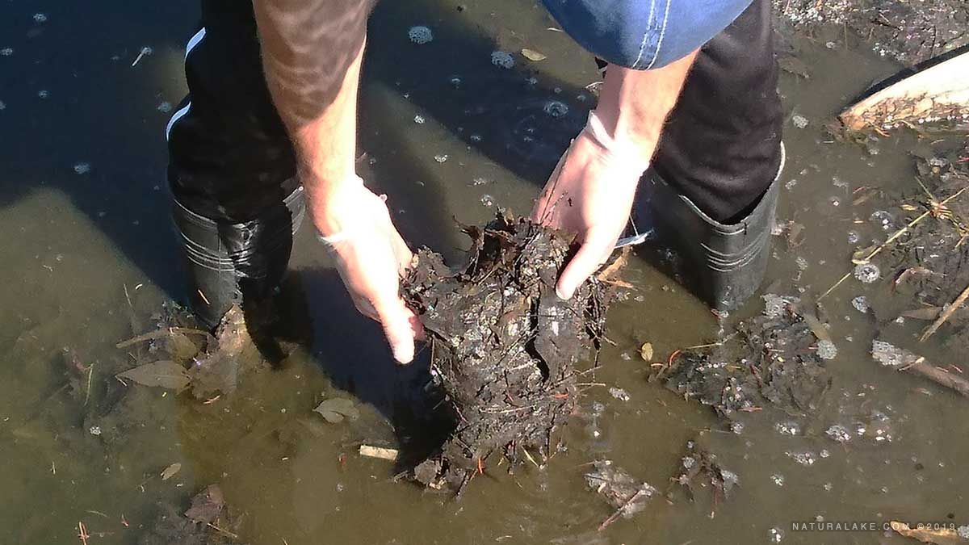

Slide 4
Promise Fulfilled (2 Samuel 2-4)
God Works in Muck
God Works through Muck

Slide 5
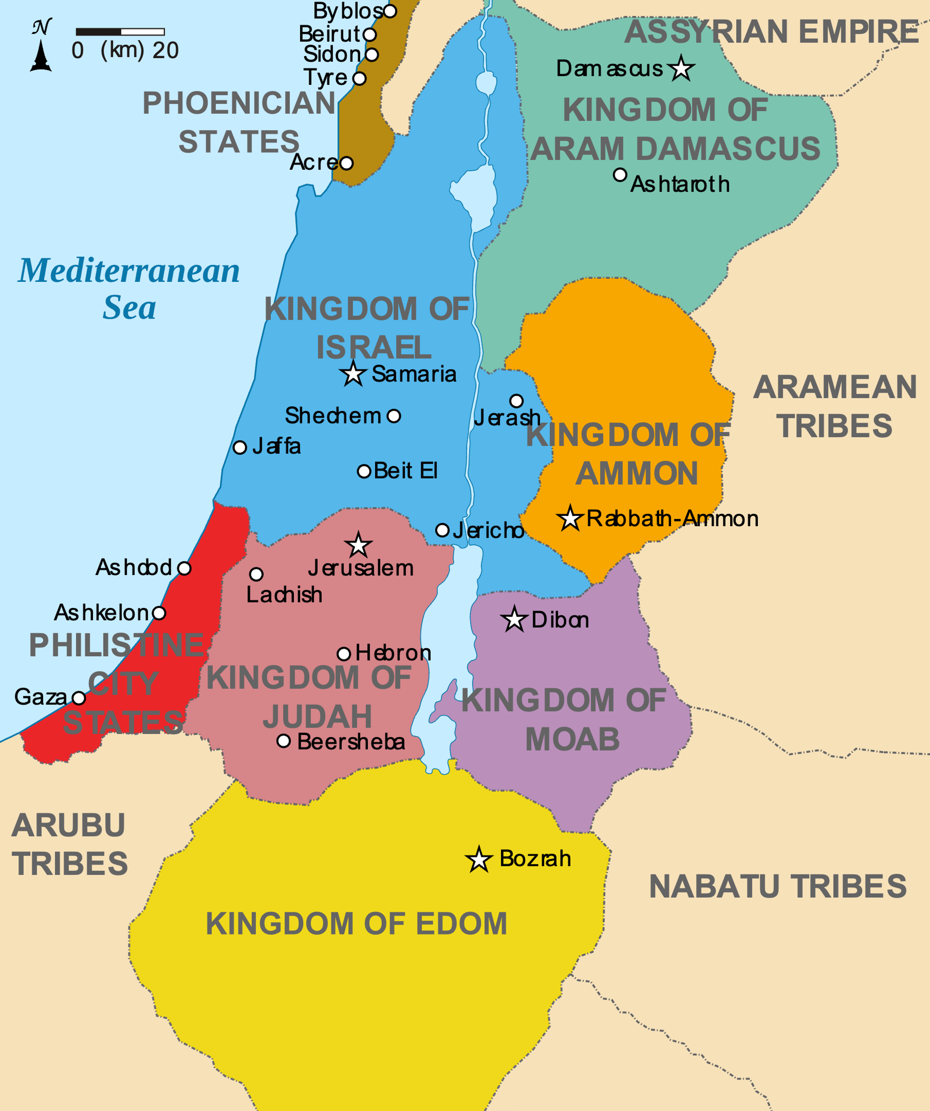
Israel around 9th BC

Slide 6
1 The war between the house of Saul and the house of David lasted a long time. David grew stronger and stronger, while the house of Saul grew weaker and weaker.
2 Sons were born to David in Hebron:
His firstborn was Amnon the son of Ahinoam of Jezreel;
3 his second, Kileab the son of Abigail the widow of Nabal of Carmel;
the third, Absalom the son of Maakah daughter of Talmai king of Geshur;
4 the fourth, Adonijah the son of Haggith;
the fifth, Shephatiah the son of Abital;
5 and the sixth, Ithream the son of David’s wife Eglah.
These were born to David in Hebron.

Slide 7
Israel around 9th BC

Slide 8
13 “Good,” said David. “I will make an agreement with you. But I demand one thing of you: Do not come into my presence unless you bring Michal daughter of Saul when you come to see me.” 14 Then David sent messengers to Ish-Bosheth son of Saul, demanding, “Give me my wife Michal, whom I betrothed to myself for the price of a hundred Philistine foreskins.”
15 So Ish-Bosheth gave orders and had her taken away from her husband Paltiel son of Laish. 16 Her husband, however, went with her, weeping behind her all the way to Bahurim. Then Abner said to him, “Go back home!” So he went back.

Slide 9
Misogyny?
Polygamy is bad!
Treatment of the Michal is bad!
Treatment of the concubine is appalling!

Slide 10
19 Abner also spoke to the Benjamites in person. Then he went to Hebron to tell David everything that Israel and the whole tribe of Benjamin wanted to do. 20 When Abner, who had twenty men with him, came to David at Hebron, David prepared a feast for him and his men. 21 Then Abner said to David, “Let me go at once and assemble all Israel for my lord the king, so that they may make a covenant with you, and that you may rule over all that your heart desires.” So David sent Abner away, and he went in peace.
22 Just then David’s men and Joab returned from a raid and brought with them a great deal of plunder. But Abner was no longer with David in Hebron, because David had sent him away, and he had gone in peace. 23 When Joab and all the soldiers with him arrived, he was told that Abner son of Ner had come to the king and that the king had sent him away and that he had gone in peace.

Slide 11
27 Now when Abner returned to Hebron, Joab took him aside into an inner chamber, as if to speak with him privately. And there, to avenge the blood of his brother Asahel, Joab stabbed him in the stomach, and he died.

Slide 12
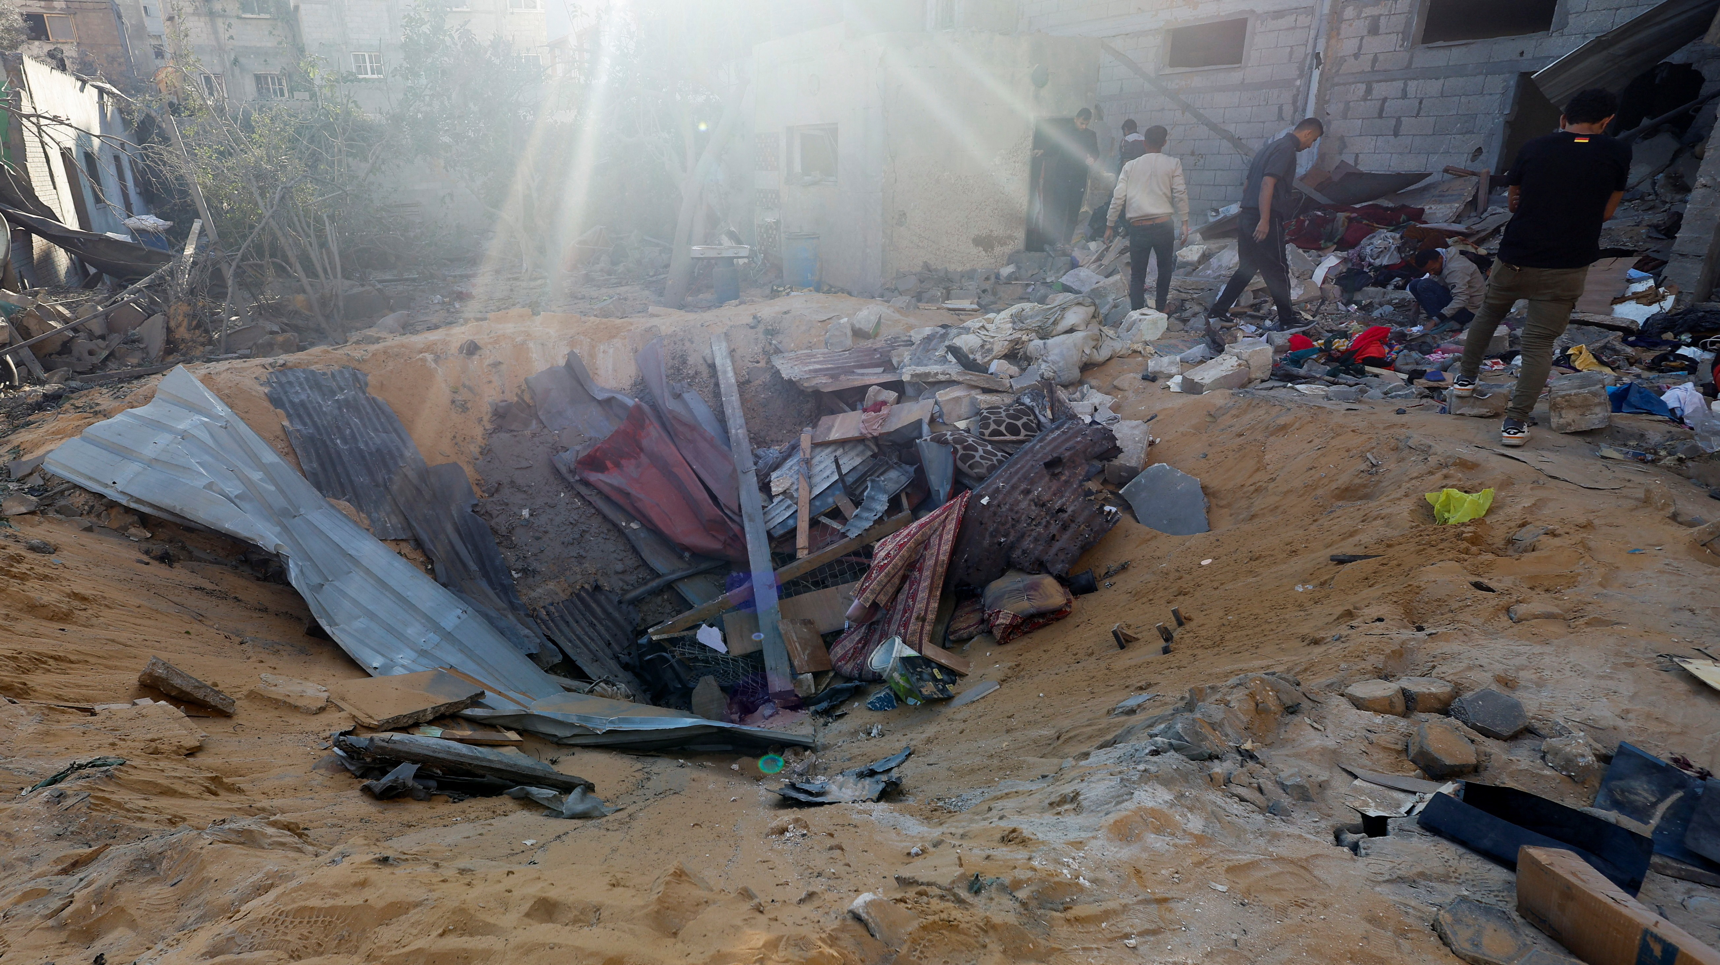

Slide 13
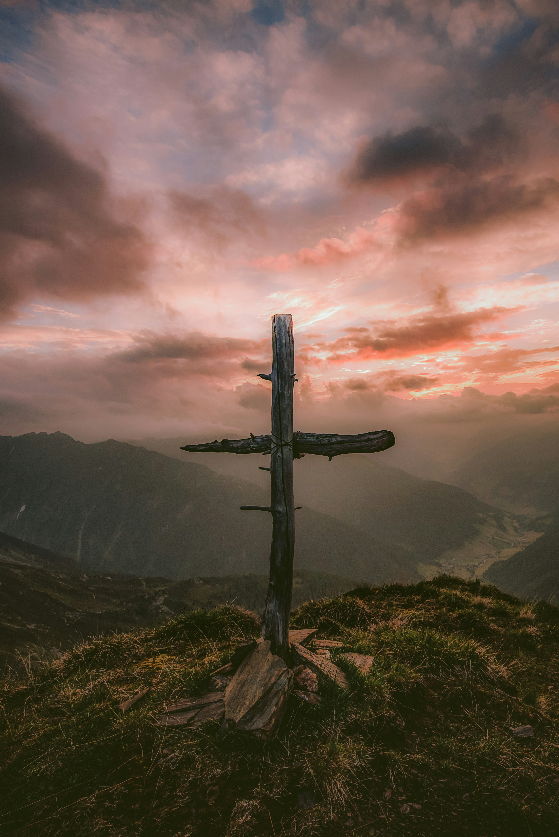
And in imagination I have turned instead to that lonely, twisted, tortured figure on the cross, nails through hands and feet, back lacerated, limbs wrenched, brow bleeding from thorn-pricks, mouth dry and intolerably thirsty, plunged in God-forsaken darkness. That is the God for me! He laid aside his immunity to pain. He entered our world of flesh and blood, tears and death. He suffered for us."
- John Stott, Cross of Christ

Slide 14
2. God Works Through Muck

Slide 15
3:36, All the people took note and were pleased; indeed, everything the king did pleased them.³⁷ So on that day all the people there and all Israel knew that the king had no part in the murder of Abner son of Ner.
5:3, When all the elders of Israel had come to King David at Hebron, the king made a covenant with them at Hebron before the Lord, and they anointed David king over Israel.

Slide 16
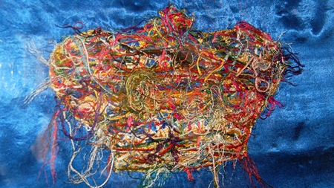

Slide 17
