Slide 2


Slide 3
2 Samuel 111: Temptations
Temptation to Sin
Sin Begets Sin
Judgment of God

Slide 4
1. Temptation to Sin
1 In the spring, at the time when kings go off to war, David sent Joab out with the king’s men and the whole Israelite army. They destroyed the Ammonites and besieged Rabbah. But David remained in Jerusalem. 2 One evening David got up from his bed and walked around on the roof of the palace. From the roof he saw a woman bathing. The woman was very beautiful

Slide 5
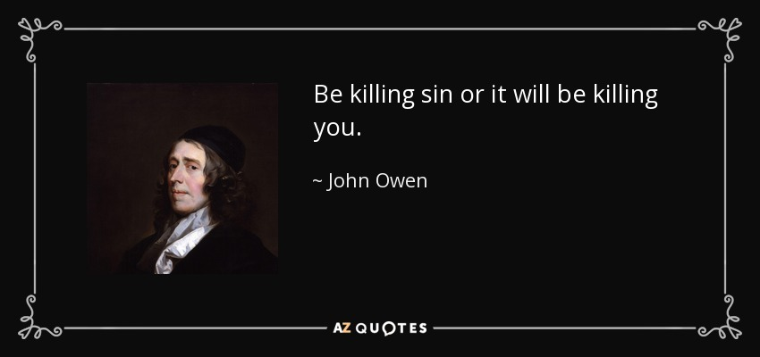

Slide 6
2. Sin Begets Sin

Slide 7
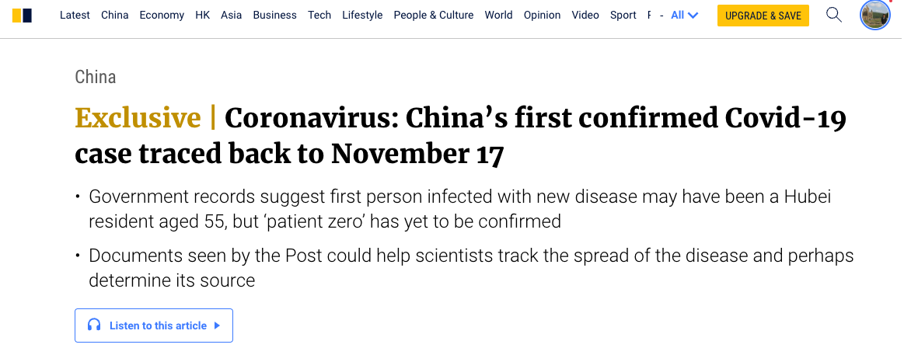

Slide 8
2. Sin Begets Sin
Consequences of sin
Right diagnosis – sin
Sin cuts us off from God

Slide 9
3. Judgment of God
25 David told the messenger, “Say this to Joab: ‘Don’t let this upset you; the sword devours one as well as another. Press the attack against the city and destroy it.’ Say this to encourage Joab.” 26 When Uriah’s wife heard that her husband was dead, she mourned for him. 27 After the time of mourning was over, David had her brought to his house, and she became his wife and bore him a son. But the thing David had done displeased the Lord.
12:1 The Lord sent Nathan to David. When he came to him, he said, “There were two men in a certain town, one rich and the other poor.

Slide 10
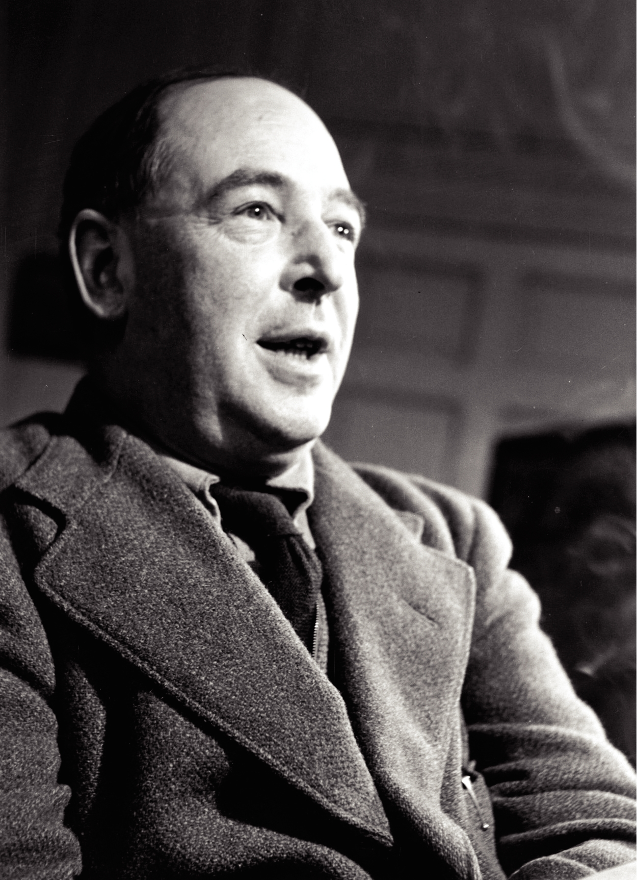
‘Forgiveness says, "Yes, you have done this thing, but I accept your apology; I will never hold it against you and everything between us two will be exactly as it was before." If one was not really to blame then there is nothing to forgive. In that sense forgiveness and excusing are almost opposites.’

Slide 11
