Slide 2
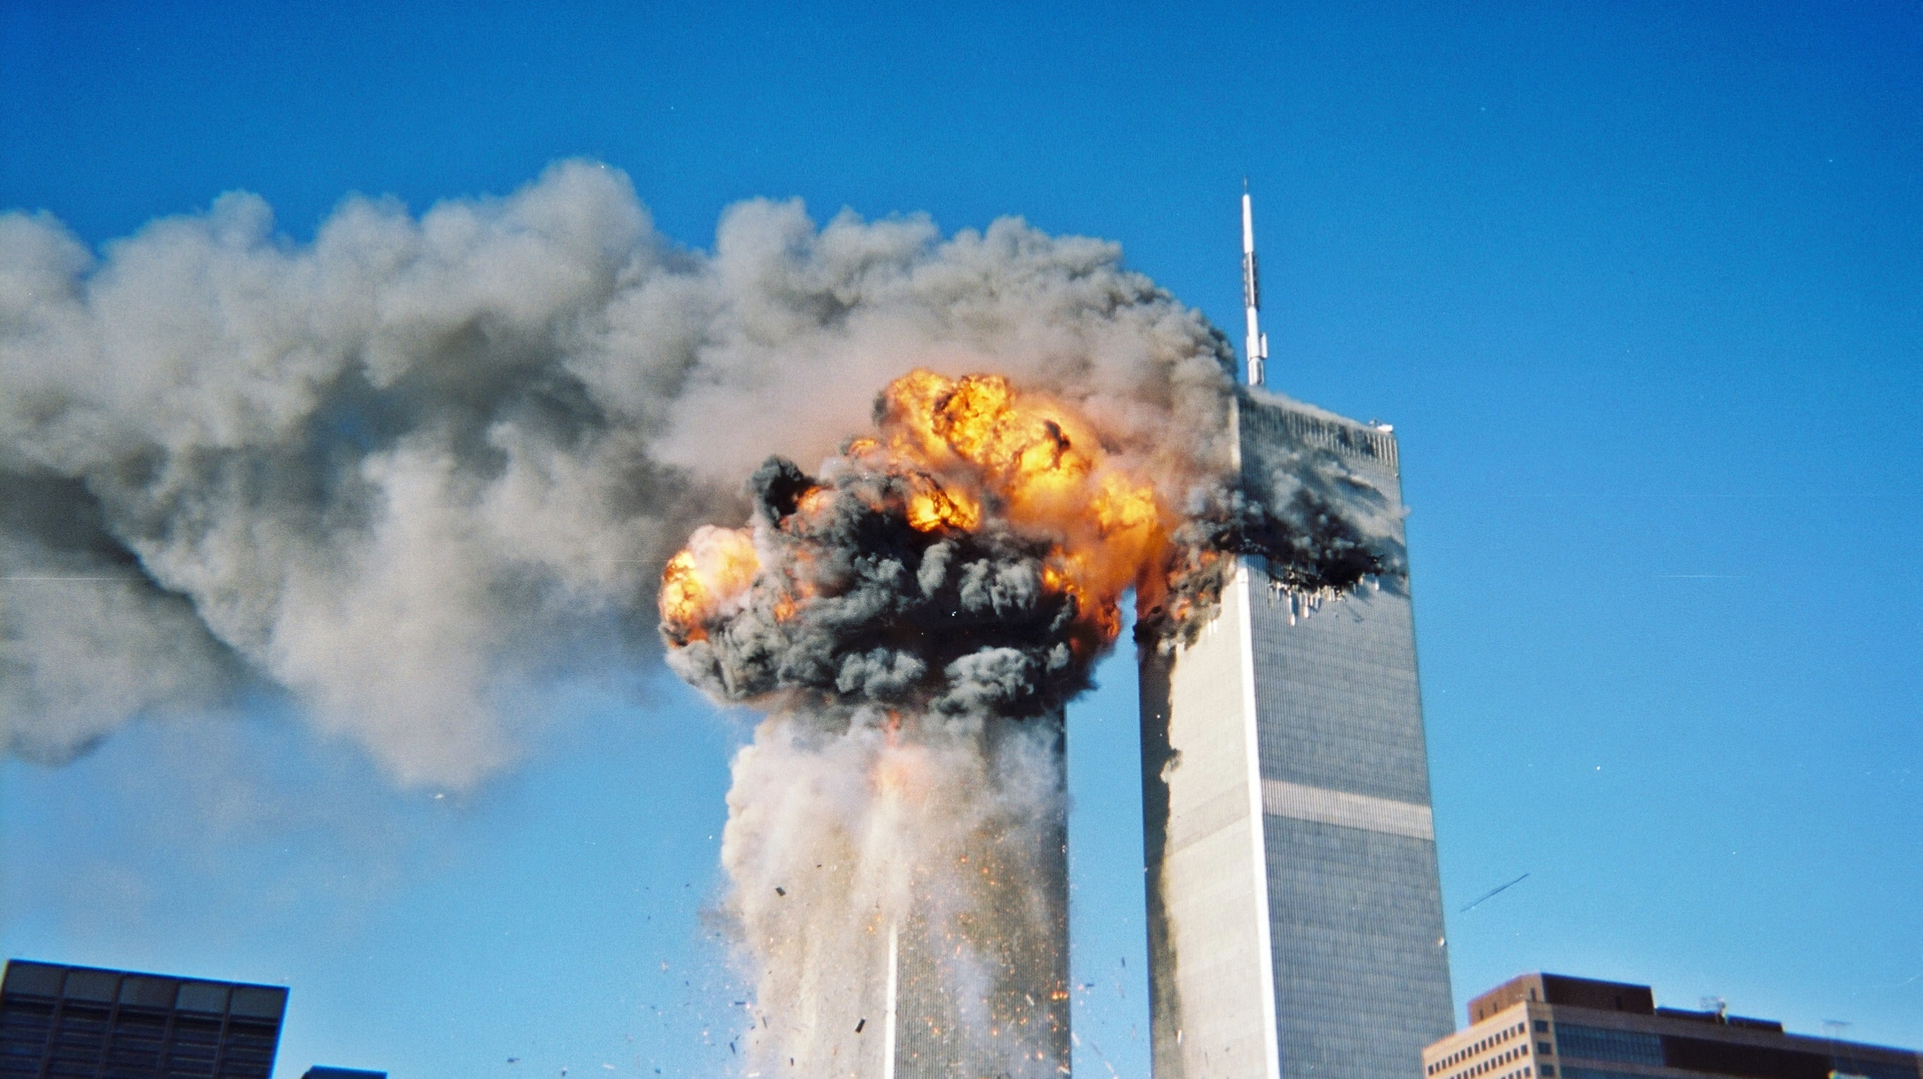

Slide 3
“For David had done what was right in the eyes of the Lord and had not failed to keep any of the Lord’s commands all the days of his life—except in the case of Uriah the Hittite”
- 1 Kings 15:5

Slide 4
Amnon rapes Tamar (Ch.13)
Absalom returns to Jerusalem after 3 years in exile (Ch14)
Absalom stages a coup; Ahitophel joins as a senior advisor (Ch.15)
Absalom kills Amnon (Ch.13)
David flees Jerusalem; sends Hushai as an advisor to Absalom (Ch.15)
Absalom listens to Hushai over Ahitophel (Ch.17)
David's forces defeats Absalom's
Joab personally kills Absalom (Ch.18)

Slide 5
1. Sin Reverberates (Chs13-15)

Slide 6
1. Sin Reverberates (Chs13-15)
13:21 When King David heard all this, he was furious. 22 And Absalom never said a word to Amnon, either good or bad; he hated Amnon because he had disgraced his sister Tamar.

Slide 7
Amnon rapes Tamar (Ch.13)
Absalom returns to Jerusalem after 3 years in exile (Ch14)
Absalom stages a coup; Ahitophel joins as a senior advisor (Ch.15)
Absalom kills Amnon (Ch.13)
David flees Jerusalem; sends Hushai as an advisor to Absalom (Ch.15)
Absalom listens to Hushai over Ahitophel (Ch.17)
David's forces defeats Absalom's
Joab personally kills Absalom (Ch.18)

Slide 8

“The temporal nature of human justice serves as a picture of God’s final justice. It presents the abuser an opportunity to come face to face with the reality and severity of his sin. It is a call to the abuser to repent....”
-Rachael Denhollander

Slide 9
Amnon rapes Tamar (Ch.13)
Absalom returns to Jerusalem after 3 years in exile (Ch14)
Absalom stages a coup; Ahitophel joins as a senior advisor (Ch.15)
Absalom kills Amnon (Ch.13)
David flees Jerusalem; sends Hushai as an advisor to Absalom (Ch.15)
Absalom listens to Hushai over Ahitophel (Ch.17)
David's forces defeats Absalom's
Joab personally kills Absalom (Ch.18)

Slide 10
2. Take Refuge in God (ch.15)
24 Zadok was there, too, and all the Levites who were with him were carrying the ark of the covenant of God. They set down the ark of God, and Abiathar offered sacrifices until all the people had finished leaving the city.
25 Then the king said to Zadok, “Take the ark of God back into the city. If I find favor in the Lord’s eyes, he will bring me back and let me see it and his dwelling place again. 26 But if he says, ‘I am not pleased with you,’ then I am ready; let him do to me whatever seems good to him.”

Slide 11
2. Take Refuge in God (ch.15)
31 Now David had been told, “Ahithophel is among the conspirators with Absalom.” So David prayed, “Lord, turn Ahithophel’s counsel into foolishness.”
32 When David arrived at the summit, where people used to worship God, Hushai the Arkite was there to meet him, his robe torn and dust on his head.33 David said to him, “If you go with me, you will be a burden to me. 34 But if you return to the city and say to Absalom, ‘Your Majesty, I will be your servant; I was your father’s servant in the past, but now I will be your servant,’ then you can help me by frustrating Ahithophel’s advice.

Slide 12
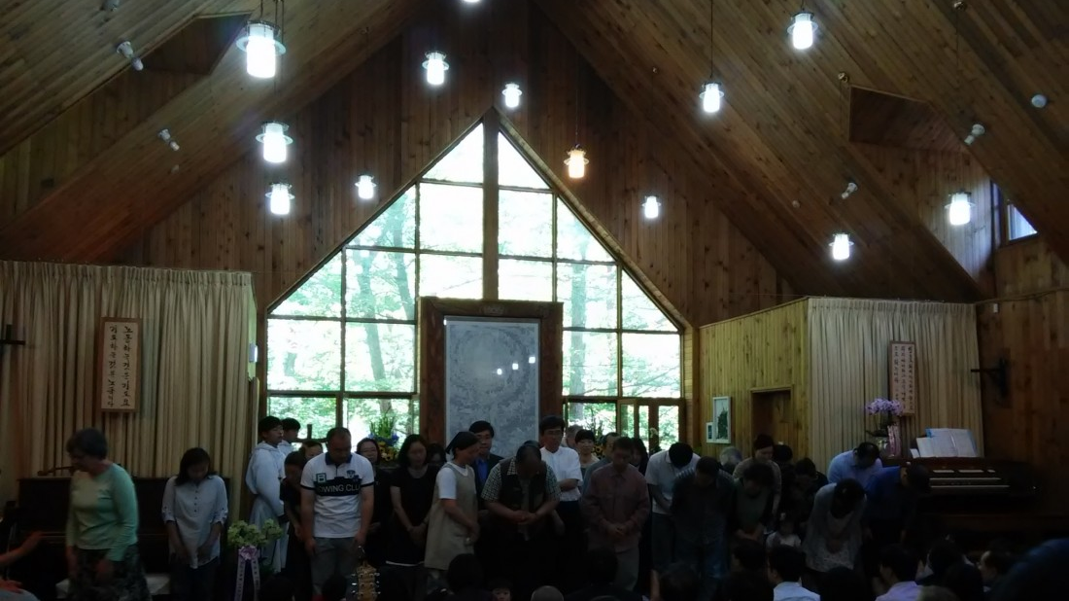

Slide 13
3. God Restores (Chs 17-18)
14:25 In all Israel there was not a man so highly praised for his handsome appearance as Absalom. From the top of his head to the sole of his foot there was no blemish in him. 26 Whenever he cut the hair of his head—he used to cut his hair once a year because it became too heavy for him—he would weigh it, and its weight was two hundred shekels by the royal standard.

Slide 14
Amnon rapes Tamar (Ch.13)
Absalom returns to Jerusalem after 3 years in exile (Ch14)
Absalom stages a coup; Ahitophel joins as a senior advisor (Ch.15)
Absalom kills Amnon (Ch.13)
David flees Jerusalem; sends Hushai as an advisor to Absalom (Ch.15)
Absalom listens to Hushai over Ahitophel (Ch.17)
David's forces defeats Absalom's
Joab personally kills Absalom (Ch.18)

Slide 15
3. God Restores (Chs 17-18)
Many are the plans in a person’s heart,
but it is the Lord’s purpose that prevails
- Proverbs 19:21

Slide 16
18:6 David’s army marched out of the city to fight Israel, and the battle took place in the forest of Ephraim. … 8 The battle spread out over the whole countryside, and the forest swallowed up more men that day than the sword. 9 Now Absalom happened to meet David’s men. He was riding his mule, and as the mule went under the thick branches of a large oak, Absalom’s hair got caught in the tree. He was left hanging in midair, while the mule he was riding kept on going.

Slide 17
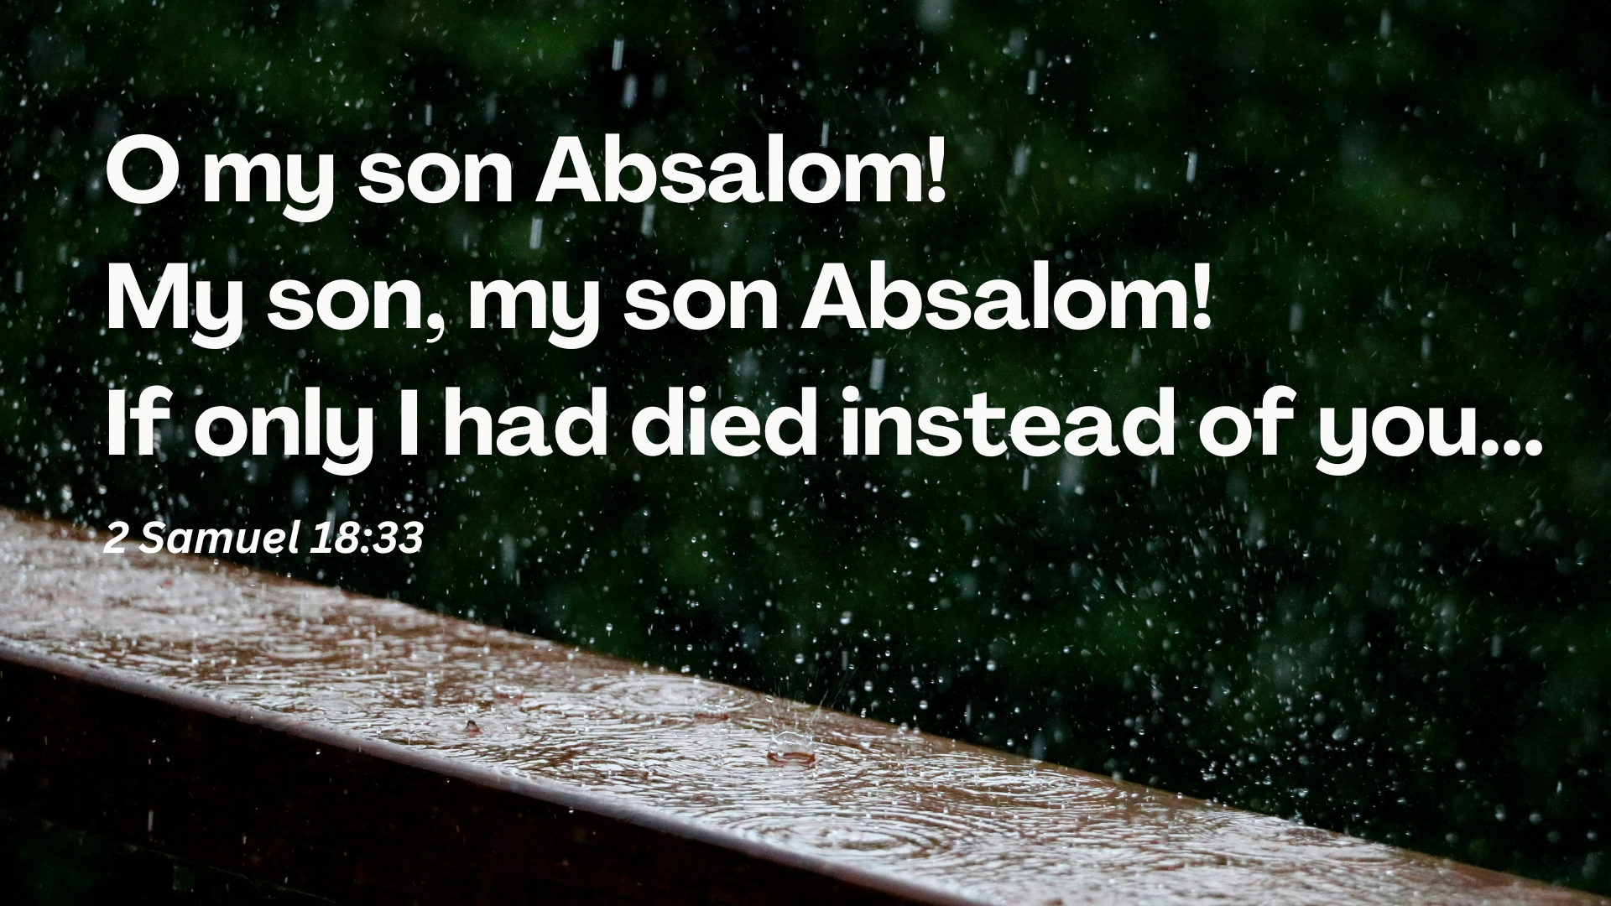

Slide 18


Slide 19

“Look! God’s dwelling place is now among the people, and he will dwell with them. They will be his people, and God himself will be with them and be their God. ‘He will wipe every tear from their eyes. There will be no more death’ or mourning or crying or pain, for the old order of things has passed away.”
(Revelation 21:3-4)

