Slide 2


Slide 3
Lasting Legacy (2 Samuel 24)
Proud Self-Reliance (v.1-9)
Judgment Wrapped in Mercy (v.10-17)
Lasting Sacrifice (v.18-25)

Slide 4
v.1 – mystery of God’s sovereignty and human freedom
Again the anger of the Lord burned against Israel, and he incited David against them, saying, “Go and take a census of Israel and Judah.” (2 Samuel 24:1)
  Satan rose up against Israel and incited David to take a census of Israel. (1 Chronicles 21:1).
Exodus 7:3, “But I [the LORD] will harden Pharaoh’s heart….”
Exodus 8:5, “But when Pharaoh saw that there was relief, he hardened his heart”

Slide 5


Slide 6
2. Judgment Wrapped in Mercy (v.10-17)
David said to Gad, “I am in deep distress. Let us fall into the hands of the Lord, for his mercy is great; but do not let me fall into human hands” (v14).

Slide 7
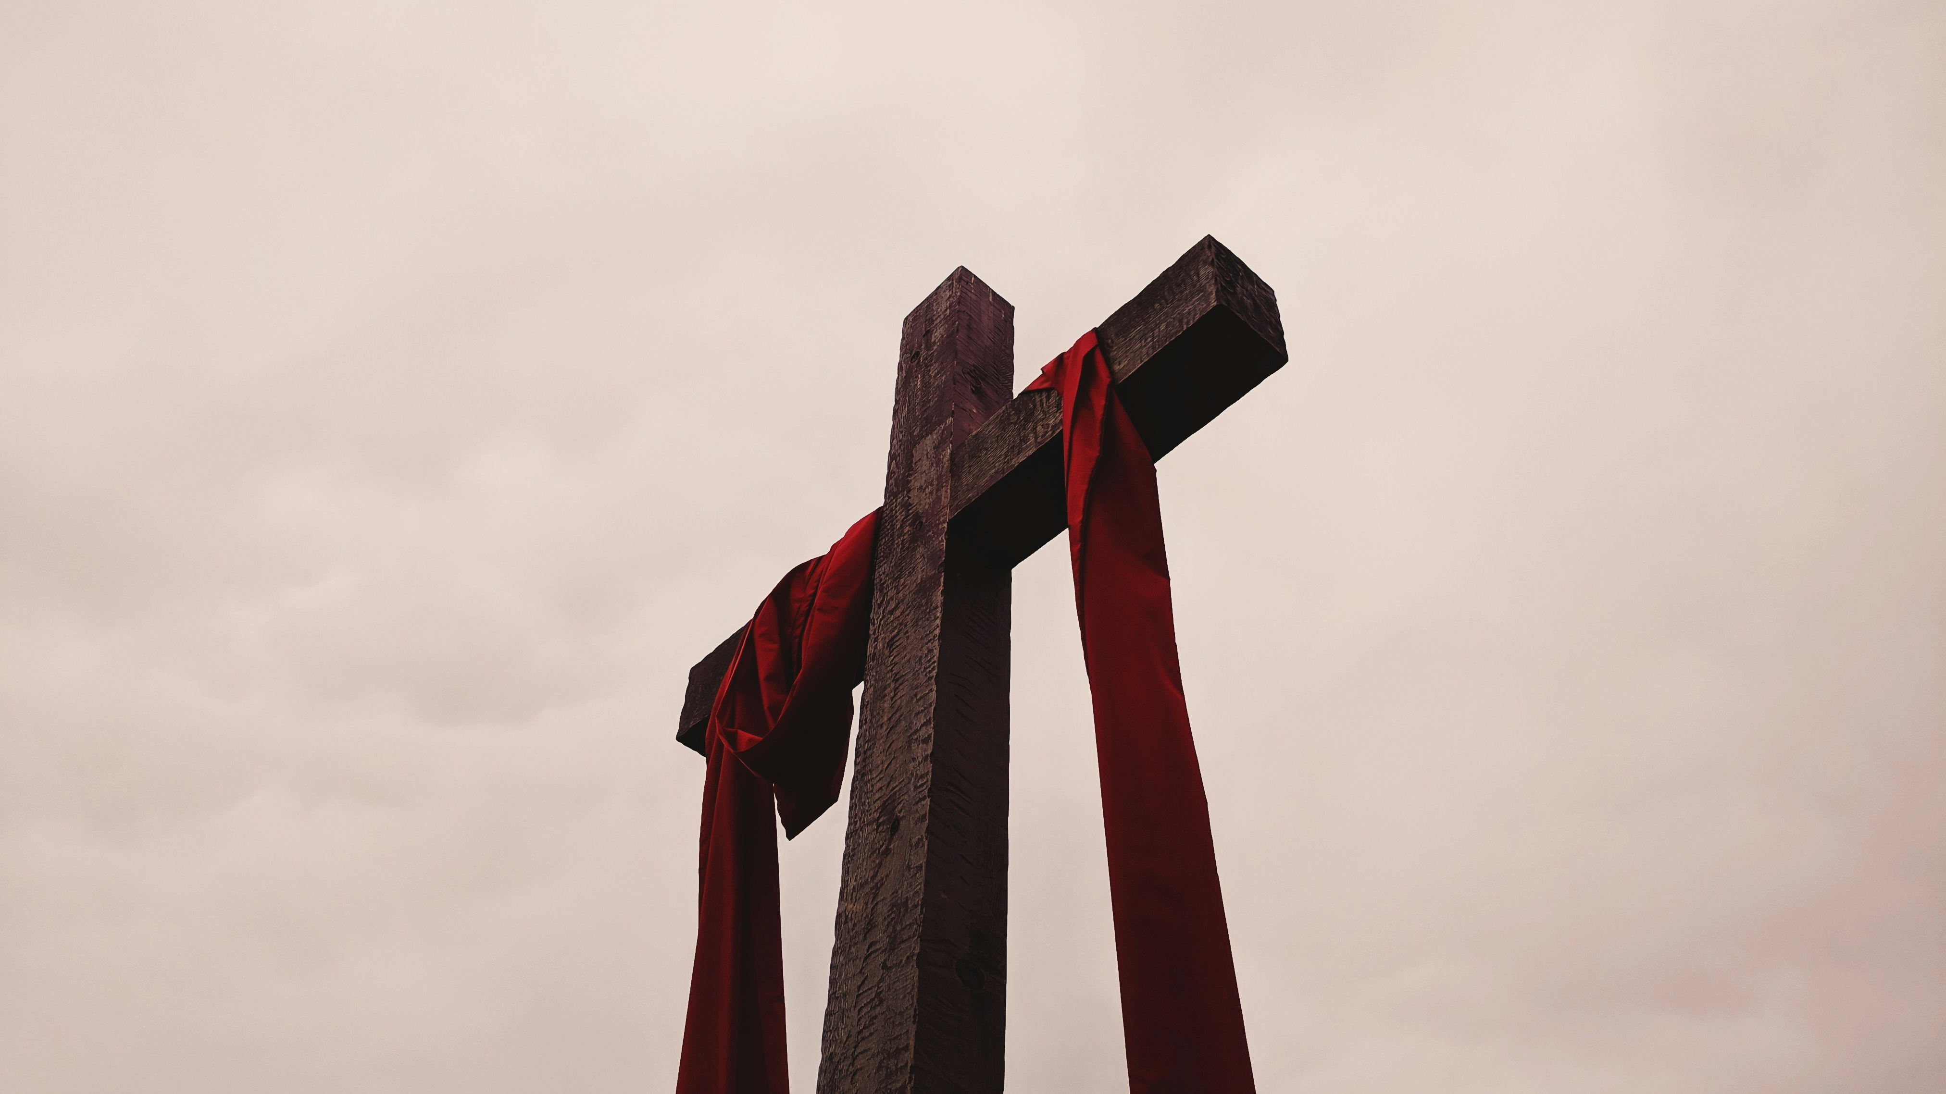

Slide 8
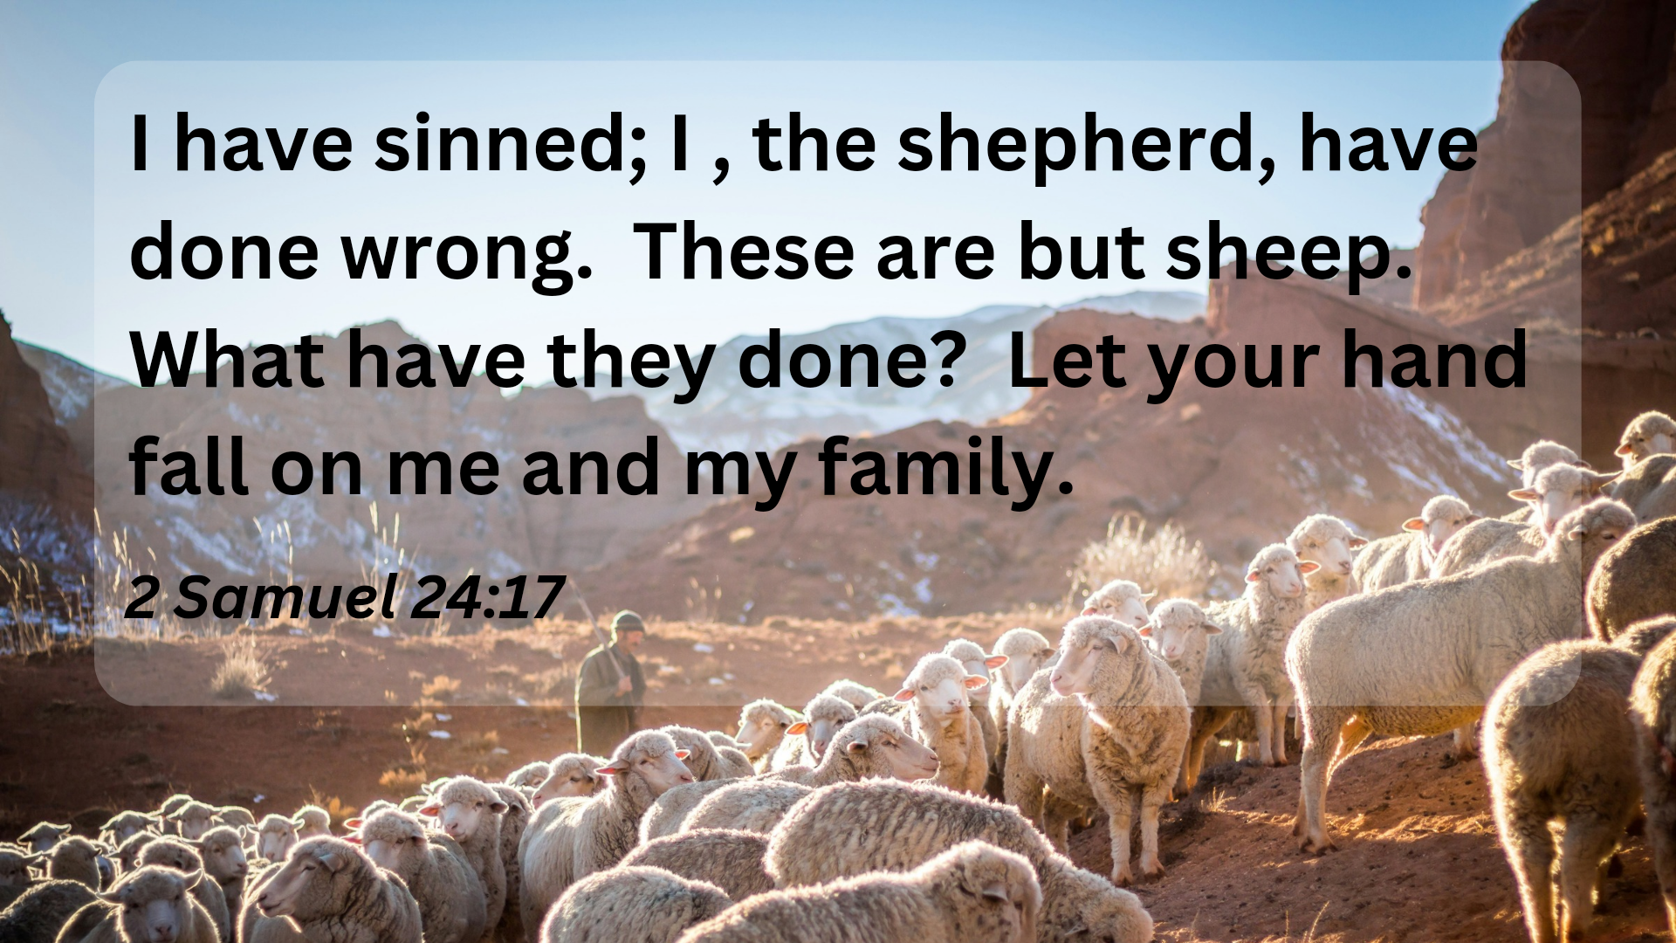

Slide 9
3. Lasting Sacrifice (v.18-25)
“Then Solomon began to build the temple of the Lord in Jerusalem on Mount Moriah, where the Lord had appeared to his father David. It was on the threshing floor of Araunah the Jebusite, the place provided by David.”
(1 Chronicles 3:1)

