Slide 1
The Compromising Church
Revelations 2:12-17
Pergamum – problem with compromise
Today’s Pergamum
Undivided
One Truth – Single mindedness
Notes:
Intro: Have you ever had a performance review? The supervisor usually starts with what you did well then brings up the things you didn’t do so well before closing with what you can do to improve? He or she will sometimes tell you what will happen if you improve or what will happen if you don’t. Well, these letters to the 7 churches in Asia Minor are basically performance reviews except the supervisor is none other than the King of Kings.
Last week Rhoda gave an overview of the 7 churches so today I’m going to focus on Pergamum.

Slide 2
Pergamum – problem with compromise
Pergamum was a cultural hub; known for its culture and education
v13: “you did not renounce your faith in me, not even in the days of Antipas.”
v14-15: “Nevertheless, I have a few things against you: There are some among you who hold to the teaching of Balaam, who taught Balak to entice the Israelites to sin so that they ate food sacrificed to idols and committed sexual immorality. ¹⁵ Likewise, you also have those who hold to the teaching of the Nicolaitans.”
Problem of doublemindedness
Notes:
Pergamum was likely the most well known city in Asia Minor at that time. It had one of the largest libraries and was the political center of the Roman empire in Asia. It was a vibrant cultural, intellectual and arts center. Much like HK or London or NYC of our times. Jesus commended Pergamum for its faithfulness, you can see it in v13 “you did not renounce your faith in me, not even in the days of Antipas.” Antipas was the bishop at Pergamum during the time of Domitian. He refused to acknowledge Domitian as a god. It was rather simple; just words but Antipas held firm. He was also casting out demons and spoke out against the pagan worship. For this, he was roasted alive inside a bull. Jesus commended them for their faithfulness. Yet, the Christians of Pergamum also followed Balaam and Nicolatian teachings.
Balaam was a prophet and is well known for how he tried to curse Israel at the behest of Moabite king Balak but instead God caused him to bless the Israelites instead. He subsequently succeeded in leading the Israelites to inter-marry with the Moabites and commit sexual immoral acts and idol worship. Nicolatians were known for its indifference to adultery. Some have said that Nicolas (the originator of the believe who was a deacon) approved of polygamy and even allowed other men to sleep with his wife. In today’s culture we may see that as extreme behavior, but the culture in Pergamum encouraged and embraced this type of sexual immorality. So Nicolatians would not have been seen as outliners but the norm.
The Christians in the church of Pergamum struggled with doublemindedness. Proclaiming themselves as followers of Christ but also accepting the cultural practices and beliefs. Saying they believe in God but their actions says something else. Maybe they did this to survive, after all look at what happened to Antipas. The problem of doublemindedness means we are torn, torn between what we want to believe and what the culture says we should believe. Saying one thing but doing another. Jerry Falwell Jr was the president of Liberty University, a Christian school. He was a high profile Christian leader. In 2020 it was revealed that he watched while his wife was having sex with her lover. Before you start thinking that will never happen to me, be careful because usually that’s the first step in falling down a slippery slope.
The church in Pergamum lived amongst the pagans, at times even standing up to the pressure of idol worship as Antipas did. But in the end they compromised. They compromised on what THEY felt was right. See they knew that proclaiming the Roman emperor as Lord was wrong, but they convinced themselves that sexual immorality was ok. Their actions did not match their belief. It’s easy to blame them for being weak; but remember, this is the same group of people that produced Antipas. So it’s not just weakness, it’s compromising on something that suits you. We don’t like everything in the Bible; so we take the bits we like and throw away the bits we don’t like. Along the way we find reasons to justify our decisions and behavior. Double mindedness.

Slide 3

Today’s Pergamum
Doublemindedness in our lives
Tolerance vs Beliefs
Conflicts within our culture
Notes:
How are we doubleminded today? It’s not difficult to find examples of our doublemindedness. Or put it another way, our lack of integrity. I just shared the example of Jerry Falwell Jr., there’s also other public Christian figures who were accused of sexual immorality and sexual abuse. Ravi Zacharias was the founder of RZIM and an icon in the apologetics community. Yet he was accused of sexually abusing and intimidating women for decades. How did this happen? These men did incredible things for God’s kingdom but at the same time they betrayed God by succumbing to a deep personal desire. They compromised on their belief. And when we stand from afar, we don’t just wonder how it happen but also feel that won’t happen to me. But it does happen to us. That we behave one way in church but another way at home or in the office. Maybe it’s not an issue of sexual immorality; but a deep personal desire to fit in. This desire will lead to compromise.
Have you had the conversation with your children about pre-marital sex? How did it go? Not an easy conversation. It is easier to compromise; and by compromising I don’t mean to encourage but to tolerate; to accept as it’s ok; almost like a form of resignation. If we say to a Gen Z that we must not have sex outside of marriage, we would be deemed as unreasonable, out of touch, old fashion, dogmatic. Even in adultery, as much of a taboo as it still is, how often is it that we rationalize the sin because we’re so good in other areas. We are no different than Pergamum. It’s in every facet of our culture, the idea that we have to be good to ourselves, as long as I’m ok with it, then it’s ok. I have to look out for myself because no one else will. I have to take care of myself first before I can take care of anyone else. It is so ingrained in our culture, it’s like water to fish.
Recently it’s only gotten worse because any hint of disagreement and we are labeled as intolerant and cancelled. The late Tim Keller once said “Tolerance isn't about not having beliefs. It's about how your beliefs lead you to treat people who disagree with you.” We should absolutely be tolerant to those who hold a different point of view. But that doesn’t mean we embrace or accept their beliefs. It definitely does not mean we do not speak out against it. Our society is so polarized right now that disagreeing with someone will turn into an argument; will easily turn ugly with ugly words flying around. Maybe that’s why we either retreat and isolate or we “get along”, telling ourselves that it’s not a big deal. But things like adultery is a big deal, pre-marital sex is a big deal, following superstitious practices based on other gods is a big deal.

Slide 4
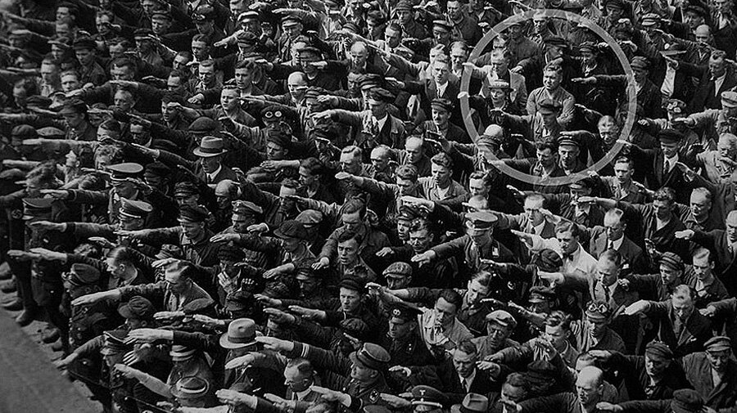
Notes:
What sticks out in this picture? The man who crossed his arms whilst everyone else was saluting. In a nation of Nazis he stood firm in his beliefs; a simple belief of love. The man in the circle is August Landmesser. He was German shipyard worker who had a child with a Jewish girl. When he was not allowed to marry her, he tried to leave Germany with his family. He was caught and sent to penal military service and subsequently died in action. His wife died in a concentration camp. This is someone who risked his livelihood and his life for someone he loved; something he believed in. There’s a cost in standing firm.

Slide 5
Undivided
1 John 2:4 “Whoever says, “I know him,” but does not do what he commands is a liar, and the truth is not in that person.”
There’s two outcomes
  Sword of his mouth – Judgement
  Reward for obedience – Everlasting life and new identity
Notes:
Undivided. That’s the call. Jesus calls on us to be undivided. In 1 John 2:4 “Whoever says, “I know him,” but does not do what he commands is a liar, and the truth is not in that person.” Jesus is not ok with just some faithfulness, he wants absolute faithfulness. And there are warnings on what will happen if we remain unfaithful. In v16, Jesus warns the church that if they do not repent, then they will face the sword of his mouth which refers to judgement. So first we are to repent.

Slide 6
Repentance
“All of a Christian’s life is one of repentance.”
~ Martin Luther
“Be ashamed when you sin, don’t be ashamed when you repent – Sin is the wound, repentance is the medicine.”
~ St John Chrysostom
Notes:
I want to take a moment to talk about repentance. Martin Luther said “All of a Christian’s life is one of repentance.” Before you start thinking that’s a life not worth living, please consider this quote from St John Chrysostom “Be ashamed when you sin, don’t be ashamed when you repent – Sin is the wound, repentance is the medicine.”
True repentance is absolutely necessary to have a healthy and fruitful relationship with Jesus. I’m not talking about repentance where you’re sorry for what happened, sorry for hurting someone, or sorry for the outcome. I’m talking about repentance in wanting to change and being willing to make the necessary sacrifices to change. Jesus calls out to us to Repent. I’m talking about a deeply personal conversation you have with God to acknowledge the wrong, acknowledge His power and ask for help. Repentance is vitally important because the consequence of not repenting is scary; it’s facing Jesus’ judgement because he has said that he will fight against it with the sword of his mouth. But repentance is also cleansing, it’s a medicine, it cures our heart of its imperfection. Why? Because our God is sovereign, all knowing and gracious. We have an advocate who speaks to our Father in our defense. We have the best defense attorney in Jesus. We’re not in the repentance box alone, Jesus is with us. Do you think there are any sins of the past present and future that God doesn’t know? There’s nothing to hide. There are all kinds of impure and selfish actions in our hearts that hasn’t come out yet. They’ll come out later; right now we don’t even know about it. But God knows. And He still loves you. Why? Because we have an advocate who speaks for us.

Slide 7
Undivided
1 John 2:4 “Whoever says, “I know him,” but does not do what he commands is a liar, and the truth is not in that person.”
There’s two outcomes
  Sword of his mouth – Judgement
  Reward for obedience – Everlasting life and new identity
Notes:
So the choice is very clear. If we do not repent, we receive the sword of his mouth. The image of the sword of his mouth refers to judgement; a very real judgement if we do not begin to repent with a desire to change. But we if we repent, we receive hidden manna and white stone. This refers to the reward for obedience. Hidden manna refers to the bread of life. The Christians at Pergamum were also eating meat that was sacrificed to idols; following the customs of the times. So Jesus is highlighting again that what is important is we are continuously fed spiritually by Jesus himself. The other reward mentioned is the white stone. According to commentators, this stands for a new identity; one that is built on Jesus.

Slide 8

Single mindedness
John 14:6 “I am the way, and the truth, and the life”
Truth and love
Grace
Notes:
So what do we do? Honestly I don’t know. This passage does not give any answers or any clues. There’s no simple answer. The Amish live in a high degree of separation and I suppose that might avoid the problem. But we are also called to witness to non-believers because Jesus wants to save ALL. So we cannot avoid a pluralistic society, a society of self reliance, a society of alternate truths; and then our beliefs are challenged. It becomes easy to tolerate and compromise our beliefs. But we need to engage effectively without compromise. Going back to Keller’s quote, it’s about how we treat people who disagree with us. How do we survive in today’s society when we hold on to our beliefs; beliefs that contradict what is popular.
I think we start with acknowledging the one truth in Jesus. Jesus’ words are well documented. He doesn’t really leave anything for our imagination. Sure we can question, debate, discuss but what we shouldn’t do is compromise. I want to be very clear here because refusal to compromise can be mis-interpreted easily and then we become oppressive, combative and sometimes just plain mean. Especially in the current culture where there are alternate truths and competing sources of truth. If we do not affirm opposing beliefs especially in matters of faith, then we are told we’re being intolerant. And some will go as far as saying that’s not Christ like. But that shouldn’t stop us from believing in one truth. It wasn’t a coincidence that the church in Ephesus was rebuked for its lack of love in what they do. Love as the single motivating force behind our action is critical. It’s our love for Jesus, our love for truth and our love for one another. Armed with truth and love, we can engage in this hostile environment and let our actions be seen. What is truth and love? It means we are unwavering in our believe but we are loving in action and words. Imagine your friend is an alcoholic. By not confronting him with the truth about his addiction will only enable him and ultimately hurt him. But to confront him with truth without love will only alienate him and make him feel condemned and worthless. We need to meet opposition with truth in love. In Ephesians 4:15, “Instead, speaking the truth in love, we will grow to become in every respect the mature body of him who is the head, that is, Christ.” This might sound impossible. It is if we attempt this without the Holy Spirit. We must ask for the Spirit to guide and humble us so we can deliver the truth in love.
One final point. None of us is absolutely faithful. All of us have and will at some point say one thing and do another. So what’s the point when we can’t achieve some degree of perfection? This viewpoint fails to consider grace. Because perfection was achieved on the cross. And it was done FOR US. All of our past, present and future sins are nailed on the cross. 2 Corinthians 5:21 says God made him who had no sin to be sin^{[b]} for us, so that in him we might become the righteousness of God.” It is this costly grace that redeems us and allows us to claim righteousness in God’s presence. Not our righteousness but Jesus’ righteousness, his holiness, his perfection. We no longer have to obey to be saved. We obey to please the one who saved us
And none of us are alone to fight through this. We have fellowship through Links, church prayer meeting, men’s group, SALT, and many others. Groups that will encourage us; and hopefully groups that will show us truth in love. We’re also given the power of prayer. Don’t underestimate the power of prayer. It’s not a matter of getting what we want from prayer but how God will explain to us why He gave us what we need in prayer. With fellowship and prayer, we can face opposition with truth in love and we can persevere knowing and experiencing God’s grace.
So let us be single minded on the cross and be undivided in our love for Jesus.

