Slide 1
A Church that loves christ
Revelation 2:1-11

Slide 2


Slide 3

Rekindle our love for God
Revelation 2:1-7

Slide 4
“To the angel of the church in Ephesus write:
These are the words of him who holds the seven stars in his right hand and walks among the seven golden lampstands.

Slide 5
2 I know your deeds, your hard work and your perseverance. I know that you cannot tolerate wicked people, that you have tested those who claim to be apostles but are not, and have found them false. 3 You have persevered and have endured hardships for my name, and have not grown weary.

Slide 6
4 Yet I hold this against you: You have forsaken the love you had at first. 5 Consider how far you have fallen! Repent and do the things you did at first. If you do not repent, I will come to you and remove your lampstand from its place.

Slide 7
Whoever has ears, let them hear what the Spirit says to the churches. To the one who is victorious, I will give the right to eat from the tree of life, which is in the paradise of God.

Slide 8

Rekindle your love for Christ
Remember
Repent
Do the first things

Slide 9


Slide 10
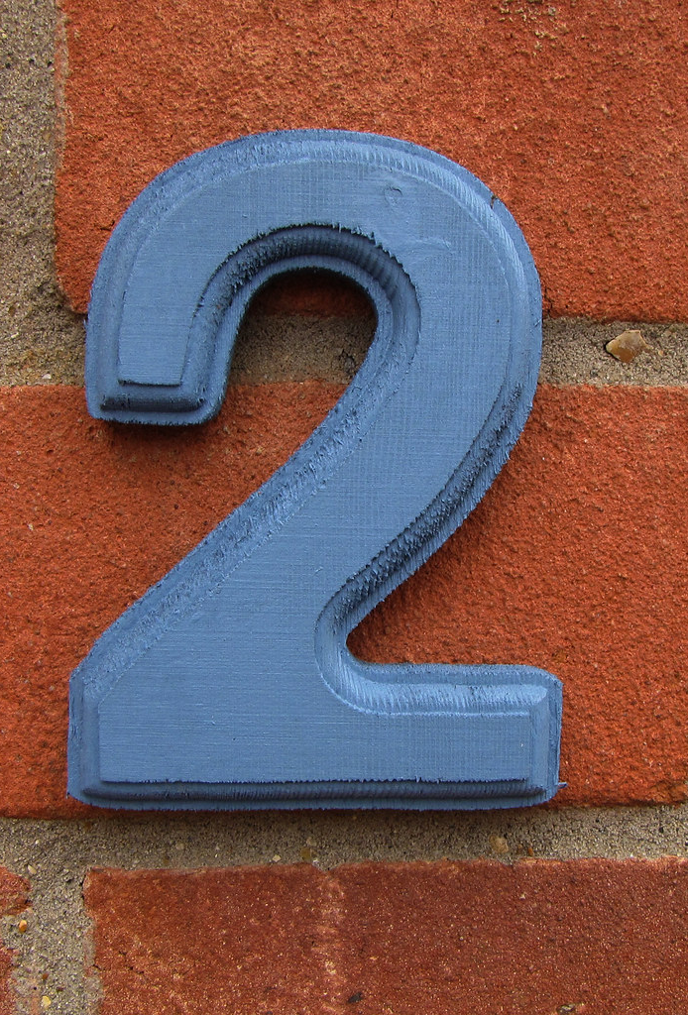
Holding on to God’s love when faced with adversity
Revelation 2:8-11
This Photo by Unknown Author is licensed under CC BY-SA-NC

Slide 11
“To the angel of the church in Smyrna write:
These are the words of him who is the First and the Last, who died and came to life again.

Slide 12
I know your afflictions and your poverty—yet you are rich! I know about the slander of those who say they are Jews and are not, but are a synagogue of Satan.

Slide 13
10 Do not be afraid of what you are about to suffer. I tell you, the devil will put some of you in prison to test you, and you will suffer persecution for ten days. Be faithful, even to the point of death, and I will give you life as your victor’s crown.

Slide 14
Whoever has ears, let them hear what the Spirit says to the churches. The one who is victorious will not be hurt at all by the second death.

Slide 15
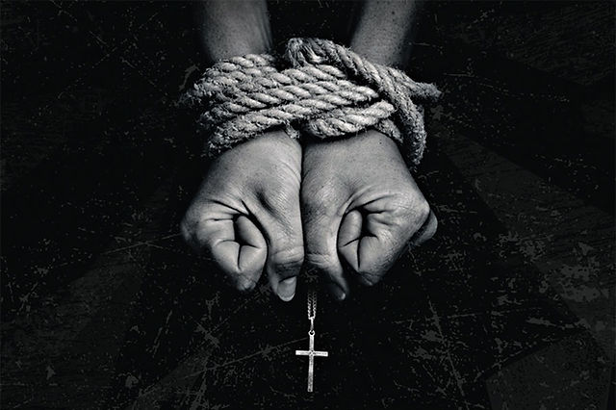
Be ready when adversity comes
Are you ready to Live out your faith when adversity comes?

Slide 16

“86 years have I have served him,” Polycarp declared, “and he has done me no wrong. How can I blaspheme my King and my Savior?”

Slide 17


Slide 18
A Church that loves christ
Revelation 2:1-11

