Slide 1
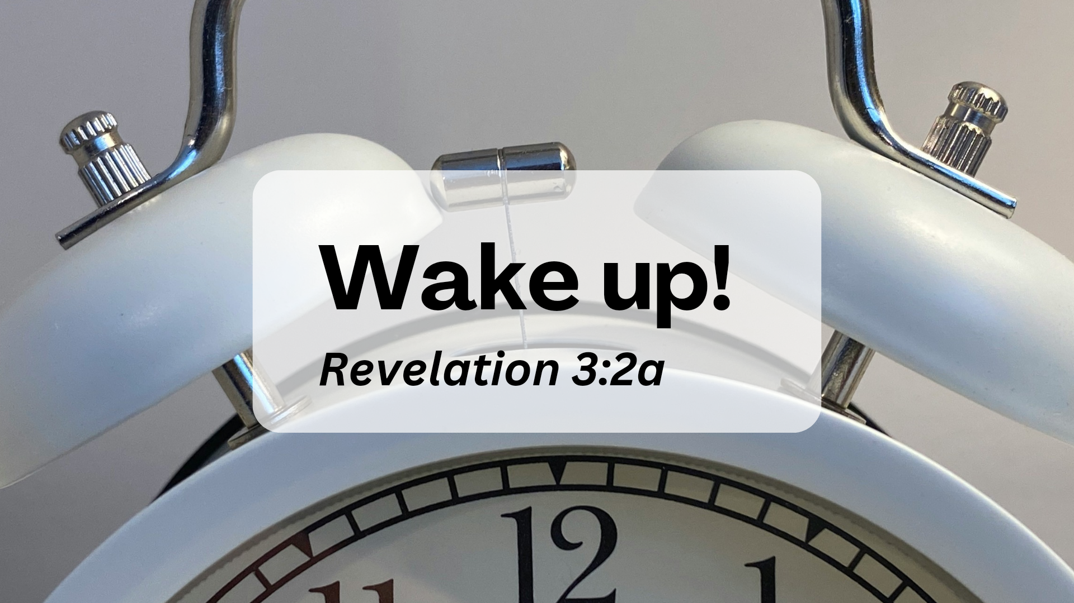

Slide 2
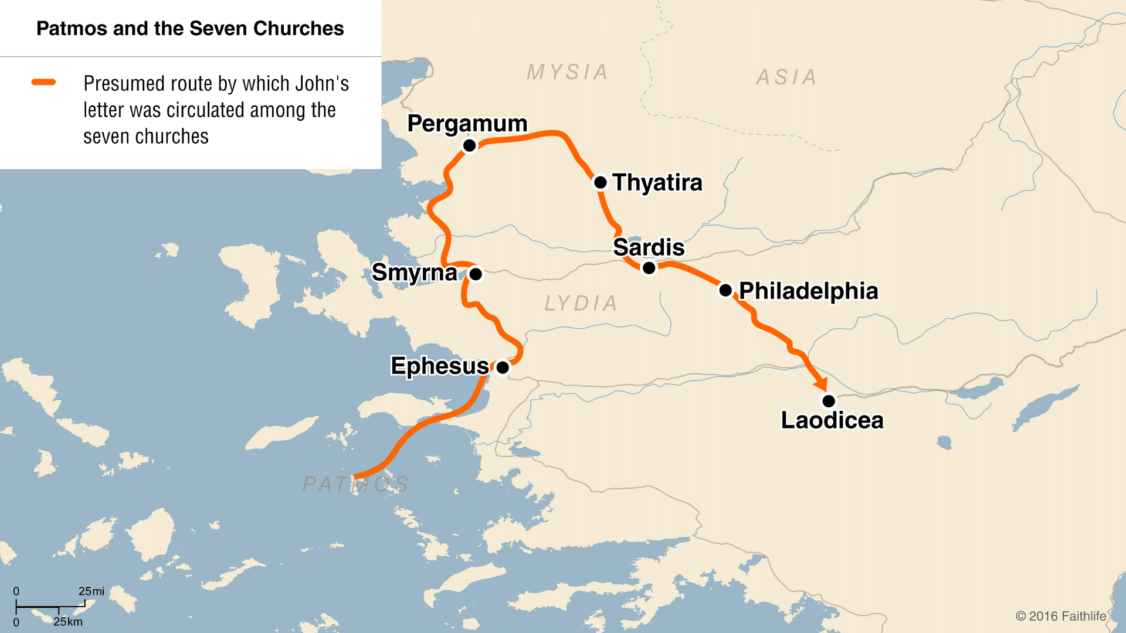

Slide 3
1. Life in the Spirit
1“To the angel of the church in Sardis write: These are the words of him who holds the seven spirits of God and the seven stars. I know your deeds; you have a reputation of being alive, but you are dead.

Slide 4
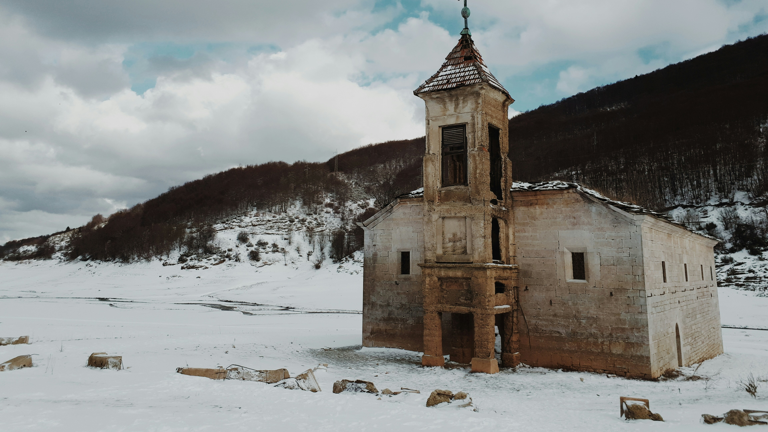

Slide 5
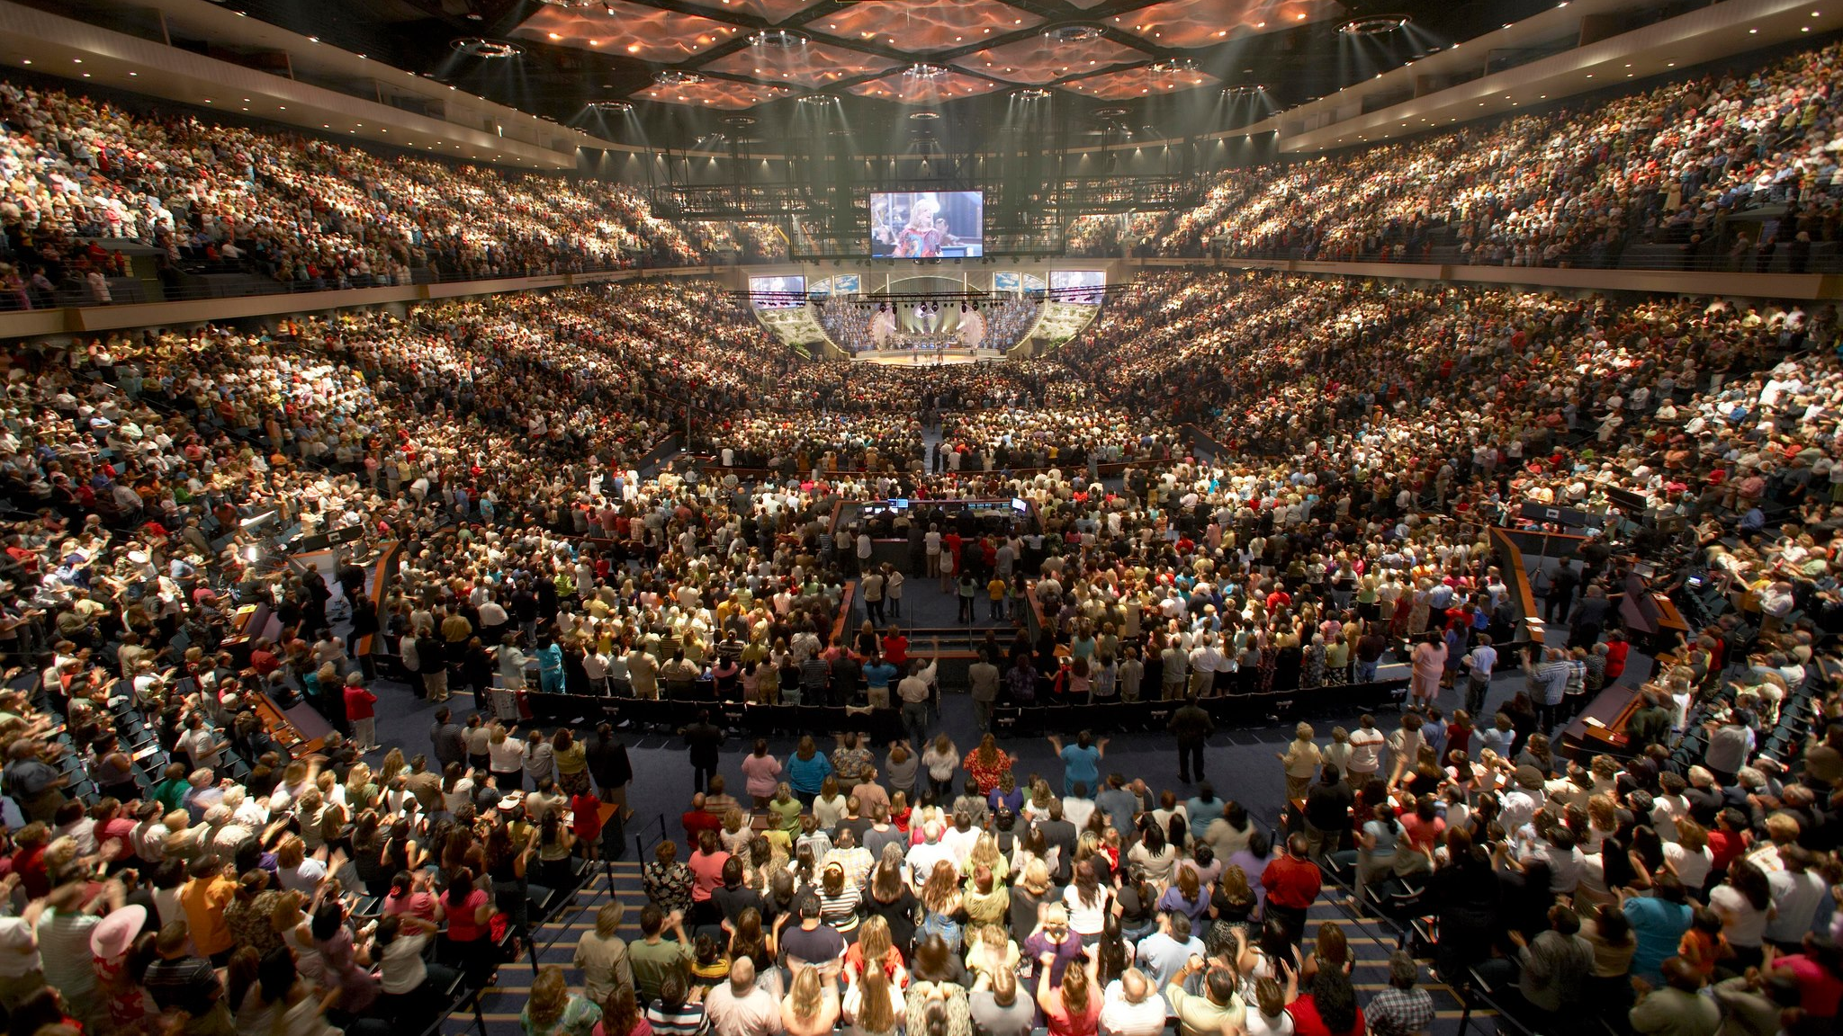

Slide 6
1. Life in the Spirit
What do we live for?

Slide 7
1. Life in the Spirit
What do we live for?
Relying on God’s power or our own?

Slide 8

1. Life in the Spirit
What do we live for?
Relying on God’s power or our own?
Fruit of the Spirit

Slide 9
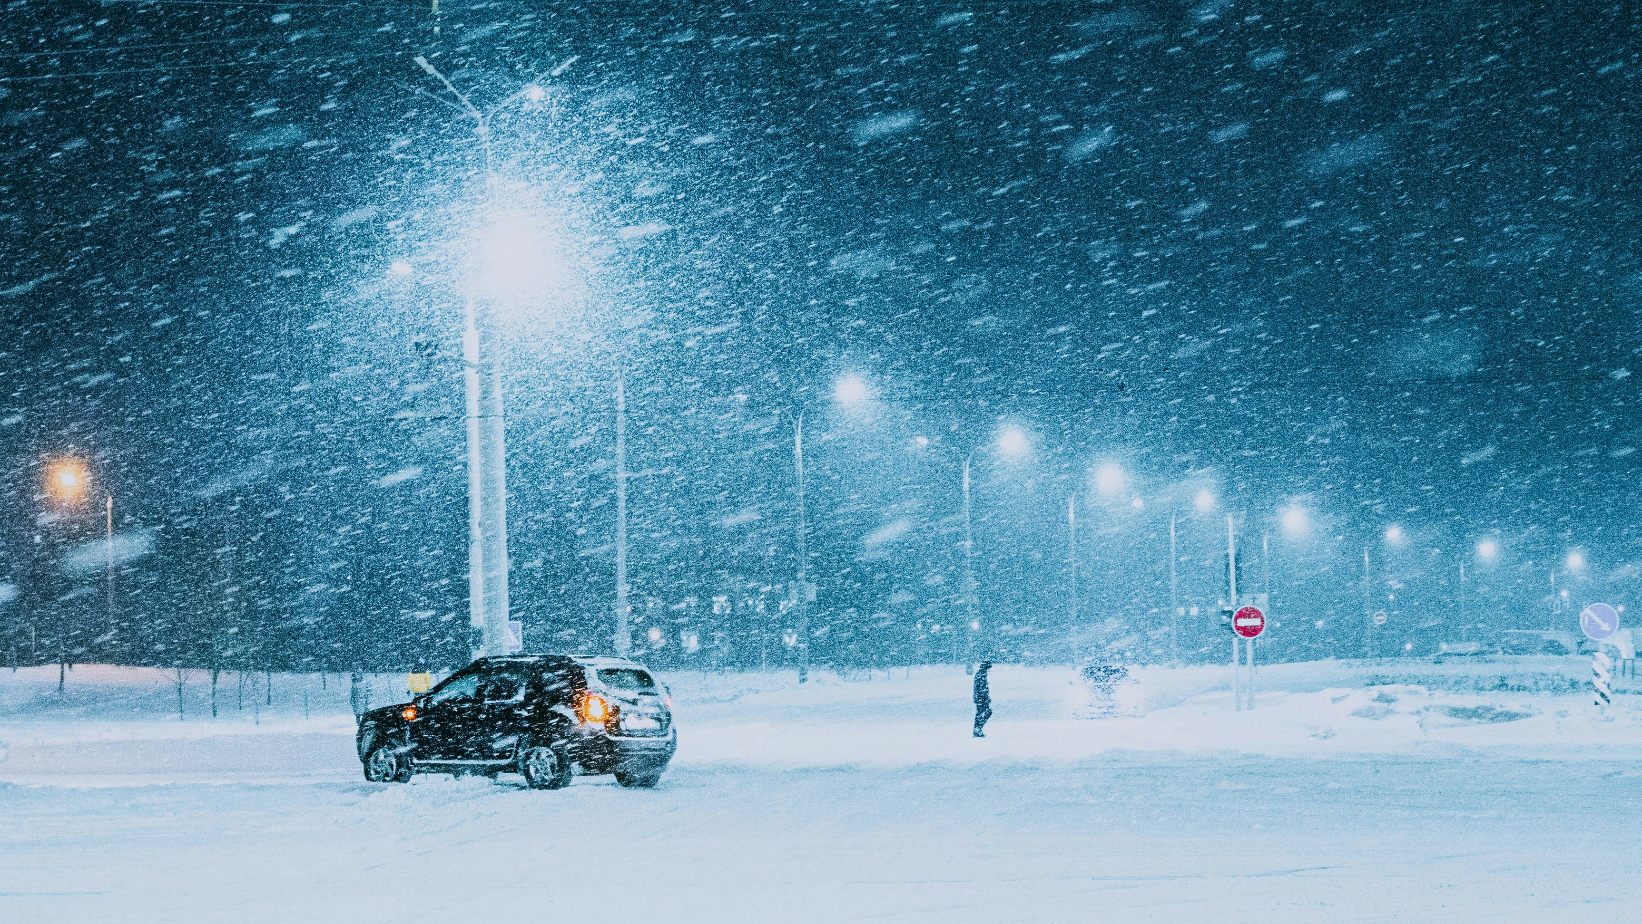

Slide 10
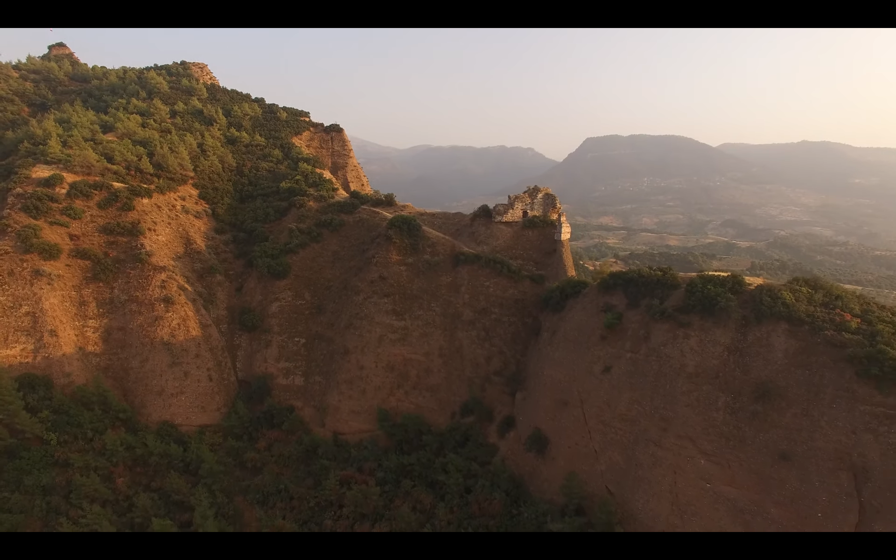

Slide 11
2. Wake Up!
2 Wake up! Strengthen what remains and is about to die, for I have found your deeds unfinished in the sight of my God. 3 Remember, therefore, what you have received and heard; hold it fast, and repent. But if you do not wake up, I will come like a thief, and you will not know at what time I will come to you.

Slide 12
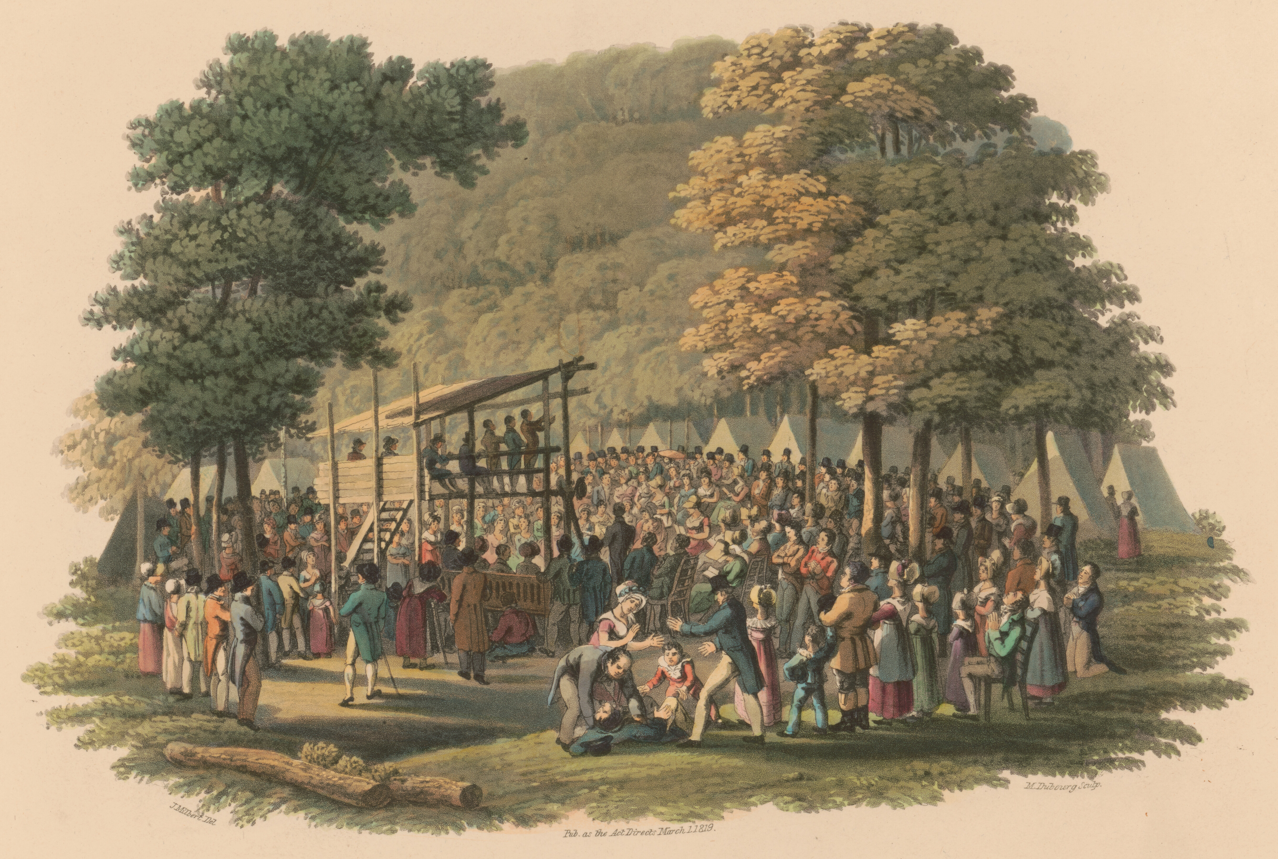
“…but there are always, in a genuine Revival, deep convictions of sin….”
- Charles Finney

Slide 13
3. All in White
4 Yet you have a few people in Sardis who have not soiled their clothes. They will walk with me, dressed in white, for they are worthy. 5 The one who is victorious will, like them, be dressed in white. I will never blot out the name of that person from the book of life, but will acknowledge that name before my Father and his angels.

Slide 14
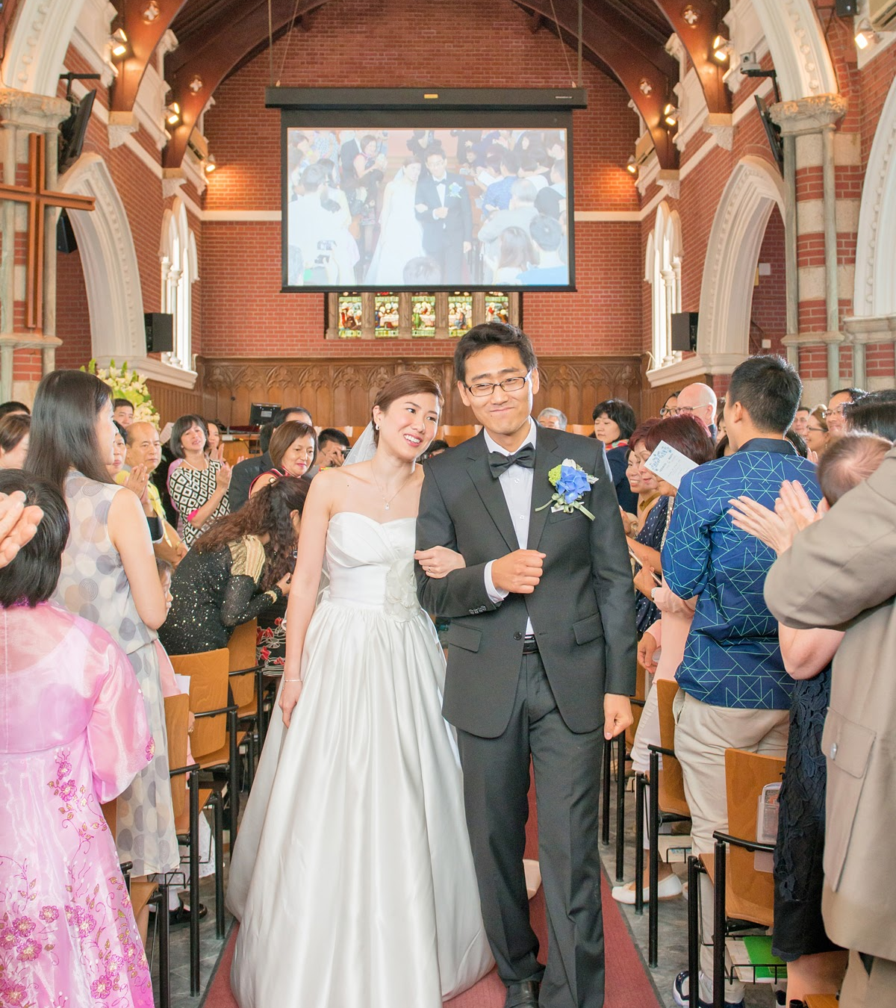
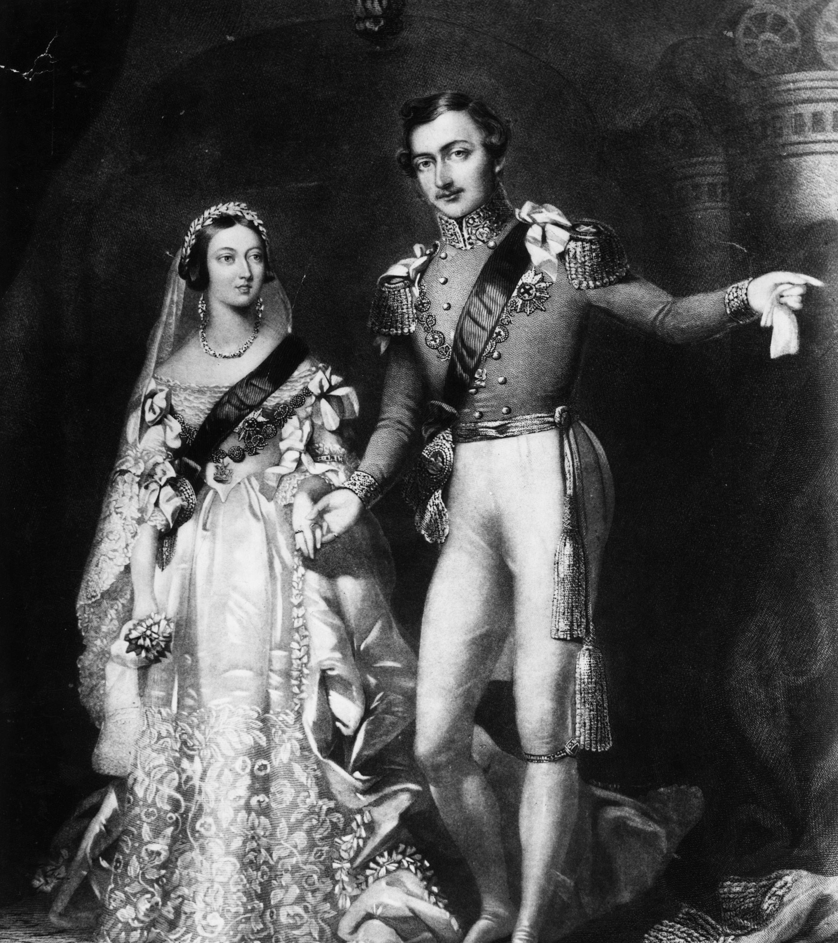

Slide 15
After this I looked, and there before me was a great multitude that no one could count, from every nation, tribe, people and language, standing before the throne and before the Lamb. They were wearing white robes and were holding palm branches in their hands…. And he said, “These are they who have come out of the great tribulation; they have washed their robes and made them white in the blood of the Lamb.
- Rev. 7:9-14

Slide 16
3. All in White
4 Yet you have a few people in Sardis who have not soiled their clothes. They will walk with me, dressed in white, for they are worthy. 5 The one who is victorious will, like them, be dressed in white. I will never blot out the name of that person from the book of life, but will acknowledge that name before my Father and his angels.

