Slide 2
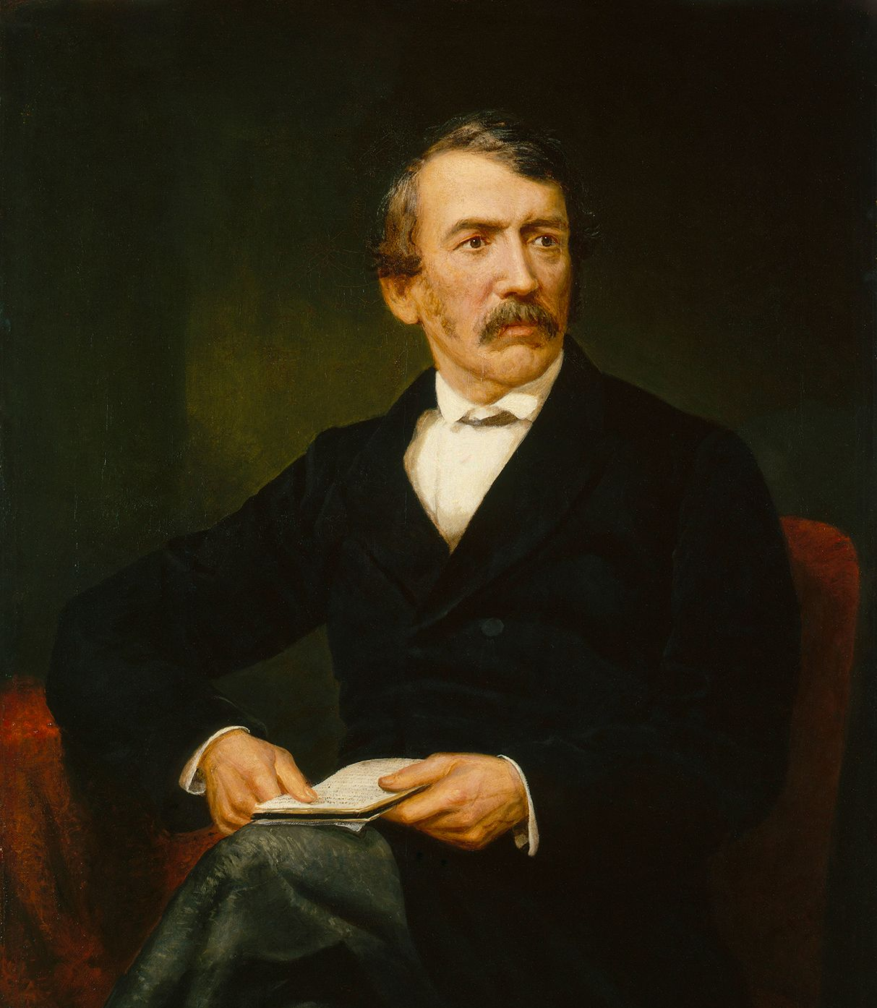
“Away with the word in such a view, and with such a thought! It is emphatically no sacrifice. Say rather it is a privilege. Anxiety, sickness, suffering, or danger, now and then, with a foregoing of the common conveniences and charities of this life, may make us pause, and cause the spirit to waver, and the soul to sink; but let this only be for a moment. All these are nothing when compared with the glory which shall be revealed in and for us. I never made a sacrifice” (David Livingstone).

Slide 3
Pharisee, Child, and a Wealthy Man
What Does Your Heart Seek? (v.9-14)
The Asking Will Receive (v.15-17)
With God, It’s Possible (v.18-30)

Slide 4
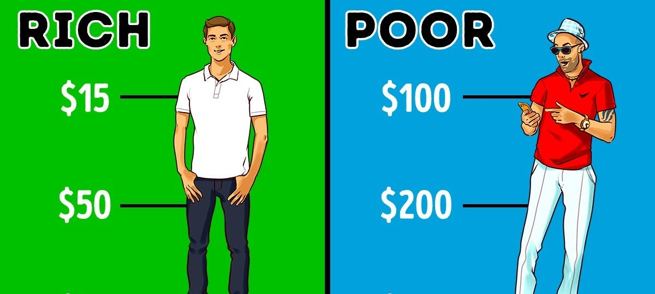
1. What Does Your Heart Seek (v.9-14)

Slide 5
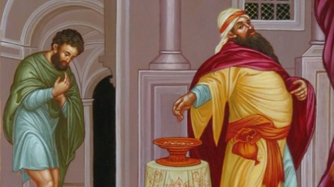

Slide 6
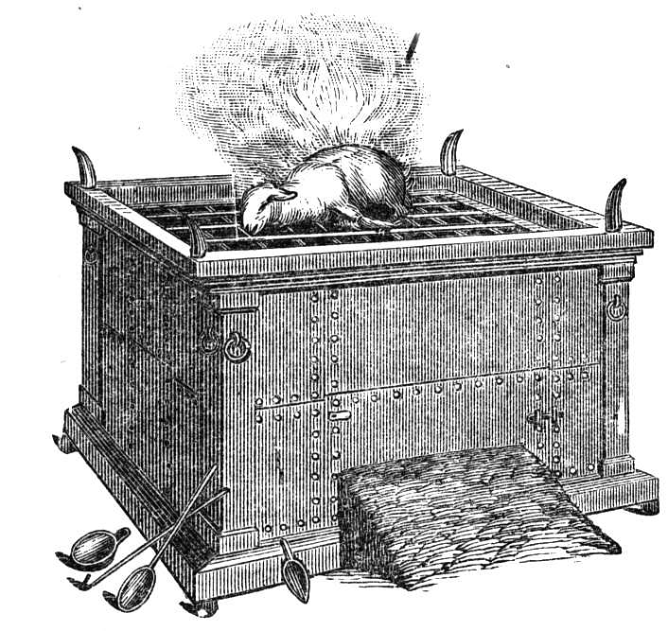

Slide 7
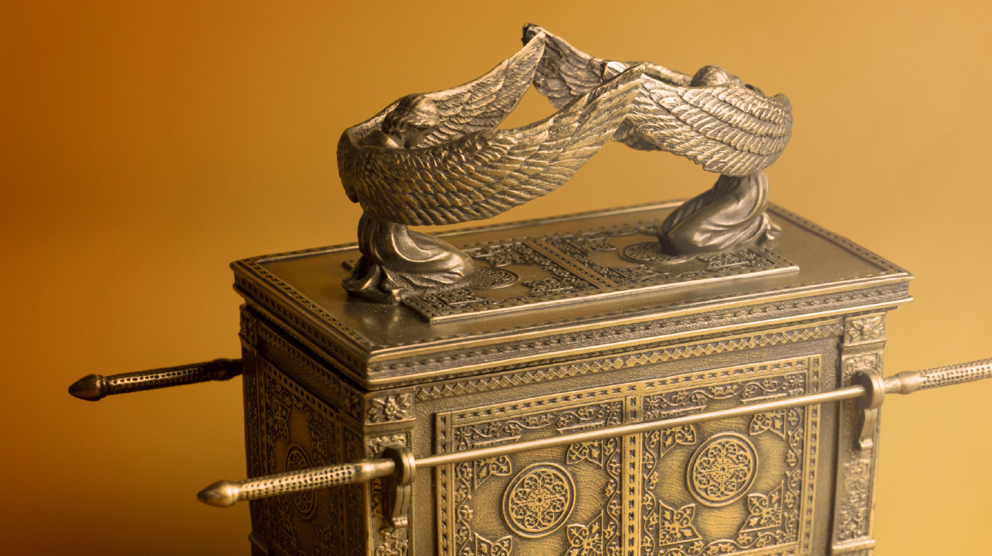

Slide 8
1. What Does Your Heart Seek?
Does your heart seek justification before God or his mercy?
A Christian understands that we’re always dependent on God’s mercy.

Slide 9
2. The Asking Will Receive (v.15-17)

Slide 10
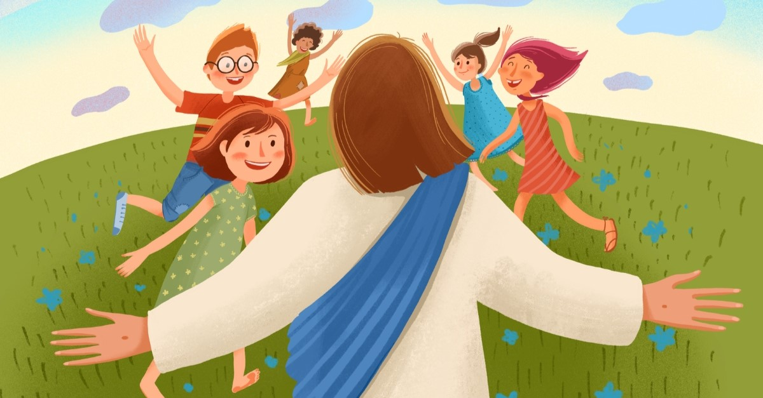

Slide 11
2. The Asking Will Receive (v.15-17)
17 Truly I tell you, anyone who will not receive the kingdom of God like a little child will never enter it.”
18 A certain ruler asked him, “Good teacher, what must I do to inherit eternal life?”

Slide 12
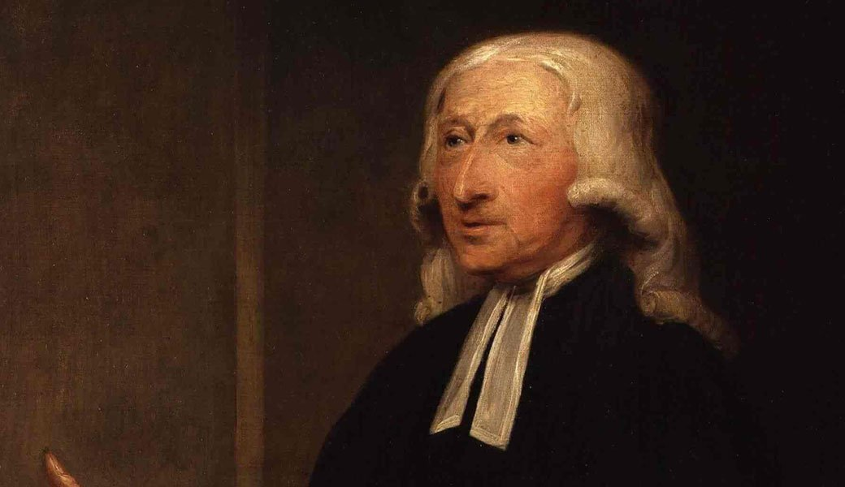

Slide 13
2. The Asking Will Receive (v.15-17)

Slide 14
3. With God, It’s Possible (v.18-30)
18 A certain ruler asked him, “Good teacher, what must I do to inherit eternal life?”

Slide 15
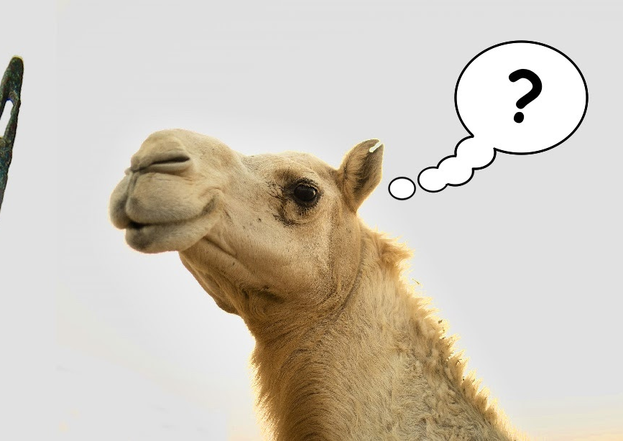
3. With God, It’s Possible (v.18-30)
We’re all idol worshippers left to ourselves. We cannot save ourselves!

Slide 16
3. With God, It’s Possible (v.18-30)
We’re all idol worshippers left to ourselves. We cannot save ourselves!
But with God, it is possible to sever ties to idols and wholly attach ourselves to Christ.
  Often this is what we commit to doing when we receive our salvation!

Slide 17


Slide 18


