Slide 2
A Living Sacrifice
In View of God’s Mercy (chs 1-11)
Offer Your Bodies (v.1)
Be Transformed (v.2)

Slide 3
I. Introduction (Romans 1:1-17)
A. Greeting and Introduction (1:1-7)
B. Paul's Desire to Visit Rome (1:8-15)
C. The Theme of the Letter: The Righteousness of God (1:16-17)
II. The Need for Salvation (Romans 1:18-3:20)
A. God's Wrath Against Sin (1:18-32)
B. The Judgment of God (2:1-16)
C. The Jews and the Law (2:17-29)
D. No One is Righteous (3:1-20)
III. Justification by Faith (Romans 3:21-5:21)
A. Righteousness Through Faith (3:21-31)
B. Abraham Justified by Faith (4:1-25)
C. Peace and Hope in Christ (5:1-11)
D. Adam and Christ (5:12-21)
IV. The Life in Christ (Romans 6:1-8:39)
A. Dead to Sin, Alive in Christ (6:1-14)
B. Slaves to Righteousness (6:15-23)
C. The Struggle with Sin (7:1-25)
D. Life Through the Spirit (8:1-17)
E. Future Glory (8:18-30)
F. God’s Love and Assurance (8:31-39)
V. Israel's Unbelief (Romans 9:1-11:36)

Slide 4
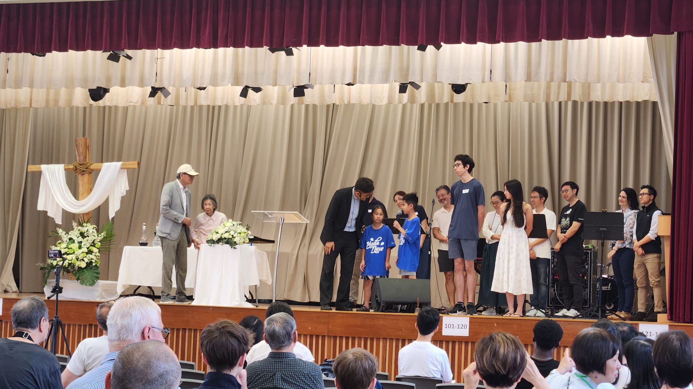

Slide 5
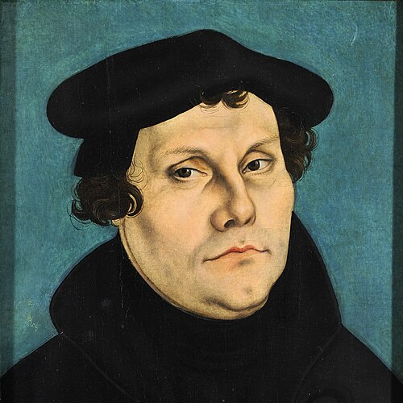
“He does not give saintliness to any but sinners, nor wisdom to any but fools. In short: He has mercy on none but the wretched and gives grace to none but those who are in disgrace.”
- Martin Luther

Slide 6
2. Offer Your Bodies (v.1)
“Therefore, I urge you, brothers and sisters, in view of God’s mercy, to offer your bodies as a living sacrifice, holy and pleasing to God—this is your true and proper worship” (v.1).

Slide 7
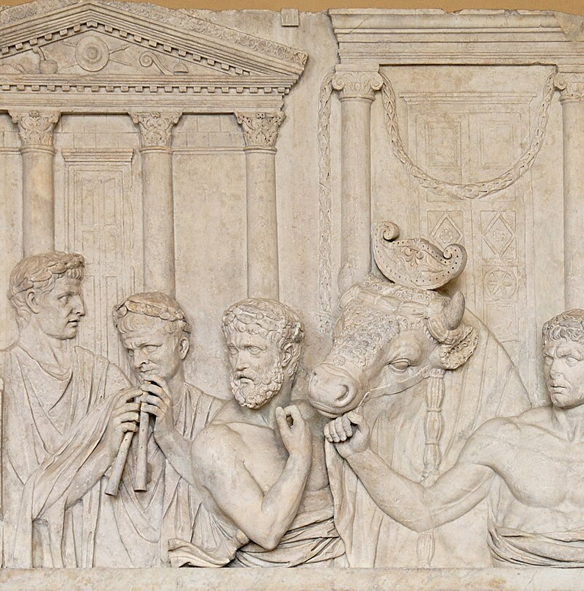
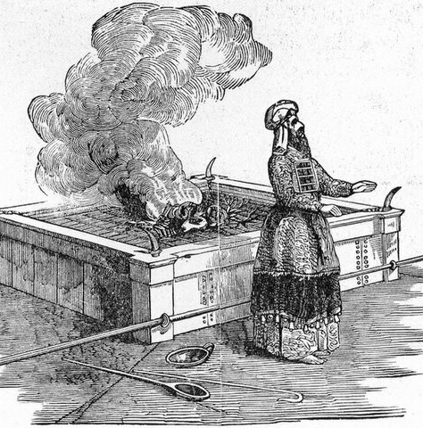

Slide 8
2. Offer Your Bodies (v.1)
Gracious Father, we bow down before you the sovereign Lord of history and redemption. From eternity past, you purposed to lavish grace on undeserving sinners through the blood of your beloved Son. We praise you for the glory of your mercy, unearned, unmeasured, made manifest in Christ crucified and risen. May our lives redeemed and sanctified by your Spirit be vessels of praise to the riches of your grace. To you be glory forever and ever. Amen. (Prayer by ChatGPT)

Slide 10
3. Be Transformed (v.2)
2 Do not conform to the pattern of this world, but be transformed by the renewing of your mind. Then you will be able to test and approve what God’s will is—his good, pleasing and perfect will.

Slide 11


Slide 12
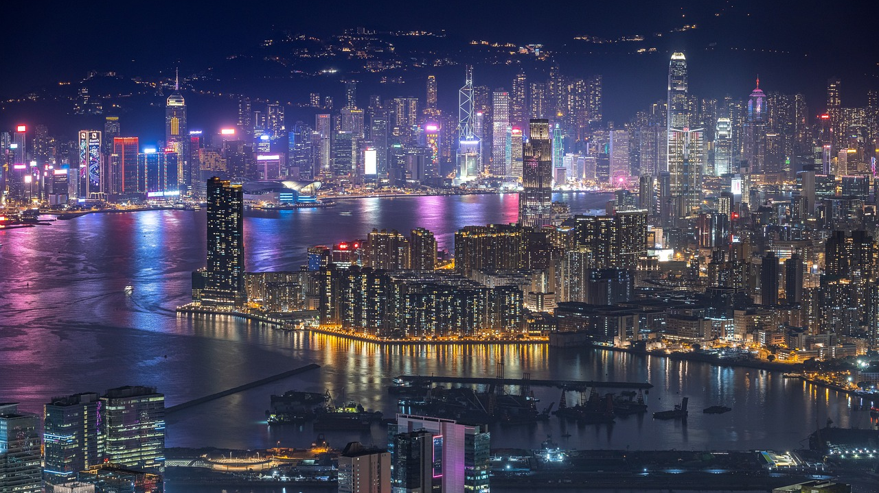

Slide 13
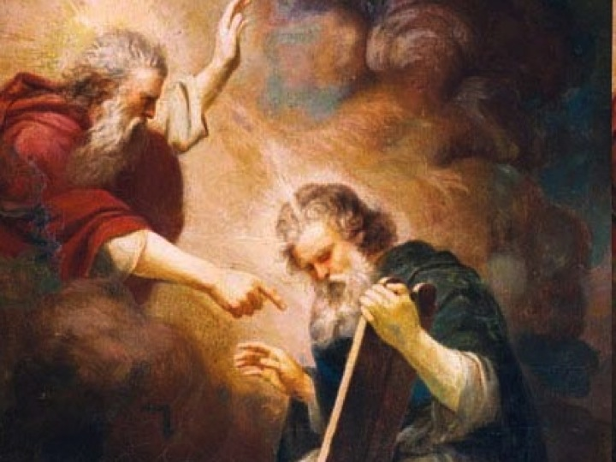
“And we all, who with unveiled faces contemplate the Lord’s glory, are being transformed into his image with ever-increasing glory, which comes from the Lord, who is the Spirit.” (2 Cor 3:18)

Slide 14
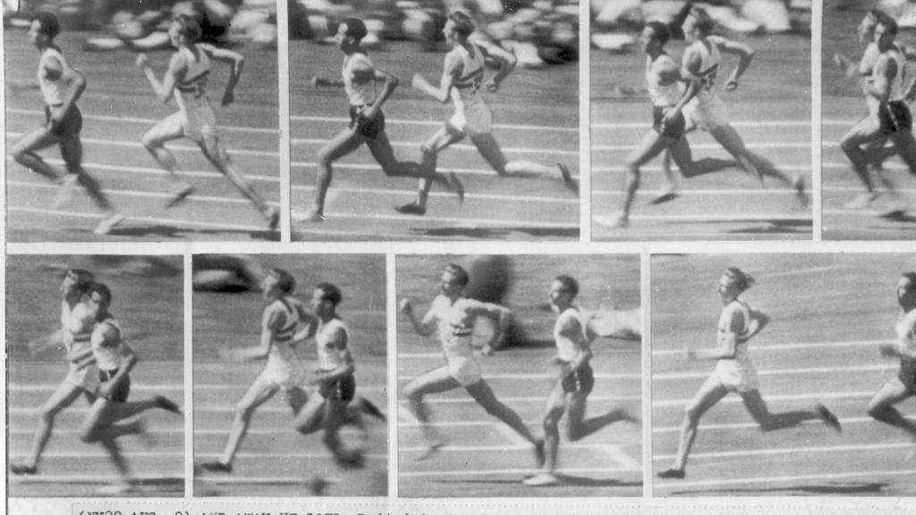

Slide 15
