Slide 1
Godly Ambition
Romans 15:14-33

Slide 2
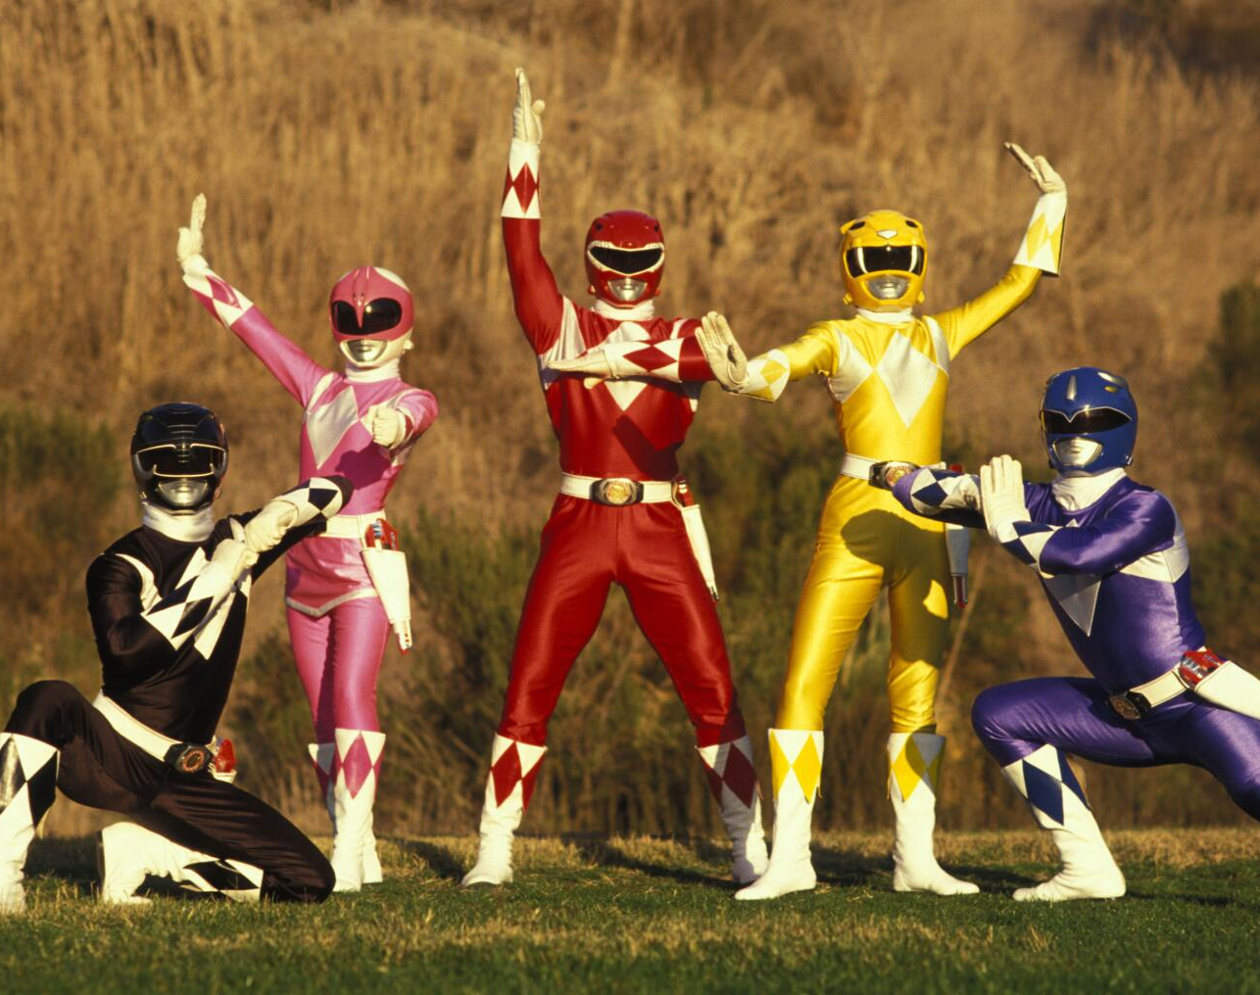


Slide 3

1. Sharing the Gospel
2. Christ’s power through Us
3. Participating in God’s greater mission.
Godly Ambition

Slide 4
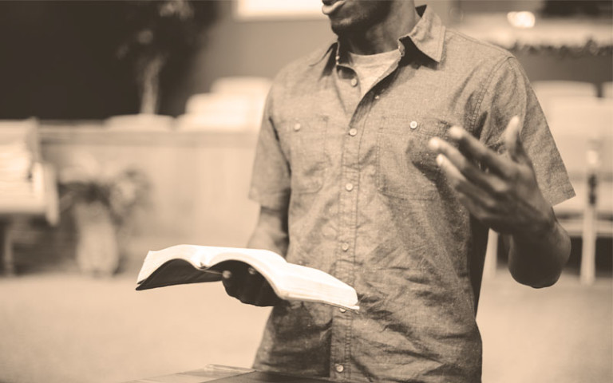
Sharing the gospel
Romans 15:14-16
This Photo by Unknown Author is licensed under CC BY-SA-NC

Slide 5
Romans 15:16
¹⁶ to be a minister of Christ Jesus to the Gentiles. He gave me the priestly duty of proclaiming the gospel of God, so that the Gentiles might become an offering acceptable to God, sanctified by the Holy Spirit.

Slide 6
Romans 12:1
Therefore, I urge you, brothers and sisters, in view of God’s mercy, to offer your bodies as a living sacrifice, holy and pleasing to God—this is your true and proper worship.

Slide 7

Be equipped to share the Gospel
This Photo by Unknown Author is licensed under CC BY-SA-NC

Slide 8

Christ’s power through us
Romans 15:17-24

Slide 9
Romans 15:18-19a
I will not venture to speak of anything except what Christ has accomplished through me in leading the Gentiles to obey God by what I have said and done—by the power of signs and wonders, through the power of the Spirit of God.

Slide 10
Romans 15:22-24
It has always been my ambition to preach the gospel where Christ was not known, so that I would not be building on someone else’s foundation.

Slide 11
Romans 15:22-24
This is why I have often been hindered from coming to you.
23 But now that there is no more place for me to work in these regions, and since I have been longing for many years to visit you, 24 I plan to do so when I go to Spain. I hope to see you while passing through and to have you assist me on my journey there, after I have enjoyed your company for a while.

Slide 12

Recognize that it is God working in you (vs 18-19)

Slide 13

Accept God’s Plan rather than your own (vs 20-24)

Slide 14
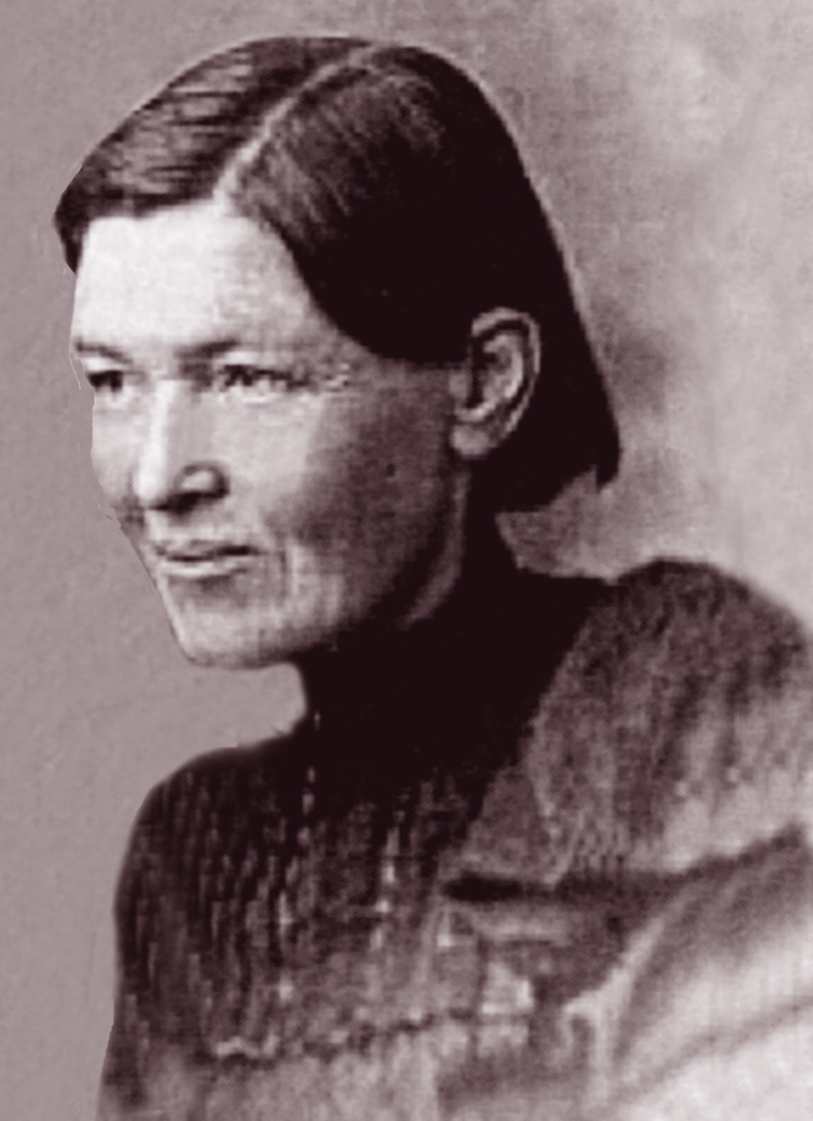
“Christ never was in a hurry. There was no rushing forward, no anticipating, no fretting over what might be. Each day’s duties were done as each day brought them, and the rest was left with God.”

Slide 15

Participate in God’s greater mission
Romans 15:25-33

Slide 16
Romans 15:26-27a
For Macedonia and Achaia were pleased to make a contribution for the poor among the Lord’s people in Jerusalem. ²⁷ They were pleased to do it, and indeed they owe it to them.

Slide 17
Romans 15:30-33
I urge you, brothers and sisters, by our Lord Jesus Christ and by the love of the Spirit, to join me in my struggle by praying to God for me. 31 Pray that I may be kept safe from the unbelievers in Judea and that the contribution I take to Jerusalem may be favorably received by the Lord’s people there, 32 so that I may come to you with joy, by God’s will, and in your company be refreshed. 33 The God of peace be with you all. Amen.

Slide 18
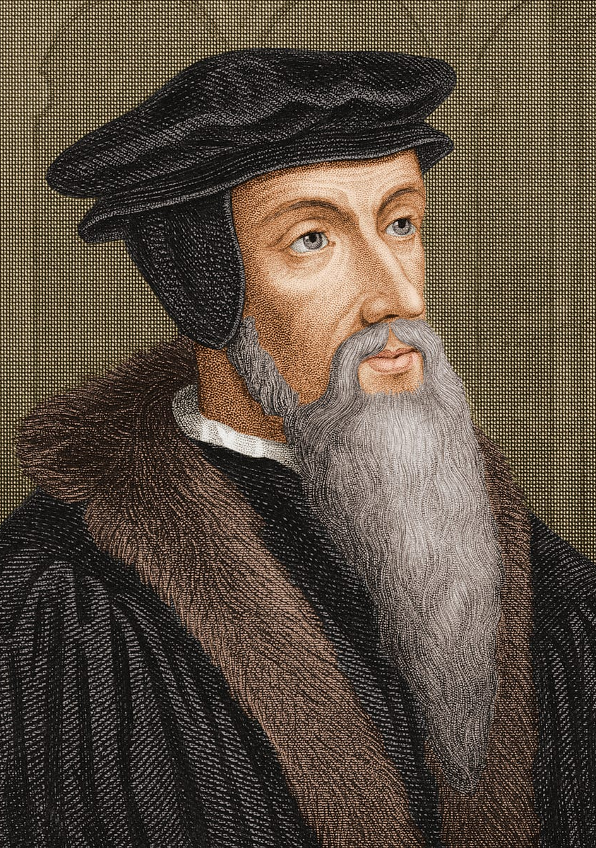
“shows how the godly ought to pray for their brethren, that they are to assume their person, as though they were placed in the same difficulties.”

Slide 19
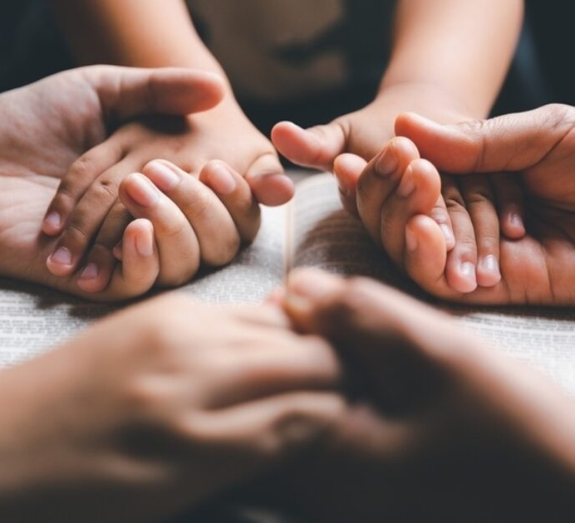
Give and Pray with empathy

Slide 20
