Slide 2
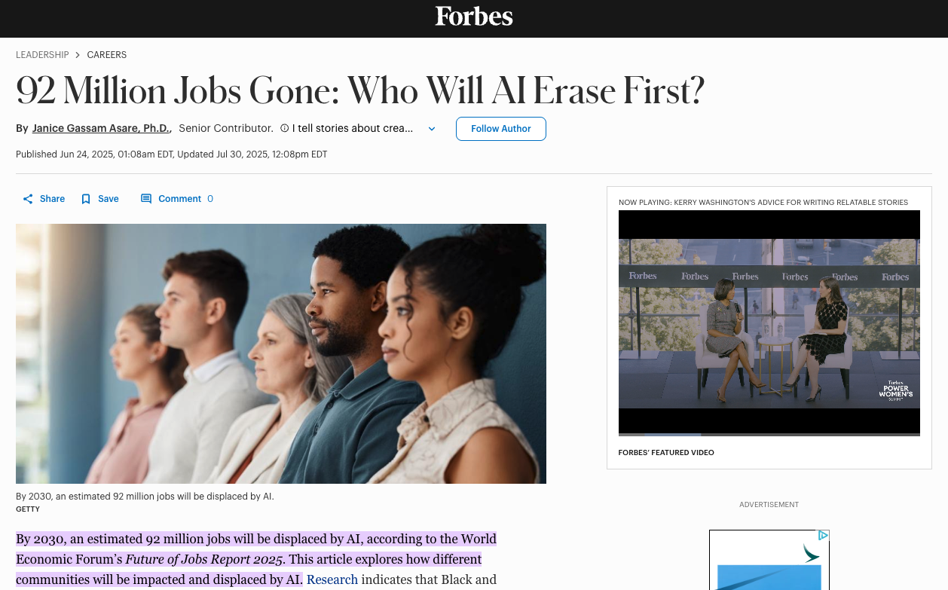

Slide 3
The Beginnings: Work
We Are Creative Workers
We Work God’s Way
We Are Servants, not Saviors

Slide 4
1. We Are Creative Workers
We’re created in God’s image to work
^{1:26} Then God said, “Let us make mankind in our image, in our likeness, so that they may rule over the fish in the sea and the birds in the sky, over the livestock and all the wild animals,^{[a]} and over all the creatures that move along the ground.”
^{2:15} The Lord God took the man and put him in the Garden of Eden to work it and take care of it.

Slide 5
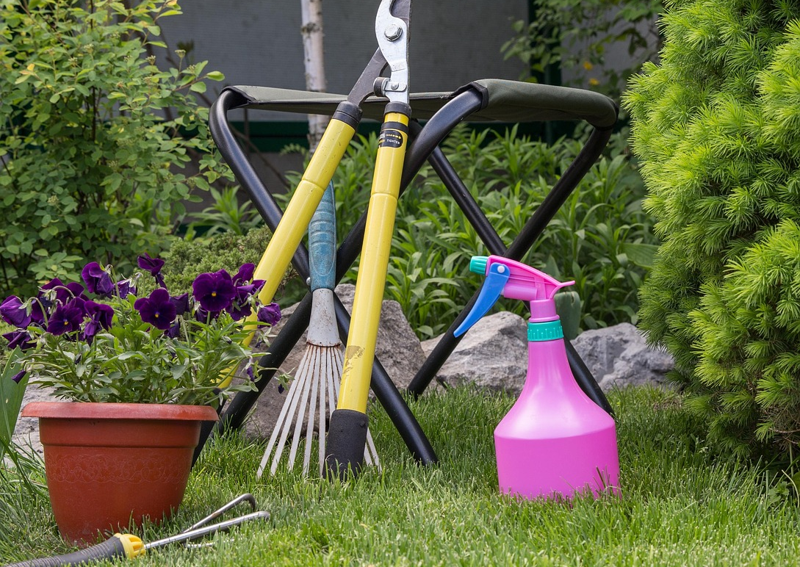
1. We Are Creative Workers
We’re created in God’s image to work
We are to continue the work of gardening
Organizing, rearranging, pruning, and nurturing

Slide 6
1. We Are Creative Workers
We’re created in God’s image to work
We are to continue the work of gardening
We work as a form of worship and partnership with God.

Slide 7

2. We Work God’s Way
We work within the bounds of God’s ethics
^{2:16} And the Lord God commanded the man, “You are free to eat from any tree in the garden; ¹⁷ but you must not eat from the tree of the knowledge of good and evil, for when you eat from it you will certainly die.”

Slide 8
2. We Work God’s Way
We work within the bounds of God’s ethics
Working his way brings flourishing; working our way brings death!

Slide 9
2. We Work God’s Way
We work within the bounds of God’s ethics
Working his way brings flourishing; working our way brings death!
When we can’t work God’s way…
we might need to consider resigning

Slide 10
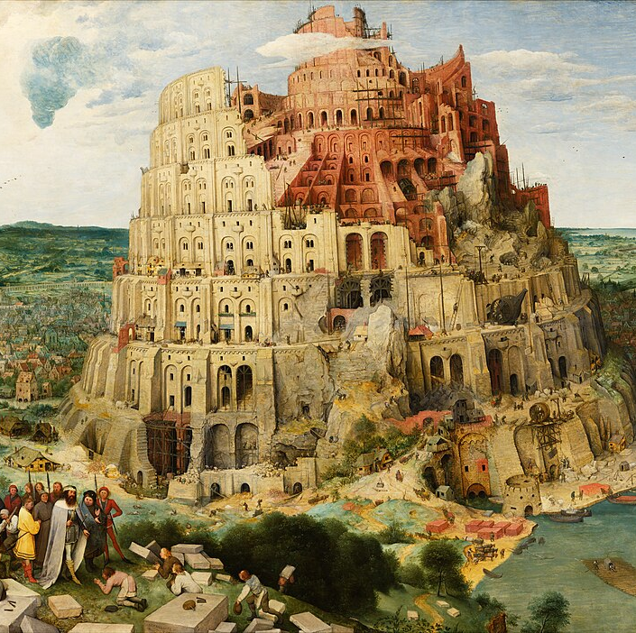
3. We are servants, not Saviors
This means we do not derive our self-worth, significance or purpose from our jobs, but from our relationship with Christ.

Slide 11
3. We are servants, not Saviors
This means we do not derive our self-worth, significance or purpose from our jobs, but from our relationship with Christ.
It’s okay if our jobs are less than ideal.

