Slide 1
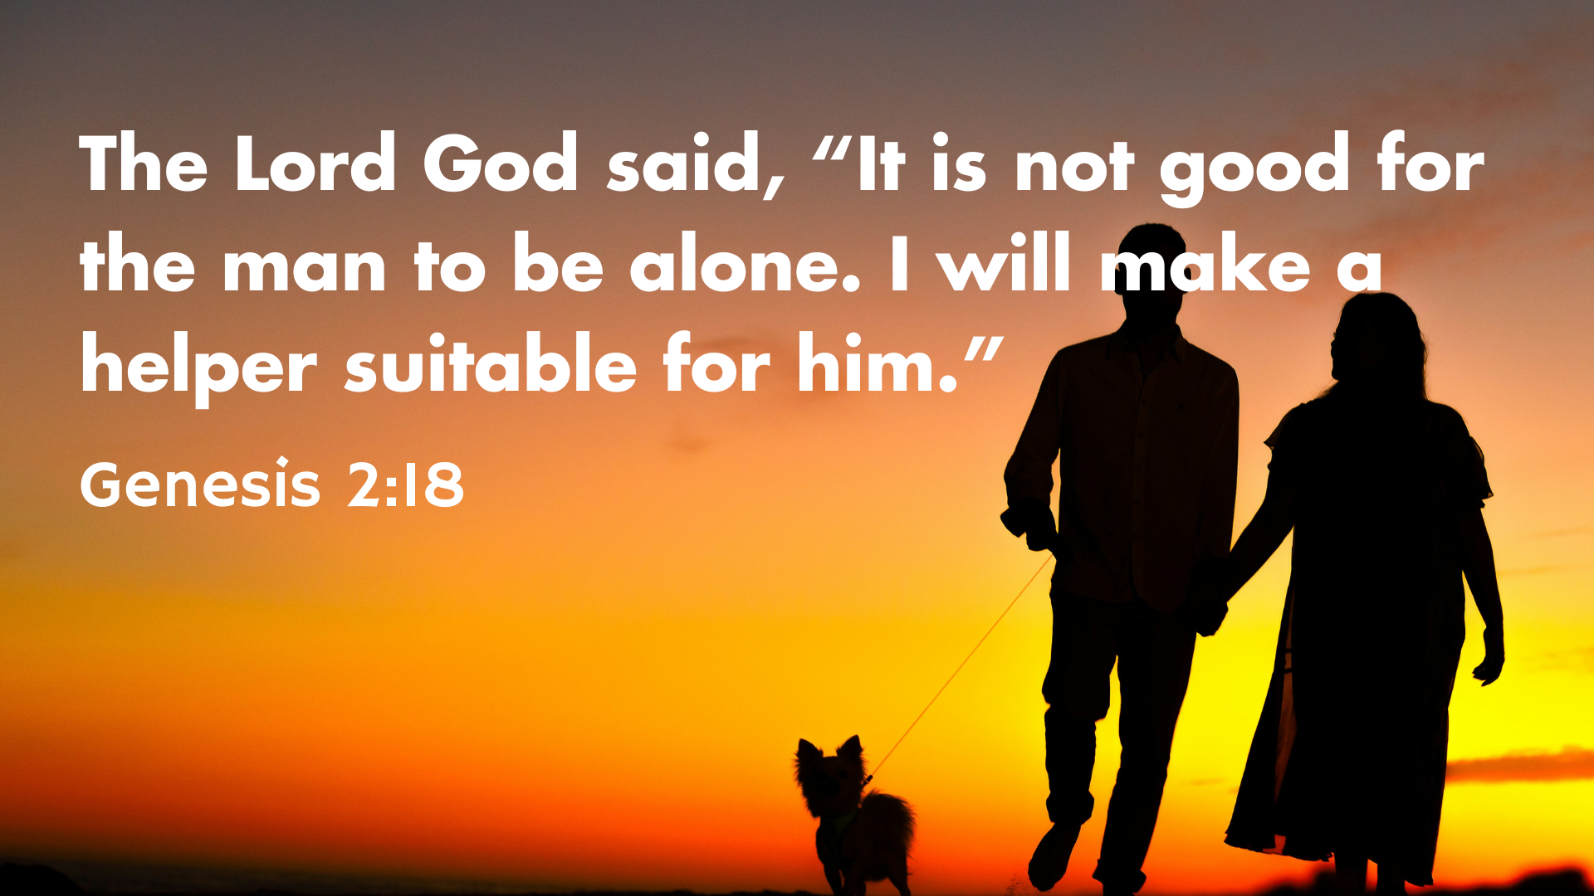

Slide 2
Beginnings: Relationships
Created for God (Christ)
Created for Intimacy
Created for Partnership

Slide 3


Slide 4
³⁰ for we are members of his body. ³¹ “For this reason a man will leave his father and mother and be united to his wife, and the two will become one flesh.” ³² This is a profound mystery—but I am talking about Christ and the church. (Ephesians 5:30-32)

Slide 5

1. Created for God (Christ)

Slide 6
2. Created for Intimacy
¹⁸ The Lord God said, “It is not good for the man to be alone. I will make a helper suitable for him.” (Gen 2:18)

Slide 7
2. Created for Intimacy
This is about being an intimate community
“When the dead rise, they will neither marry nor be given in marriage” (Mark 12:25).
Jesus
1 Corinthians 7

Slide 8


Slide 9
2. Created for Intimacy
This is about being an intimate community
Paradise wasn’t a paradise without friends
So let’s work at being this community here in Shatin Church!

Slide 10
3. Created for Partnership
¹⁸ The Lord God said, “It is not good for the man to be alone. I will make a helper suitable for him.” (Gen 2:18)

Slide 11
3. Created for Partnership
Partnership –
Being fruitful/multiplying,
Ruling over the world

Slide 12
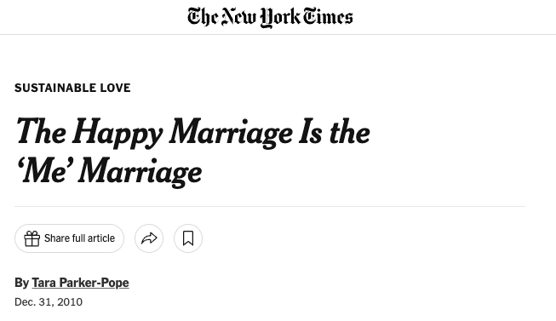
"The Happy Marriage Is the 'Me' Marriage." She writes, “in modern relationships, people are looking for a partnership, and they want partners who make their lives more interesting... [who] help each of them attain valued goals… If your partner is helping you become a better person, you become happier and more satisfied in the relationship.”

Slide 13
3. Created for Partnership
Partnership in marriage–
Being fruitful/multiplying,
Ruling over the world
Partnership of God’s people
Multiplying God’s Kingdom
Ruling over the world

Slide 14
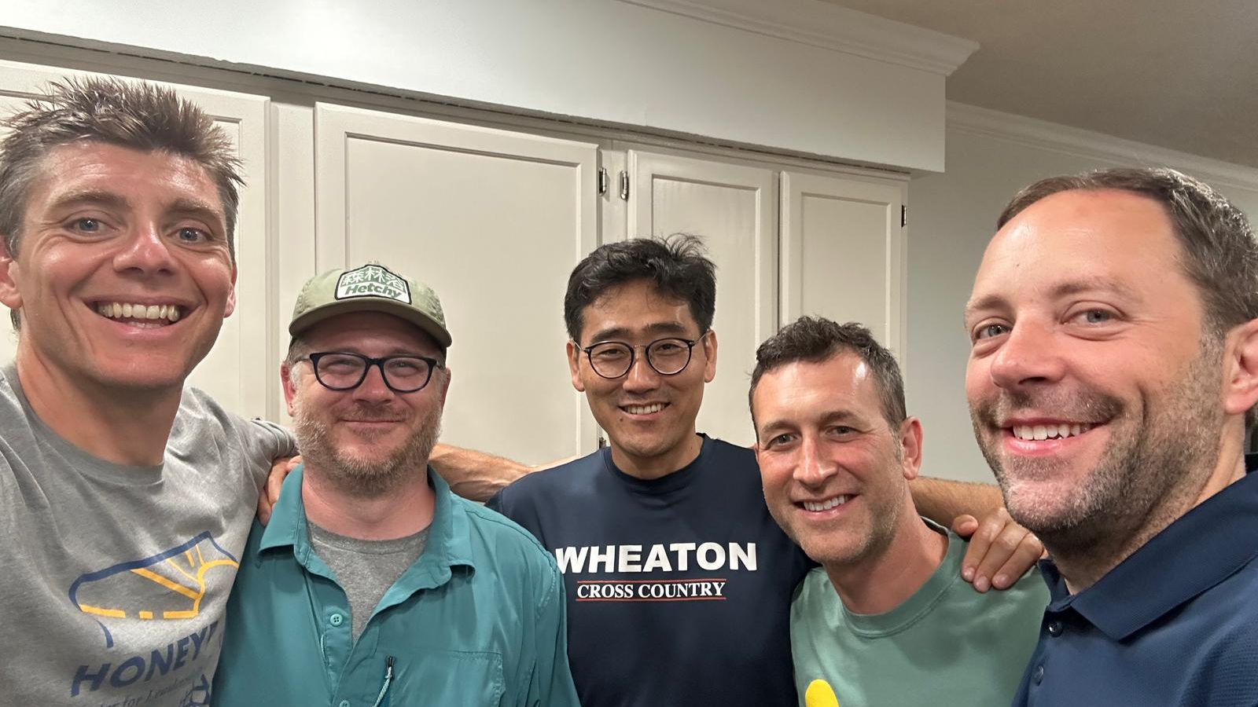

Slide 15
Beginnings: Relationships
Created for God (Christ)
Created for Intimacy
Created for Partnership

