Slide 2

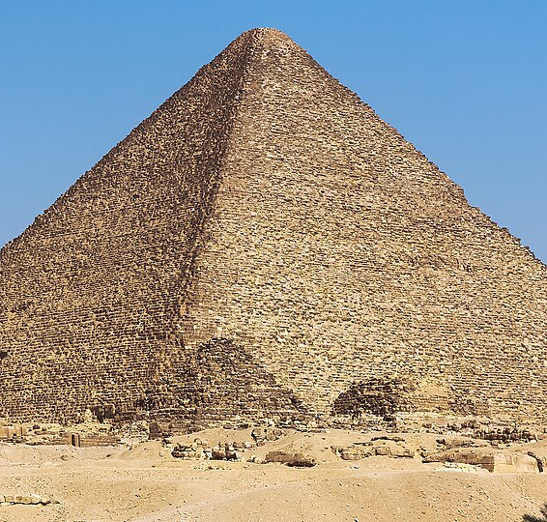
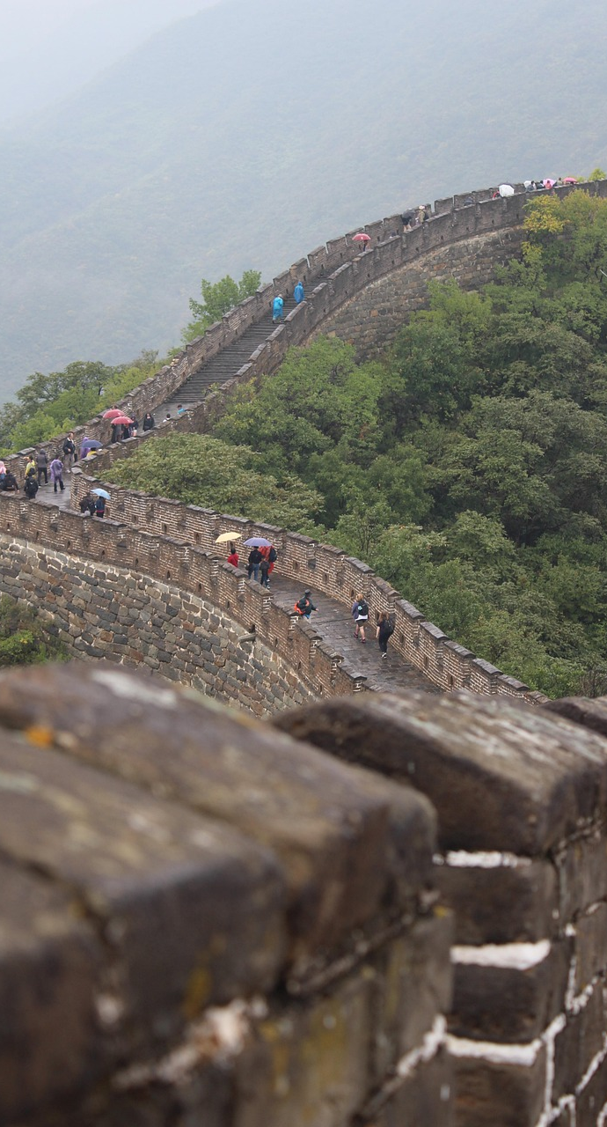

Slide 3
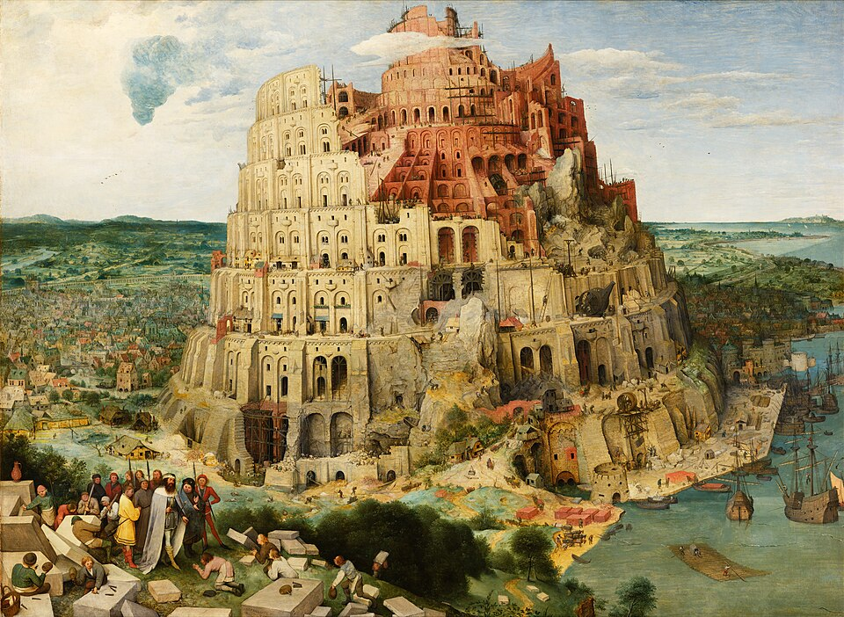
Dangers of Success (v.1-4)
Grace of God’s Discipline (v.5-9)
Unity under Christ (Acts 2)

Slide 4
1. Dangers of Success (v.1-4)
11 Now the whole world had one language and a common speech. ² As people moved eastward, they found a plain in Shinar and settled there. ³ They said to each other, “Come, let’s make bricks and bake them thoroughly.” They used brick instead of stone, and tar for mortar. ⁴ Then they said, “Come, let us build ourselves a city, with a tower that reaches to the heavens, so that we may make a name for ourselves; otherwise we will be scattered over the face of the whole earth.”

Slide 5
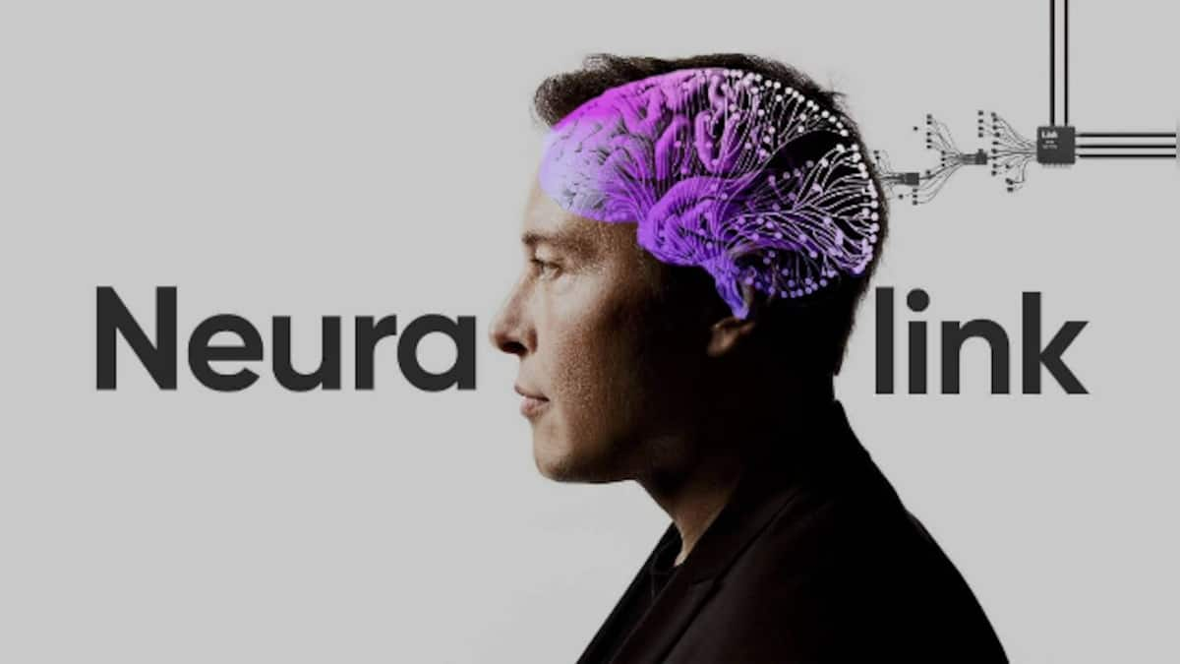

Slide 6
1. Dangers of Success (v.1-4)
Don’t let success get to your heads.
Don’t settle for a name you can make for yourself.
Names in a building?
Records that will be broken?
Robotic consciousness?
A good reputation?

Slide 7
1. Dangers of Success (v.1-4)
Don’t let success get to your heads.
Don’t settle for a name you can make for yourself.
Live for God’s name!

Slide 8

2. Grace of God’s Discipline (v.5-9)
⁵ But the Lord came down to see the city and the tower the people were building…. ⁷ Come, let us go down and confuse their language so they will not understand each other.”

Slide 9
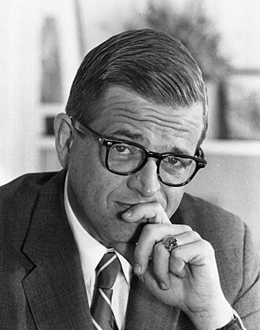
"...all my achievements meant nothing in God's economy. No, the real legacy of my life was my biggest failure—that I was an ex-convict. My greatest humiliation—being sent to prison—was the beginning of God's greatest use of my life…” (Chuck Colson)

Slide 10
2. Grace of God’s Discipline (v.5-9)
The Lord disciplines us
He accomplishes his purpose through his judgment.

Slide 11
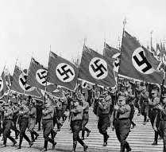
3. Unity in Christ (Acts 2)
God confused their language so that we cannot be one in our name. This limits the evil we can do.

Slide 12
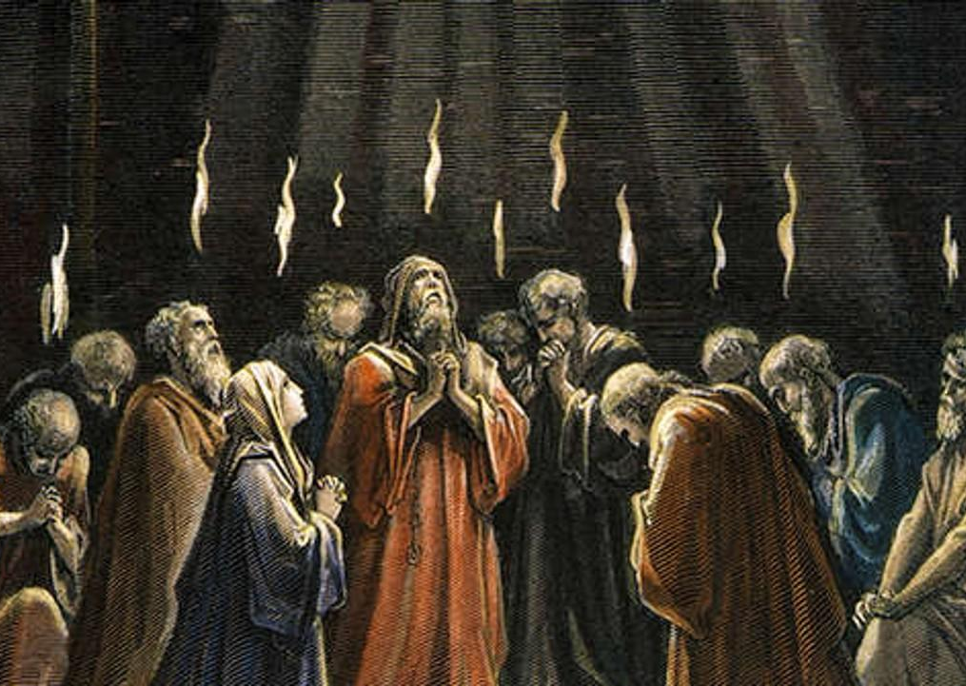
² Suddenly a sound like the blowing of a violent wind came from heaven and filled the whole house where they were sitting. ³ They saw what seemed to be tongues of fire that separated and came to rest on each of them. ⁴ All of them were filled with the Holy Spirit and began to speak in other tongues as the Spirit enabled them.

Slide 13
