Slide 2
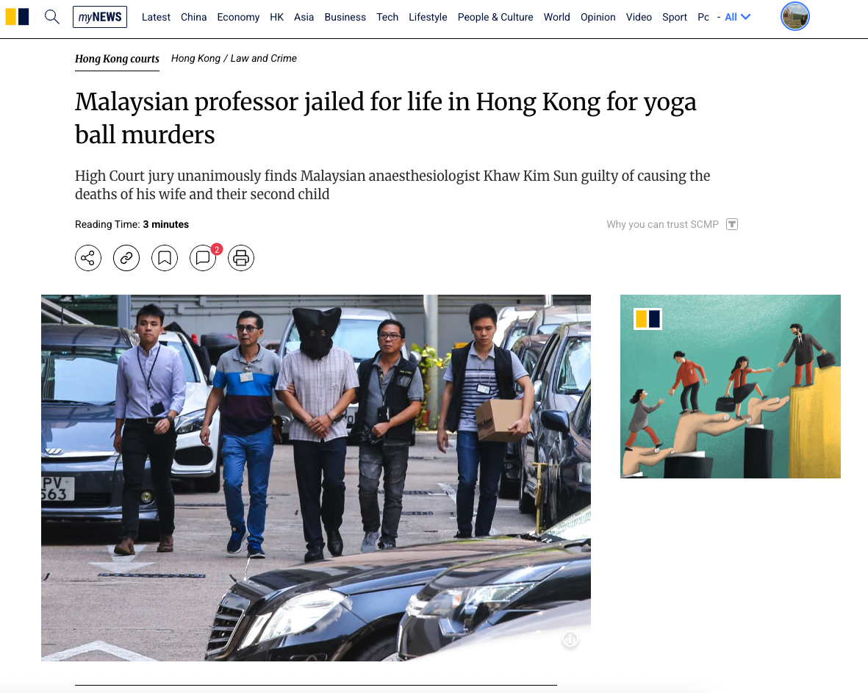

Slide 3
Genesis 4-5: Beginnings – Sin Spreads
Sin’s Deepening Grip
Need to Master It
God’s Unwavering Grace

Slide 4
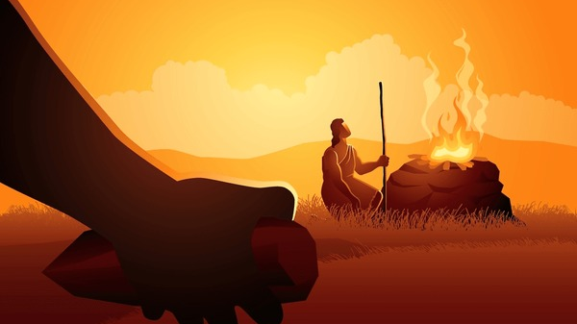
1. Sin’s Deepening Grip

Slide 5
² Later she gave birth to his brother Abel. Now Abel kept flocks, and Cain worked the soil. ³ In the course of time Cain brought some of the fruits of the soil as an offering to the Lord. ⁴ And Abel also brought an offering—fat portions from some of the firstborn of his flock. The Lord looked with favor on Abel and his offering, ⁵ but on Cain and his offering he did not look with favor. So Cain was very angry, and his face was downcast. ⁶ Then the Lord said to Cain, “Why are you angry? Why is your face downcast? 7 If you do what is right, will you not be accepted? But if you do not do what is right, sin is crouching at your door; it desires to have you, but you must rule over it.”

Slide 6
1. Sin’s Deepening Grip
Comparison between ch3 and 4
External evil vs. internalized evil
Satan intervenes vs. God intervenes to no avail
Shame vs. no shame
Shamefully tell the truth vs. outright lie
Receives the due punishment vs. protests the punishment

Slide 7
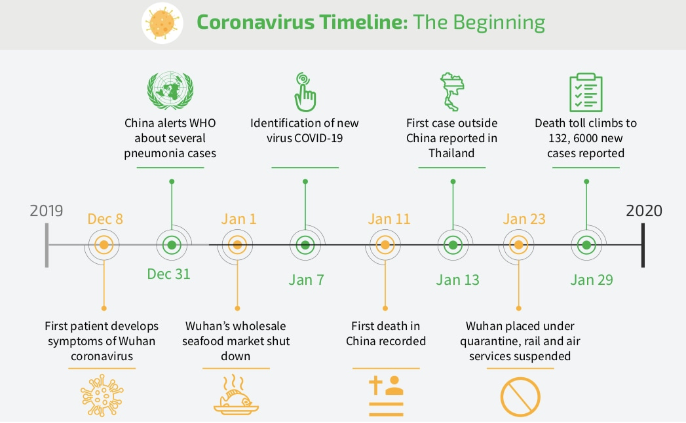

Slide 8
¹⁹ Lamech married two women, one named Adah and the other Zillah…
²³ Lamech said to his wives,
“Adah and Zillah, listen to me;
wives of Lamech, hear my words.
I have killed a man for wounding me,
a young man for injuring me.
²⁴ If Cain is avenged seven times,
then Lamech seventy-seven times.”

Slide 9
1. Sin’s Deepening Grip

Slide 10
2. Need for Mastery of Sin
⁷ If you do what is right, will you not be accepted? But if you do not do what is right, sin is crouching at your door; it desires to have you, but you must rule over it.”
We’re both good and evil, still responsible for our sins.

Slide 11

2. Need for Mastery of Sin

Slide 12
¹⁷ Cain made love to his wife, and she became pregnant and gave birth to Enoch. Cain was then building a city, and he named it after his son Enoch….
¹⁹ Lamech married two women, one named Adah and the other Zillah. ²⁰ Adah gave birth to Jabal; he was the father of those who live in tents and raise livestock. ²¹ His brother’s name was Jubal; he was the father of all who play stringed instruments and pipes. ²² Zillah also had a son, Tubal-Cain, who forged all kinds of tools out of^{[g]} bronze and iron. Tubal-Cain’s sister was Naamah.

Slide 13
2. Need for Mastery of Sin
⁷ If you do what is right, will you not be accepted? But if you do not do what is right, sin is crouching at your door; it desires to have you, but you must rule over it.”
We’re both good and evil, still responsible for our sins.
We can do great good and/or evil
  Art, technological advances, medicine, music, literature, money, power….etc.

Slide 14
2. Need for Mastery of Sin

Slide 15
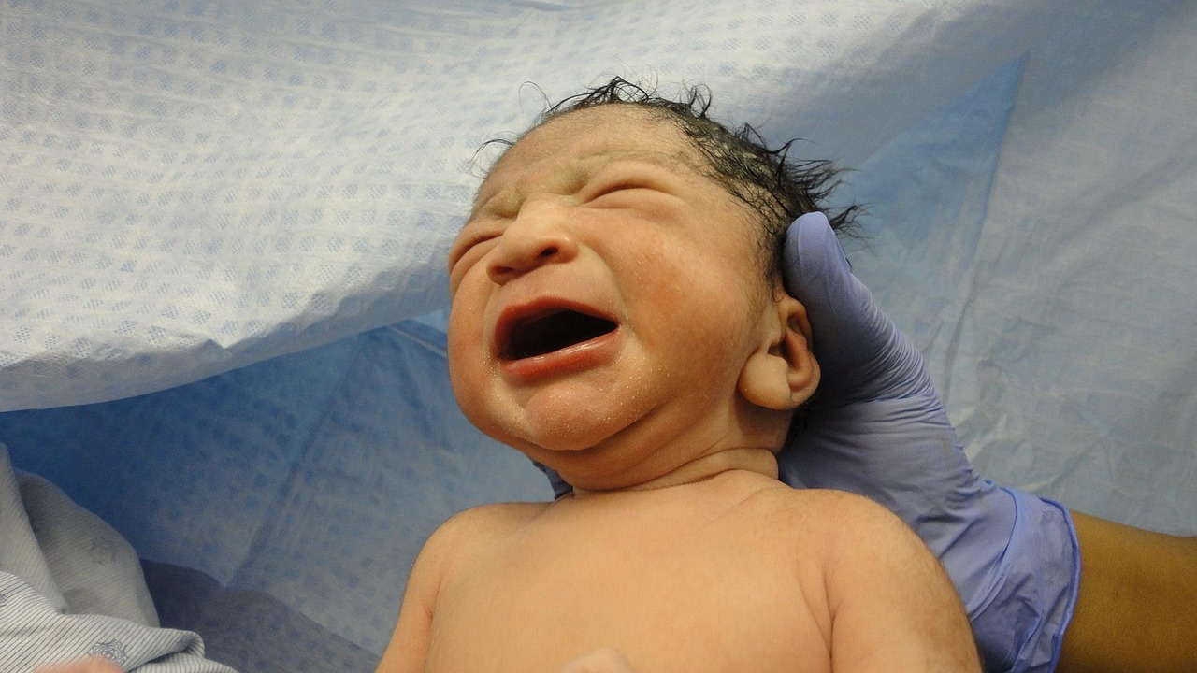
3. God’s Unwavering Grace

Slide 16
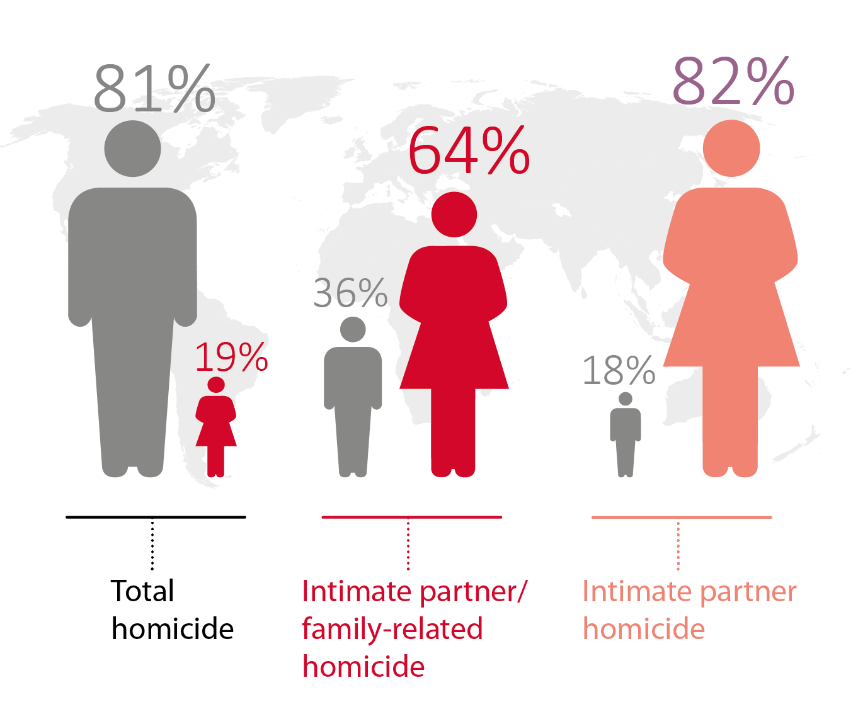
God’s Unwavering Grace
God is present with his fallen people (v.1)
God does not abandon Cain, but warns him (v.7)
God is God of justice
Mark of Cain (v.15)

Slide 17
3. God’s Unwavering Grace

