Slide 2


Slide 3
Beginnings – a New People (Gen 12:1-9)
God’s Plan to Bless
Abram’s Faithful Response
Hope of Worship

Slide 4
1. God’s Plan to Bless
“I will make you into a great nation, and I will bless you; I will make your name great, and you will be a blessing. ³ I will bless those who bless you, and whoever curses you I will curse; and all peoples on earth will be blessed through you.”

Slide 5
1. God’s Plan to Bless
“Scripture foresaw that God would justify the Gentiles by faith, and announced the gospel in advance to Abraham: ‘All nations will be blessed through you.’ So those who rely on faith are blessed along with Abraham, the man of faith” (Gal 3:8-9).
“But you are a chosen people, a royal priesthood, a holy nation, God’s special possession, that you may declare the praises of him who called you out of darkness into his wonderful light” (1 Peter 2:9)

Slide 6
1. God’s Plan to Bless
We are the antidote to the barren and hopelessness of the world.

Slide 7
2. Abram’s Faithful Response
The Lord had said to Abram, “Go from your country, your people and your father’s household to the land I will show you” (12:1)

Slide 8
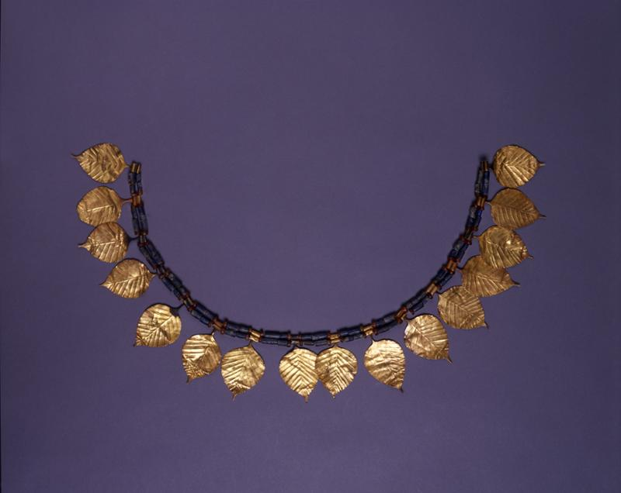

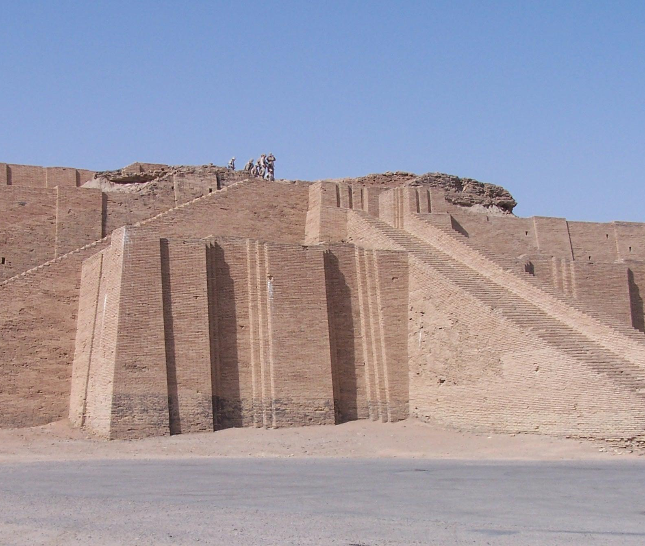
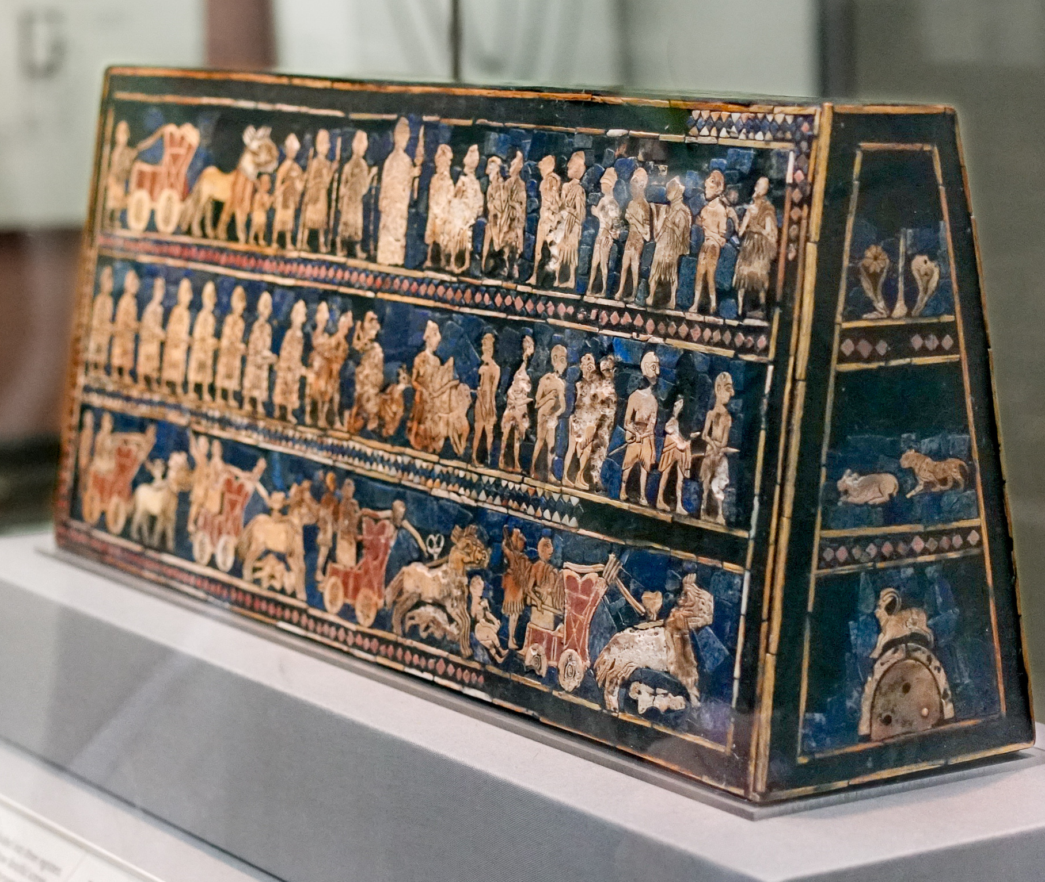
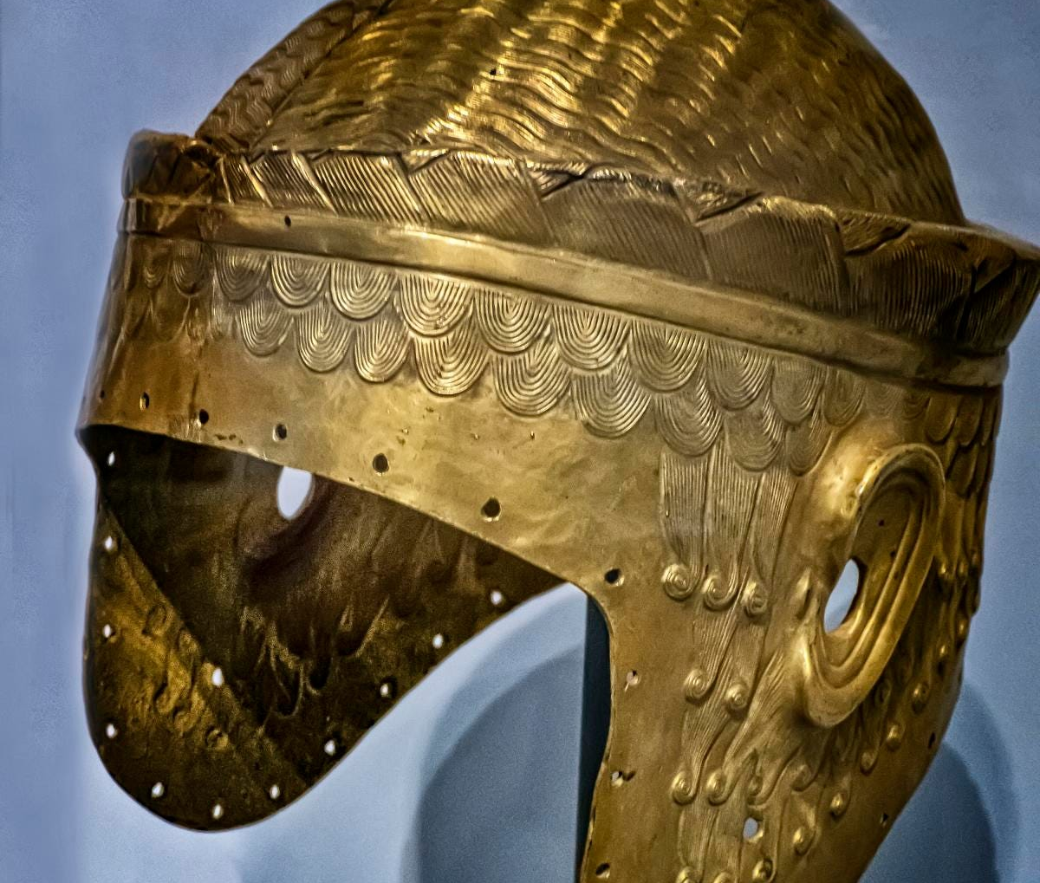

Slide 9
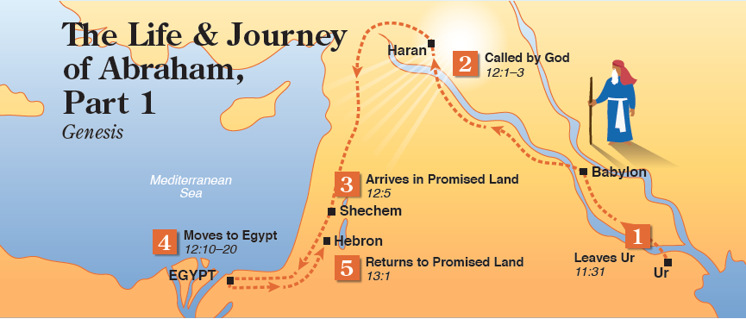

Slide 10
2. Abram’s Faithful Response
Discipleship begins with leaving
“The courage to break his cultural and familial ties and abandon the gods of his ancestors out of allegiance to a God of all families and all cultures was the original Abrahamic revolution. In the same way Christians depart from their original culture. Christians can never be first of all Asians or Americans, Russians….” (Miroslav Volf, Exclusion and Embrace).

Slide 11

3. Hope of Worship

Slide 12


Slide 13
3. Hope of Worship
“I will make you into a great nation, and I will bless you; I will make your name great, and you will be a blessing. ³ I will bless those who bless you, and whoever curses you I will curse; and all peoples on earth will be blessed through you.”

Slide 14
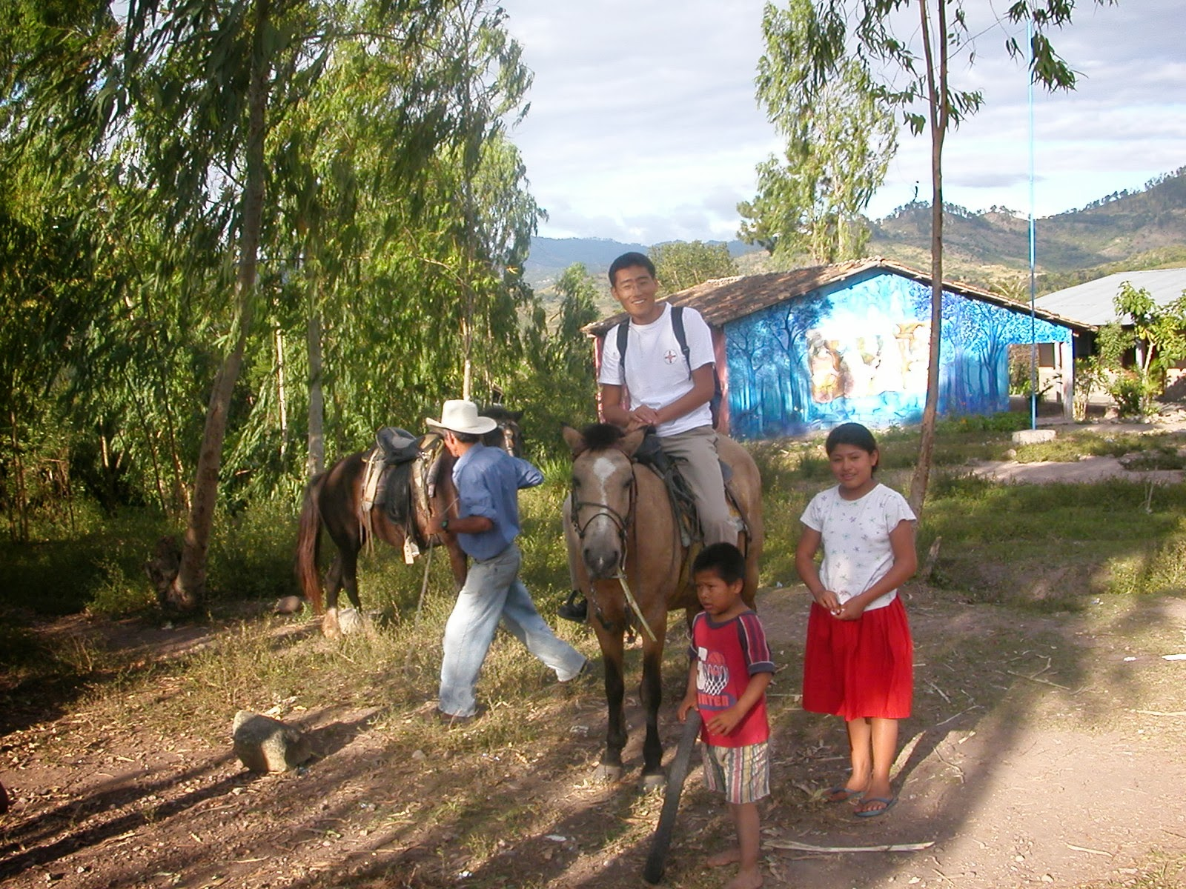

Slide 15
