Slide 1
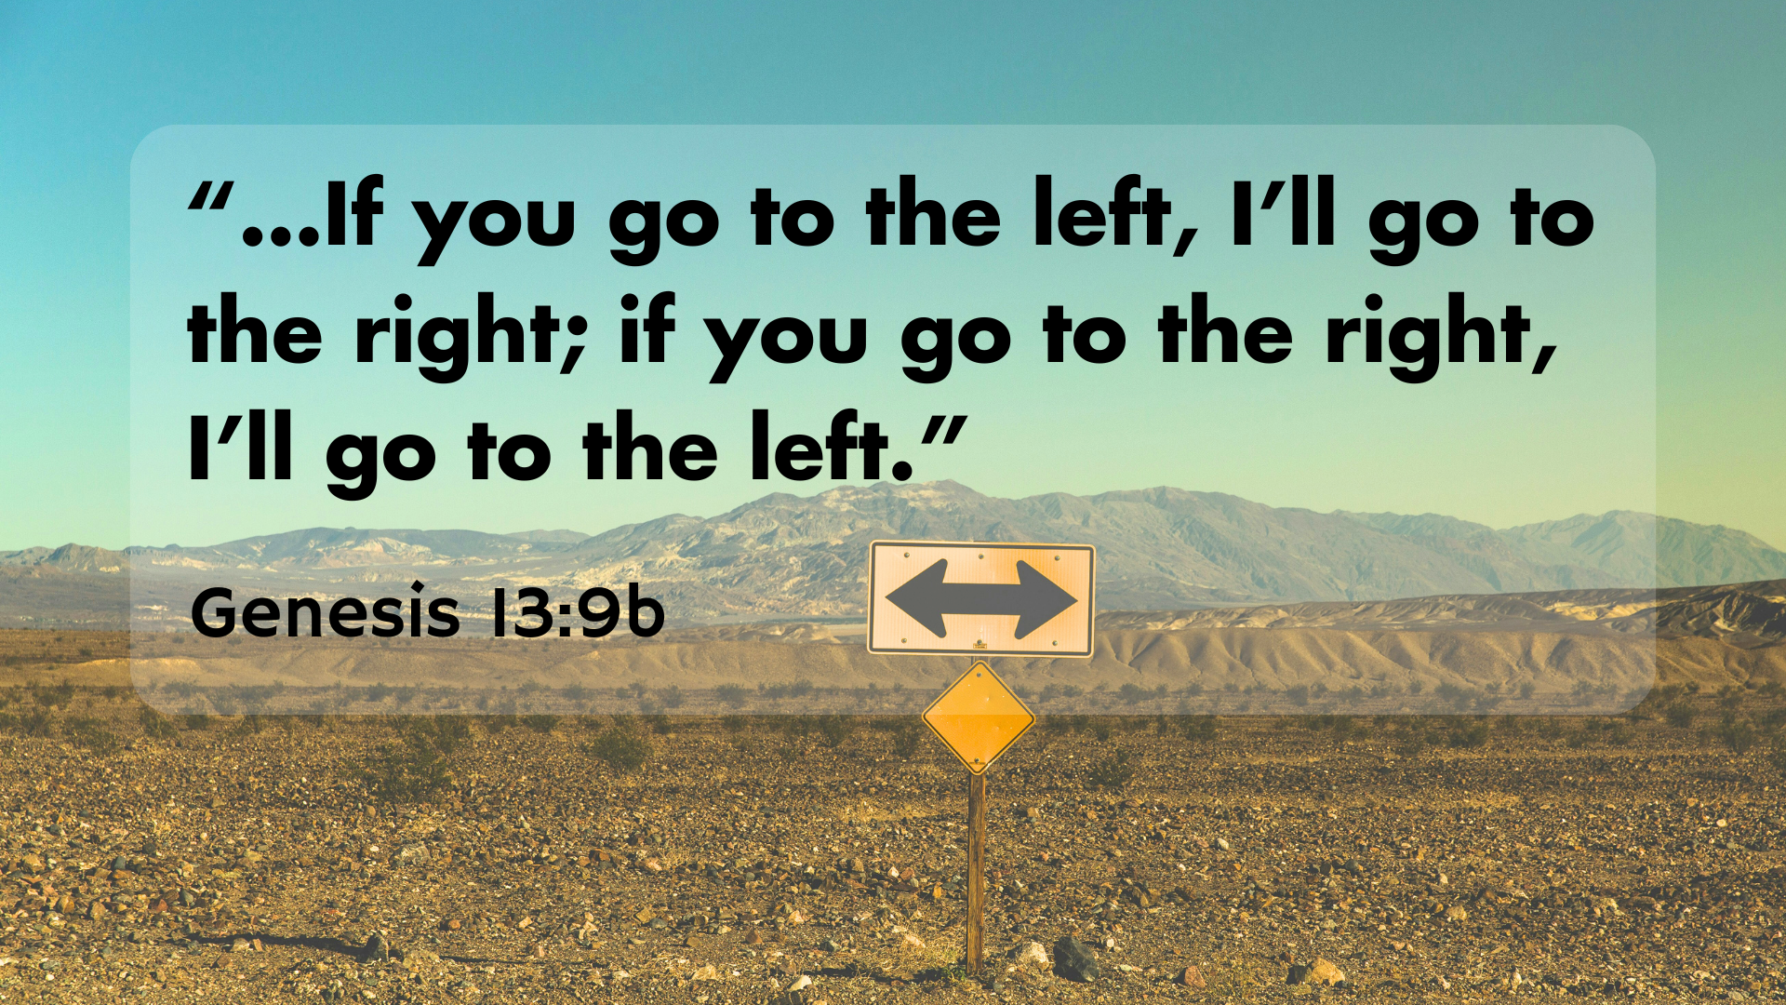

Slide 2
Genesis 13: Living by Faith
Living by Fatih
Lot’s Ambition
God’s Promises

Slide 4
1. Living by Faith
Peace makers
Forgiveness
Sacrifices

Slide 5
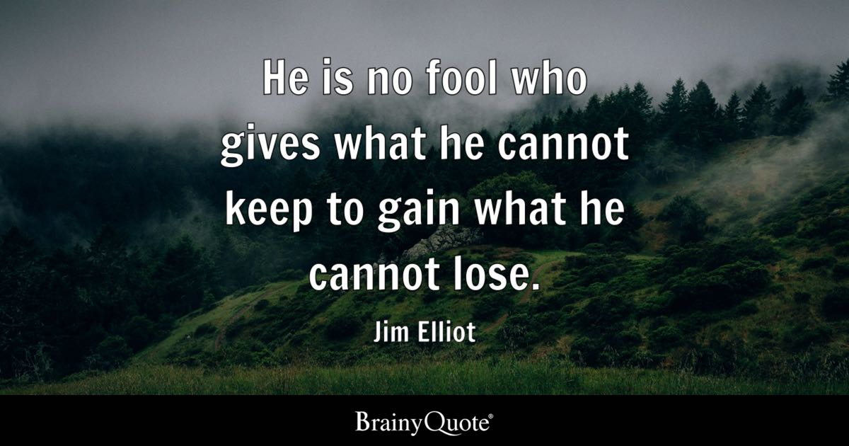

Slide 6
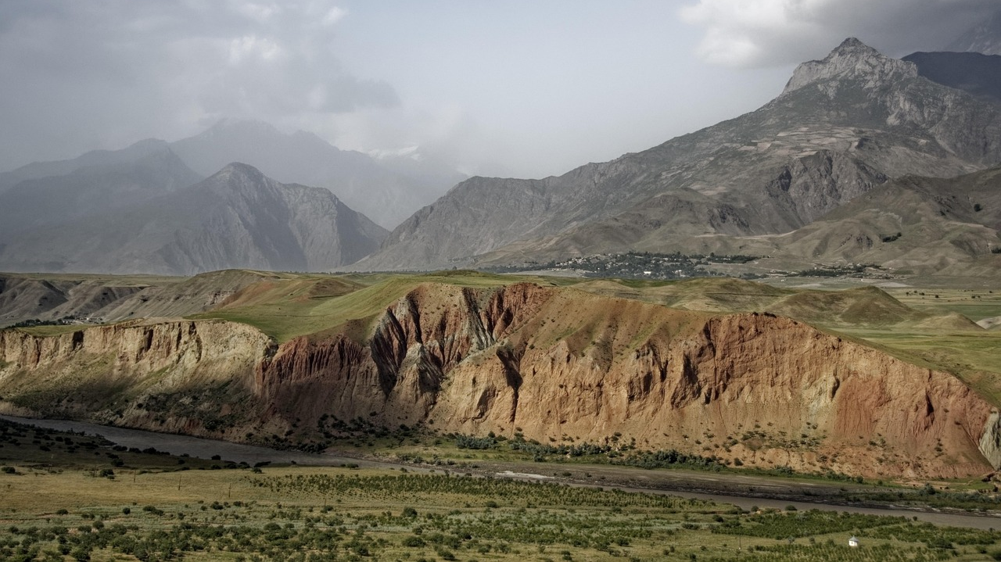
2. Lot’s Ambition

Slide 7
¹⁰ Lot looked around and saw that the whole plain of the Jordan toward Zoar was well watered, like the garden of the Lord, like the land of Egypt. (This was before the Lord destroyed Sodom and Gomorrah.) ¹¹ So Lot chose for himself the whole plain of the Jordan and set out toward the east. The two men parted company: ¹² Abram lived in the land of Canaan, while Lot lived among the cities of the plain and pitched his tents near Sodom. ¹³ Now the people of Sodom were wicked and were sinning greatly against the Lord.

Slide 8




Slide 9
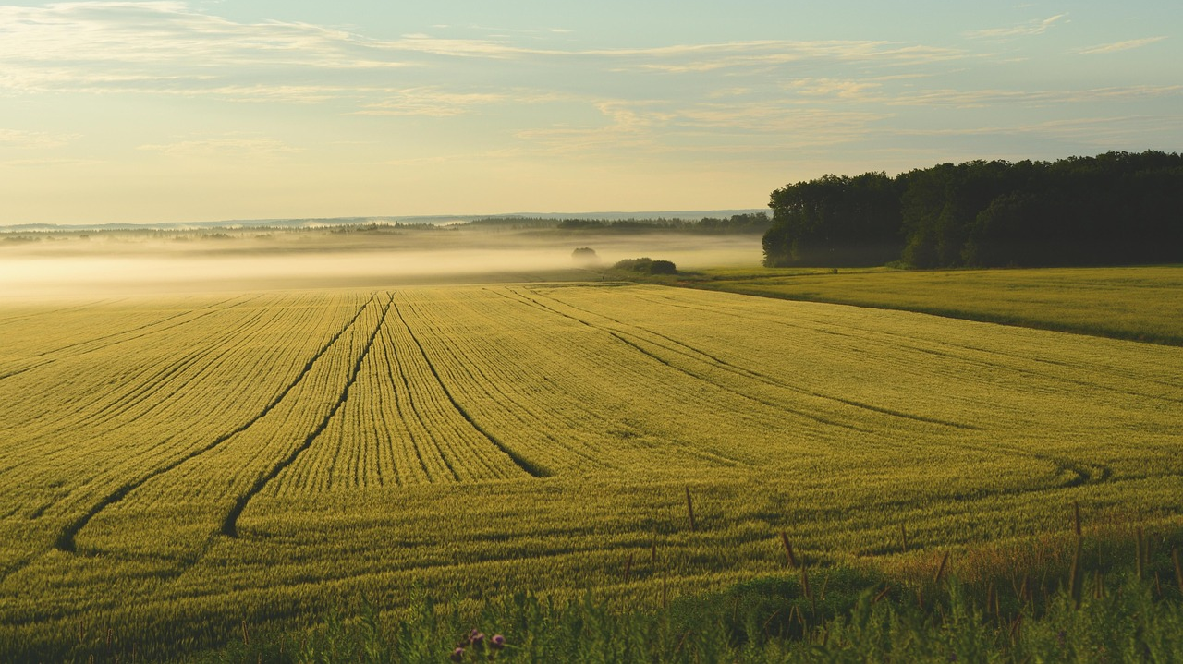
3. God’s Promises

Slide 10


Slide 11
