Slide 1


Slide 2

"Jesus was not conceived via the Holy Spirit... the Church, not knowing how to handle the death of Jesus, this idea [the virgin birth] had to be presented. It is the ultra-fabrication”
- Paul Verhoeven, Jesus of Nazareth

Slide 3
Immanuel, God with Us
Jesus Is God
Jesus Is Man
Jesus Came to Save

Slide 4
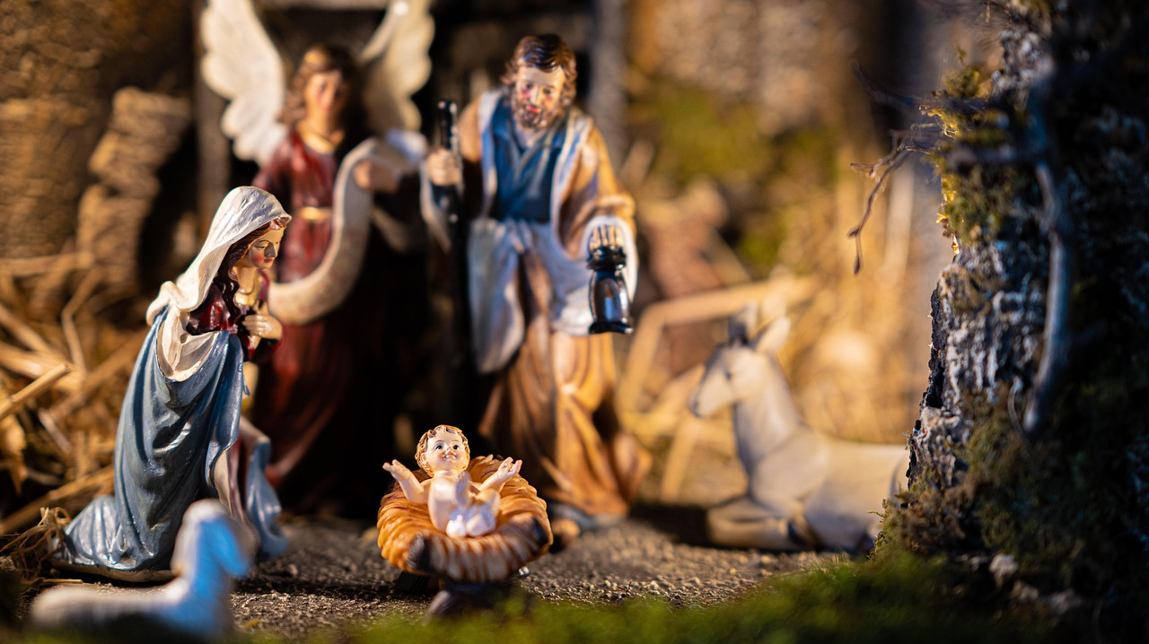

Slide 5
1. Jesus Is God
Virgin birth tells us God became a human being

Slide 6
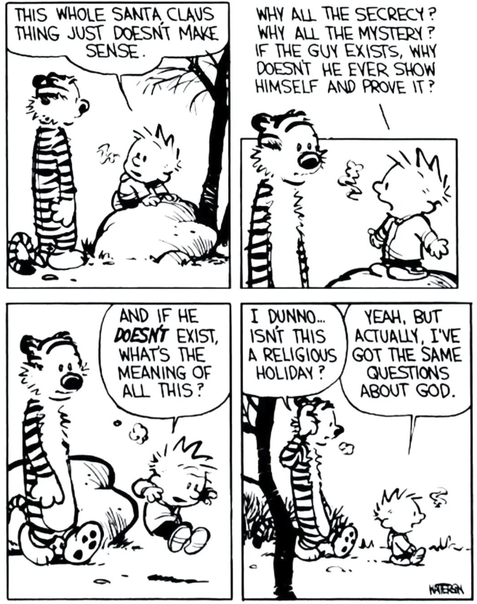

Slide 7
1. Jesus Is God
Virgin birth tells us God became a human being
Jesus claimed to be God!
His disciples believed him to be God
Find out more! (Join us at CE on Jan 17th)

Slide 8
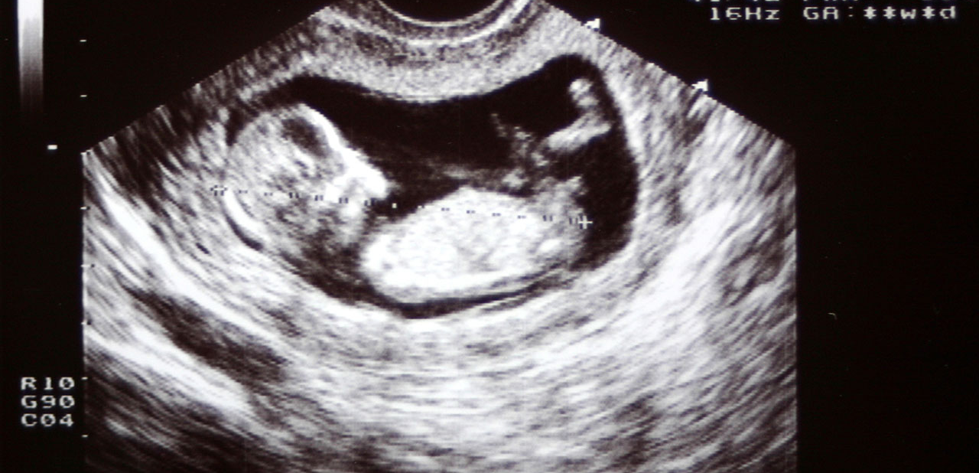
2. Jesus Is Man

Slide 9
2. Jesus Is Man
Humanity is invaluable

Slide 10

2. Jesus Is Man
Humanity is valuable
God knows what human beings go through

Slide 11
2. Jesus Is Man
Humanity is valuable
God knows what human beings go through
God can be our representative

Slide 12
3. Jesus Came to Save Us
21 She will give birth to a son, and you are to give him the name Jesus, because he will save his people from their sins.”

Slide 13


Slide 14


Slide 15
“Joy to the world; the Lord is come;
Let earth receive her King.
Let every heart prepare him room,
and heaven and nature sing…”

