Slide 2
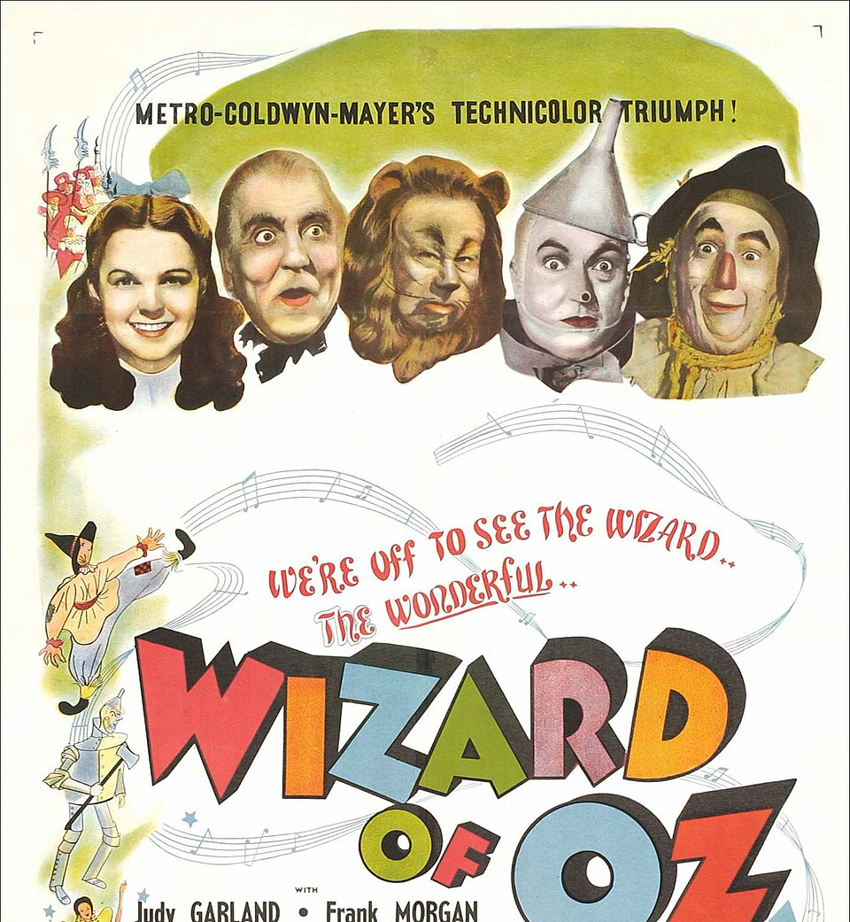
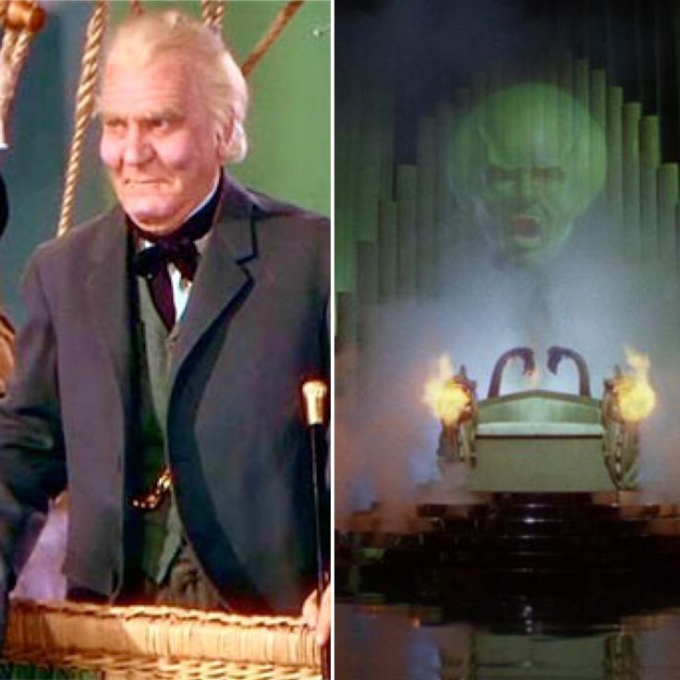

Slide 3
Ehud the Unlikely Savior
Unlikely Hero
Grotesque Tyrant
Laughable Nothing

Slide 4
Banishment
Crying Out
Deliverer
Apostasy
Judges Cycle

Slide 5
1. Unlikely Hero
Tribe of Benjamin (see 1:21)
V.15 – left-handed or ‘unable to use the right hand’
Uses deceit and trickery
LORD is missing in this plot

Slide 6
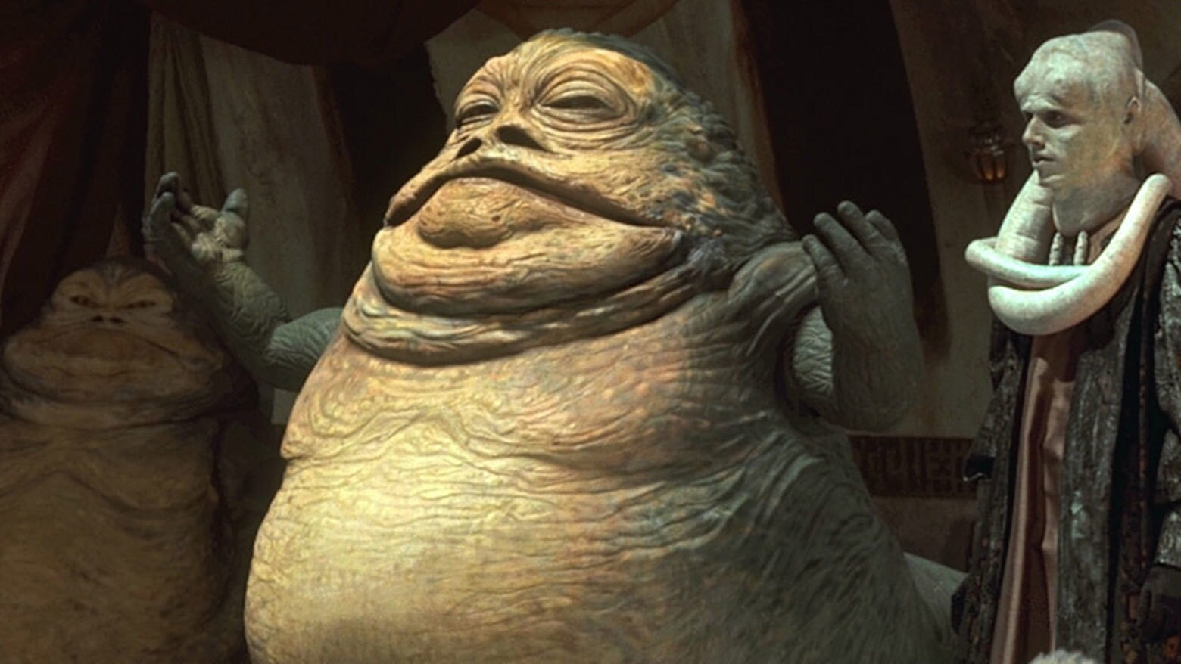
2. Grotesque Tyrant

Slide 7
2. Grotesque Tyrant
Sin and idols might look attractive and impressive, but they are evil and grotesque
  Porn, gambling…
  Finance, legal, even religious institutions

Slide 8
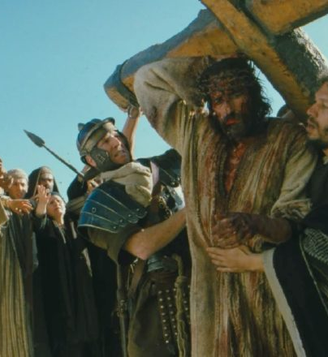


Slide 9

3. Laughable Nothing
“All’s well that ends well.”

Slide 10
¹ Why do the nations conspire
and the peoples plot in vain?
² The kings of the earth rise up
and the rulers band together
against the Lord and against his anointed, saying,
³ “Let us break their chains
and throw off their shackles.”
⁴ The One enthroned in heaven laughs;
the Lord scoffs at them.
- Psalm 2:1-4

