Slide 2
Judges 3: Forgetting God
The Forgotten God
The Forgotten Judge
The Eternal God

Slide 3
Banishment
Crying Out
Deliverer
Apostasy
Judges Cycle

Slide 4
1. Forgetting God
Not about a memory lapse, but about obedience
  Remembering, on the other hand, is about acting on the covenantal relationship (Exd 2:24)
There is no spiritual vacuum; if we are not obeying God, we’re obeying something else!

Slide 5
2. The Forgotten Judge
Othniel is the model judge in this book.
  Man from the tribe of Judah, marries within the tribe
  Ambitious for God’s kingdom, and courageous
  Defeats an evil king (doubly wicked tyrant from a powerful nation)
  No ‘fuss’ in his deliverance. He simply obeys.
  v.9 – ‘who saved them’: Othniel or God?

Slide 6
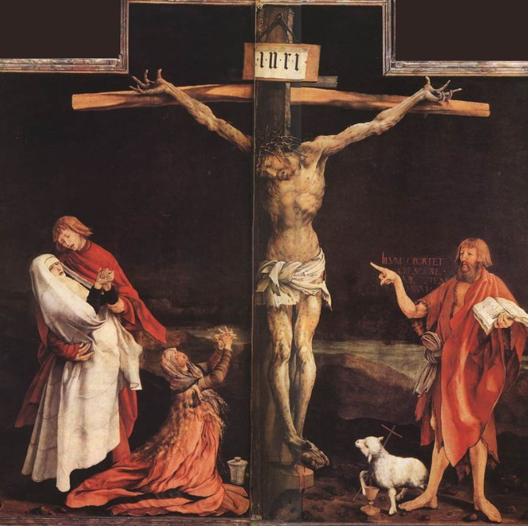
“He must become greater; I must become less” (John 3:30)

Slide 7
3. The Eternal Judge
¹¹ So the land had peace for forty years, until Othniel son of Kenaz died.

Slide 8
3. The Eternal Judge
¹¹ So the land had peace for forty years, until Othniel son of Kenaz died. 12 Again the Israelites did evil in the eyes of the Lord, and because they did this evil the Lord gave Eglon king of Moab power over Israel.

Slide 9
3. The Eternal Judge
There is no perfect leader (even the good ones die);
Look always to Jesus
  Spirit of God remained in him
  Is God and man
  Defeated death and will rule forever
  Will bring God’s perfect kingdom

