Slide 2
“
It is not the critic who counts; not the man who points out how the strong man stumbles, or where the doer of deeds could have done them better. The credit belongs to the man who is actually in the arena, whose face is marred by dust and sweat and blood; who strives valiantly; who errs, who comes short again and again, because there is no effort without error and shortcoming… if he fails, at least fails while daring greatly, so that his place shall never be with those cold and timid souls who neither know victory nor defeat.
^{Teddy Roosevelt}

Slide 3
An Unwilling Rescuer, Judges 4-5
Participating in God’s Plan
Living with a Fuller Perspective
Heroes of Faith

Slide 4
Banishment
Crying Out
Deliverer
Apostasy
Judges Cycle

Slide 5
1. Participating in God’s Plan
What stops us from participating in God’s plan?
  Taking risks?
  Comforts of the present?
  Unwilling to pay the cost?

Slide 6
2. Living with a Fuller Perspective
Notes:
Bible Verse Slide
Title: (make this your sermon point)
> For the style, use font: Avenir, Heavy (Bold), size: 40pt,
> Please use Title Case (each word is capitalised)
Main Body:
> For the style, use font: Avenir, Book, size: 28pt,
> Please use Sentence case (first word is capitalised)
> Superscript the verse numbers (use the same style, font Avenir, size: 28pt)
> Right align and superscript the Bible reference Superscript the verse numbers (use the same style, font Avenir, size: 28pt)
> If you’d like to highlight a word or a phrase, use the colour ‘Yellow’ in the standard colours (there is no need to use bold, underline or italicize this text)

Slide 7
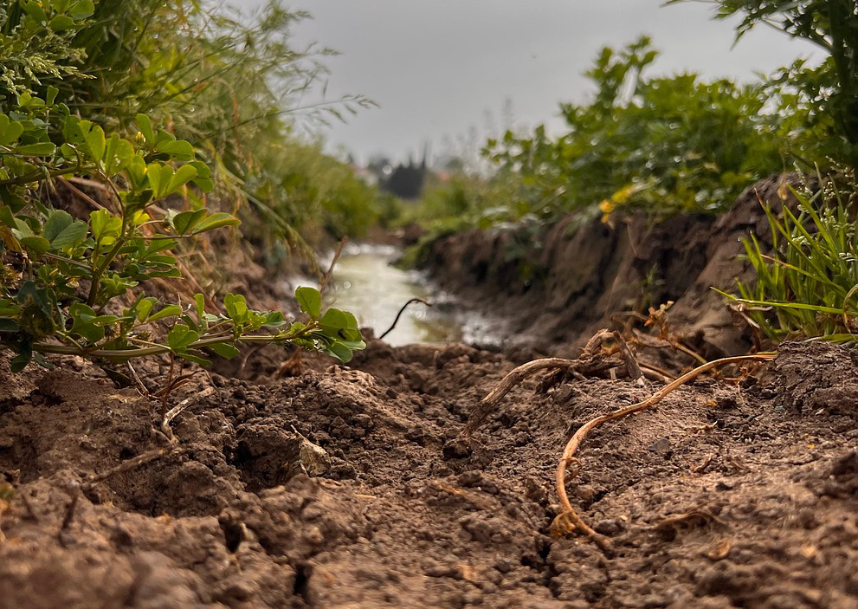
“
⁴ “When you, Lord, went out from Seir,
when you marched from the land of Edom,
the earth shook, the heavens poured,
the clouds poured down water.

Slide 8
2. Living with a Fuller Perspective
With which perspective do you see the world? Ch.4 or 5?
Spiritual and/or gratitude journal?
Regular worship and celebration of God’s actions.

Slide 9
“
³² And what more shall I say? I do not have time to tell about Gideon, Barak, Samson and Jephthah, about David and Samuel and the prophets,
^{Hebrews 11:32}

Slide 10


