Slide 1
Jephthah’s Tragic Vow
Judges 10-11

Slide 2
Jephthah’s Story
Jephthah’s Background (v1-3)
Negotiation with Gilead’s Elders (v.4-11)
Dispute with Ammon (v.12-28)
Spirit’s Empowerment and Vow (v.29-31)
Victory and Tragedy (v.32-40)

Slide 3
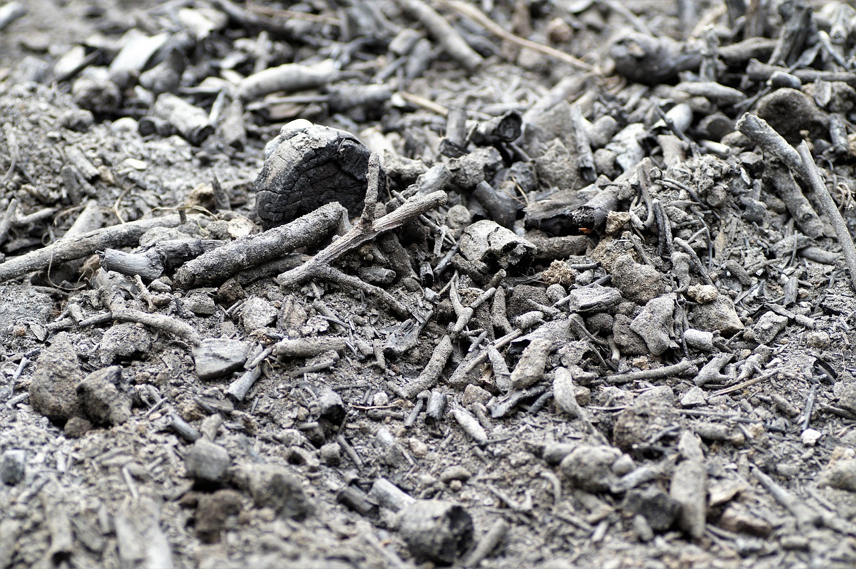
³⁴ When Jephthah returned to his home in Mizpah, who should come out to meet him but his daughter, dancing to the sound of timbrels! She was an only child. Except for her he had neither son nor daughter. ³⁵ When he saw her, he tore his clothes and cried, “Oh no, my daughter! You have brought me down and I am devastated. I have made a vow to the Lord that I cannot break.”

Slide 4
Applications
God Can Use Anyone
John Newton
Beth Moore

Slide 5
Applications
God Can Use Anyone
Examine Your Motives
Therefore, if anyone is in Christ, the new creation has come: The old has gone, the new is here! (2 Cor 5:17).

Slide 6
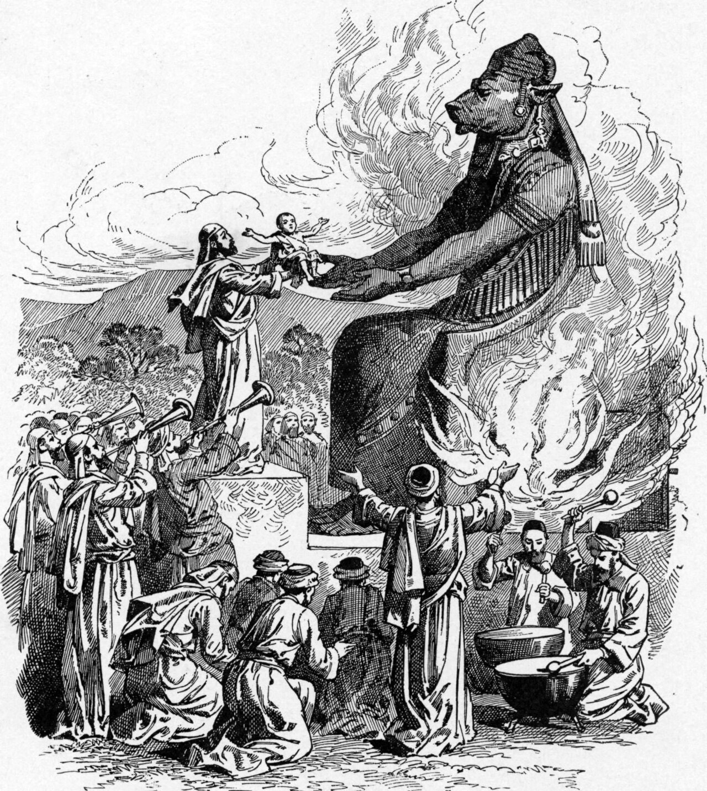
Applications
God Can Use Anyone
Examine Your Motives
God or the Culture?

Slide 7
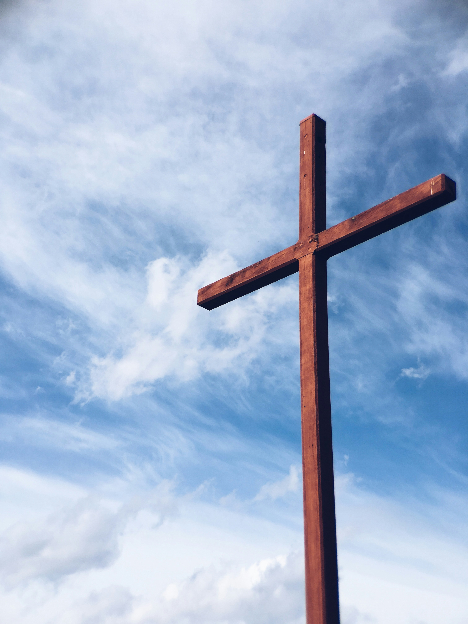
Applications
God Can Use Anyone
Examine Your Motives
God or the Culture?
Right View of God
Transactional or grace based?

Slide 8
¹⁵ Here is a trustworthy saying that deserves full acceptance: Christ Jesus came into the world to save sinners—of whom I am the worst. ¹⁶ But for that very reason I was shown mercy so that in me, the worst of sinners, Christ Jesus might display his immense patience as an example for those who would believe in him and receive eternal life.
- 1 Tim 1:15-16

