Slide 2
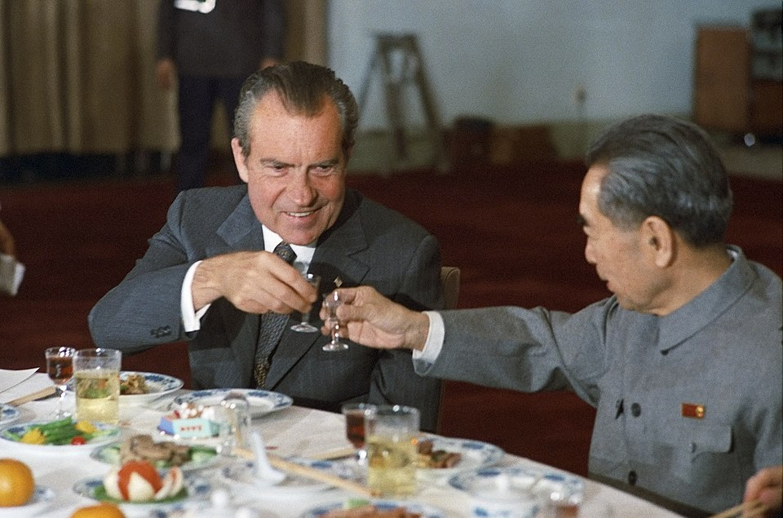

Slide 3
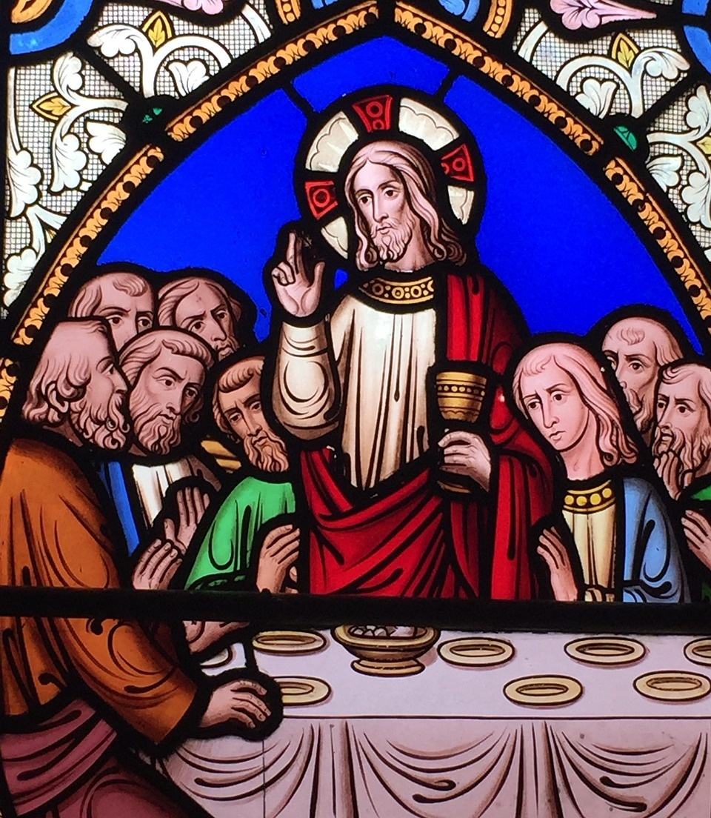
New Covenant Meal
Inward to Our Hearts
Backward to Jesus
Forward to the New Creation

Slide 4
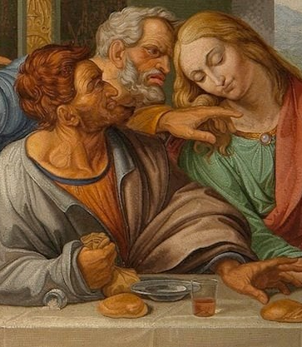
1. Look Inward to Our Hearts

Slide 5
1. Look Inward to Our Hearts
“Surely you don’t mean me, Rabbi!” (v.25).
‘But Peter declared, “Even if I have to die with you, I will never disown you.” And all the other disciples said the same’ (v.35).

Slide 6
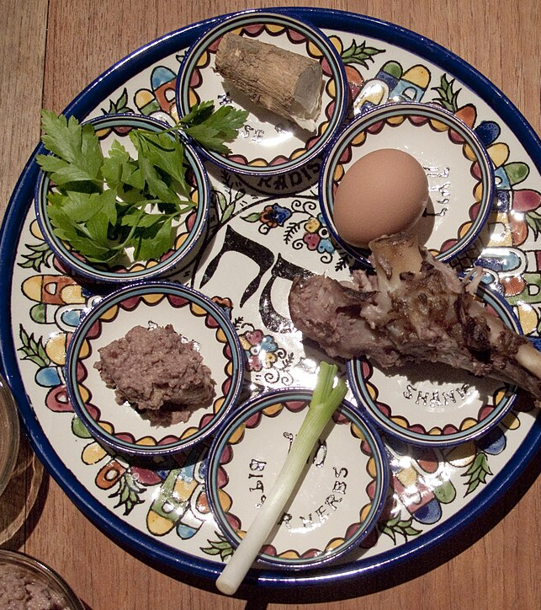
2. Look Backward to Jesus

Slide 7
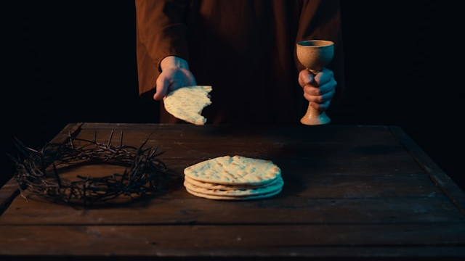

Slide 8
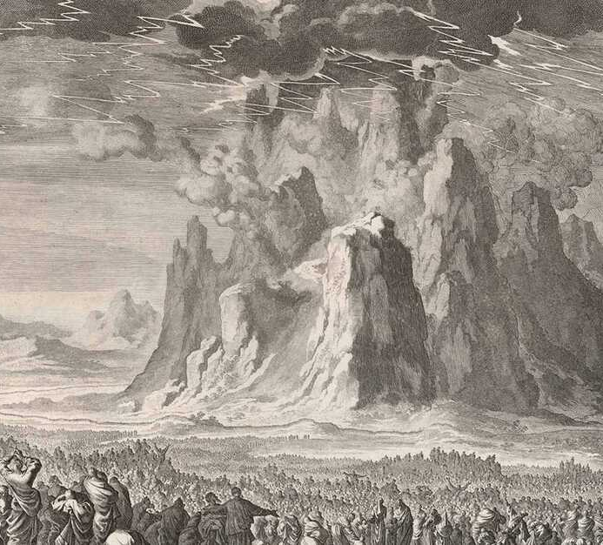
Moses then took the blood, sprinkled it on the people and said, “This is the blood of the covenant that the Lord has made with you in accordance with all these words.” (Exodus 24:8)

Slide 9

“This is the covenant I will make with the people of Israel… after that time,” declares the Lord. “I will put my law in their minds and write it on their hearts. I will be their God, and they will be my people. …
“For I will forgive their wickedness and will remember their sins no more.”
- Jeremiah 31:33-34

Slide 10
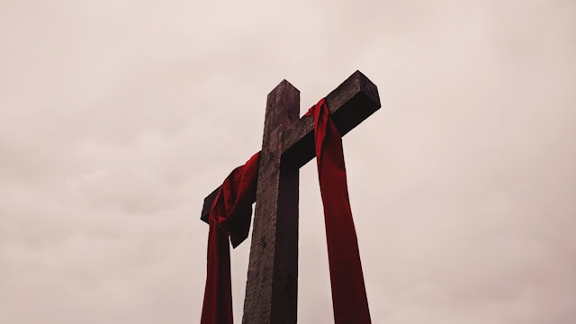

Slide 11
3. Look Forward to the Coming Kingdom
“I tell you, I will not drink from this fruit of the vine from now on until that day when we drink it new with you in the Father’s kingdom” (v.29).

Slide 12


