Slide 1
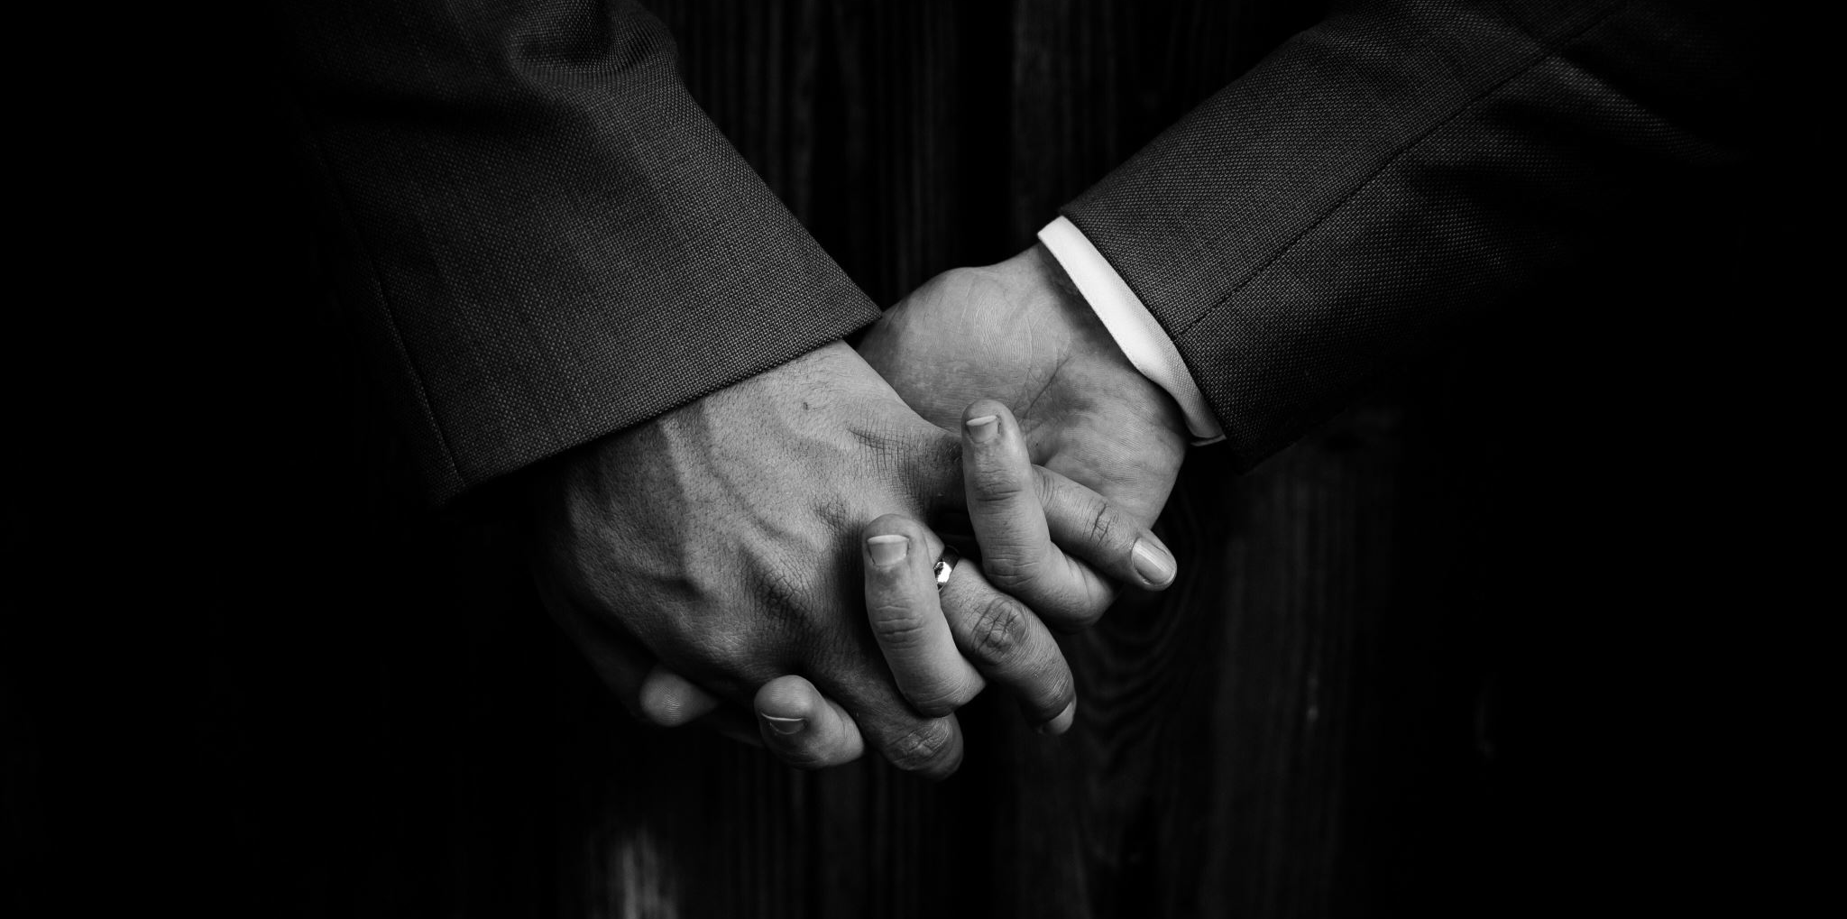
Master of Forgiveness
Matthew 18:15-35

Slide 2


Slide 3
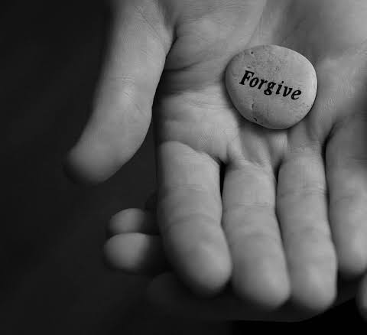
Pursing Godly Forgiveness
Pursuing Reconciliation
Receive God’s Forgiveness
Replicating God’s Forgiveness Towards Others

Slide 4

Pursuing Reconciliation

Slide 5
Matthew 18:15a
““If your brother or sister sins, go and point out their fault, just between the two of you.

Slide 6
Matthew 18:15-17
15 “If your brother or sister sins, go and point out their fault, just between the two of you. If they listen to you, you have won them over.16 But if they will not listen, take one or two others along, so that ‘every matter may be established by the testimony of two or three witnesses.’ 17 If they still refuse to listen, tell it to the church; and if they refuse to listen even to the church, treat them as you would a pagan or a tax collector.

Slide 7
Matthew 18:18-20
¹⁸ “Truly I tell you, whatever you bind on earth will be bound in heaven, and whatever you loose on earth will be loosed in heaven.
¹⁹ “Again, truly I tell you that if two of you on earth agree about anything they ask for, it will be done for them by my Father in heaven.

Slide 8

Seek out reconciliation

Slide 9


Slide 10

Receive God’s Forgiveness

Slide 11
Matthew 18:21-22
Then Peter came to Jesus and asked, “Lord, how many times shall I forgive my brother or sister who sins against me? Up to seven times?”
²² Jesus answered, “I tell you, not seven times, but seventy-seven times.

Slide 12
Matthew 18:23-24
“Therefore, the kingdom of heaven is like a king who wanted to settle accounts with his servants. As he began the settlement, a man who owed him ten thousand bags of gold was brought to him.

Slide 13

1 Denarius = 1 day of work
1 talent – 6,000 denarii
10,000 x 6 – 60,000,000 days of work
60,000,000/312 = 192,308 years
192,308/50 = 3846 lifetimes

Slide 14
Matthew 18:27
The servant’s master took pity on him, canceled the debt and let him go.

Slide 15

Realize How Much God Has Forgiven You

Slide 16

Replicating God’s Forgiveness Towards Others

Slide 17
Matthew 18:28
“But when that servant went out, he found one of his fellow servants who owed him a hundred silver coins. He grabbed him and began to choke him. ‘Pay back what you owe me!’ he demanded.

Slide 18
Matthew 18:
“This is how my heavenly Father will treat each of you unless you forgive your brother or sister from your heart.”

Slide 19

Called to forgive

Slide 20

Brad Hambrick
“Forgiveness says some combination of, “I want good for you. I want you to come to know God’s forgiveness and freedom. I want God to change you into the kind of person who would not do again what you did, and then I want you to flourish. I want the freedom to enjoy the good things in my life without comparing them to the good things in your life.”

Slide 21
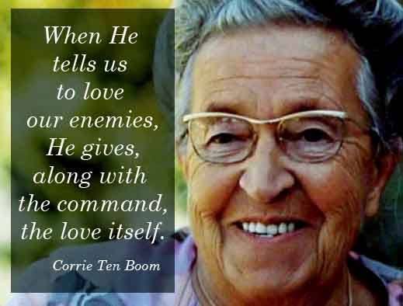

Slide 22
Master of Forgiveness
Matthew 18:15-35

