Slide 2
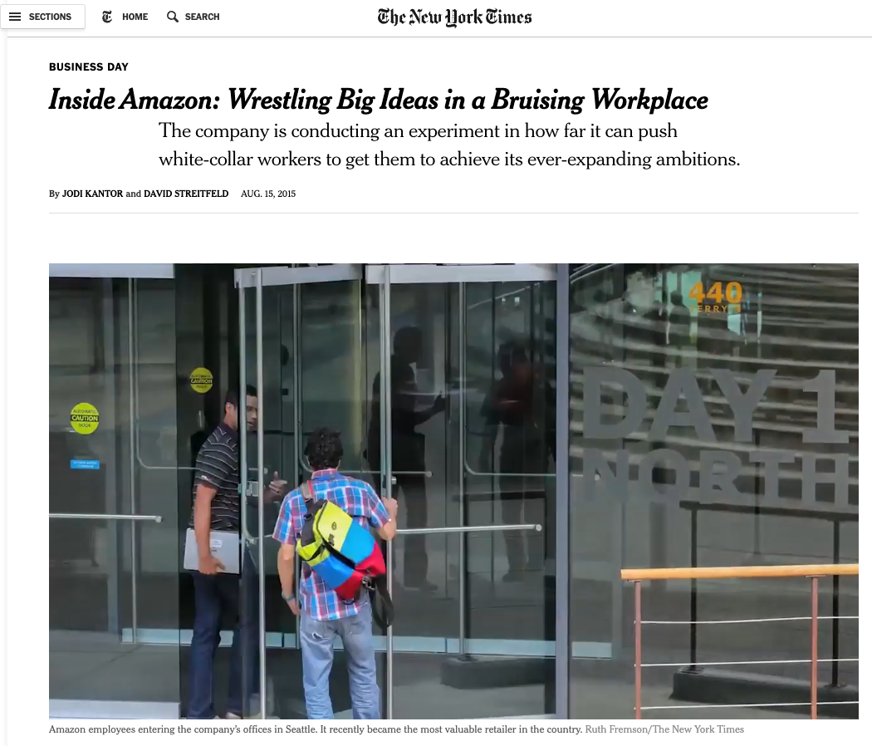

Slide 3
Upside Down Kingdom: Pursuing Greatness
Pursuing Humility (v.1-4)
Protecting the Weak(v.5-9)
Valuing the Lost (v.10-14)

Slide 4
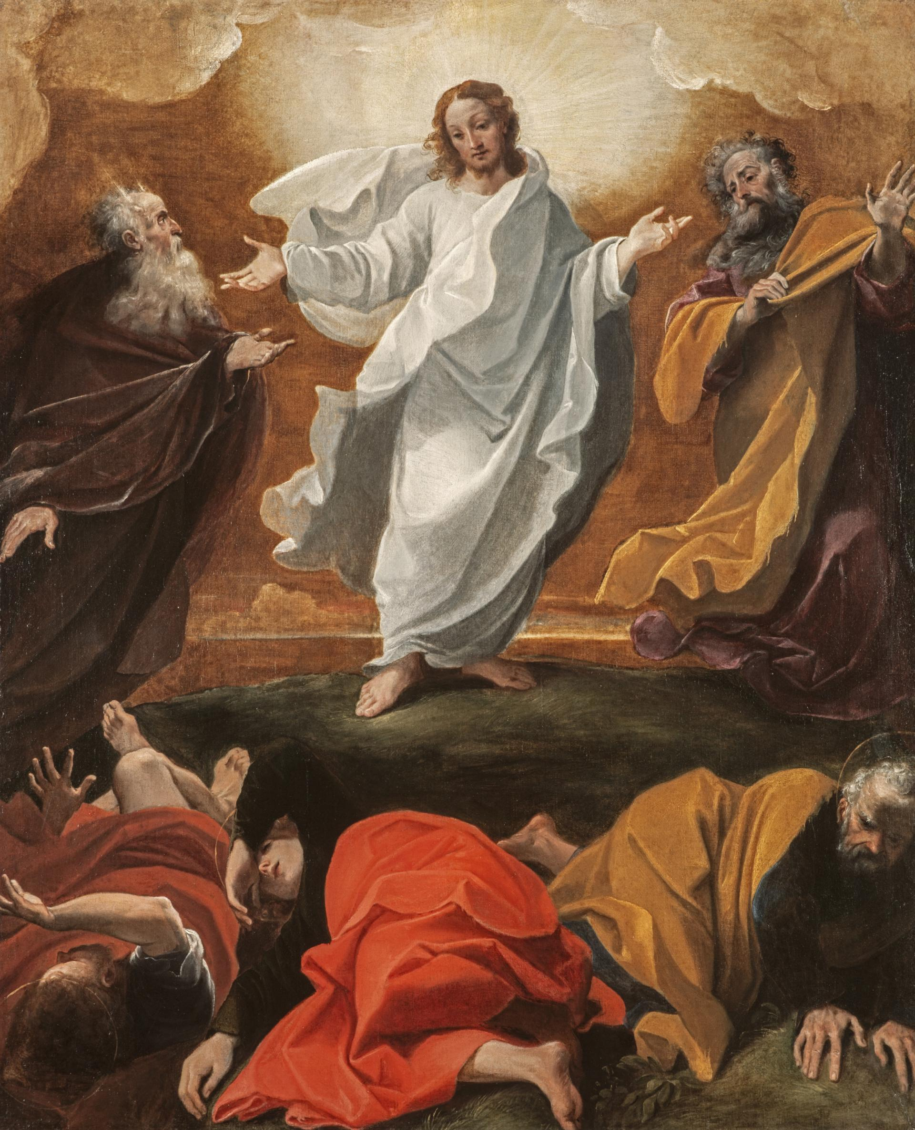
1. Pursuing Humility (v.1-5)
Context
  Matthew 16:16, “you are the Christ, son of the living God"
  Matthew 17:2, “…His face shone like the sun and his clothes became as white as the light.”
  18:1, “Who is the greatest in the kingdom of heaven?”
“The Transfiguration” by Ludovicio @National Galleries of Scotland

Slide 5
1. Pursuing Humility (v.1-5)
18 At that time the disciples came to Jesus and asked, “Who, then, is the greatest in the kingdom of heaven?”
² He called a little child to him, and placed the child among them. ³ And he said: “Truly I tell you, unless you change and become like little children, you will never enter the kingdom of heaven. ⁴ Therefore, whoever takes the lowly position of this child is the greatest in the kingdom of heaven. ⁵ And whoever welcomes one such child in my name welcomes me.

Slide 6
1. Pursuing Humility (v.1-5)
We are to pursue humble position of a child
  Children are unconcerned about status!
  In what ways are we pursuing status and recognition?
Mark of true humility is the company we keep (v.5)
  Are we a church that welcomes those the world rejects?

Slide 7
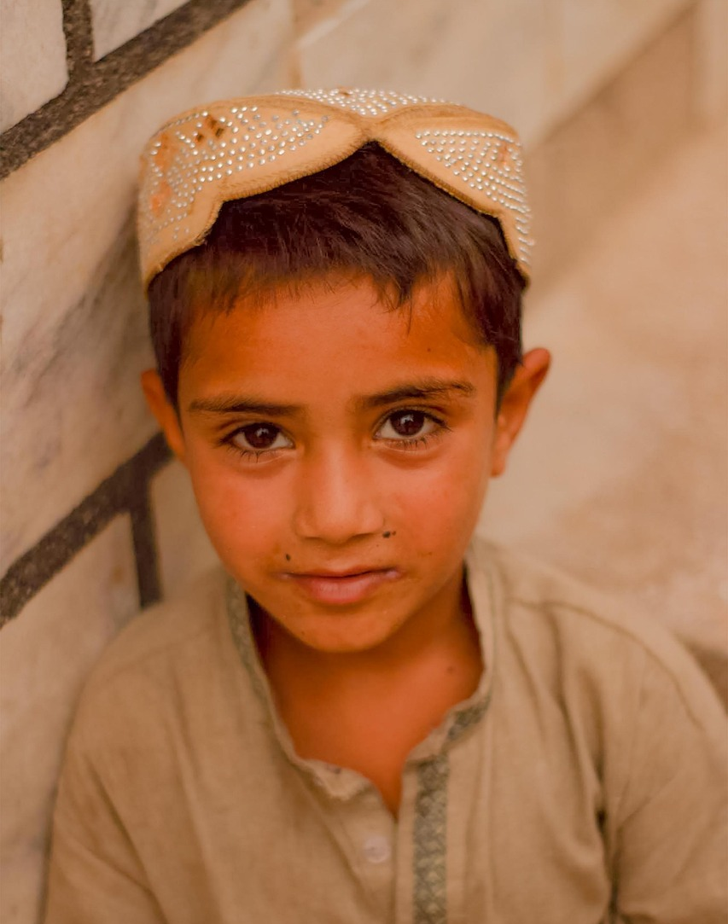
2. Protecting the Weak (v.6-9)
⁶ “If anyone causes one of these little ones—those who believe in me—to stumble, it would be better for them to have a large millstone hung around their neck and to be drowned in the depths of the sea.”

Slide 8
2. Protecting the Weak (v.6-9)
How might we cause others to sin?
  Hypocrisy?
  Legalism?
  Abuse of power and influence?

Slide 9
2. Protecting the Weak (v.6-9)
How might we cause others to sin?
  Hypocrisy?
  Legalism?
  Abuse of power and influence?
We are to take sanctification seriously (v.8-9)

Slide 10
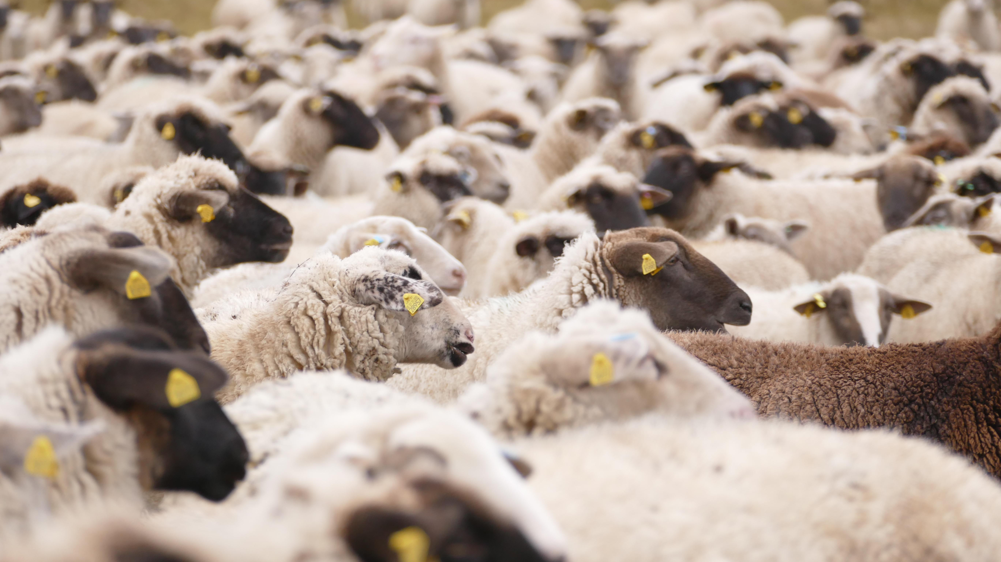
3. Valuing the Lost (v.10-14)

Slide 11
3. Valuing the Lost (v.10-14)
¹³ And if he finds it, truly I tell you, he is happier about that one sheep than about the ninety-nine that did not wander off. ¹⁴ In the same way your Father in heaven is not willing that any of these little ones should perish.

Slide 12
3. Valuing the Lost (v.10-14)
¹³ And if he finds it, truly I tell you, he is happier about that one sheep than about the ninety-nine that did not wander off. ¹⁴ In the same way your Father in heaven is not willing that any of these little ones should perish.
Do you know others in the church?
Text those whom you haven’t seen
Belong to a small group

Slide 13
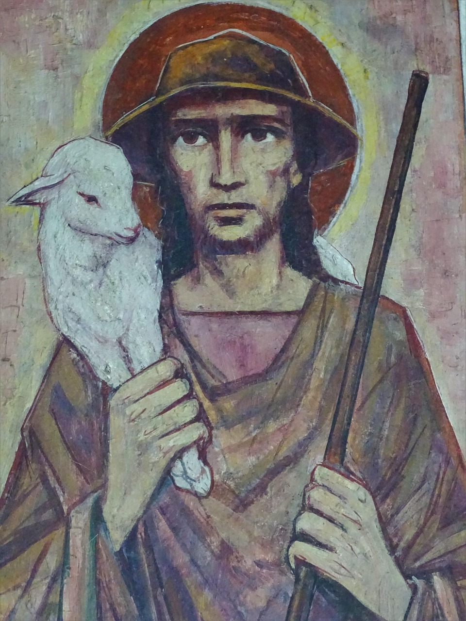
Upside Down Kingdom: Pursuing Greatness
Pursuing Humility (v.1-4)
Protecting the Weak(v.5-9)
Valuing the Lost (v.10-14)

